Slide 1
Arrays

Slide 2
Definition – Array
A collection of objects of the same type stored contiguously in memory under one name
    May be type of any kind of variable
For ease of access to any member of array
For passing to functions as a group

Slide 3
Array
  Consecutive group of memory locations
  Same name and type
To refer to an element, specify
  Array name and position number
Format: arrayname[ position number ]
  First element at position 0
  n element array c:
      c[ 0 ], c[ 1 ]…c[ n - 1 ]
Array elements are like normal variables
      c[ 0 ] = 3;
      cout << c[ 0 ];
Performing operations in subscript. If x = 3,
      c[ 5 – 2 ] == c[ 3 ] == c[ x ]

Slide 4
Name of array (Note that all elements of this array have the same name, c)
c[0]
-45
c[1]
6
c[2]
0
c[3]
72
c[4]
1543
c[5]
-89
c[6]
0
c[7]
62
c[8]
-3
c[9]
1
c[10]
6453
c[11]
78
Position number of the element within array c

Slide 5
Declaring Arrays
Declaring arrays - specify:
  Name
  Type of array
  Number of elements
  Examples
      int c[ 10 ];
        float hi[ 3284 ];
Declaring multiple arrays of same type
  Similar format as other variables
  Example
        int b[ 100 ], x[ 27 ];

Slide 6
Examples Using Arrays
Initializers
      int n[ 5 ] = { 1, 2, 3, 4, 5 };
If size omitted, the initializers determine it
      int n[] = { 1, 2, 3, 4, 5 };
  5 initializers, therefore n is a 5 element array

Slide 7
Strings
  Arrays of characters
  All strings end with null ('\0')
  Examples:
      char string1[] = "hello";
      char string1[] = { 'h', 'e', 'l', 'l', 'o','\0’ };
  Subscripting is the same as for a normal array
      String1[ 0 ] is 'h'
      string1[ 2 ] is 'l'

Slide 8
Multiple Dimensional Arrays
Multiple dimensional array
  tables with rows, columns
    Like matrices: specify row, then column

Slide 9
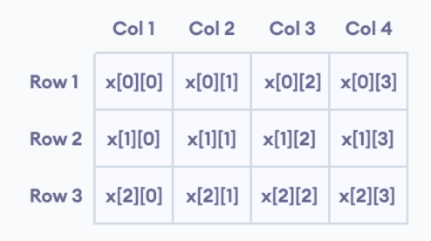
2D Array Example
int x[3][4];

Slide 10
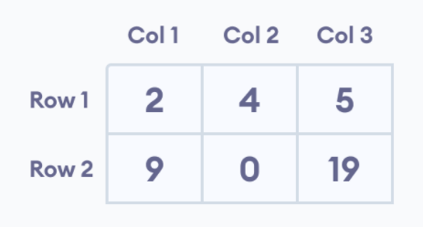
Initialization of 2-D array
int test[2][3] = { {2, 4, 5}, {9, 0, 19}};

Slide 11
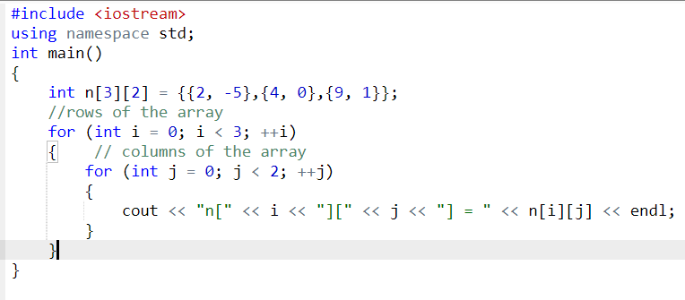
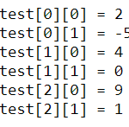
Output

Slide 12
Passing Arrays to Functions
Function prototype:
      void modifyArray(int b[4]);
  Parameter names optional in prototype
    int b[] could be simply int []

Slide 13
