Slide 1

Merge

Slide 2
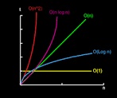
Merge sort is a sorting technique based on divide and conquer technique. With worst- case time complexity being Ο(n log n), it is one of the most respected algorithms.
Merge sort first divides the array into equal halves and then combines them in a sorted manner.

Slide 3
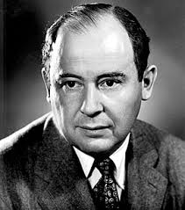
Invented by John von Neumann (1903-1957)
Follows divide and conquer paradigm.
Developed merge sort for EDVAC in 1945

Slide 4
Divide and Conquer
Divide: Divide the unsorted list into two sub lists of about half the size.
Conquer: Sort each of the two sub lists recursively until we have list sizes of length 1,in which case the list itself is returned.
Combine: Merge the two-sorted sub lists back into one sorted list.

Slide 5
Algorithms
MERGE SORT (A,p,r) //divide
if p < r
then
q= [ (p + r) / 2 ] MERGE SORT(A,p,q) MERGER SORT(A,q + 1,r) MERGE(A,p,q,r)

Slide 6
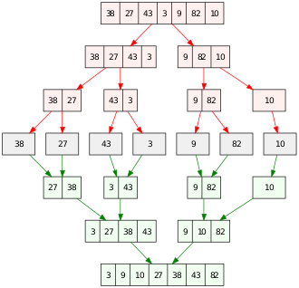

Slide 7
10 elements 0.2s
100 elements 1.593s
1000 elements 2.069s
10000 elements 3.5s
100000 elements 8.09s
1000000 elements 22.59s

