Slide 1
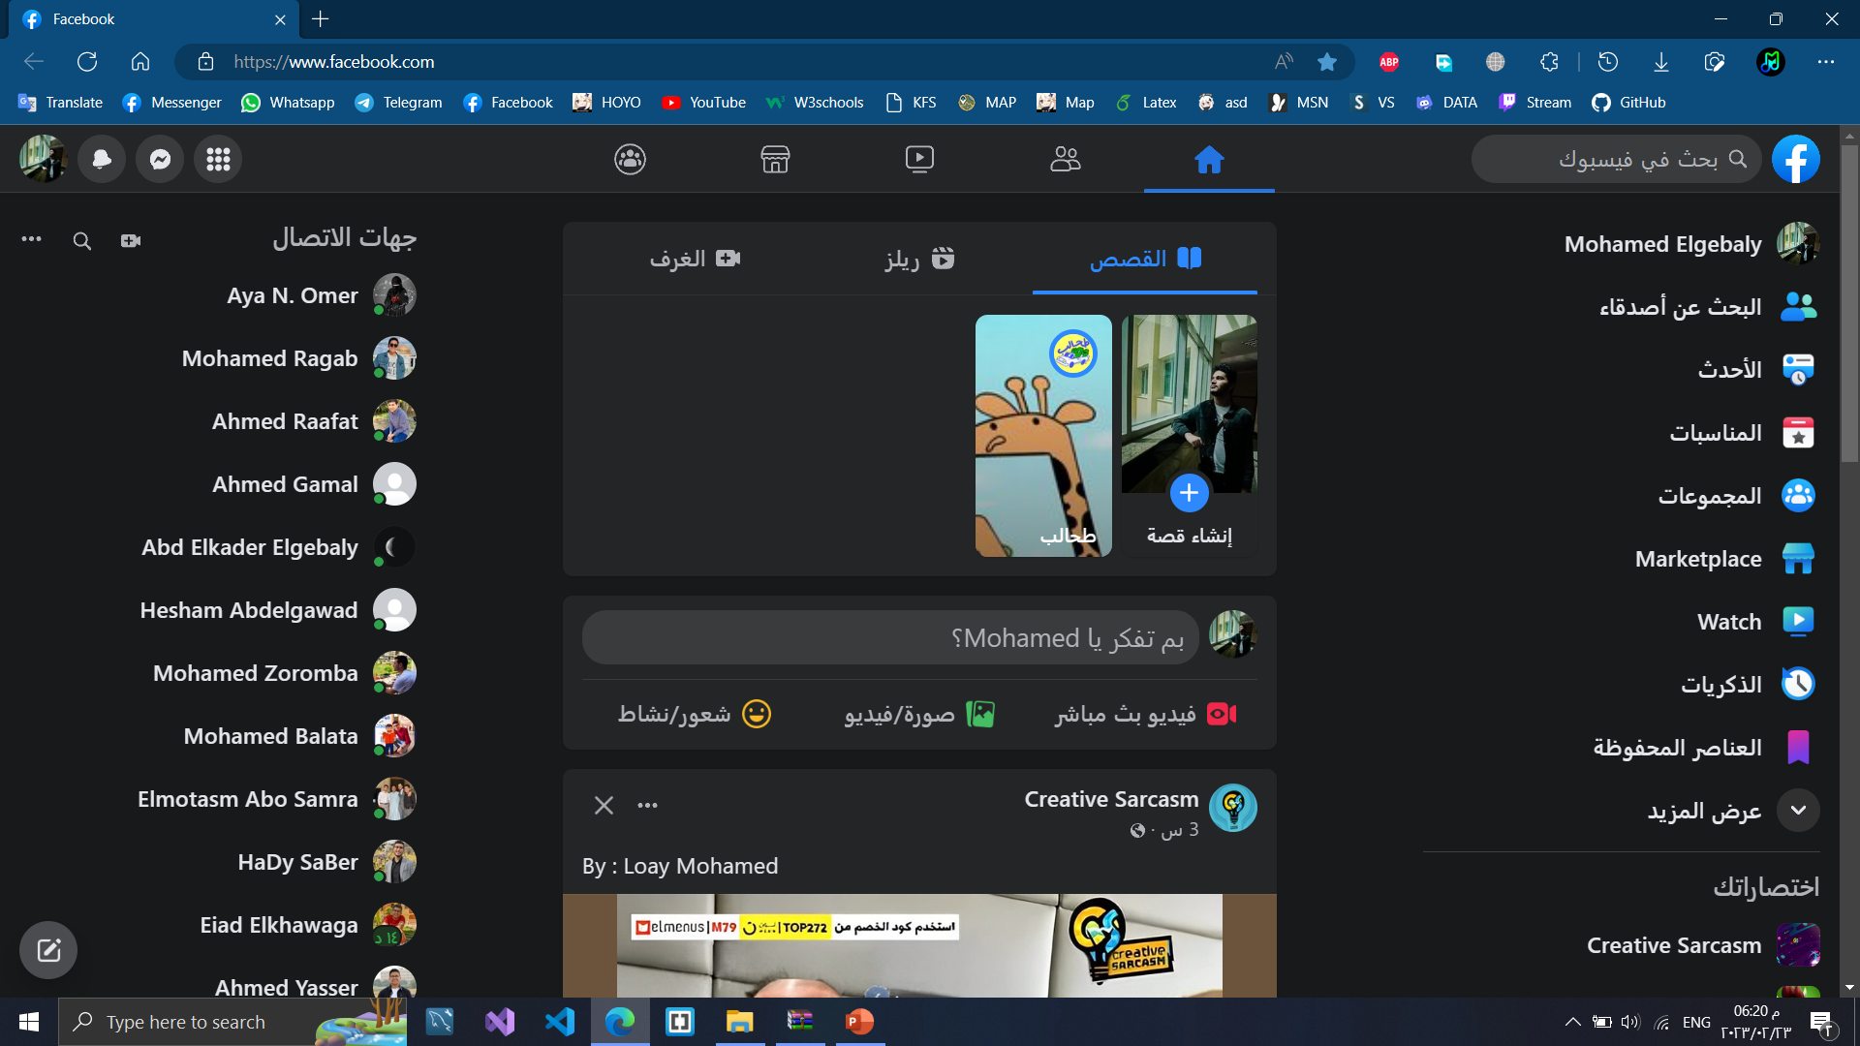

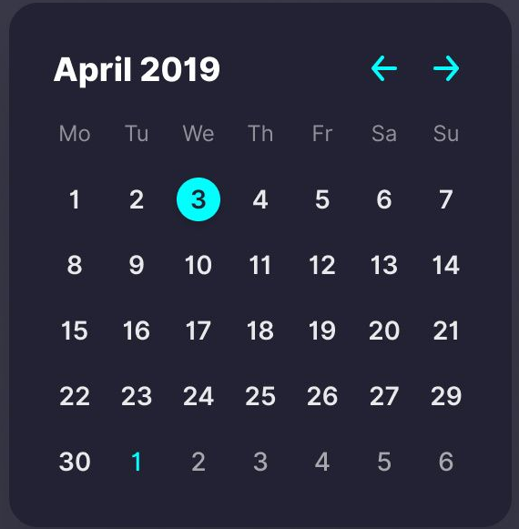
Add note
Add
Today’s Schedule
09:00
11:00
13:00
15:00
Q & A
Tomorrow’s Schedule
Wednesday - 3rd April
09:00
11:00
13:00
15:00
Data Structure Assignment_2 Deadline today 23:59
_____________________
Statistics Quiz_1 due 11:00

Slide 2
First name:
E-mail:
Password:
Section:
Division:
Last name:
Phone number:
Confirm password:
Level:
Department:
Wednesday - 3rd April
Data Structure Assignment_2 Deadline today 23:59
_____________________
Statistics Quiz_1 due 11:00
Log out
Edit
Delete

Slide 3
Lecturer: Dr. Ahmed Abo Samra
Courses: 8 Lectures, 6 Sections
Duration: 10 Weeks
In this course, we will study databases and its structure and how to design an effective database. We will go through the fundamental of blah blah blah.
Lecture 3
Size: 1.02 MB
PPTX File
Lecture 3
Size: 1.02 MB
PPTX File
Open
Open
Download
Download
Wednesday - 3rd April
Lecture 3
Size: 1.02 MB
PPTX File
Lecture 3
Size: 1.02 MB
PPTX File
Open
Open
Data Structure Assignment_2 Deadline today 23:59
_____________________
Statistics Quiz_1 due 11:00
Download
Download

Slide 4

Log in
User ID:
Password:
Log in
Create new account

Slide 5
Sign up
First name:
E-mail:
Password:
Section:
Division:
Last name:
Phone number:
Confirm password:
Level:
Department:
Sign up

