Slide 1
Orthogonal-Frequency-Regularized Discriminative Regression
for Real-World Single-Image Super-Resolution
RealSR (V3) · ×2 · official Test.m (Limited-range Y, no shave, 100 pairs)
PSNR-Y 34.41 · SSIM 0.9285 · MUSIQ 55.96 · MANIQA 0.3534 (18.7M params)

Slide 2
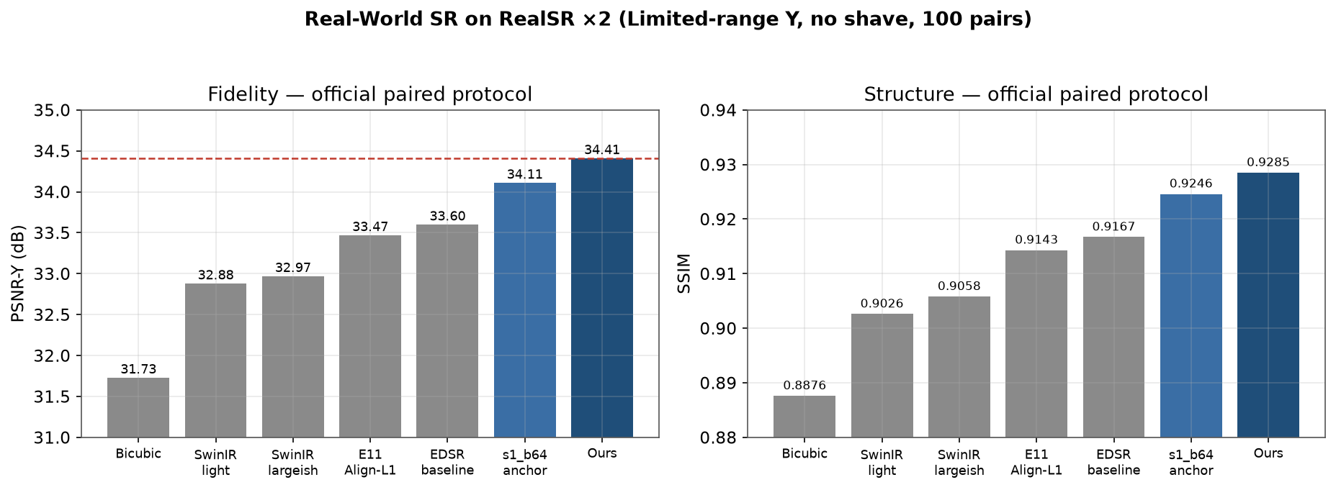
Results on the official paired protocol
Ours tops every fidelity/structure metric; dashed line = our result
Reproduced baselines share our exact A-strict protocol. vs re-trained SwinIR: +1.44 dB / +0.023 SSIM / +9.2 MUSIQ / +0.048 MANIQA
RealSR ×2 · Real-World SR · stride-1 + wavelet-HF + Muon + TTA
1

Slide 3
Results — official paired protocol (100 pairs)
Limited-range Y · uint8 · modcrop4 · no shave
Method | Type | Params | PSNR-Y | SSIM | MUSIQ | MANIQA
Bicubic | floor | — | 31.73 | 0.8876 | 39.40 | 0.278
SwinIR-light (re-trained) | Transformer | 0.61M | 32.88 | 0.9026 | 45.43 | 0.302
SwinIR-largeish (re-trained) | Transformer | 3.96M | 32.97 | 0.9058 | 46.79 | 0.305
E11 Mod-SwinIR (Align-L1) | Transformer | 4.05M | 33.47 | 0.9143 | 49.15 | 0.309
EDSR-baseline (repro.) | CNN | 1.19M | 33.60 | 0.9167 | 53.14 | 0.327
s1_b64 (AdamW, zero-pretrain) | U-Net | 18.7M | 34.11 | 0.9246 | 55.22 | 0.342
latent rectified-flow (ours) | Generative | 32.9M | 28.36 | 0.790 | 50.12 | 0.224
Ours (full recipe + TTA) | U-Net stride-1 | 18.7M | 34.41 | 0.9285 | 55.96 | 0.3534
RealSR ×2 · Real-World SR · stride-1 + wavelet-HF + Muon + TTA
2

Slide 4
Method — one recipe, four levers
Stride-1 U-Net regressor — no lossy downsample in the trunk; residual-bicubic with a
  zero-init head (step-0 = exact bicubic). Biggest single lever (+0.38 dB).
Orthogonal wavelet high-frequency loss — multi-scale L1 on Haar HL/LH/HH (λ≈8);
  counters L1's mean-shrinkage of the high band at zero inference cost.
Shift-ensemble of that loss (avg over dyadic offsets) ≈ shift-invariance — best perceptual arm.
Muon optimizer (Newton–Schulz orthogonalised ≥2D updates) lr 5e-3 — beats AdamW at every lr.
BSRGAN synthetic pretrain → RealSR finetune; D4 8-fold test-time augmentation.
RealSR ×2 · Real-World SR · stride-1 + wavelet-HF + Muon + TTA
3

Slide 5
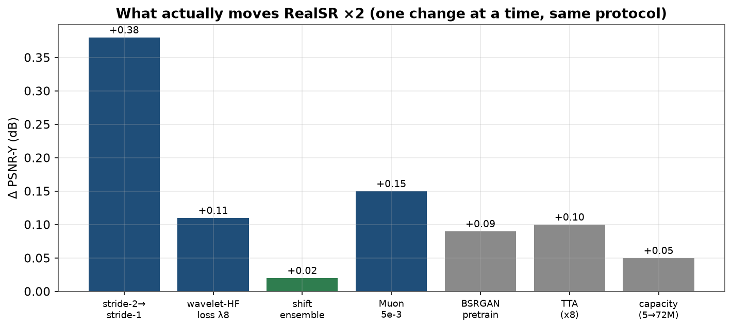
What actually moves RealSR ×2
One change at a time, identical protocol. Mechanism levers (architecture + frequency loss) dominate; extra capacity saturates.
RealSR ×2 · Real-World SR · stride-1 + wavelet-HF + Muon + TTA
4

Slide 6
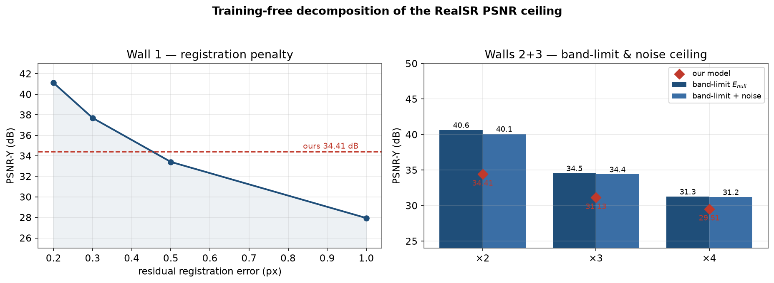
The empirical ceiling (training-free, no model)
diffusion/oracle.py — the three physical walls of RealSR
Registration is the binding wall: at 0.3–0.4 px residual misalignment the ceiling is 34.4–35.7 dB — our 34.41 sits inside it. Corrects the “38–40 dB noise floor” folklore (noise is small here).
RealSR ×2 · Real-World SR · stride-1 + wavelet-HF + Muon + TTA
5

Slide 7
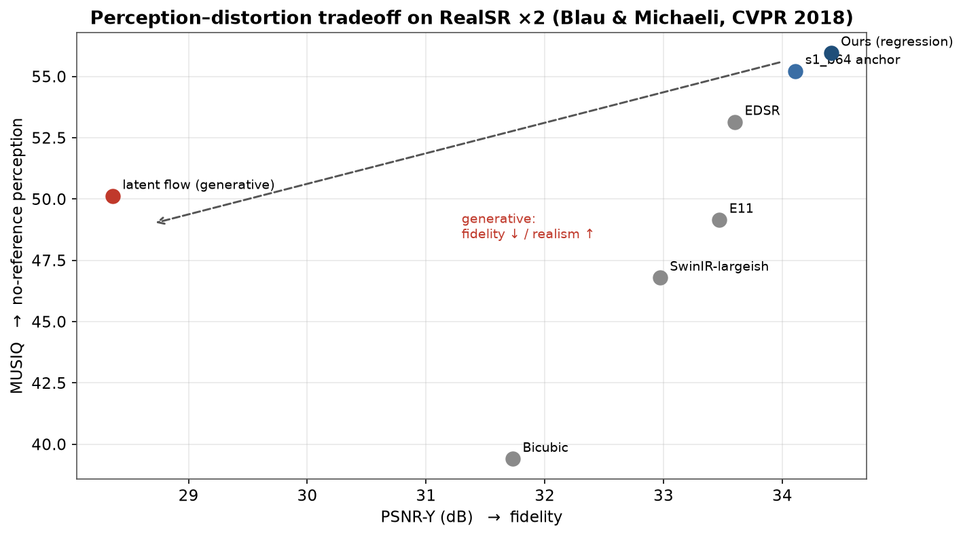
Perception–distortion tradeoff, reproduced in-house
Same test set & protocol: our regression is at the fidelity frontier; our own generative arm pays ~6 dB for no-reference IQA — the Blau–Michaeli law made concrete on RealSR.
RealSR ×2 · Real-World SR · stride-1 + wavelet-HF + Muon + TTA
6

Slide 8
Baselines: reproduced vs cited
Reproduced in-repo, SAME protocol (A-strict):
  SwinIR (light/largeish) · EDSR-baseline ✓ · RCAN / SRResNet / RRDB (pipeline).
Cited with an explicit protocol tag, never mixed into a claim:
  GAN real-ISR: BSRGAN · Real-ESRGAN · LDL · FeMaSR (D-blind / B-128/512).
  Diffusion: StableSR · DiffBIR · SeeSR · ResShift · SinSR · OSEDiff · AdcSR ·
  TSD-SR · TinySR · PURE · RealSR-R1 — 22.6–28.7 dB on a synthetically re-degraded
  RealSR (a harder/different input).
Full table + sources: docs/baseline/README.md · citations: exp/RELATED_WORK_AND_UPPER_BOUND.md
RealSR ×2 · Real-World SR · stride-1 + wavelet-HF + Muon + TTA
7

Slide 9
Negative results — 28+ arms, all reported
Discriminative-capacity ceiling: capacity 5M→72.5M and pyramid flattening: saturating/negative.
Mamba / VSS scan backbone: −2.3 dB at equal sample budget (memory-bound, poor sample efficiency).
Loss/geometry regularisers tried & rejected: D4 equivariance, coord injection, freq-routing, gated FFN.
Frequency experiments: bijective wavelet U-Net, dual-branch wavelet U-Net, DTCWT basis — none beat
  the plain wavelet-HF loss + shift-ensemble.
Generative: pixel/latent diffusion, frequency-domain rectified flow (HF residual), adversarial data
  mining (N3) — fidelity collapses or plateau (consistent with the ceiling).
Lesson: at 390 real pairs, discriminative regression already captures the recoverable signal.
RealSR ×2 · Real-World SR · stride-1 + wavelet-HF + Muon + TTA
8

Slide 10
Why protocol discipline matters
RealSR numbers are inconsistent across papers: Limited-range Y vs full-range RGB
  (Y ≈ 0.4–0.8 dB lower), border shave, test subset, and Protocol A vs B.
We report the strictest form and tag every external figure (A-strict / B-128-512 / C-REdeg / D-blind).
Pretrained blind weights (Real-ESRGAN etc.) and diffusion SOTA are a different task on a
  re-degraded input — comparing them to a paired-protocol PSNR would be misleading.
Takeaway: our headline is a defensible same-protocol result, not a leaderboard number.
RealSR ×2 · Real-World SR · stride-1 + wavelet-HF + Muon + TTA
9

Slide 11
Conclusions & what's next
A recipe wins: stride-1 + wavelet-HF(+shift) + Muon + BSRGAN pretrain + TTA → 34.41 dB / 0.9285 SSIM.
×2 PSNR is physics-capped (~34.4–35.7 dB, registration) — we are at the ceiling, not model-capped.
Open fidelity headroom is at ×3/×4 (lighter-tuned here): 31.13 vs ceiling 34.4 (×3).
Beyond fidelity: the frontier is perceptual (MUSIQ / LPIPS / FID) and data-limited at this scale.
Reproduce: README §9 · measure the ceiling: python -m diffusion.oracle --scale 2
Artefacts: exp/FINAL_REPORT.md · docs/baseline/ · docs/figs · this deck (docs/slides.pptx).
RealSR ×2 · Real-World SR · stride-1 + wavelet-HF + Muon + TTA
10

Slide 12
References
Cai et al., RealSR / LP-KPN, ICCV 2019.
Liang et al., SwinIR, ICCV-W 2021 · Lim et al., EDSR, CVPR-W 2017 · Zhang et al., RCAN, ECCV 2018.
Wang et al., ESRGAN, ECCV-W 2018 · Zhang et al., BSRGAN, ICCV 2021 · Wang et al., Real-ESRGAN, ICCV-W 2021.
Qiao et al., RealSR-R1, arXiv:2506.16796 (2025) · TinySR, arXiv:2508.17434 (2025) — baseline tables.
Blau & Michaeli, The Perception-Distortion Tradeoff, CVPR 2018 (DOI 10.1109/CVPR.2018.00652).
Baker & Kanade, Limits on Super-Resolution..., IEEE TPAMI 2002 (DOI 10.1109/TPAMI.2002.1033210).
Robinson & Milanfar, Fundamental Limits in Image Registration (TIP 2004) & Statistical SR (TIP 2006).
Chatterjee & Milanfar, Is Denoising Dead?, IEEE TIP 2010 · Zhou et al., Updating the Evaluation of SR, CVPR 2021.
RealSR ×2 · Real-World SR · stride-1 + wavelet-HF + Muon + TTA
11

