Slide 1
AutoML Prototype: A Cross Platform Application
Object Oriented Programming (CSEG2020/CSEG2120)
Project Presented By: Arin Bansal
Presented To: Proff. Sourav Kumar
B.Tech CSE (Big Data) - B1, 2nd Year
Date: 22/04/2025

Slide 2
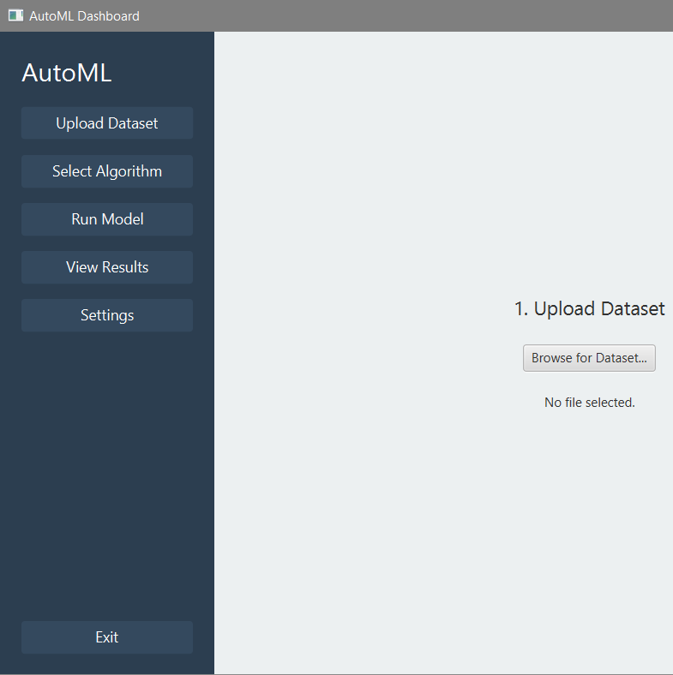
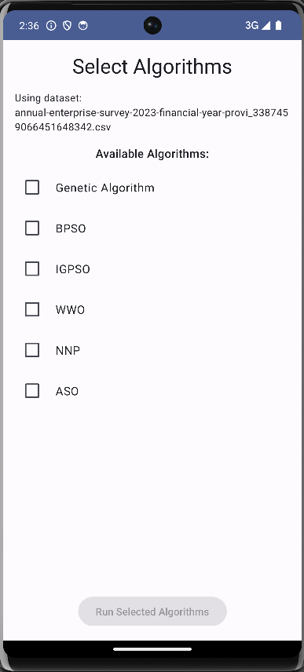
Introduction & Goals
Project Overview
Objectives
Developed a cross-platform AutoML prototype using Java. Focused on hyperparameter optimization with mock algorithms via Smile ML backend.
Demonstrate solid OOP principles with modular core logic. Build reusable Java library supporting Desktop (JavaFX) and Android (Jetpack Compose) UIs. Visualize model results effectively.
Learning Goals
Apply practical OOP concepts in real-world setting. Promote code reuse and maintainability across platforms.

Slide 3
System Architecture
Module Layers
Design Benefits
automl_core: Shared logic for data, algorithms, and services
The modular structure promotes high cohesion and low coupling, allowing code reuse and platform-tailored interfaces. Separation of concerns ensures easier maintenance and extensibility.
desktop-app: JavaFX-based desktop UI implementation
android-app: Jetpack Compose Android UI module

Slide 4
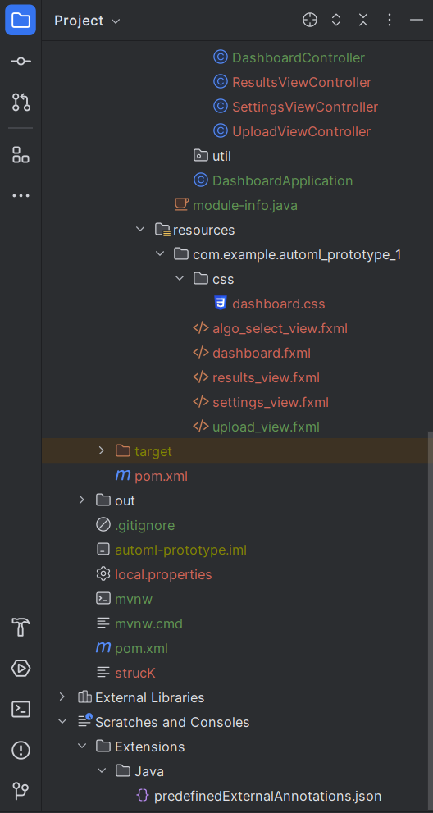
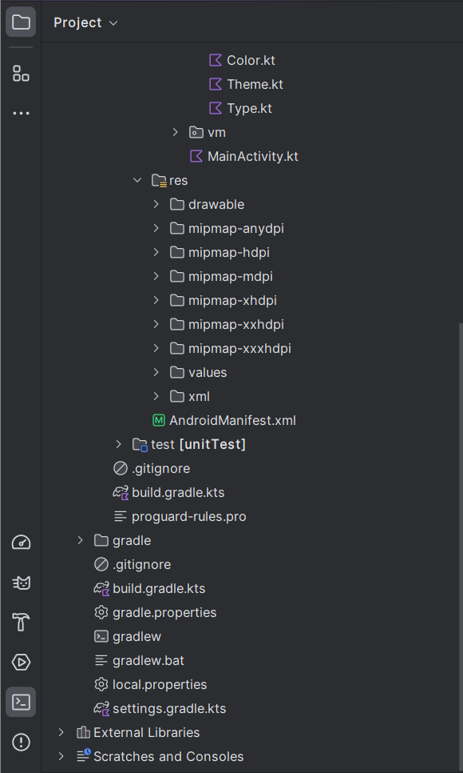
Tools & Technologies Used
Core
Java 17+, Maven, JPMS
Smile ML library for mock ML algorithms
Apache Commons CSV for data processing
Desktop
JavaFX 21+, FXML UI markup
Jackson for JSON parsing
Android
Kotlin, Jetpack Compose for declarative UI
Navigation and Coroutines for concurrency
Android SDK and Gradle build system
Common
GitHub repository for version control
Gradle build automation

Slide 5
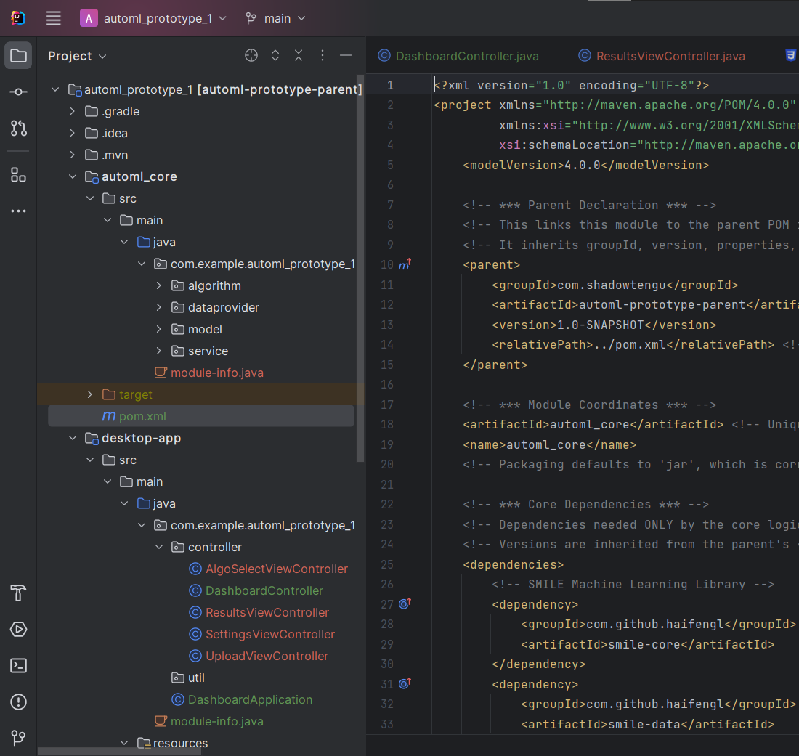




Shared Core Logic
(automl_core)
Models
Defines Dataset and ExecutionResult objects to encapsulate data and outcomes.
Data Provider
Handles CSV file parsing and management, ensuring seamless data input.
Services
Manages execution flow and application state across platforms.
Algorithms
Interface definition with mock implementations to simulate hyperparameter optimization.
Designed for platform-independence using Maven and Java Platform Module System to ensure scalability and easy integration.

Slide 6
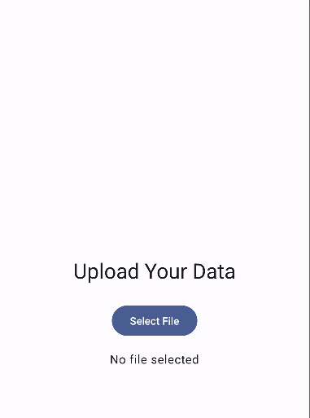
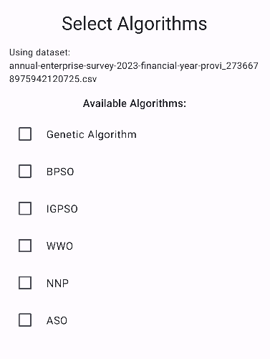
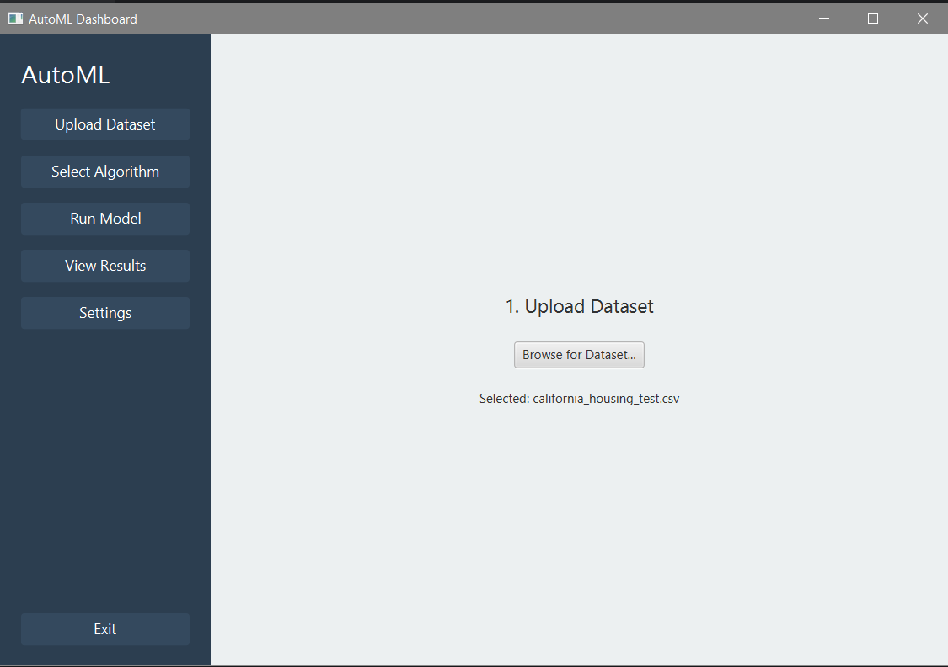
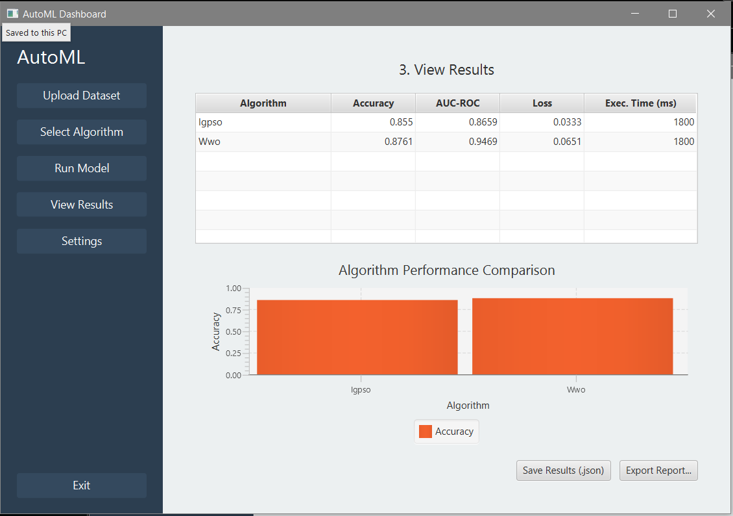
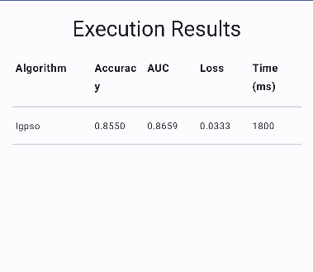
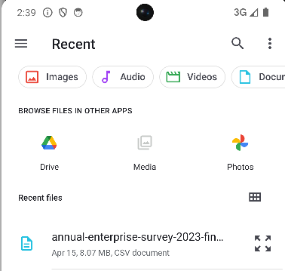
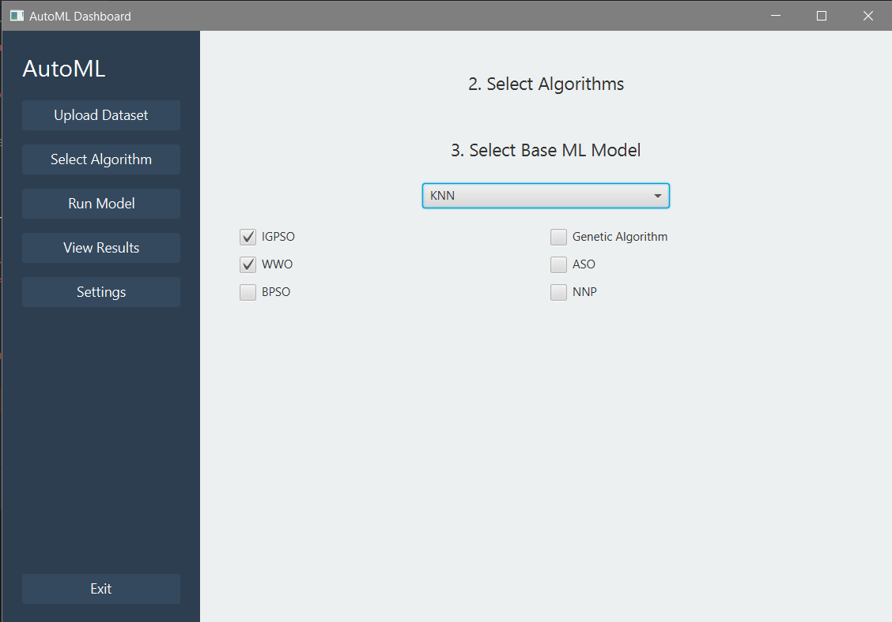
User Interfaces for Desktop & Android
Desktop UI
Android UI
Follows MVC/MVP design pattern implemented in JavaFX. Uses ExecutionService running on JavaFX Tasks to ensure responsive UI. Features include file upload, algorithm selection, and result display table.
Implemented with MVVM architecture and Kotlin Coroutines for concurrency. Uses a URI workaround with temporary file copying to address Smile ML compatibility issues on Android.

Slide 7





Applying OOP Principles in Practice
Inheritance & Polymorphism
Encapsulation
AbstractAlgorithm base class and interfaces enable flexible algorithm implementations.
2
POJOs and service classes manage internal data and expose controlled interfaces.
1
Exception Handling & IO
3
Robust error handling with Java exceptions and IO streams ensures stability.
Multithreading
5
JavaFX Tasks and Kotlin Coroutines efficiently manage asynchronous operations.
Collections & Generics
4
Use of List, Map, and generic types for type-safe data structures.

Slide 8
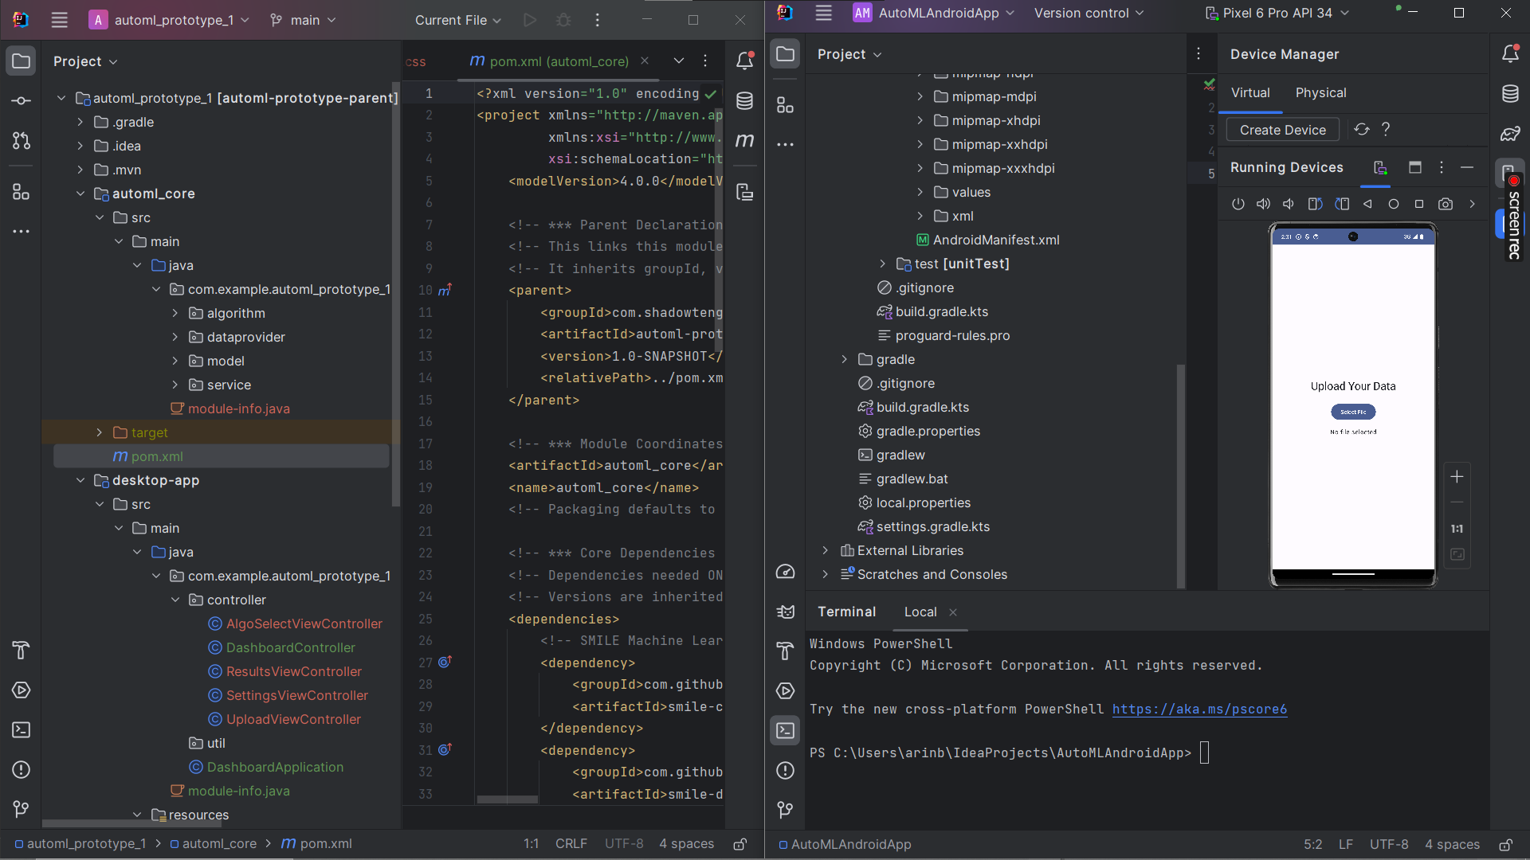
Key Development Challenges & Solutions
Android Uri Handling
Resolved using temporary file copy workaround to adapt Smile ML input requirements.
Build Configuration
Aligned Gradle and Maven versions; fixed certificate errors to stabilize builds.
Core Integration
Implemented defensive programming to avoid NullPointerExceptions and refactored code.
UI Glitches
Fixed conflicting imports and placeholders in Android UI to ensure smooth user interactions.

Slide 9
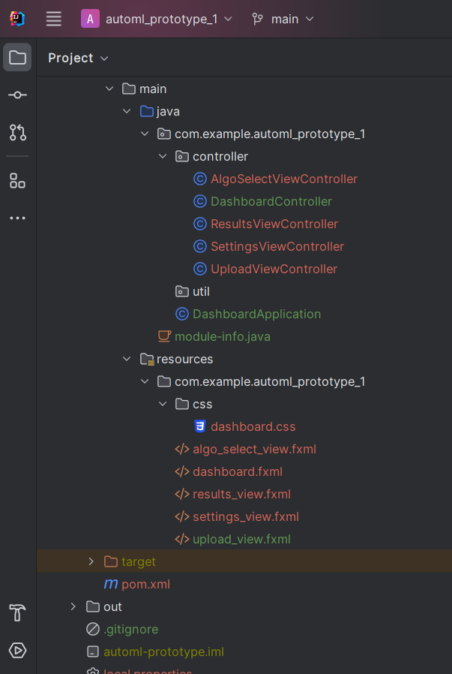
Future Enhancements & Roadmap
Algorithm Integration
Add real Smile ML algorithms to replace mocks for practical AI experiments.
User Interface
Enable parameter tuning UI, support new file formats like ARFF, and add richer visualizations.
Reliability
Improve error handling, provide detailed user feedback, and implement comprehensive testing.
Features & Storage
Add export/save options, persistent storage, and dependency injection for modular scalability.

Slide 10
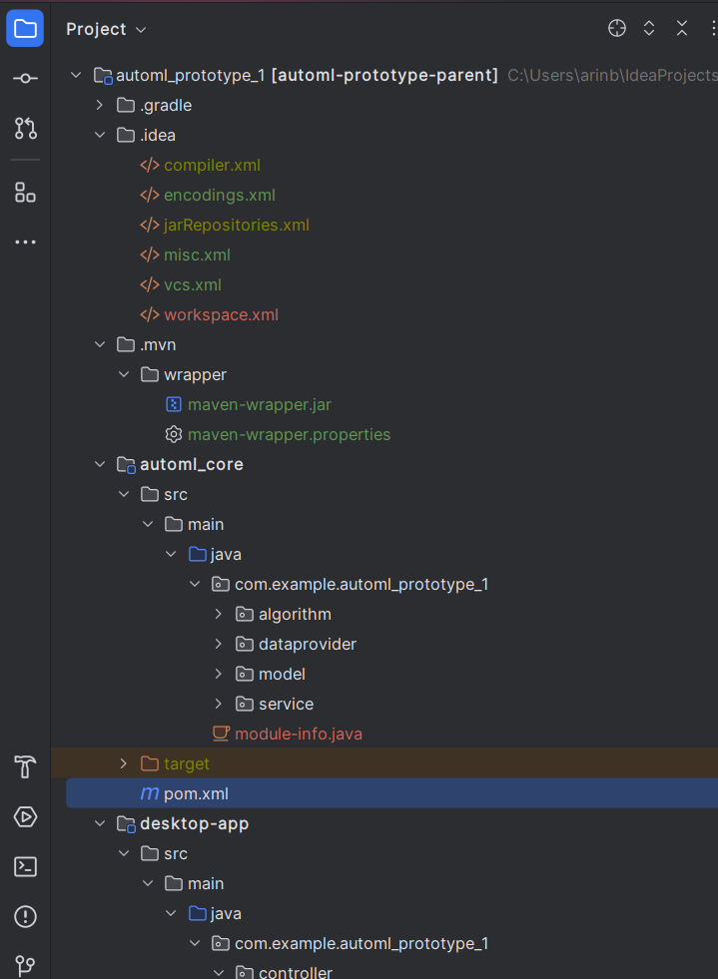
Summary & Questions
This project delivered a cross-platform AutoML application with practical OOP implementation across JavaFX and Jetpack Compose UIs integrating Smile ML.
Key takeaways include handling real-world integration issues and building a foundation for advanced automated machine learning workflows.
Thank you for your attention. Feel free to ask questions or refer to the project’s GitHub repository for more details.

