Slide 1
Introduction to Serverless Functions
Kirk Munro
@poshoholic

Slide 2
Why talk about serverless?
Not just another tool for your toolbelt
Makes it easy to run event-driven workloads in the cloud…
...on a schedule
…on demand (REST API)
…in response to many different events in the cloud
Low cost (often free, to a point), scaleable, easy way to build scripts that respond to many events (think IFTTT, Zapier, etc.)
e.g. GitHub events or actions (CI/CD), or other service that supports REST as an integration point

Slide 3
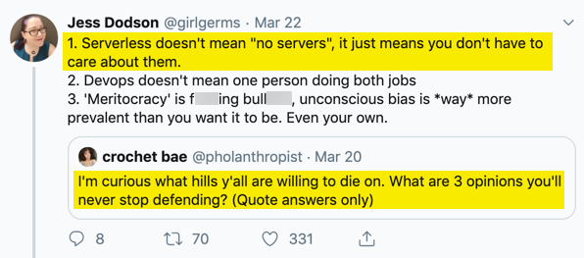
If only it were this easy...

Slide 4
A better perspective
Serverless means your function will run on servers you don’t directly manage, at a reasonable cost, in a very specific way that you don’t control, with some controls for scaling the system up and/or out within configurable limits.

Slide 5
Azure, AWS and GCP all have serverless
Azure Functions (1.x, 2.x)
AWS Lambda
Google Cloud Functions
In this talk, we’ll discuss the first two, because at this time, Google Cloud Functions do not support a PowerShell runtime…although they do support Python…

Slide 6
PowerShell in Azure Functions
Experimental support for Windows PowerShell in Azure Functions 1.x since 2016, but this implementation will not leave the experimental stage (with very good reason) https://github.com/Azure/azure-functions-host/issues/1563
Support for functions written in C#, and PowerShell can be invoked from C#, so you can run PowerShell (Windows or Core) that way in production
Support for PowerShell Core in the Azure Functions 2.x runtime added in public preview in 2019 https://devblogs.microsoft.com/powershell/public-preview-of-powershell-in-azure-functions-2-x/

Slide 7
Architectural details in Azure Functions
Functions that are invoked are run in a worker process on a virtualized server
Concurrent invocations are run in separate runspaces in an existing worker process if there is enough room, or in a new worker process if there is not enough room
Managing concurrency requires choosing an appropriate App Service Plan, and if you’re using PowerShell Core in the Azure Functions 2.x runtime, setting a maximum limit on the number of concurrent invocation

Slide 8
More architectural details in Azure Functions
When working with concurrency, you must consider whether or not your PowerShell function directly or indirectly uses process-level constructs (static variables, for example)
Some PowerShell modules are not designed properly for multi-threaded use
Side effects of using these modules include race conditions, credentials or cached connection details bleeding into other runspaces
When it comes to concurrency, you must pay close attention to the work that is being done (read source, read docs, ask questions, and run tests in PowerShell ISE!)

Slide 9
Even more architectural details in Azure Funcs
Functions are launched from one of three states:
Cold start (slowest) – function package is deployed onto worker agent, loaded, and then run once invoked
Warm start (fastest) – function package is already deployed and loaded and just runs once invoked
Lukewarm start – function package is already deployed, and loads and runs once invoked
How your function starts depends on the App Service plan associated with your Function App and the scale configuration
Note that « Always on » doesn’t really mean « Always on » https://github.com/Azure/Azure-Functions/issues/967
Read: https://liftcodeplay.com/2017/12/19/strategies-for-improving-eliminating-azure-functions-cold-starts/

Slide 10
Still more architectural details in Azure Funcs
You are responsable for building the package that will be deployed to worker agents when your function(s) are invoked, and loading that package into Azure
How you load the package depends on the type (C#, PowerShell, etc.) of function you are deploying

Slide 11
Architectural details for AWS Lambda
Each Lambda function is invoked in its own separate process space (the Lambda compute environment)
Concurrent invocations result in additional Lambda compute environments being spun up
Invocations may work in a temp folder on the local file system
Subsequent invocations reuse existing Lambda compute environments that were previously used by the same Lambda function
PowerShell Lambda functions support requirements, and AWS Lambda takes care of building a package with the requirements

Slide 12
Other important details for all cloud platforms
When working with event-driven APIs, you need to understand the needs of the caller (some systems expect to receive a response to their event within a specific time)
You can leverage cloud resources such as message queues to transition from an invocation that must respond quickly to another function that can run for much longer
You need to understand the time limits, storage limits, and any other limits that you must work within on the cloud platform, and request increases from the cloud provider or make changes appropriately in your serverless configuration files.

Slide 13
Complimentary sessions to learn more
Unleash your PowerShell with AWS Lambda and Serverless Computing Wed., May 1, 09:00-10:45
PowerShell in Azure Functions Thurs., May 2, 13:00-13:45

Slide 14
Additional resources
PowerShell Azure Functions reference: https://docs.microsoft.com/en-us/azure/azure-functions/functions-reference-powershell
AWS Lambda function documentation: https://docs.aws.amazon.com/lambda/index.html
Google Cloud Functions documentation: https://cloud.google.com/functions/docs/

