Slide 1
Performance Analysis Framework for Base Station Placement Using IEEE 802.11
Group study presentation
18.03.2020
Kirill Kukartsev
Rustam Khakov
Zufar Makhmutov

Slide 2
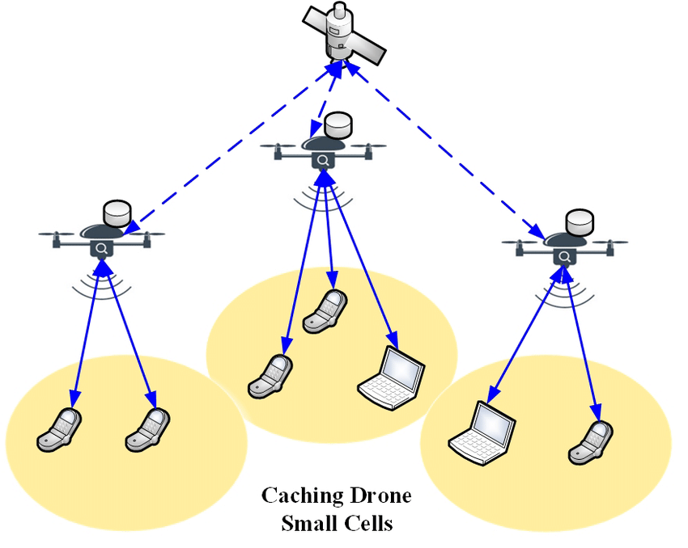
Motivation
Mobile users’ demand increasing
Higher speed, lower latency
More data and services
Tendency to be located closely to users
2G: Macro-cells
3G - 4G: Micro-cells
5G: Pico-cells
Idea: Unmanned Aerial Vehicle with
Base Stations (UAV-BS)
Problems:
How to design a placement algorithm?
How to evaluate correctness of the algorithm?
How to coordinate the elements of mobile
communication system infrastructure?
Increasing coverage and capacity
with UAV equipped with base stations[1]

Slide 3
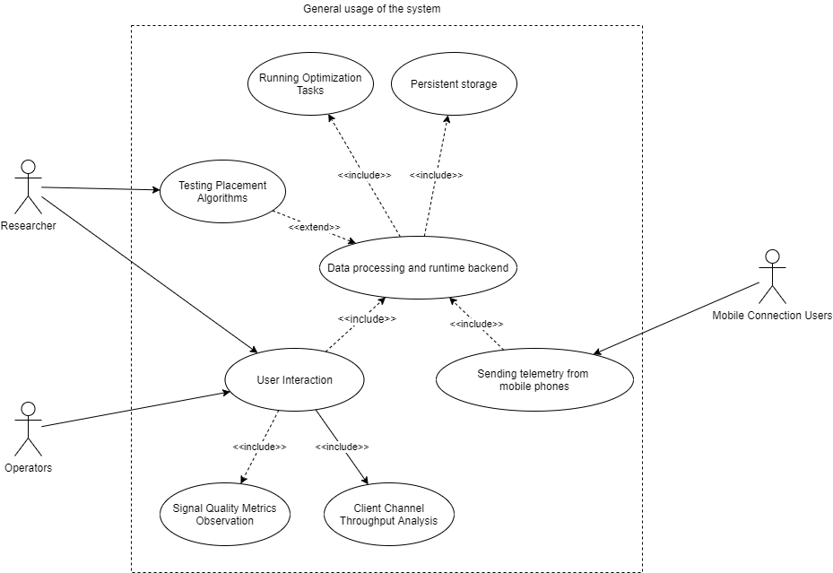
A General Use-Case for Possible Solution
A Generalized Use-Case for a Placement Algorithm Experimental Framework

Slide 4
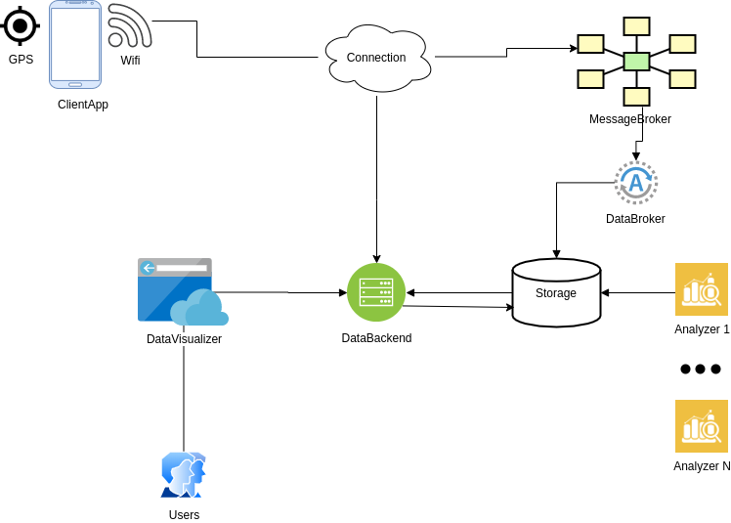
Abstract System Design
Abstract Design for component interaction for the given possible problem solution

Slide 5
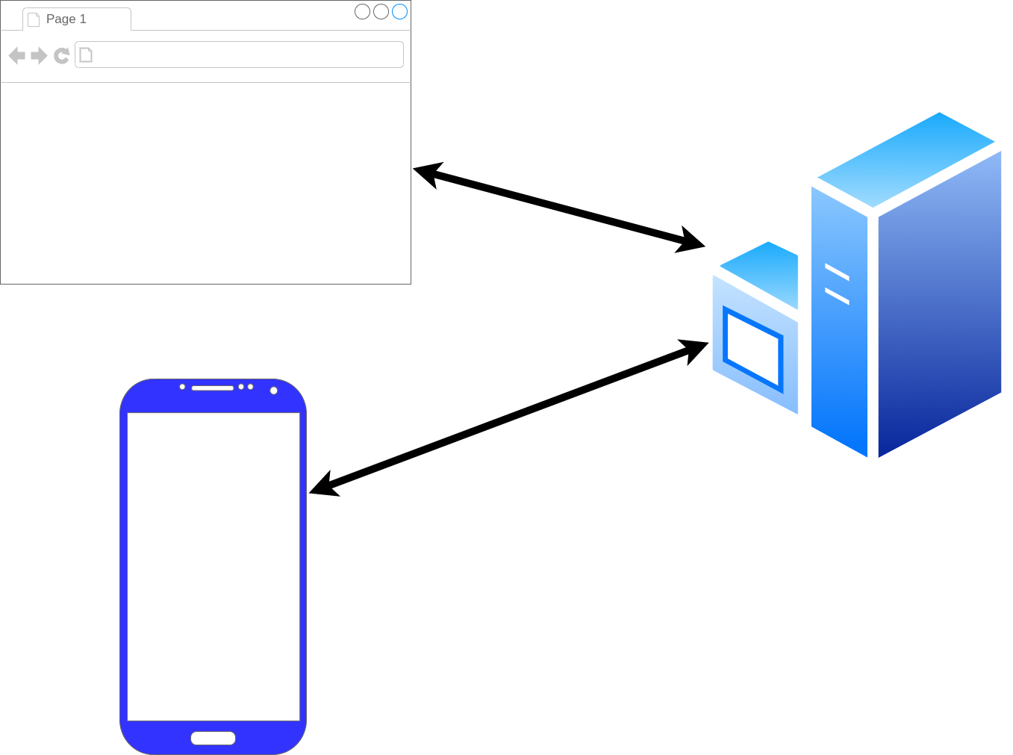
Framework Architecture Description
GPS_Frontend
GPS_Tracker
GPS_Android
Three main component of framework: a phone (GPS_Android), user interface (GPS_Frontend), data processing (GPS_Tracker)
Notes:
Rustam
<номер>

Slide 6
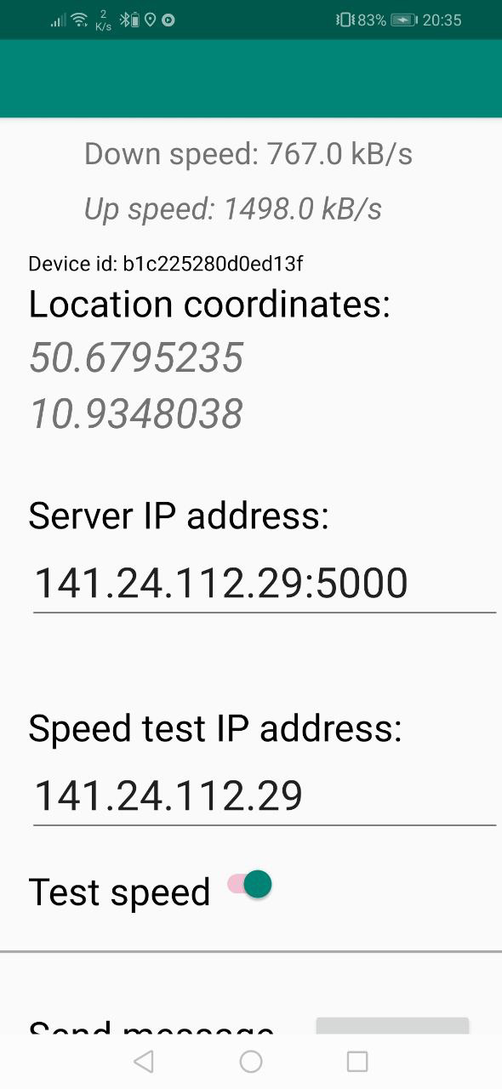
Android Component
Measure:
GNSS location
RSS of Wifi connection
Connection speed
GPS_Android installed on an Android SmartPhone

Slide 7
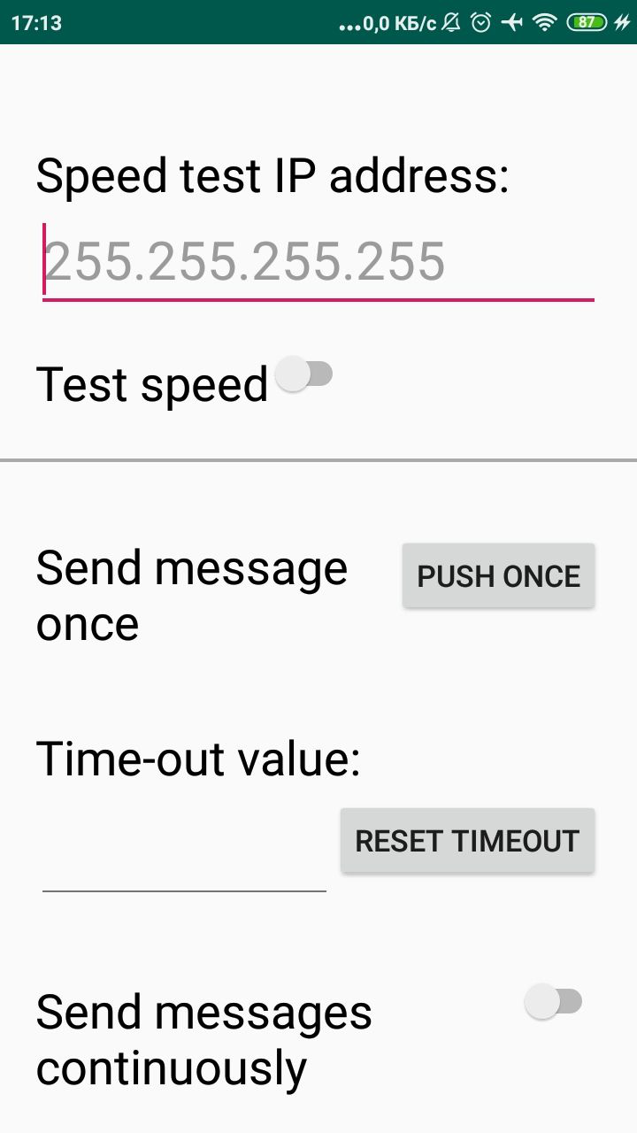
Activities:
Send measurement result to given server
Measure data periodicaly with given
timeout on background

Slide 8
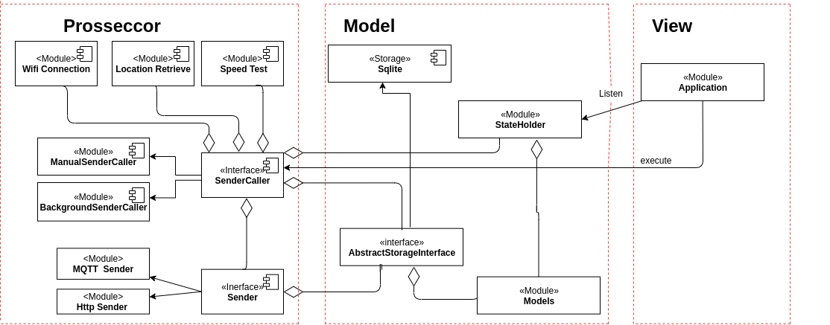

Slide 9
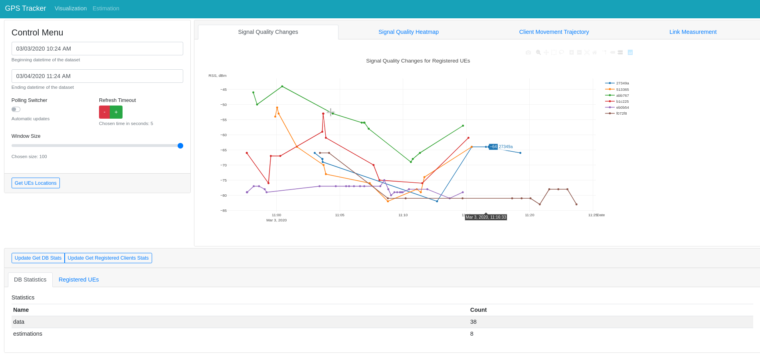
UI Component
Timeframe,
update
frequency
configuration
Location data on given
timeframe
Database
statistics
Layout of the UI implemented by GPS_Frontend. The user interact via a web-browser.
Notes:
Rustam
<номер>

Slide 10
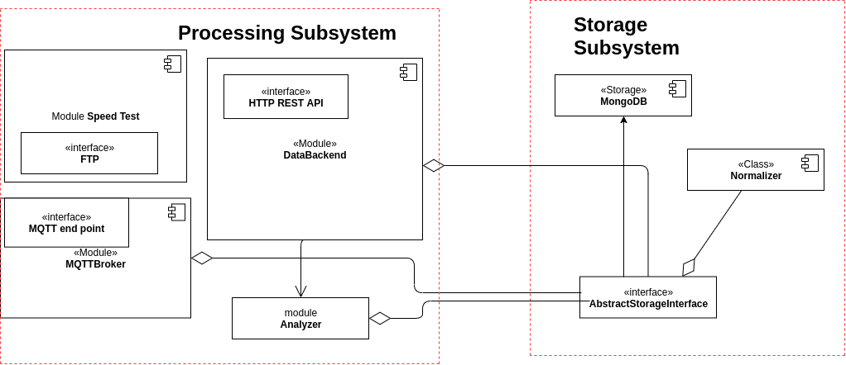
Backend Component
Component diagram for GPS_Tracker backend components.
Notes:
Rustam
<номер>

Slide 11
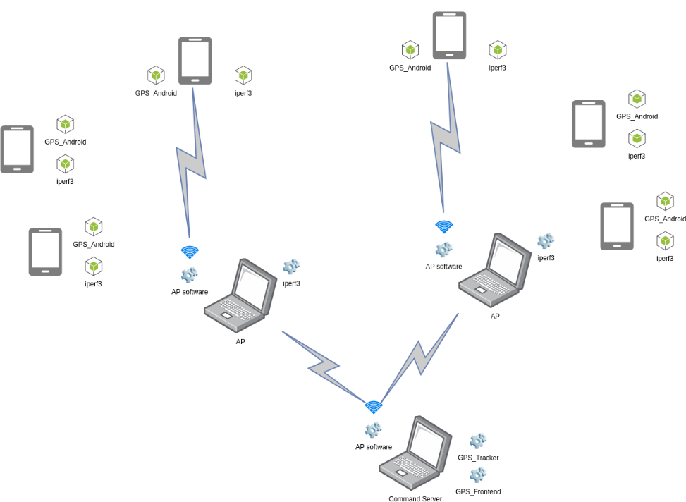
Component Layout for Experiment
Communication between components during the experiment
Notes:
Zufar
<номер>

Slide 12
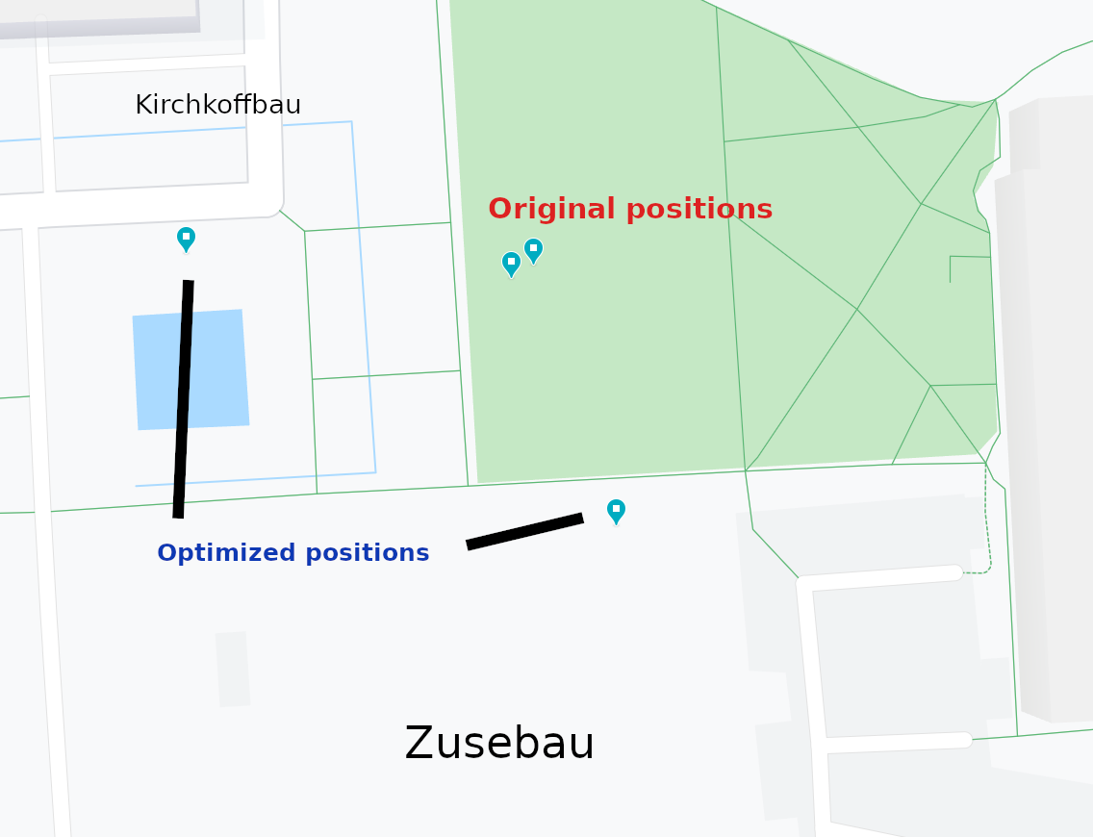
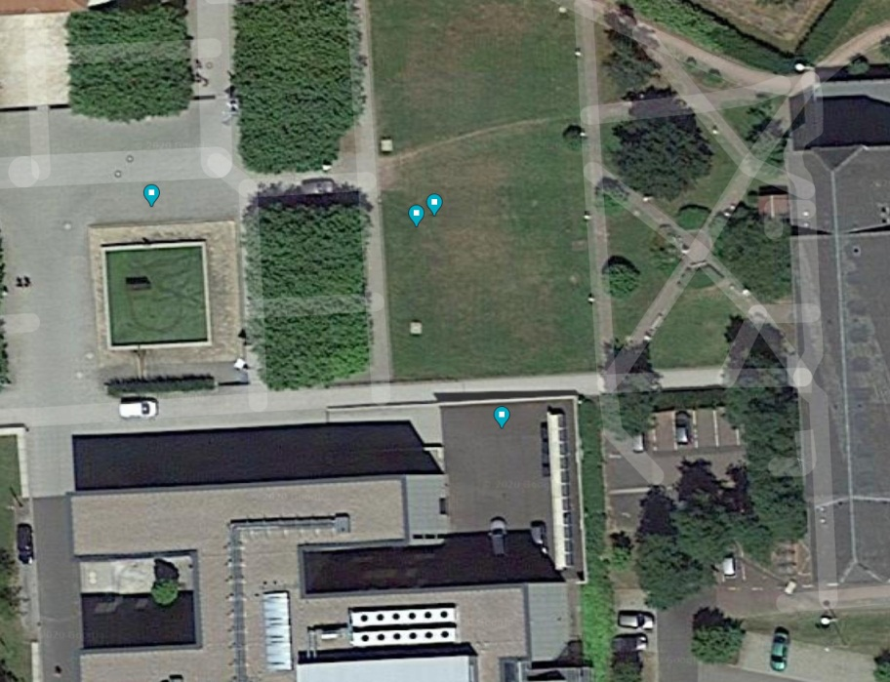
Optimized Positions for UAV-BS
Logical map for the original position and suggested optimized position. Coordinates by “clustering” (K-Means) position optimization algorithms are highly biased.
Satellite map with original and suggested positions for UAV-BS layout

Slide 13
Result of Experiment
Are the initial aims fulfilled?
 | Aspect | Result
Developed system | Functional properties | Works as expected, but had to alter architecture
Optimization algorithm | Provided positions | Calculated correctly
Result of 4 performed experiments

Slide 14
Conclusion
Good overall results
Applicable for UAVs layout optimization
Capability to analyze the measured data
Ability to be highly modified to obtain more reliable results.
Extensibility of the platform
But …
Framework architectural problem and nuances
Behavior of components are hard to model in the laboratory, but real experiment is exhausting.
Embedded algorithms have restrictions
The algorithms are simplified and produce biased results

Slide 15
Appendix. Resolved problems
Table describes significant moments of workflow
Problem | Group | Resolved way
Can’t install app via apk | Android | Install using Android Studio
Data doesn’t come to CnC | Wi-Fi | Check AP
Silent crash of app | Android | Added logging to file in phone
Error related to MQTT | Software | Replace MQTT with HTTP
Hard to describe software architecture | Report | Refactor code to follow MVVM pattern
Notes:
Zufar
<номер>

Slide 16
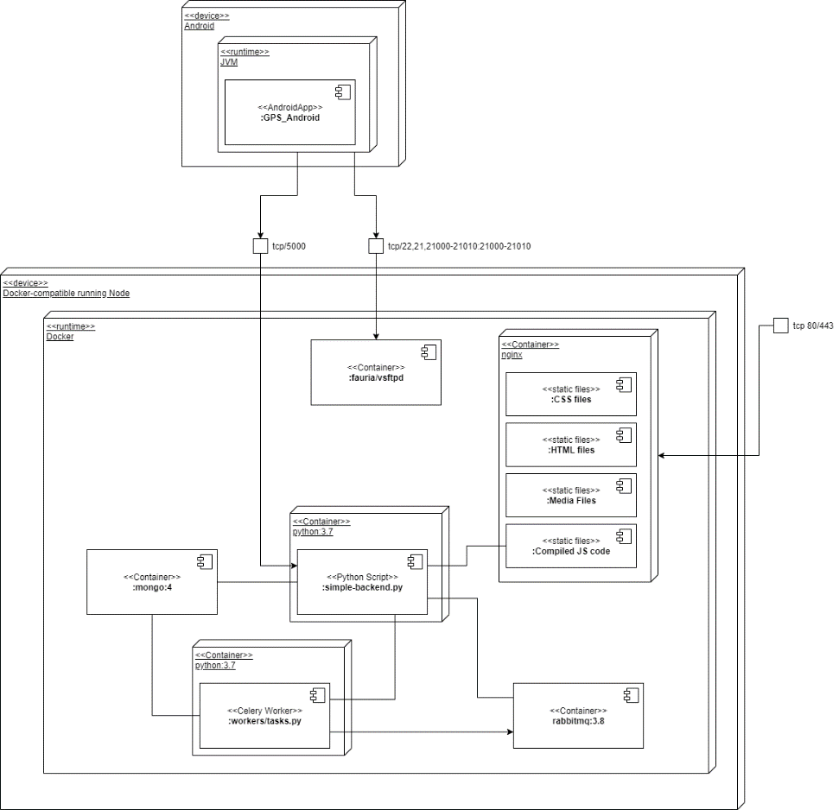
Appendix. Deployment Diagram of Framework
Dockerized infrastructure
Unified interface
Configuration in .config or OS env
A deployment case in container runtime.
Notes:
Kirill
<номер>

Slide 17
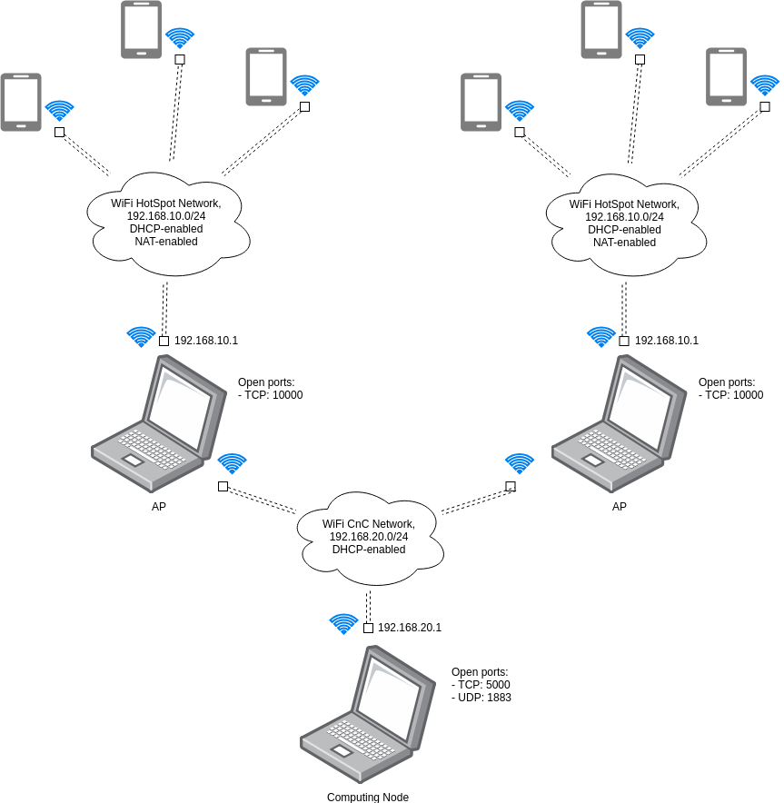
Appendix. Network Diagram of Experiment
A network scheme of experiment
Notes:
Kirill
<номер>

Slide 18
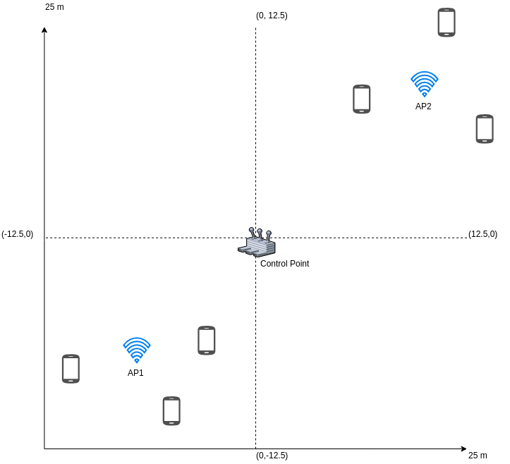
Appendix. Experiment 1/6
Experiment Case 2 – Sub-Optimal Case
Notes:
Zufar
<номер>

Slide 19
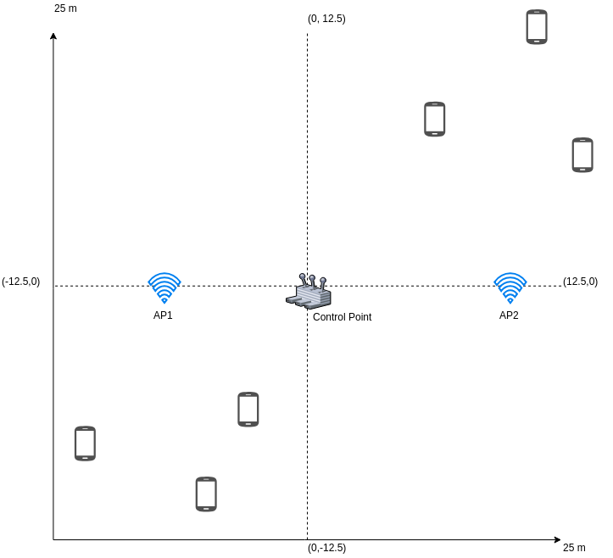
Appendix. Experiment 1/6
Experiment Case 1 – Uniform Case
Notes:
Zufar
<номер>

Slide 20
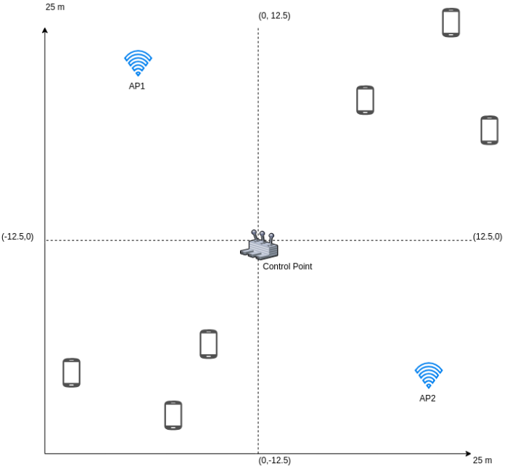
Appendix. Experiment 1/6
Experiment Case 1 – Near- Uniform Case
Notes:
Zufar
<номер>

Slide 21
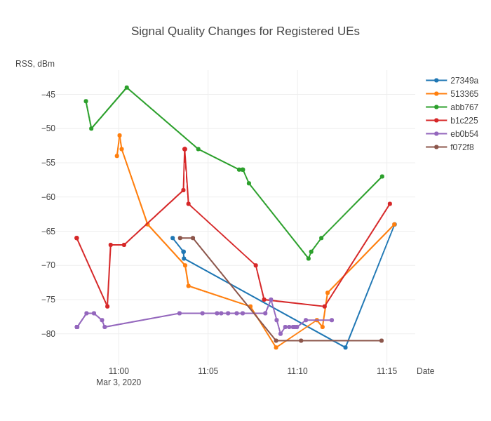
Appendix. Experiment 2/6
Overall Signal Quality (RSS) changes during the experiment.
Notes:
Zufar
<номер>

Slide 22
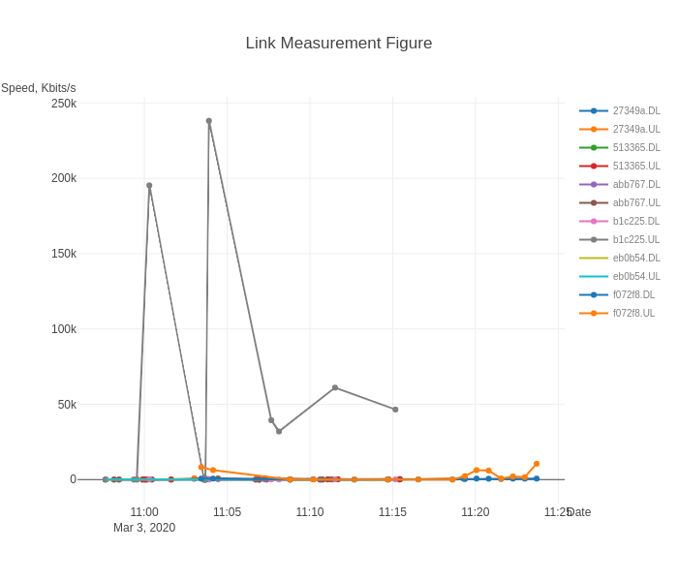
Appendix. Experiment 3/6
Measured signal link speed for uplink and downlink. Mostly metrics are degraded, cannot truly rely on them.
Notes:
Zufar
<номер>

Slide 23
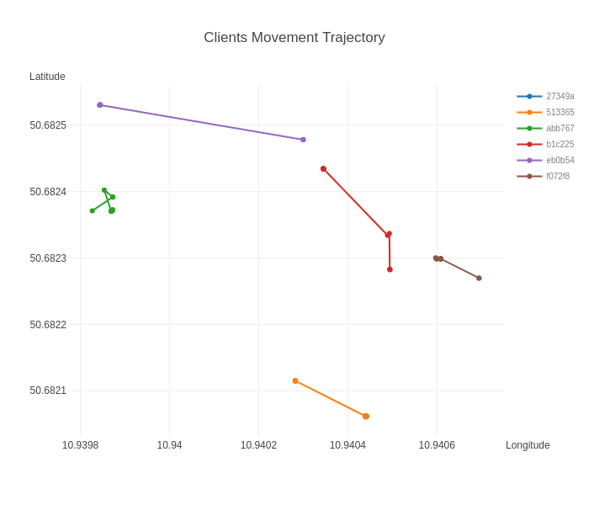
Appendix. Experiment 4/6
Overall detected coordinates changes during the experiment. Clearly shown that GPS has measurement error.
Notes:
Zufar
<номер>

Slide 24
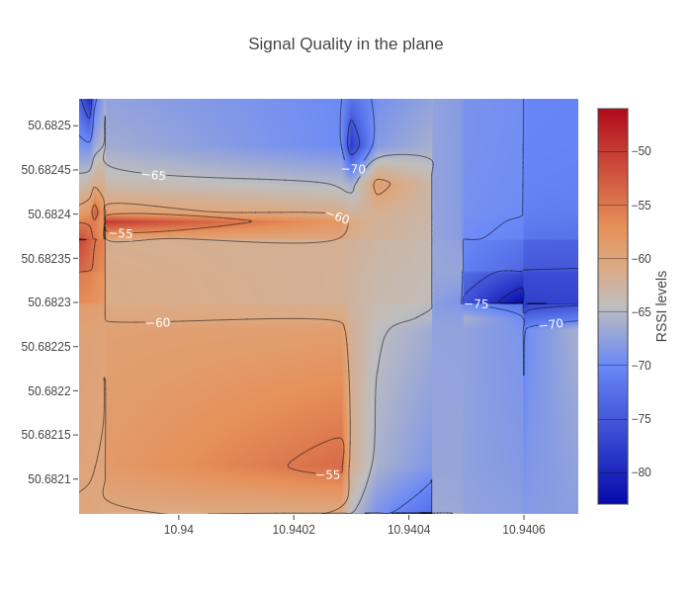
Appendix. Experiment 5/6
The heatmap of quality of WI-FI signal by GPS coordinates.
Notes:
Zufar
<номер>

Slide 25
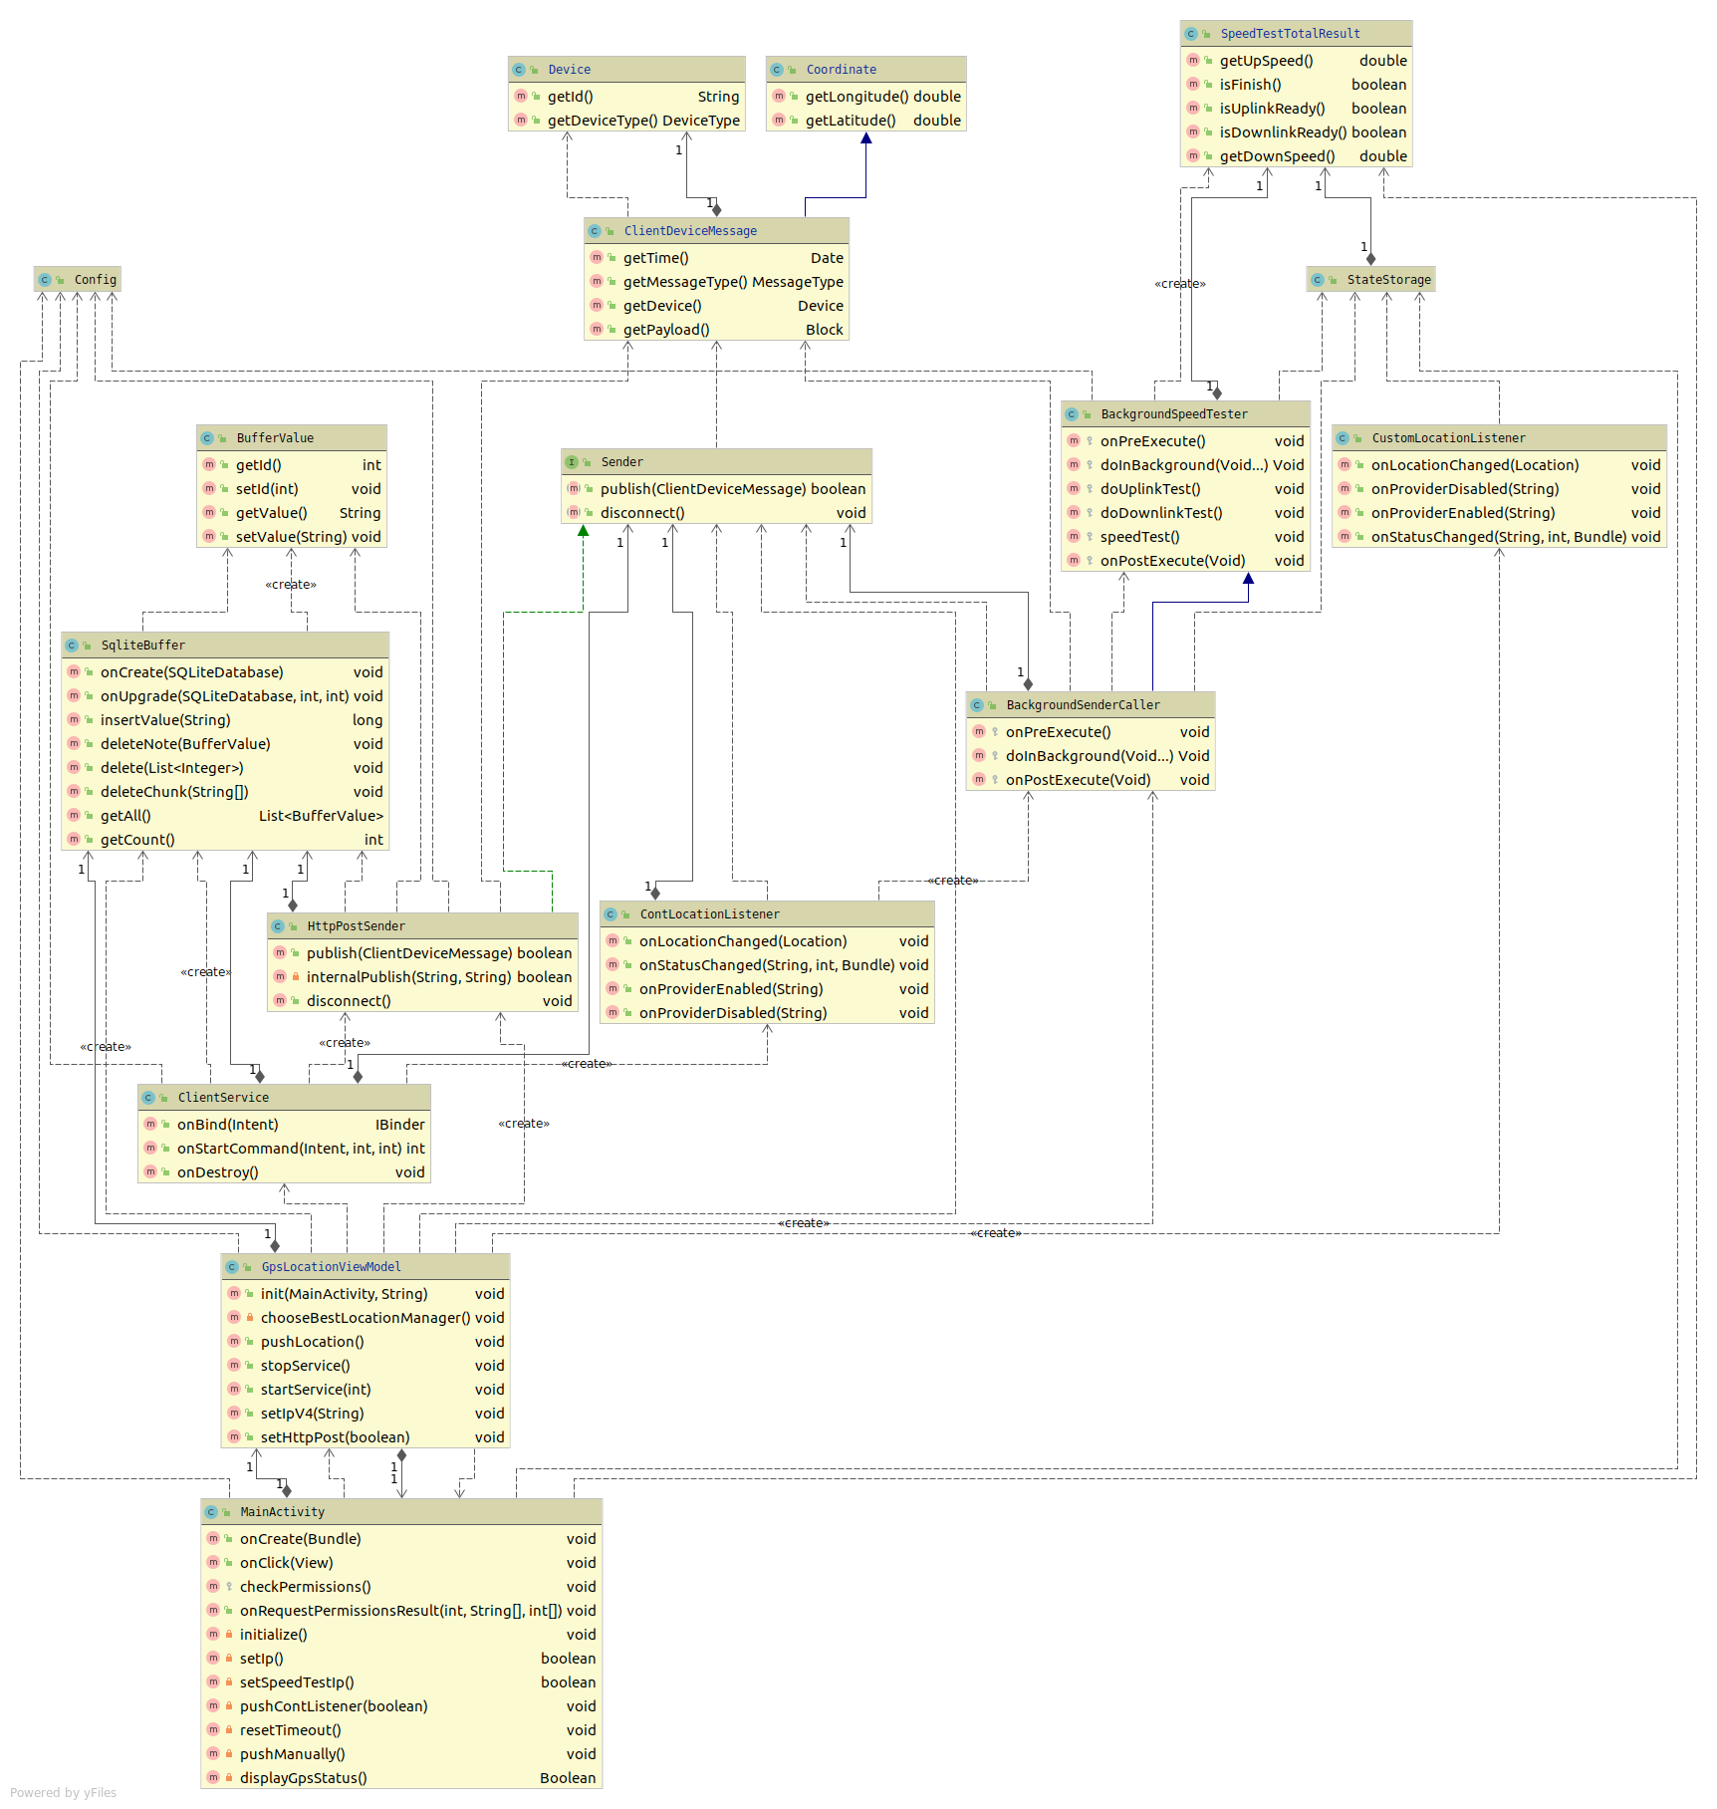

Slide 26
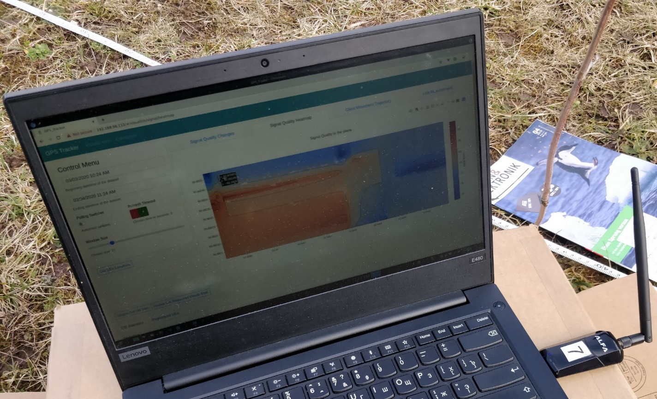
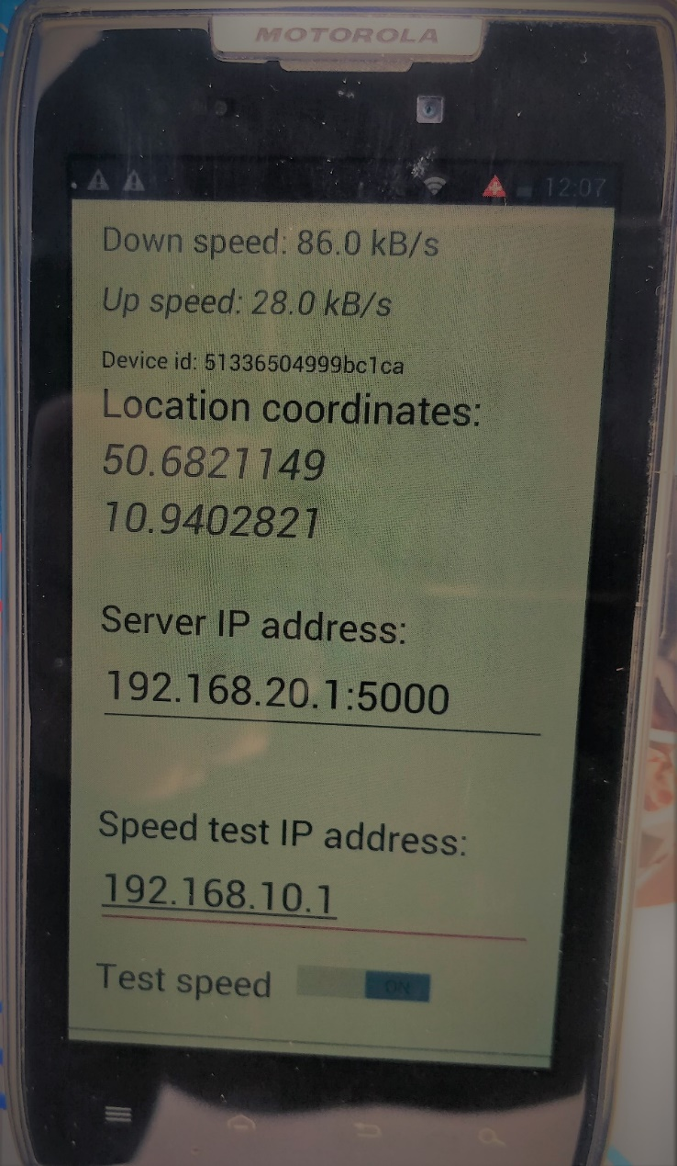
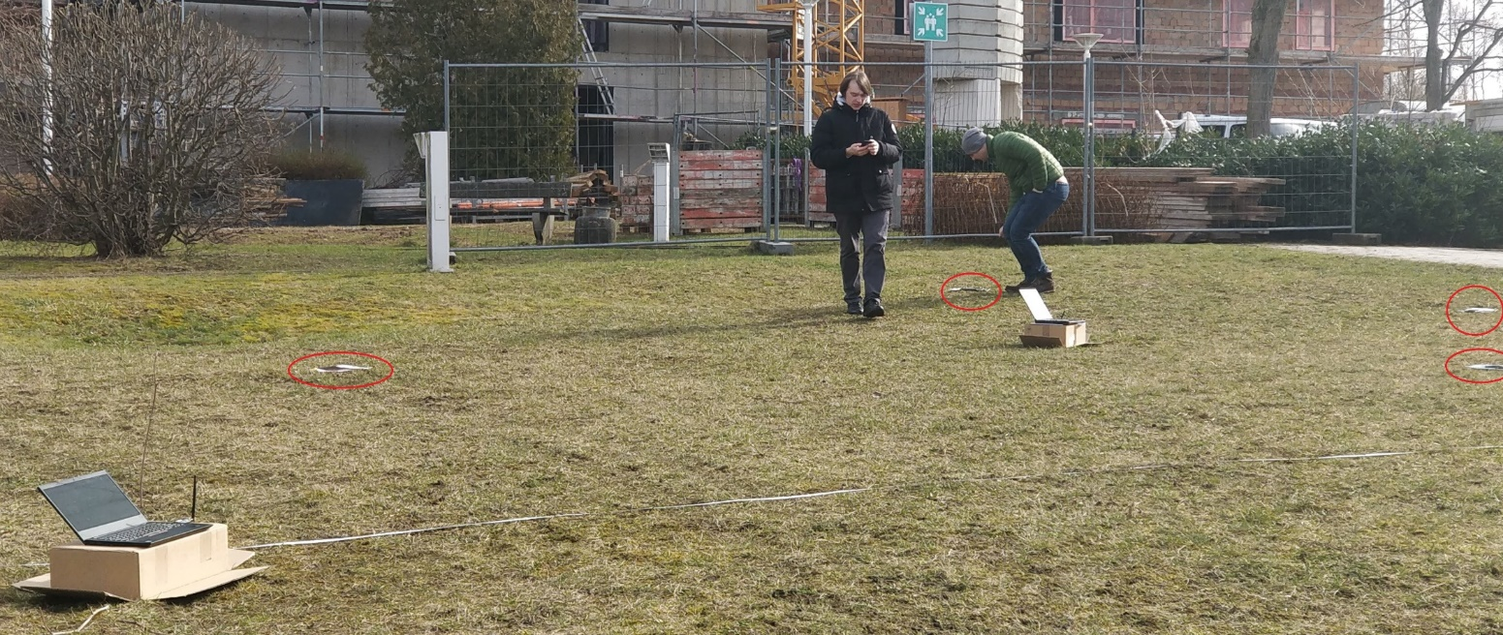
Appendix. Experiment 6/6
Notes:
Zufar
<номер>

Slide 27
References
1.https://www.researchgate.net/profile/Nan_Zhao4/publication/328853522/figure/fig2/AS:691359337938955@1541844319319/Small-cell-networks-based-on-mobile-UAV-base-stations-without-ground-SBSs.ppm

