Slide 1
Performance analysis framework for base station placement using IEEE 802.11
Group study presentation
18.03.2020
Kirill Kukartsev
Zufar Makhmutov
Rustam Khakov

Slide 2
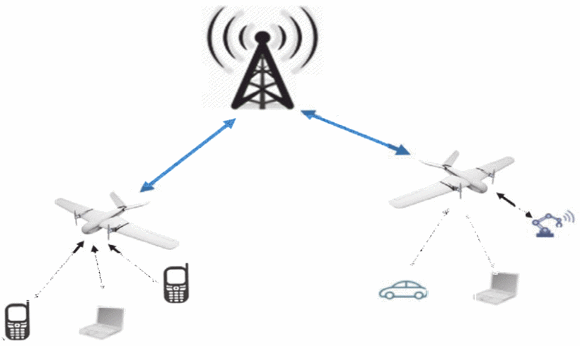
Problem Description
Mobile users’ demand increasing
Higher speed, lower latency
More data and services
Tendency to be located closely to users
2G: Macro-cells
3G - 4G: Micro-cells
5G: Pico-cells
Idea: Unmanned Aerial Vehicle with Base Stations (UAV-BS)
Problems:
How to design a placement algorithm?
How to evaluate correctness the algorithm?
How to test the algorithm in the real life?
How to coordinate the elements of mobile communication system infrastructure?
Increasing coverage and capacity
with UAV equipped with base stations, source

Slide 3
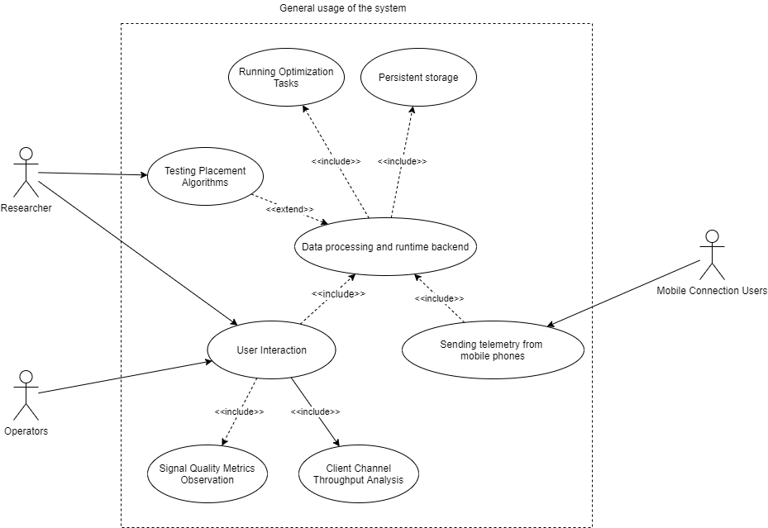
A general use-case for possible solution
A generalized use-case for a placement algorithm experimental framework

Slide 4
Result of experiment
Are the initial aims fulfilled?
 | Aspect | Result
Developed system | Functional properties | Works as expected, but had to alter architecture
 | Stability / Performance / Usability | Link may suffer collisions
Optimization algorithm | Provided positions | Calculated correctly
 | Stability / Performance / Usability | Extra data and/or other algo for higher accuracy

Slide 5
Conclusion
Applicable for UAVs layout optimization
Capability to analyze the measured data
Ability to be highly modified to obtain more reliable results.
Extensibility of the platform
But …
Still some problems
Algorithms have restrictions, simplified and produce biased results

Slide 6
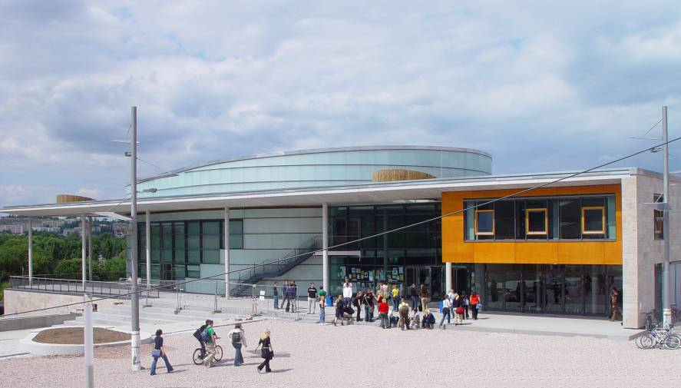

Contact
Integrated Communication Systems Group
Ilmenau University of Technology
Univ.-Prof. Dr.-Ing. Andreas Mitschele-Thiel
fon: +49 (0)3677 69 2819
fax: +49 (0)3677 69 1226 e-mail: mitsch@tu-ilmenau.de
Visitors address:
Technische Universität Ilmenau
Gustav-Kirchhoff-Str. 1 (Informatikgebäude, Room 210) D-98693 Ilmenau
www.tu-ilmenau.de/ics

Slide 7
Appendix. Resolved problems
Table describes significant moments of workflow
Problem | Group | Resolved way
Can’t install app via apk | Android | Install using Android Studio
Data do not come to CnC | Wi-Fi | Check AP
Silent crash of app | Android | Added logging to file in phone
Error related to MQTT | Software | Replace MQTT with HTTP
Hard to describe software architecture | Report | Refactor code to follow MVVM pattern

Slide 8
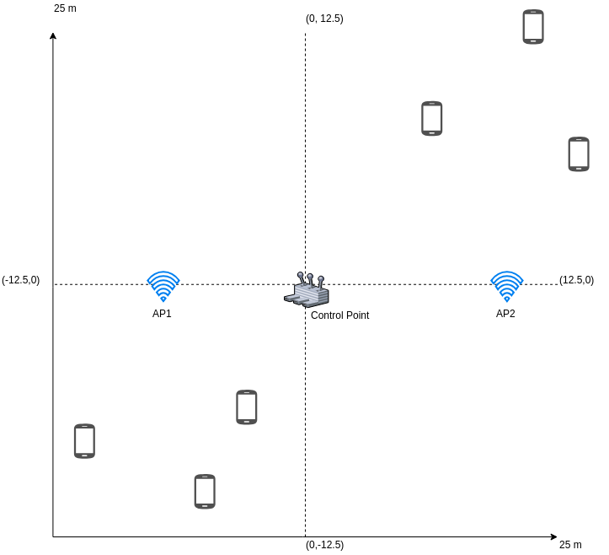
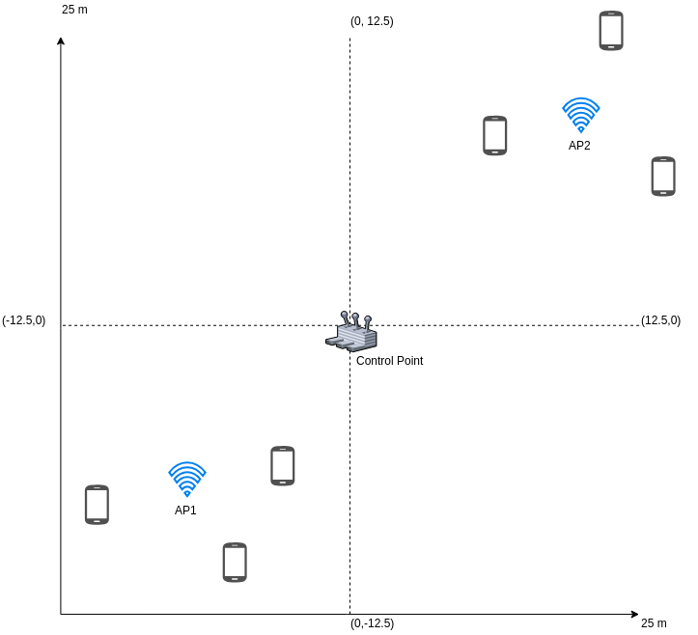
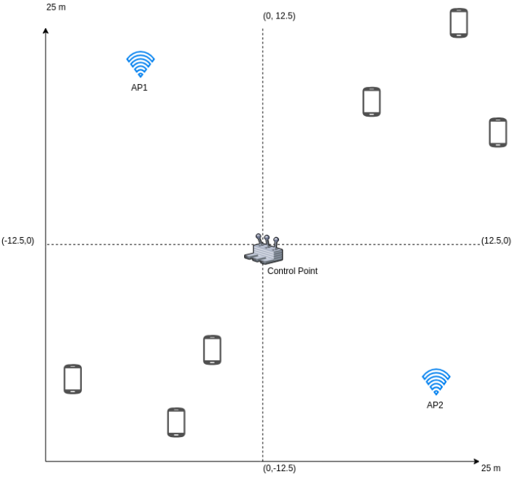
Appendix. Experiment 1/6
Near-optimal
Uniform
Uniform
Suboptimal

Slide 9
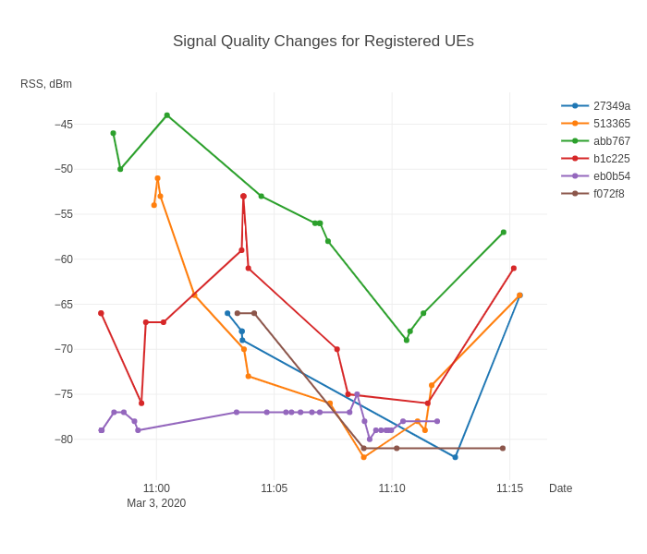
Appendix. Experiment 2/6

Slide 10
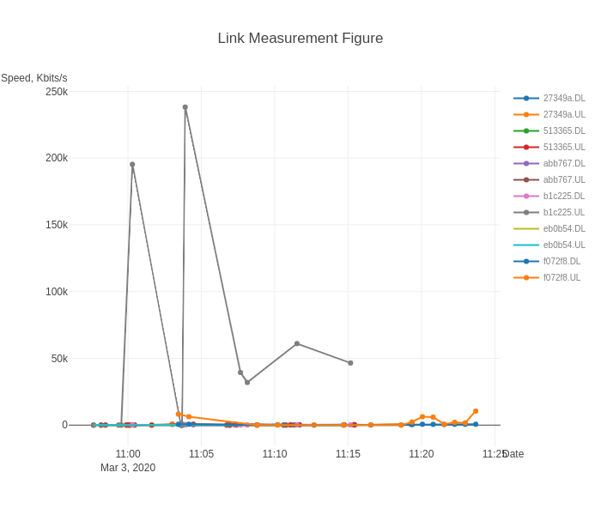
Appendix. Experiment 3/6

Slide 11
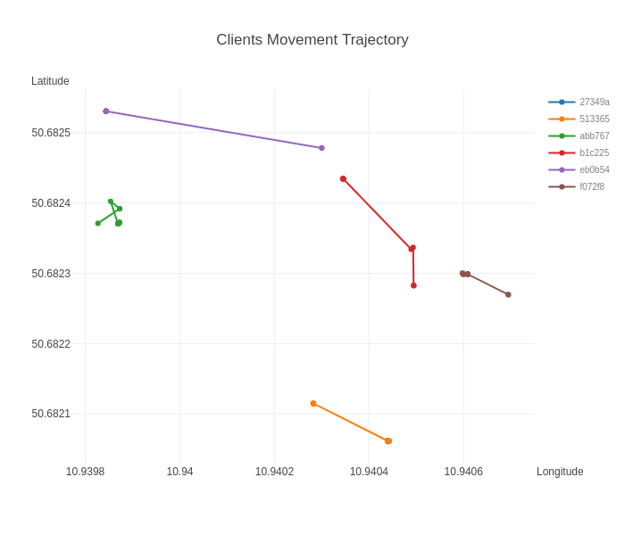
Appendix. Experiment 4/6

Slide 12
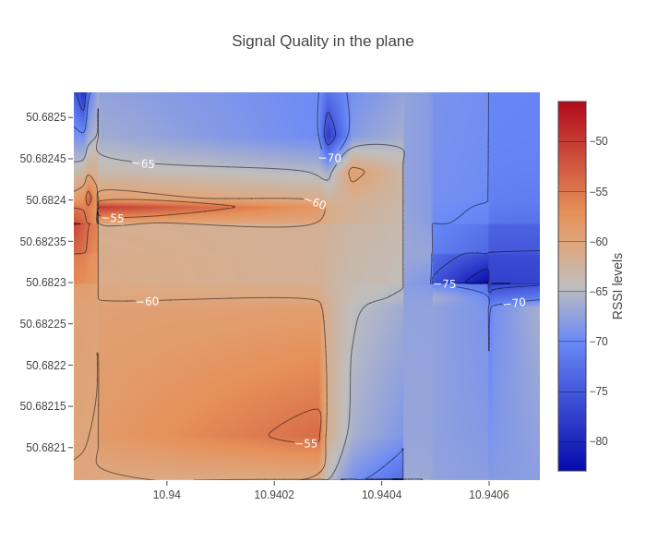
Appendix. Experiment 5/6

Slide 13
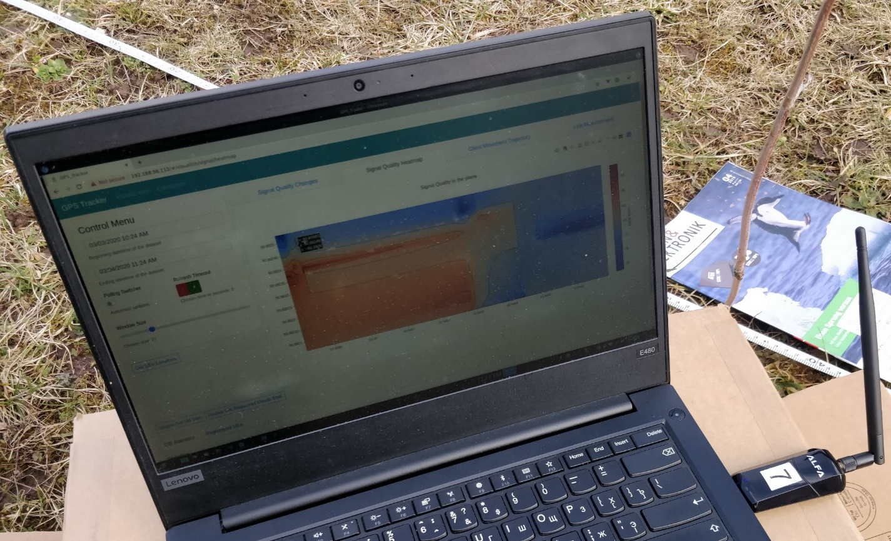
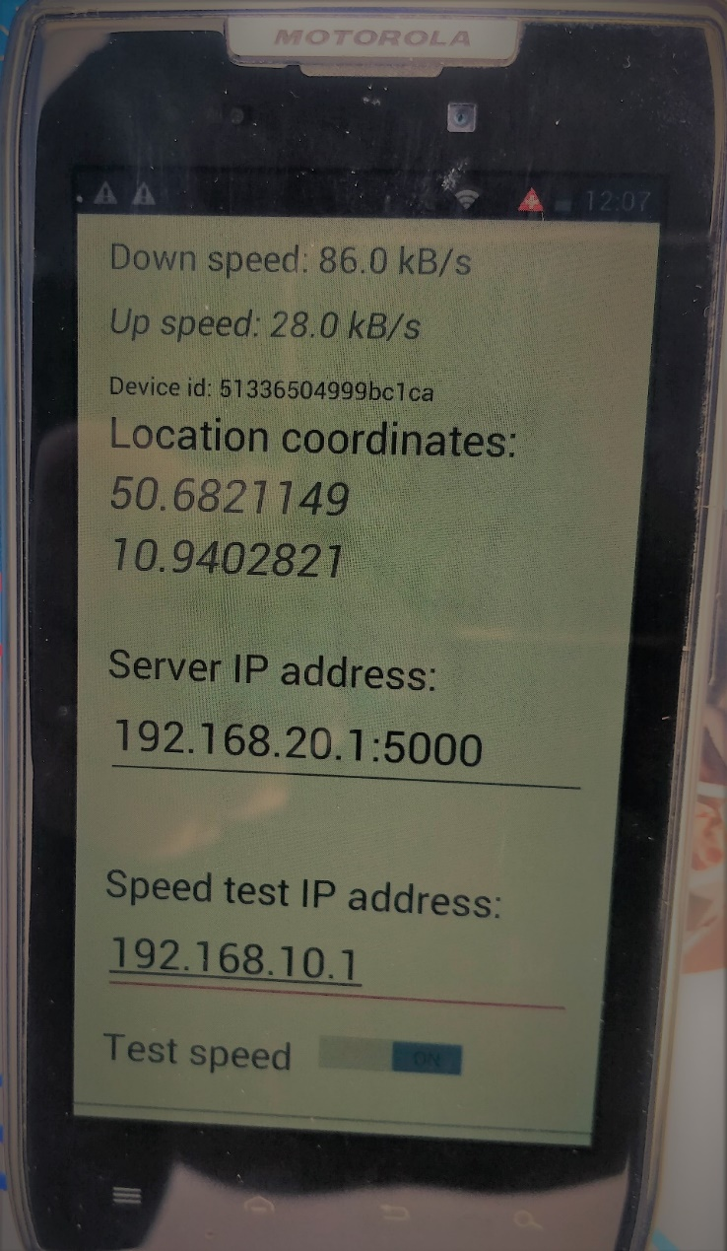
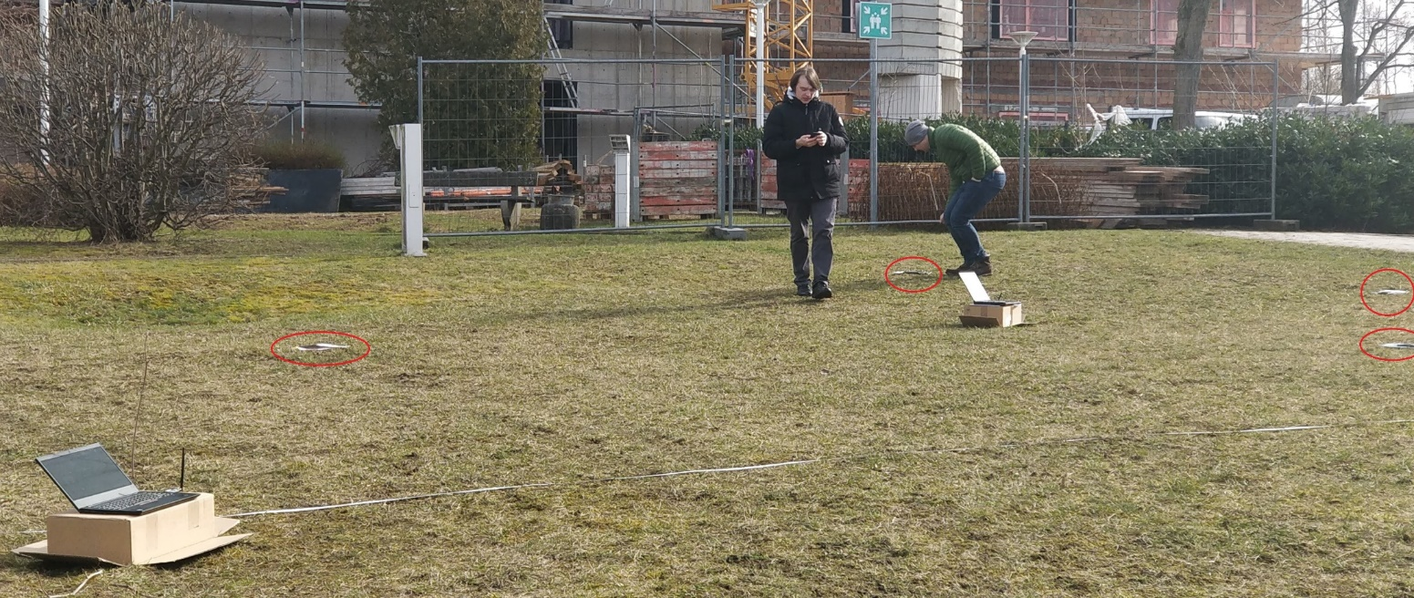
Appendix. Experiment 6/6

