Slide 1
Performance analysis framework for base station placement using IEEE 802.11
Group study presentation
18.03.2020
Kirill Kukartsev
Zufar Makhmutov
Rustam Khakov

Slide 2
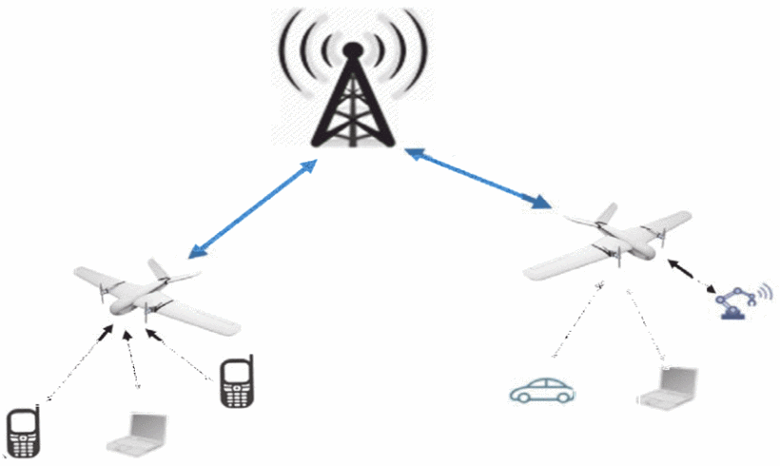
Problem Description
Mobile users’ demand increasing
Higher speed, lower latency
More data and services
Tendency to be located closely to users
2G: Macro-cells
3G - 4G: Micro-cells
5G: Pico-cells
Idea: Unmanned Aerial Vehicle with Base Stations (UAV-BS)
Problems:
How to design a placement algorithm?
How to evaluate correctness the algorithm?
How to test the algorithm in the real life?
How to coordinate the elements of mobile communication system infrastructure?
Increasing coverage and capacity
with UAV equipped with base stations, source

Slide 3
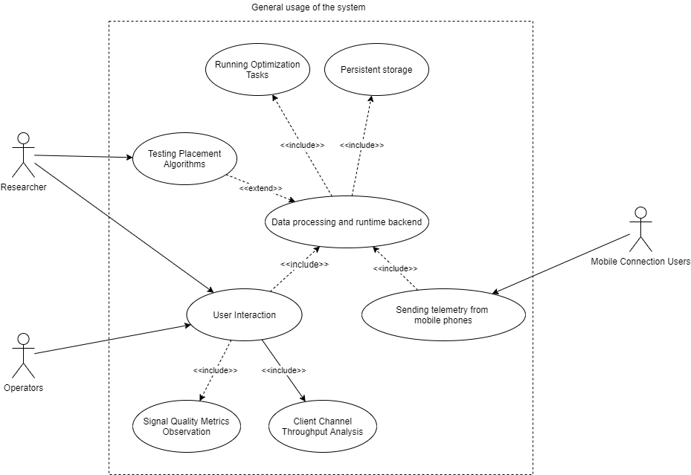
A general use-case for possible solution
A generalized use-case for a placement algorithm experimental framework

Slide 4
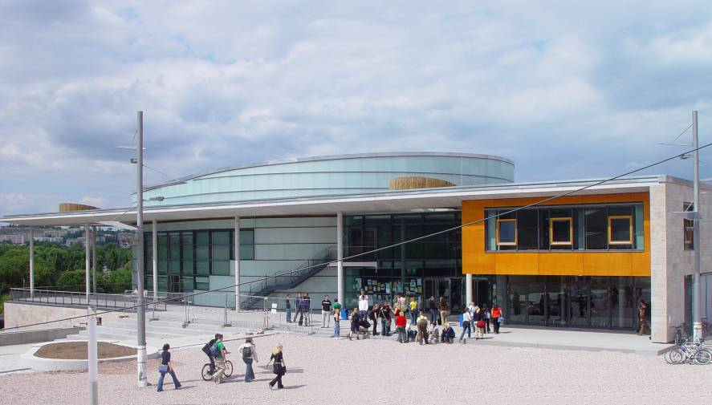

Contact
Integrated Communication Systems Group
Ilmenau University of Technology
Univ.-Prof. Dr.-Ing. Andreas Mitschele-Thiel
fon: +49 (0)3677 69 2819
fax: +49 (0)3677 69 1226 e-mail: mitsch@tu-ilmenau.de
Visitors address:
Technische Universität Ilmenau
Gustav-Kirchhoff-Str. 1 (Informatikgebäude, Room 210) D-98693 Ilmenau
www.tu-ilmenau.de/ics

