Slide 1
Performance analysis framework for base station placement using IEEE 802.11
Group study presentation
18.03.2020
Kirill Kukartsev
Zufar Makhmutov
Rustam Khakov

Slide 2
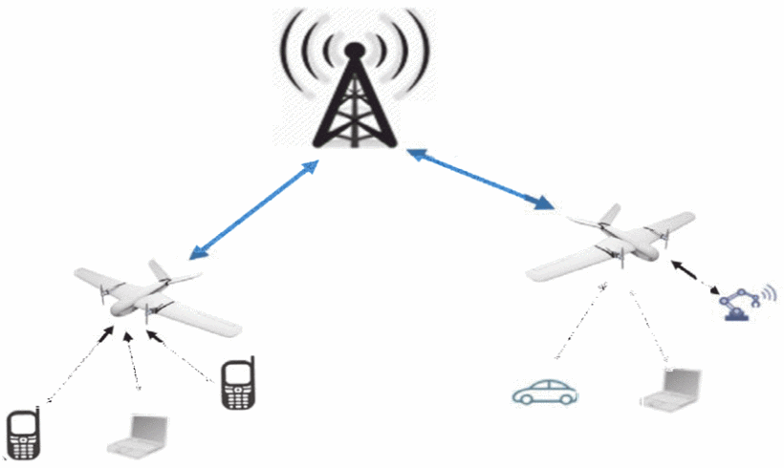
Problem Description
Mobile users’ demand increasing
Higher speed, lower latency
More data and services
Tendency to be located closely to users
2G: Macro-cells
3G - 4G: Micro-cells
5G: Pico-cells
Idea: Unmanned Aerial Vehicle with Base Stations (UAV-BS)
Problems:
How to design a placement algorithm?
How to evaluate correctness the algorithm?
How to test the algorithm in the real life?
How to coordinate the elements of mobile communication system infrastructure?
Increasing coverage and capacity
with UAV equipped with base stations, source
Notes:
<номер>

Slide 3
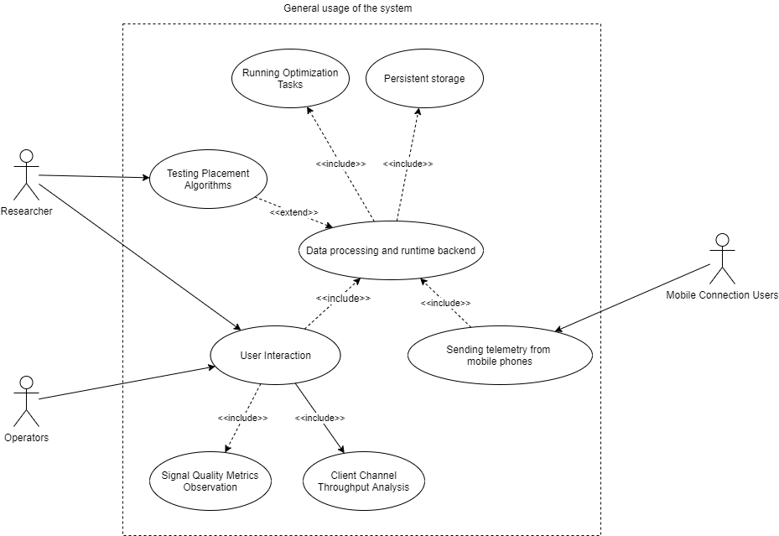
A general use-case for possible solution
A generalized use-case for a placement algorithm experimental framework

Slide 4
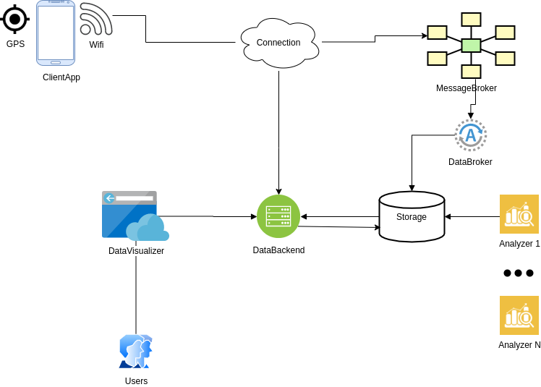
Abstract system design

Slide 5
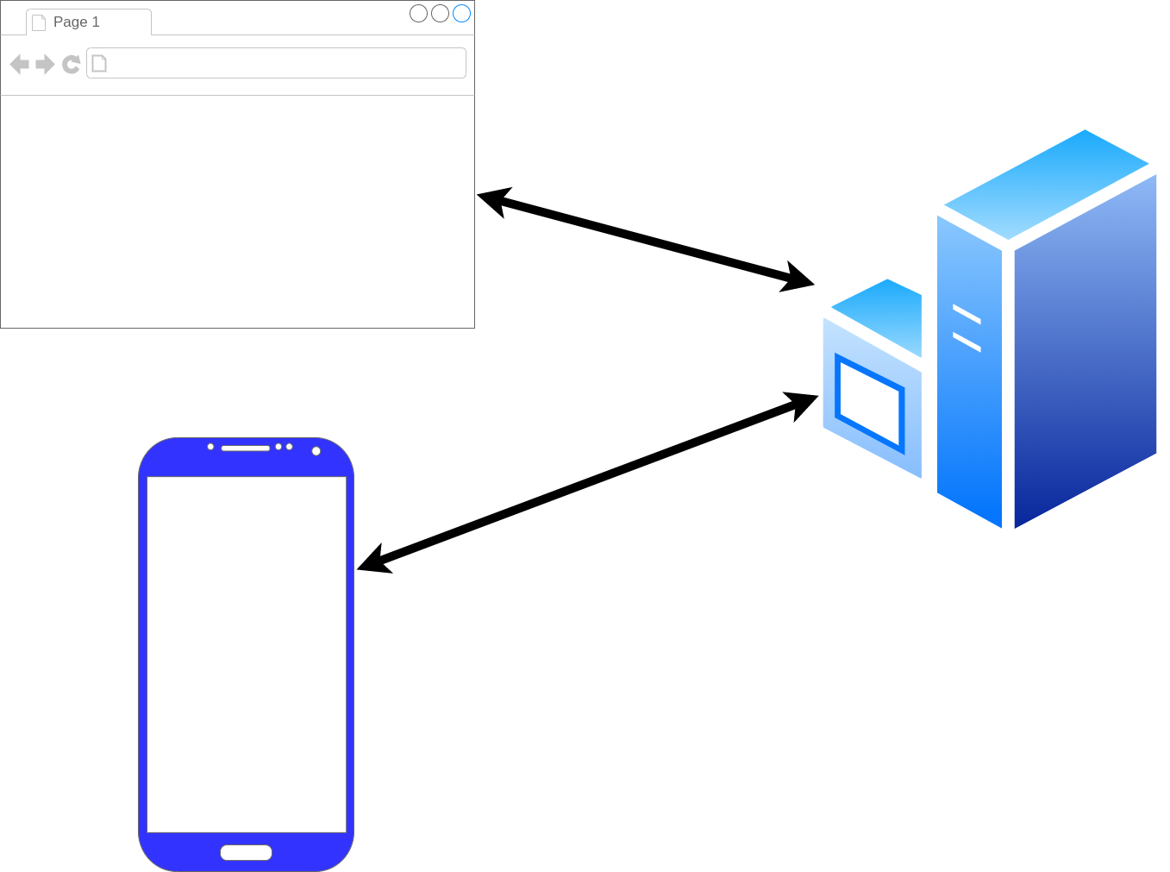
Framework architecture description
frontend
backend
android

Slide 6
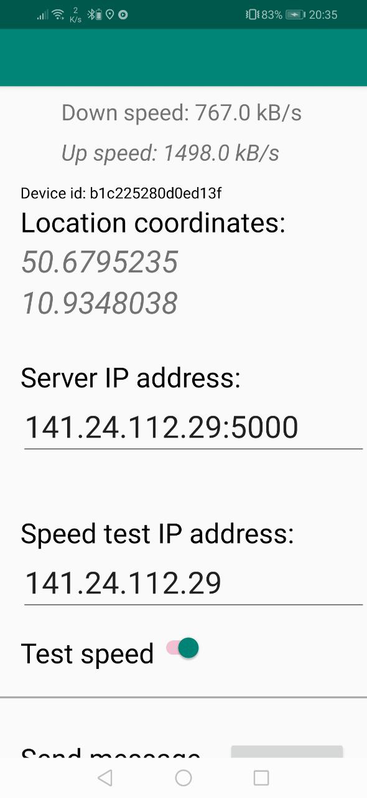
Android component
Measure:
- GPS location
- Wifi connection
- connection speed using given server by Mqqt or Http
Activities:
- Sent measurment result to given server
- Measure data periodicaly with given timeout on background

Slide 7
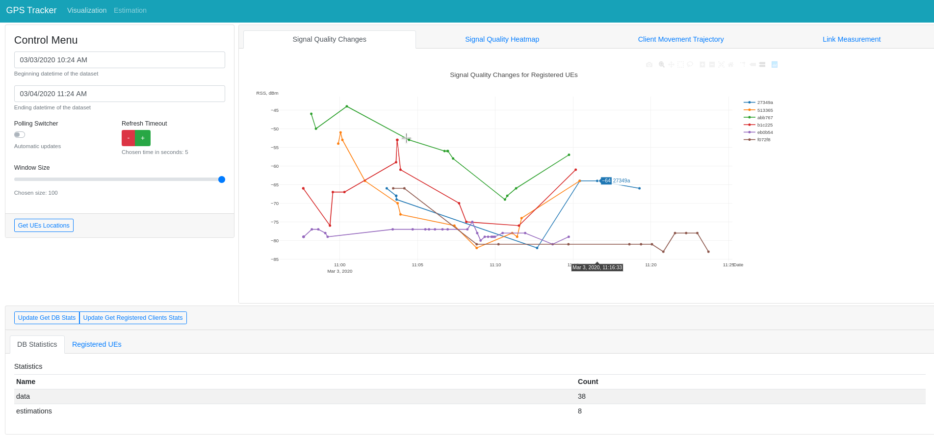
Timeframe,
update
frequency
configuration
UI component
Location data on given
timeframe
Database
statistics

Slide 8
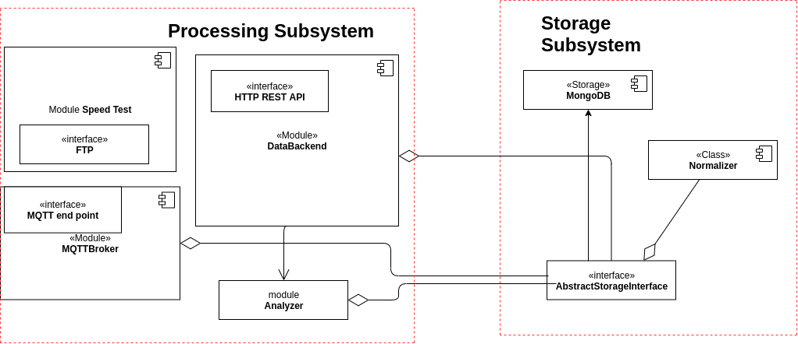
Backend component

Slide 9


Contact
Integrated Communication Systems Group
Ilmenau University of Technology
Univ.-Prof. Dr.-Ing. Andreas Mitschele-Thiel
fon: +49 (0)3677 69 2819
fax: +49 (0)3677 69 1226 e-mail: mitsch@tu-ilmenau.de
Visitors address:
Technische Universität Ilmenau
Gustav-Kirchhoff-Str. 1 (Informatikgebäude, Room 210) D-98693 Ilmenau
www.tu-ilmenau.de/ics

