Slide 1
Performance Analysis Framework for Base Station Placement Using IEEE 802.11
Group study presentation
18.03.2020
Kirill Kukartsev
Rustam Khakov
Zufar Makhmutov

Slide 2
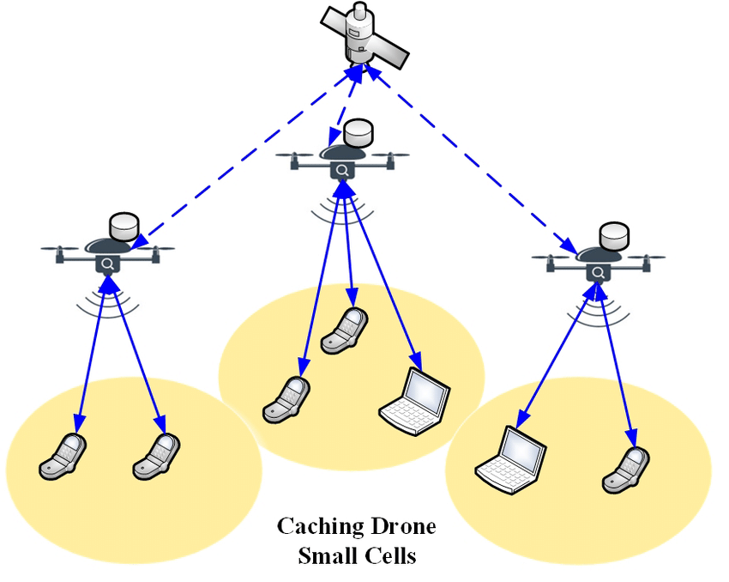
Motivation
Mobile users’ demand increasing
Higher speed, lower latency
More data and services
Tendency to be located closely to users
2G: Macro-cells
3G - 4G: Micro-cells
5G: Pico-cells
Idea: Unmanned Aerial Vehicle with
Base Stations (UAV-BS)
Problems:
How to design a placement algorithm?
How to evaluate correctness of the algorithm?
How to coordinate the elements of mobile
communication system infrastructure?
Increasing coverage and capacity
with UAV equipped with base stations[1]

Slide 3
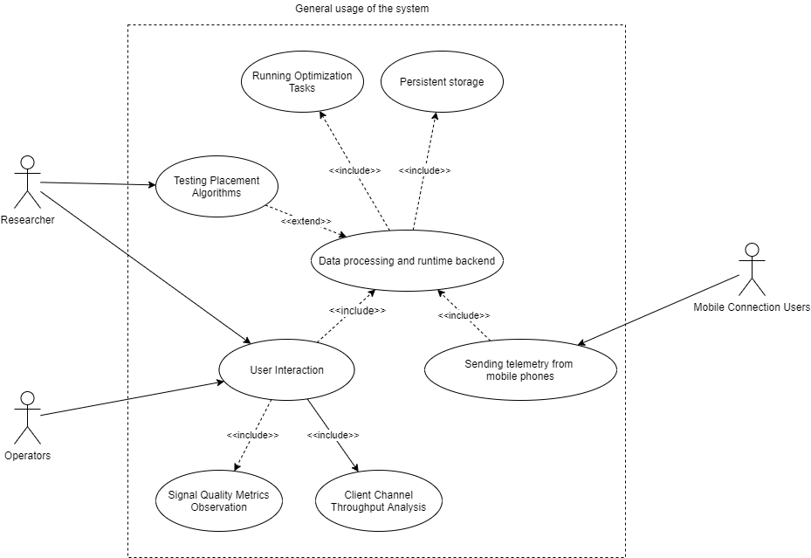
A General Use-Case for Possible Solution
A Generalized Use-Case for a Placement Algorithm Experimental Framework

Slide 4
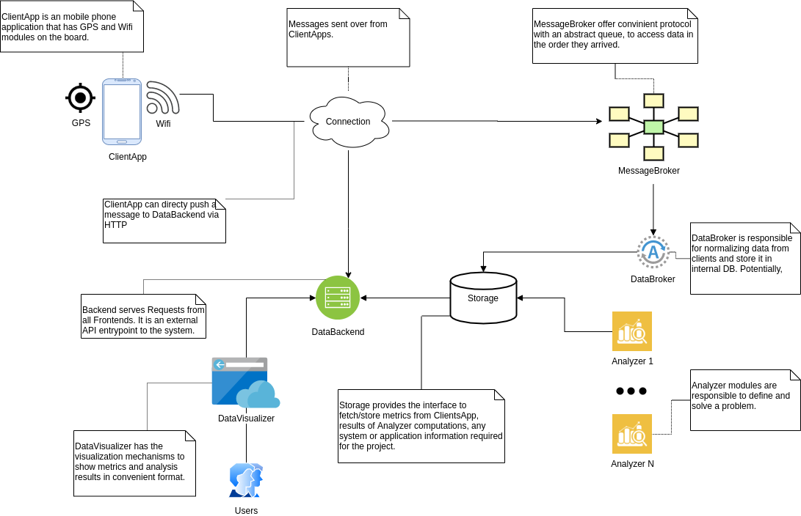
Abstract System Design
Abstract Design for component interaction for the given possible problem solution

Slide 5
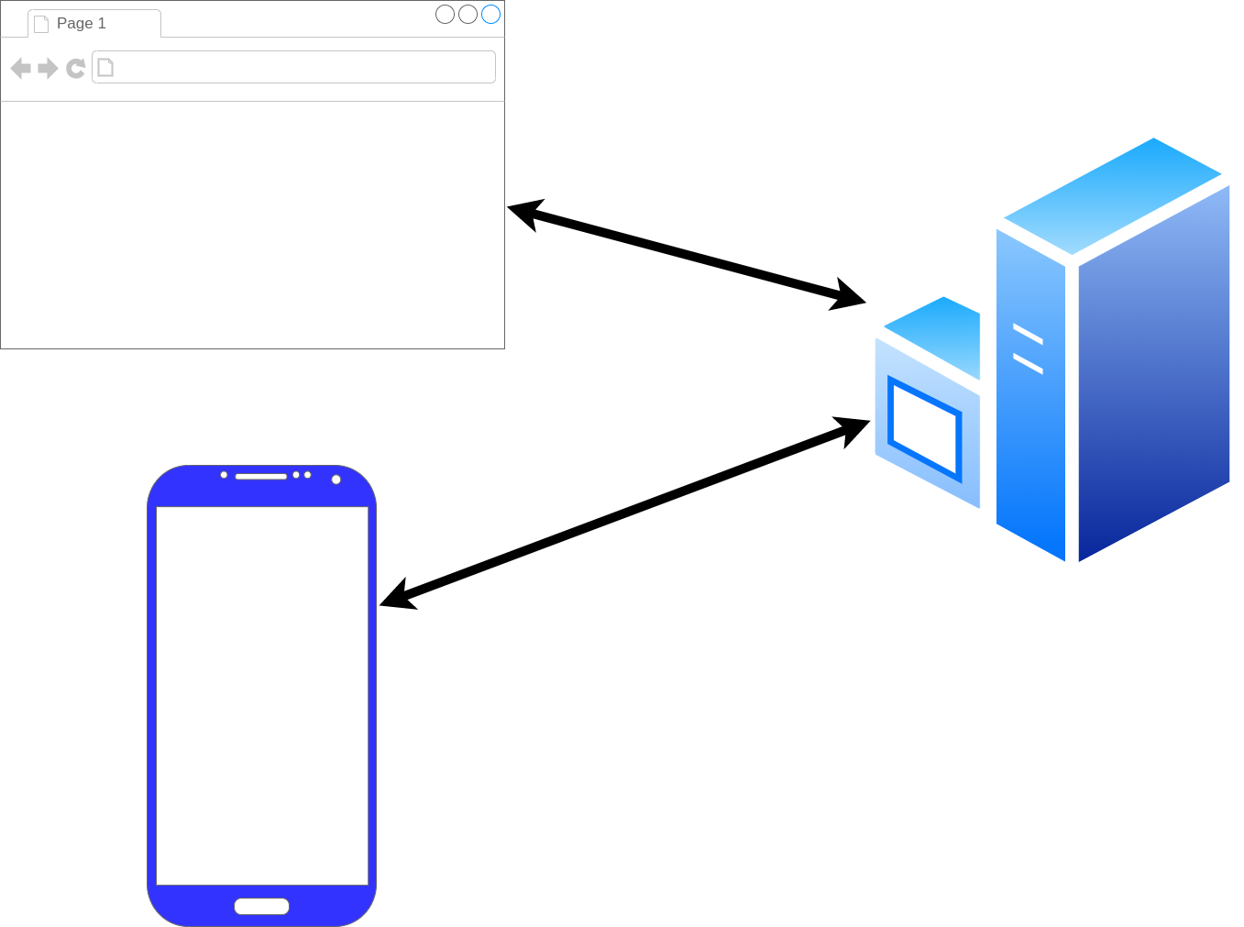
Framework Architecture Description
GPS_Frontend
GPS_Tracker
GPS_Android
Three main component of framework: a phone (GPS_Android), user interface (GPS_Frontend), data processing (GPS_Tracker)
Notes:
Rustam
<номер>

Slide 6
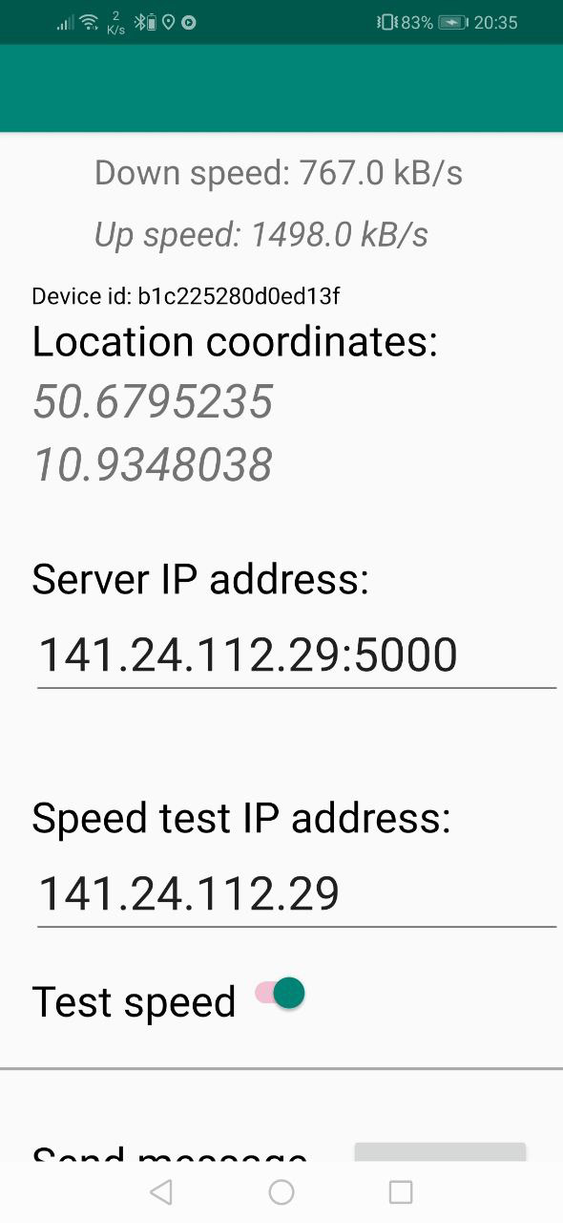
Android Component
Measure:
GNSS location
RSS of Wifi connection
Connection speed
Activities:
Send measurement result to given server
Measure data periodicaly with given
timeout on background
GPS_Android installed on an Android SmartPhone

Slide 7
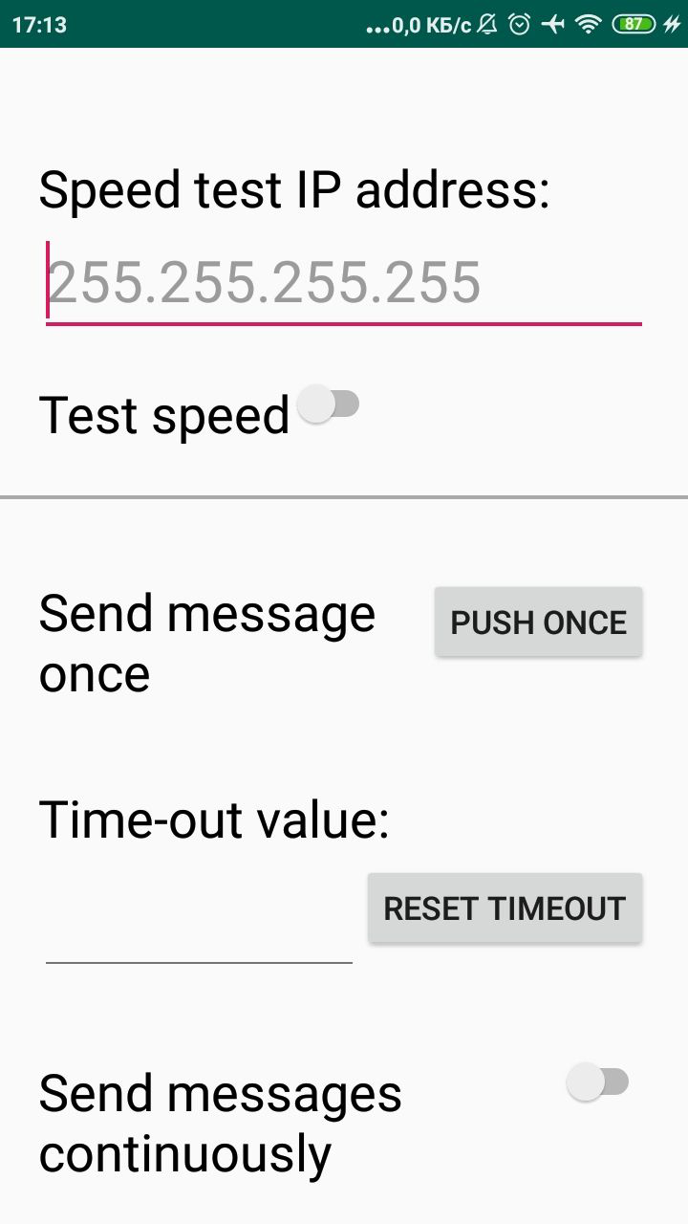
Requirements:
- Android above 4.0
- GNSS connection
- Access to Wifi

Slide 8
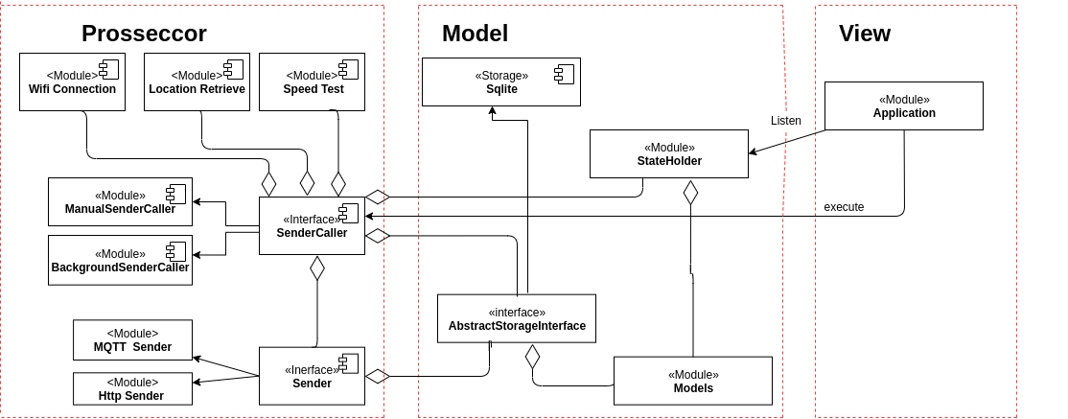
Android Application Architecture

Slide 9
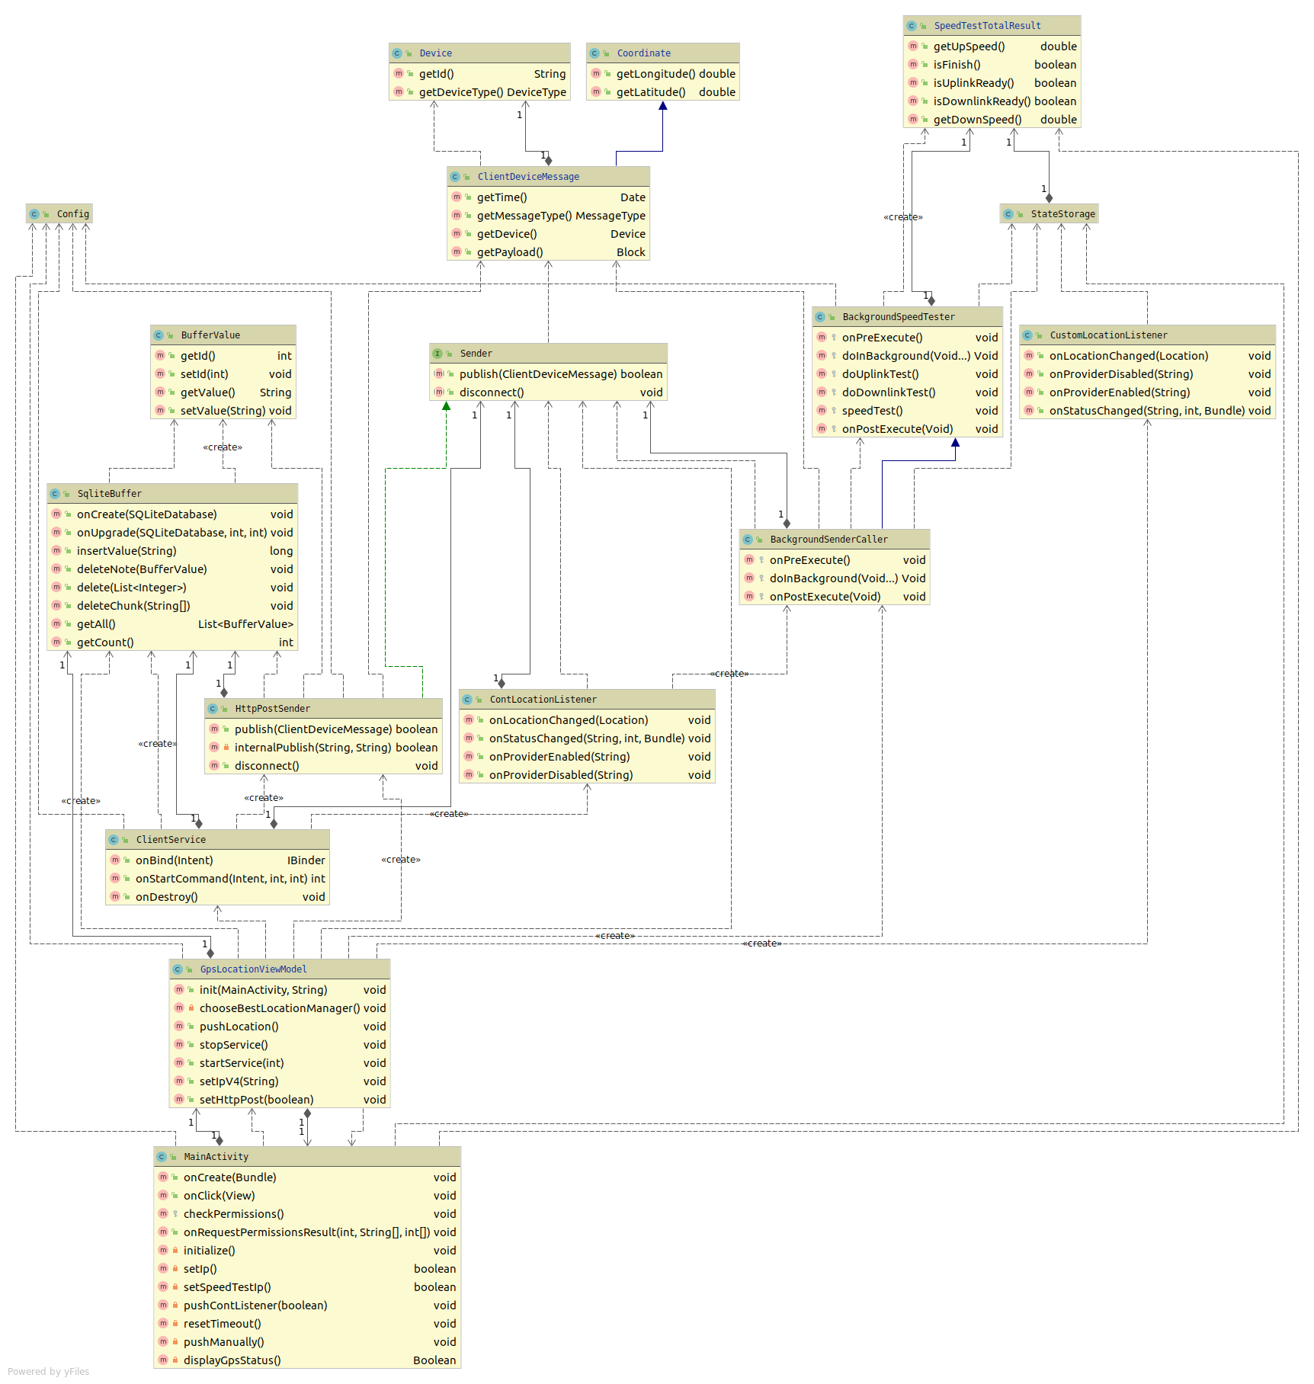

Slide 10
References
1.https://www.researchgate.net/profile/Nan_Zhao4/publication/328853522/figure/fig2/AS:691359337938955@1541844319319/Small-cell-networks-based-on-mobile-UAV-base-stations-without-ground-SBSs.ppm

