Slide 1
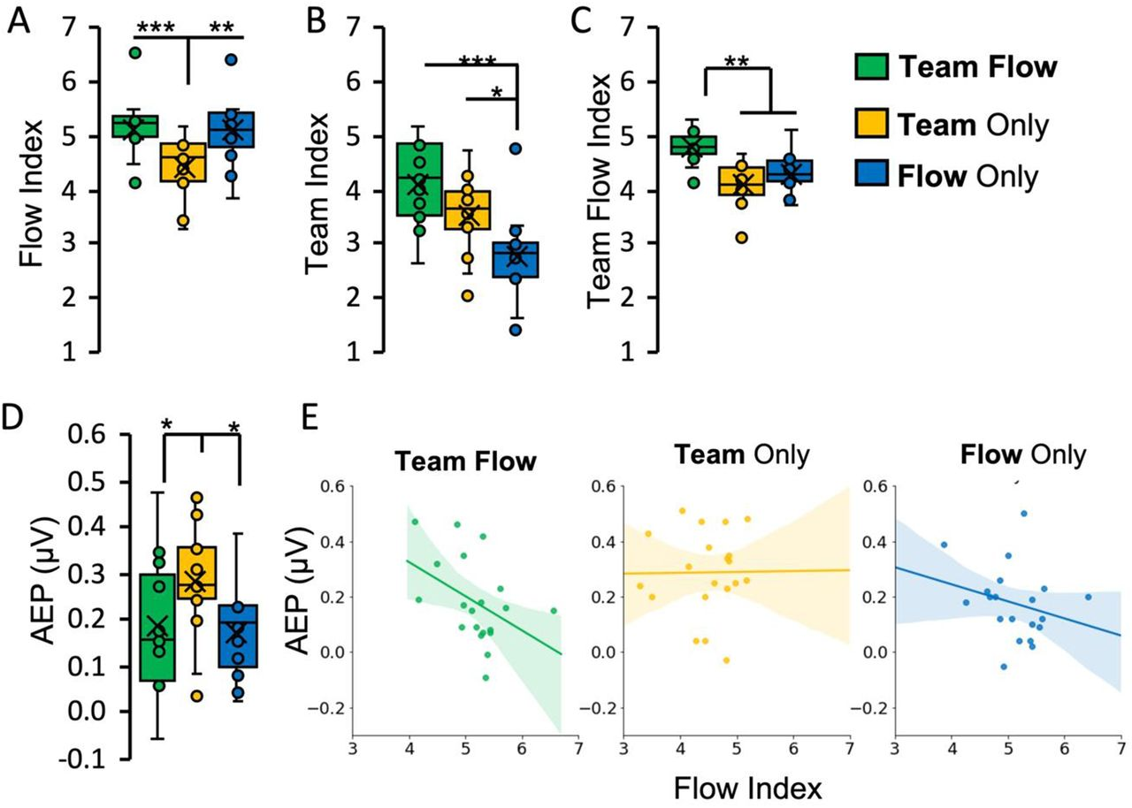
Assessment of the flow state.
Mohammad Shehata et al. eNeuro 2021;8:ENEURO.0133-21.2021
©2021 by Society for Neuroscience
Notes:
Assessment of the flow state. A–C, Subjective assessment of flow: psychometric rating indices as a measure of subjective flow (flow index; A), team interaction (team index; B), or team flow (team flow index; C) experiences (Extended Data Fig. 2-1 shows the detailed psychometric ratings for each question). Friedman test with Conover’s post hoc test; *p < 0.05, **p < 0.01, ***p < 0.001. Error bars represent mean ± SEM; n = 15. D, E, Objective assessment of flow. D, The mean AEP calculated by averaging the following time windows: N1 (110–150 ms), P1 (210–250 ms), and N2 (310–350 ms), considering polarity. The non-flow condition (Team Only) showed statistically significant higher AEP than the flow conditions. One-way repeated measures ANOVA with Bonferroni post hoc test; *p < 0.05. Error bars represent mean ± SEM; n = 15. E, Spearman’s correlation between AEP and flow index. AEP is negatively correlated with the flow index in the team flow condition (Spearman’s Rho = −0.48, p = 0.03), showing a negative correlation trend in the flow only condition (Spearman’s Rho = −0.29, p = 0.22), and no correlation in the team only condition (Spearman’s Rho = 0.11, p = 0.64). The lines indicate the regression lines. Shaded areas indicate a 95% confidence interval; n = 20. Extended Data Figure 2-2 shows the detailed AEP analysis.

