Slide 1
CloudArmor
Amin Saadaoui James Kirk

Slide 2
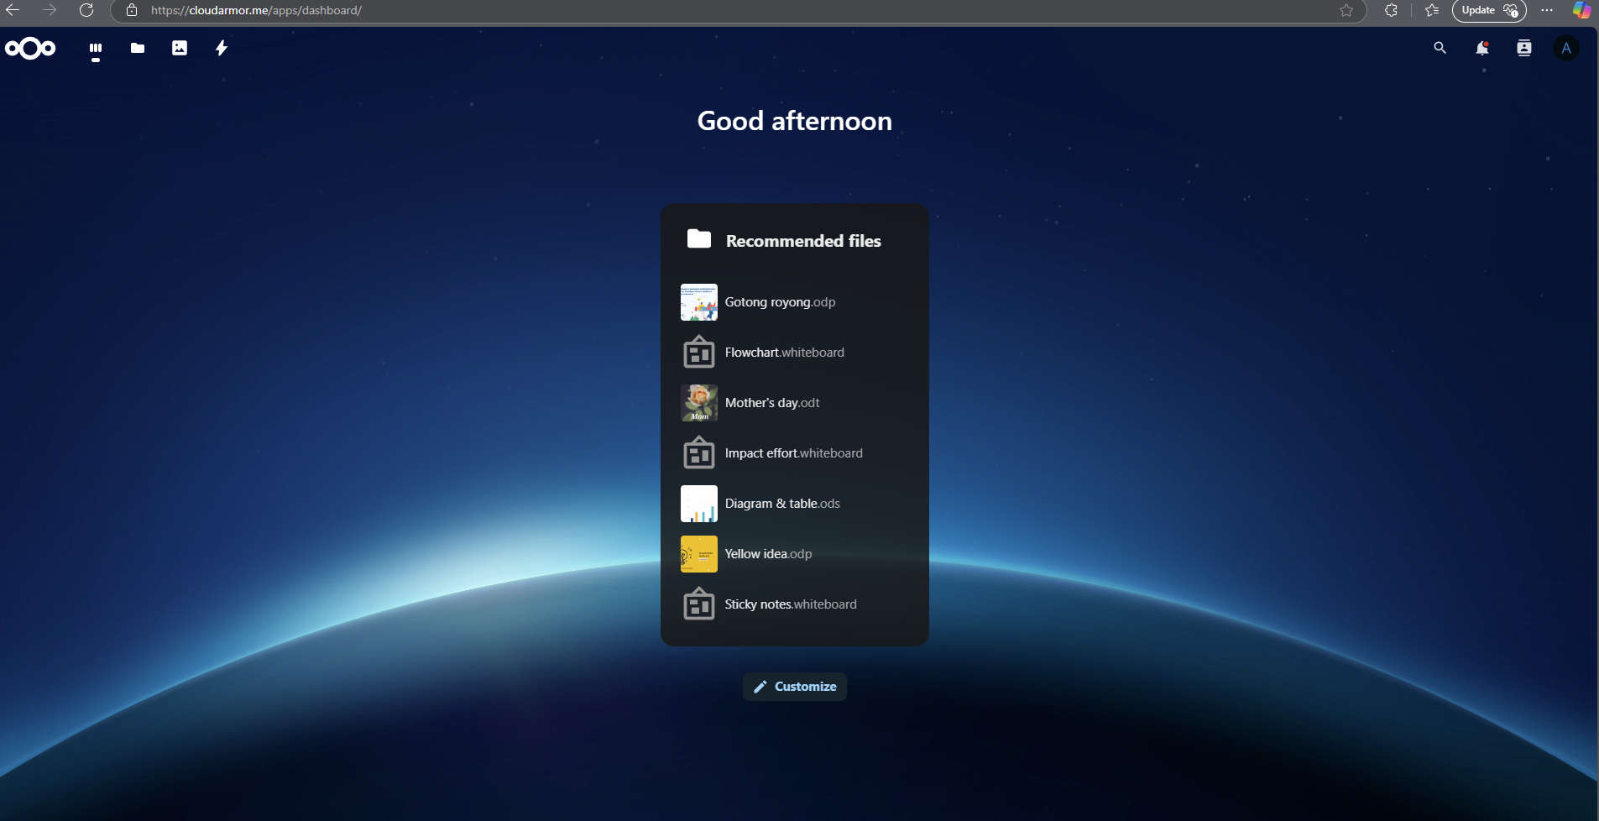
Introduction

Slide 3
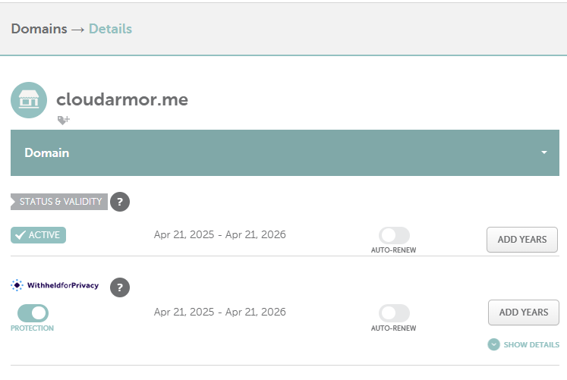
DNS

Slide 4
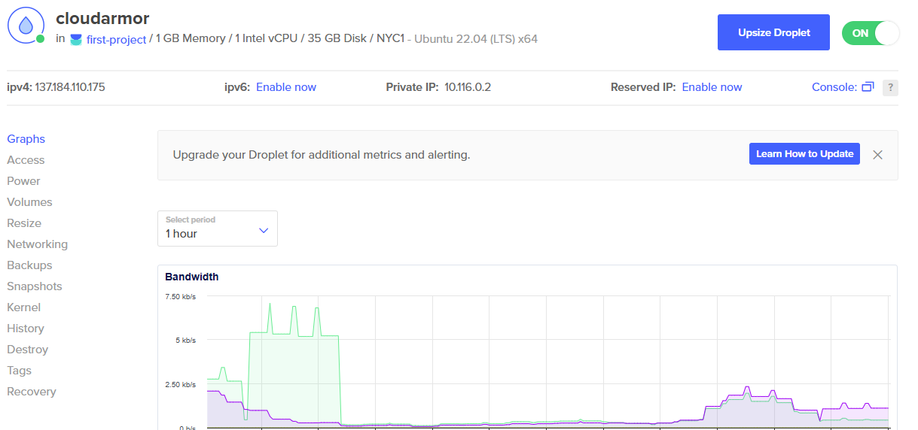
Digital Ocean

Slide 5
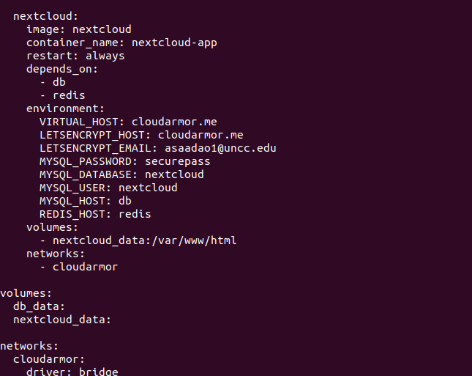
NextCloud

Slide 6
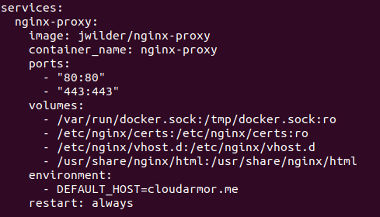
Proxy

Slide 7
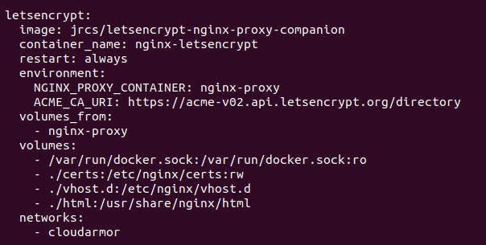
SSL

Slide 8
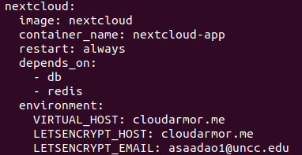
SSL

Slide 9
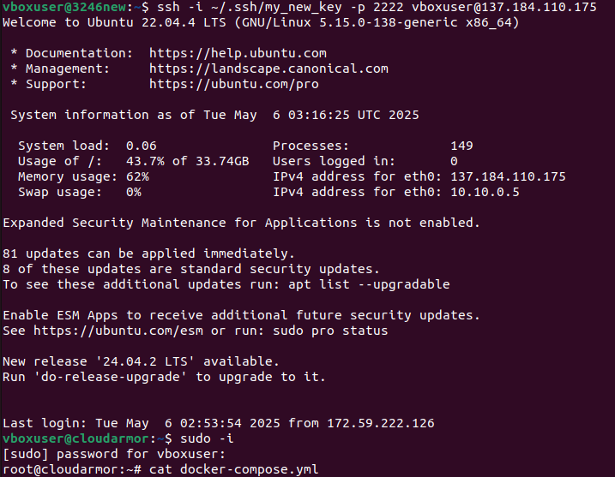
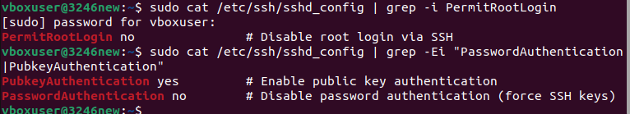
SSH Hardening

Slide 10
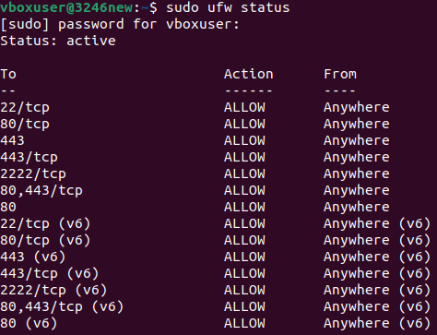
UFW

Slide 11
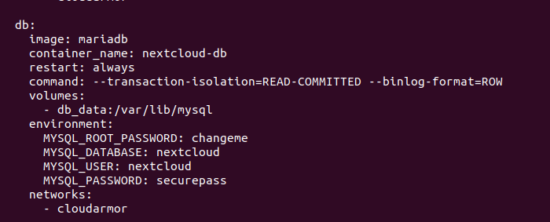
MariaDB

Slide 12
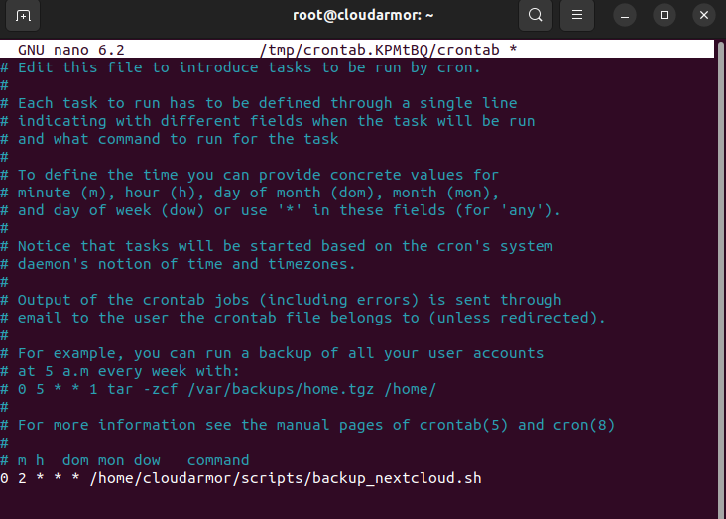
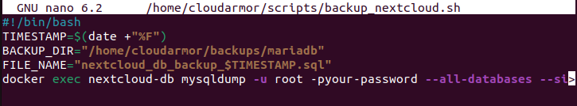
Backup

Slide 13
Demo
https://drive.google.com/file/d/1cNiDOP7RUpQxn1002R_CMZ90UmvQDPT2/view?usp=drivesdk

