Slide 1
Training with Unaligned Data - Differential DTW-
Vo, Quang Hoang Nguyen
Notes:
Title can be 30 or 32 pt
Subtitle is 28 pt
Presenter’s name can be in 20 up to 24 pt

Slide 2
Motivation
Annotations don’t come with Audio File
For example: Isophonics annotations assumes you have original CD
Audio from other sources are subject to misalignment with original Annotation (oAnnotation).

Slide 3


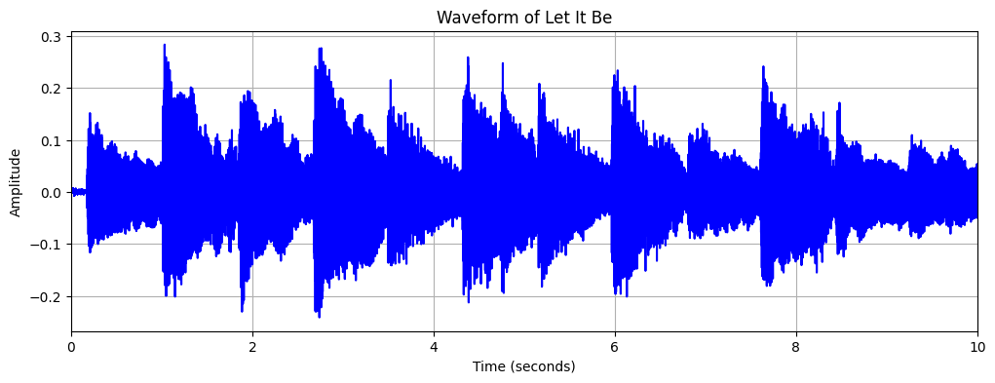
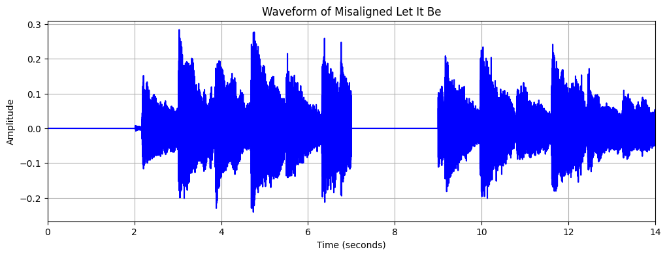
Approach – Chord Recognition
Data augmentation:
Distortion
Original Wav
Misaligned Wav
2 second silence

Slide 4
Approach – Chord Recognition
Apply Chord Recognition on mis-aligned wav
Extract time point and label (mAnnotation)
Perform tradition DTW on mAnnotation and oAnnotation
Evaluate re-alignment result
Implement Soft-DTW and compare with tradition DTW

Slide 5
References
Soft DTW: https://arxiv.org/abs/1703.01541
Connectionist Temporal Classification: https://www.cs.toronto.edu/~graves/icml_2006.pdf

Slide 6
This is the title of the presentation, some titles can be extra long
1. Fonts
2. Layout
Pictures
Positioning
Listing
3. Design
Colors
Graphical Elements

Slide 7
Fonts
Standard Font:
Continuous text: Arial
Accentuation: Arial Bold (please avoid if not necessary)
Standard Font Size: 24pt alternatively 20pt
Notes:
Font size is 24 pt, you can use 20 pt as well, but than please stick to it through the entire presentation
The second level font size is 20 or 18 pt (depending on the sice of first level font)

Slide 8
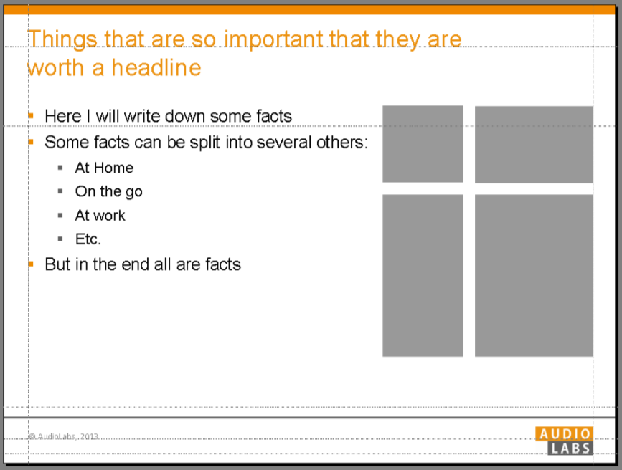
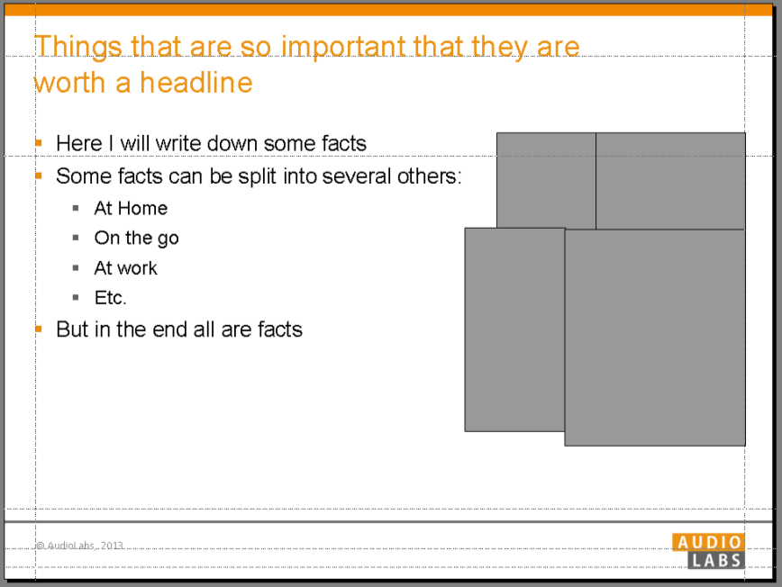
Layout Pictures
Use grid to position pictures
Never put pictures right next to each other, always leave some white space between some
Align pictures:
Notes:
If there is a second headline, make it grey (RGB:98, 98, 98)

Slide 9
Layout Listing
Powerpoint for Windows: Just use the standard tool for listing
Powerpoint for Mac: Standard tool doesn‘t work!? Copy sample below and insert text (if you copy text into the sample, use option „text only“ / „nur den Text übernehmen“)
Sample Sample Sample
Level 1
Level 2
Level 3
Level 4

Slide 10
Design Colors
The AudioLabs colors are
Orange (R 237, G 140, B 1) and Grey (R 112, G 112, B 112)
Headlines/sub-headlines
Text/captions/references
Listings/numeration/ graphical elements
Graphics
Background colors for diagrams and graphics

Slide 11
Design Graphical Elements
These elements can be copied and inserted where you need it. You can scale them according to your needs
Filled Box
AudioLabs grey
Arrows and connections
AudioLabs orange
Outlined box
AudioLabs orange
Line 2, 4, 6 or 8 pt
The bigger the box, the thicker the line
Lines
AudioLabs orange, up to 1 pt also black
Dashed line in 1 pt
Solid lines: 1, 2, 3, 4 or 5 pt

Slide 12
Questions?
Just come and see me, write a mail or give me a call:
Mandy, 09131-776 6178, mandy.garcia@iis.fraunhofer.de

