Slide 1
PORTFOLIO #1
Introduction to computing
Siaton, Charles andre

Slide 2
Table of Content
Computer Science as a Discipline
5 Computing Disciplines & Majors
Analysis
GTYK
References

Slide 3
Section 1:
COMPUTER SCIENCE AS A DISCIPLINE

Slide 4
What is Computer Science?
Computer science (abbreviated CS or CompSci) is the scientific and practical approach to computation and its applications. It is the systematic study of the feasibility, structure, expression, and mechanization of the methodical processes (or algorithms) that underlie the acquisition, representation, processing, storage, communication of, and access to information, whether such information is encoded in bits and bytes in a computer memory or transcribed engines and protein structures in a human cell. A computer scientist specializes in the theory of computation and the design of computational systems. Its subfields can be divided into a variety of theoretical and practical disciplines. The computational complexity theory which explores the fundamental properties of computational and intractable problems, are highly abstract, while fields such as computer graphics emphasize real-world visual applications.
Li, X. G. (2014). Research on the development and applications of computer science and technology. Advanced Materials Research, 926–930, 2406–2409.

Slide 5
What is Computer Science as a Discipline?
Computer science is a well-established, dynamic, and continually evolving research field that, despite its relatively recent origins, achieved a major breakthrough only some fifty years ago. Today, it has grown into a highly interdisciplinary scientific domain, with significant overlaps and collaborations with fields such as mathematics, physics, and even biology, reflecting its broad and impactful influence across various disciplines.
Fiala, D., & Tutoky, G. (2017). Computer Science Papers in Web of Science: A Bibliometric Analysis. Publications, 5(4), 23.

Slide 6
What is Computer Science as a Discipline?
"Computer Science as Discipline" refers to a way of thinking that involves problem-solving, analysis, and integration of solutions. These skills are valuable across many disciplines beyond just computer science, including engineering, scientific research, business, and even politics. Computer science is not just about programming, but rather a "disciplined mind-set" that can be applied to a broad range of design and implementation problems.
Cerf, V. G. (2016). Computer science in the curriculum. Communications of the ACM, 59(3), 7.

Slide 7
Three Main Paradigms
Computer Science as a Discipline is characterized by three main paradigms: the technocratic, rationalist, and scientific paradigms. These paradigms shape the values, attitudes, and practices within computer science education and the field more broadly, with a heavy emphasis on technical, mathematical, and engineering-oriented approaches over more human-centered considerations.
Raji, I. D., Scheuerman, M. K., & Amironesei, R. (2021). You Can’t Sit With Us. FAccT ’21: Proceedings of the 2021 ACM Conference on Fairness, Accountability, and Transparency.

Slide 8
Algorithms and Big Data in Mobile Computing
Computer Science as a discipline is primarily defined by its focus on the implementation of algorithms using computers and similar computational devices. This field is particularly concerned with how these algorithms can be put to work effectively on every platform, even on the mobile device, for processing and analyzing large volumes of information popularly known as 'Big Data'. As such, the ability to harvest and analyze Big Data through mobile technology has recently grown to become a critical part of computer science that pushes big changes in machine learning, artificial intelligence, and data-driven decisions.
Montag, C., Duke, É., & Markowetz, A. (2016). Toward Psychoinformatics: Computer Science Meets Psychology. Computational and Mathematical Methods in Medicine, 2016, 1–10.

Slide 9
SECTION 2
5 Computing Disciplines & Majors

Slide 10

Computer Engineering
Computer engineering is a relatively new academic discipline, emerging in the 1940s and 1950s, and has not yet developed a well-established research paradigm like other more traditional engineering fields. This lack of clear guidelines and restrictions on the structure of CE research articles from major publishers and organizations contributes to the distinctive rhetorical structures observed in the field. As a result, CE research articles often do not have a distinct Materials and Methods section, making it challenging to analyze the rhetorical moves in this section due to the lack of established standards in the field.
Seiradakis, E. V. (2023). MACROSTRUCTURES AND RHETORICAL MOVES IN COMPUTER ENGINEERING RESEARCH ARTICLES. European Journal of Foreign Language Teaching, 7(1).

Slide 11


Computer Engineering Areas of Interest
Computer Engineering majors often focus on areas such as embedded systems, VLSI design, digital signal processing, computer architecture, robotics and automation, Internet of Things (IoT), network security, artificial intelligence, quantum computing, wireless communication, cloud computing, parallel and distributed computing, software engineering, hardware-software integration, biomedical engineering, FPGA development, augmented and virtual reality, microcontrollers, energy-efficient computing, and automotive and aerospace systems.

Slide 12
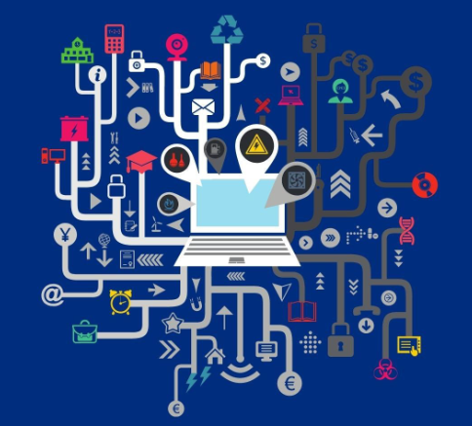
Computer Science
Computer science as an academic discipline began in the 1960’s. Emphasis was on programming languages, compilers, operating systems, and the mathematical theory that supported these areas. Courses in theoretical computer science covered finite automata, regular expressions, context-free languages, and computability. In the 1970’s, the study of algorithms was added as an important component of theory. The emphasis was on making computers useful. Today, a fundamental change is taking place and the focus is more on applications. There are many reasons for this change. The merging of computing and communications has played an important role.
Blum, A., Hopcroft, J., & Kannan, R. (2020b). Foundations of data science.

Slide 13


Computer Science Areas of Interest
Computer Science majors often explore areas such as algorithms and data structures, artificial intelligence, machine learning, cybersecurity, databases, computer graphics, human-computer interaction, computational theory, operating systems, software development, data science, cloud computing, distributed systems, programming languages, robotics, quantum computing, bioinformatics, and natural language processing.

Slide 14
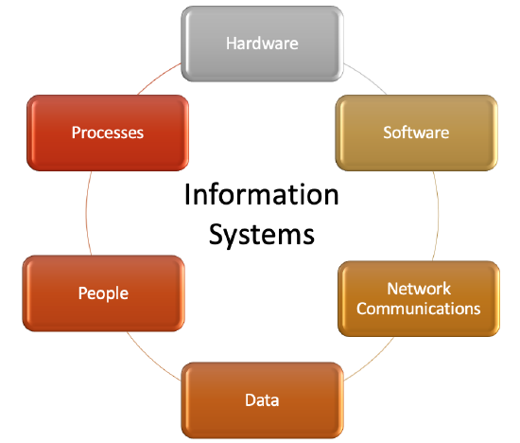
Information Systems
The Information Systems discipline (IS) is usually regarded as a social science because it includes research on human-related aspects of these systems. However, a limited number of IS research outputs use approaches that are typical of the traditional arts and humanities. Little recognition has been given to the arts and humanities-informed stream of the IS discipline. This article aims to clarify the subtle distinctions between these scientific constellations and IS’s place in it. It highlights the cluster of arts, humanities and IS in the inter-linked world of scientific disciplines and makes some recommendations to build further on these accomplishments.
Kroeze, J. H. (2019). Is the Philosophy of the Information Systems Discipline Informed by the Arts and Humanities? Phronimon, 20.

Slide 15


Information Systems Areas of Interest
Information Systems majors typically focus on areas like systems analysis and design, database management, business intelligence, enterprise systems, IT project management, cybersecurity, data analytics, e-commerce, user experience design, information policy and governance, digital transformation, supply chain management, human-computer interaction, and strategic IT management.

Slide 16

Information Technology
The Information Technology discipline is defined as meeting the needs of users within organizational or societal context through the selection, creation, administration, integration, and application of computing technologies. Successful IT professionals are those with strong hands-on, communication, and problem solving skills. The need for skilled IT professionals continues to grow in many subareas such as mobile development, Cybersecurity, administration of cloud services, and others. The information technology profession's demand for strong hands-on skills puts pressure on colleges to produce graduates with increased level of skills.
Said, H. (2016). Rethinking IT education. ACM Inroads, 7(1), 34–37.

Slide 17


Information Technology Areas of Interest
Information Technology majors often concentrate on areas such as network administration, cybersecurity, cloud computing, database management, IT project management, systems administration, web development, mobile app development, information assurance, virtualization, data analytics, IT support and troubleshooting, emerging technologies, IT infrastructure, and digital forensics.

Slide 18
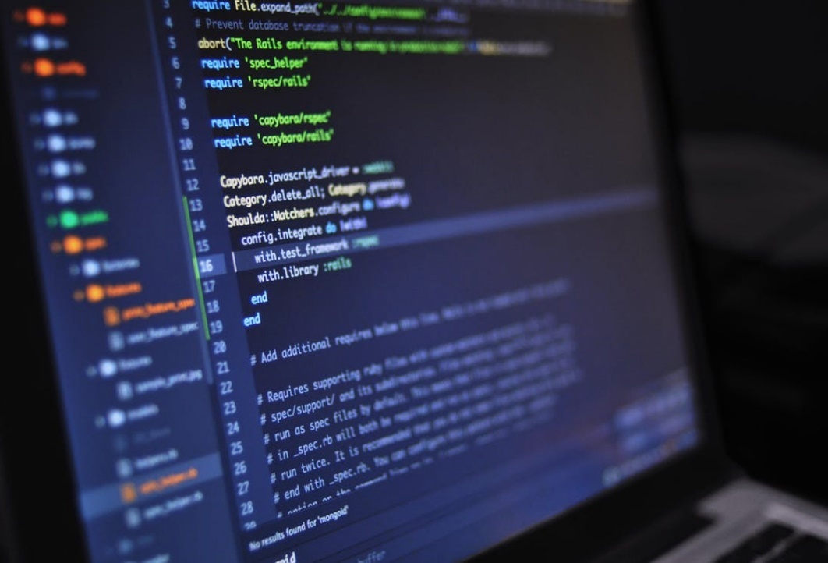
Software Engineering
Software Engineering (SE) is a discipline of Computer Science dedicated to teaching topics related to software development. It involves a wide variety of topics, so the teaching of SE is a challenge, especially to make the discipline attractive to the students. Therefore, in the last 10 years, the process of teaching SE has been applied and improved continually in the computer science course of the Computer Science Department of the Federal University of Ceará. The activities related to the discipline of SE are also presented, including dynamics and the practical use of the theory through the development of software applications by the students.
De Castro Andrade, R. M., De Sousa Santos, I., De Araújo, I. L., Aragão, B. S., & Siewerdt, F. (2017). Retrospective for the Last 10 years of Teaching Software Engineering in UFC’s Computer Department. Brazilian Symposium on Software Engineering.

Slide 19


Software Engineering Areas of Interest
Software Engineering majors usually delve into areas like software development methodologies, software architecture and design, requirements engineering, testing and quality assurance, software project management, agile development, DevOps, embedded systems, mobile app development, cloud computing, cybersecurity, human-computer interaction, version control systems, continuous integration/continuous deployment (CI/CD), and software maintenance and evolution.

Slide 20
SECTION 3
analysis

Slide 21
Scope and Definition
CS (Computer Science) in this context is the scientific and practical approach to computation of theoretical process.
It is highly related to the algorithms, which are necessary for processing data, storage and communication.
The subject is widely interdisciplinary and overlaps with mathematics, physics, biology etc. reflecting its pervasive role in so many areas

Slide 22
Historical Context
Computer Science is not a field that comes together, having origins in programming and mathematical theory dating back to the 1960s when it first appeared as an academic discipline. It has increased through the years to include many applications and is an essential part of tech development.

Slide 23
Evolution and Paradigms
Computer science has shifted from lean coverage of programming languages, compilers and operating systems in the 1960s towards a larger focus on applications over decades — most recently to data analysis & Big Data.
The field is dominated by three paradigms:
> Rationalist
> Pragmatist
> Scientific

Slide 24
Three Paradigms
The rationalist paradigm, which was common among theoretical computer scientists, defines computer science as a branch of mathematics, treats programs on a par with mathematical objects, and seeks certain, a priori knowledge about their ‘correctness’ by means of deductive reasoning.
The technocratic paradigm, promulgated mainly by software engineers, defines computer science as an engineering discipline, treats programs as mere data, and seeks probable, a posteriori knowledge about their reliability empirically using testing suites.
The scientific paradigm, prevalent in the branches of artificial intelligence, defines computer science as a natural (empirical) science, takes programs to be entities on a par with mental processes, and seeks a priori and a posteriori knowledge about them by combining formal deduction and scientific experimentation.

Slide 25
Subfields and Specializations
Related areas include Information Systems (IS) and Information Technology (IT), which concentrate on more user-facing aspects of computing technologies, such as the social sciences.
Challenges and Emerging Trends
The evolution of the discipline has resulted in new challenges notably, that Software Engineering (SE) is primarily taught and Information Technology (IT) requires hands-on skills. As the blending of computing with communications have matured and mobile technology development trading off upon innovation continues, such as machine learning and artificial intelligence areas.

Slide 26
This analysis provides a snapshot of how computer science as a discipline has evolved, its current state, and its impact on other fields. The presentation underlines the importance of a "disciplined mindset" in solving complex problems, which is a core aspect of the field.

Slide 27
SECTION 4
Get to know me

Slide 28




I am Charles Andre Siaton, 19 years of age and graduated at University of Cebu – Main Campus
I’m fond of singing and dancing, and I also love playing games online.
I chose to enroll in BS Information Technology primarily because I am very interested in computers
Fun Fact about myself
I’m a big fan of SB19 and recently got the chance to dance with one of their members

Slide 29
SECTION 5
REFERENCES

Slide 30
Blum, A., Hopcroft, J., & Kannan, R. (2020). Foundations of data science. https://doi.org/10.1017/9781108755528
Cerf, V. G. (2016). Computer science in the curriculum. Communications of the ACM, 59(3), 7. https://doi.org/10.1145/2889282
De Castro Andrade, R. M., De Sousa Santos, I., De Araújo, I. L., Aragão, B. S., & Siewerdt, F. (2017). Retrospective for the Last 10 years of Teaching Software Engineering in UFC’s Computer Department. Brazilian Symposium on Software Engineering. https://doi.org/10.1145/3131151.3131179
Fiala, D., & Tutoky, G. (2017). Computer Science Papers in Web of Science: A Bibliometric Analysis. Publications, 5(4), 23. https://doi.org/10.3390/publications5040023
Kroeze, J. H. (2019). Is the Philosophy of the Information Systems Discipline Informed by the Arts and Humanities? Phronimon, 20. https://doi.org/10.25159/2413-3086/4898
Li, X. G. (2014). Research on the development and applications of computer science and technology. Advanced Materials Research, 926–930, 2406–2409. https://doi.org/10.4028/www.scientific.net/amr.926-930.2406
Montag, C., Duke, É., & Markowetz, A. (2016). Toward Psychoinformatics: Computer Science Meets Psychology. Computational and Mathematical Methods in Medicine, 2016, 1–10. https://doi.org/10.1155/2016/2983685
Raji, I. D., Scheuerman, M. K., & Amironesei, R. (2021). You Can’t Sit With Us. FAccT ’21: Proceedings of the 2021 ACM Conference on Fairness, Accountability, and Transparency. https://doi.org/10.1145/3442188.3445914
Said, H. (2016). Rethinking IT education. ACM Inroads, 7(1), 34–37. https://doi.org/10.1145/2838737
Seiradakis, E. V. (2023). MACROSTRUCTURES AND RHETORICAL MOVES IN COMPUTER ENGINEERING RESEARCH ARTICLES. European Journal of Foreign Language Teaching, 7(1). https://doi.org/10.46827/ejfl.v7i1.4639

