Slide 1

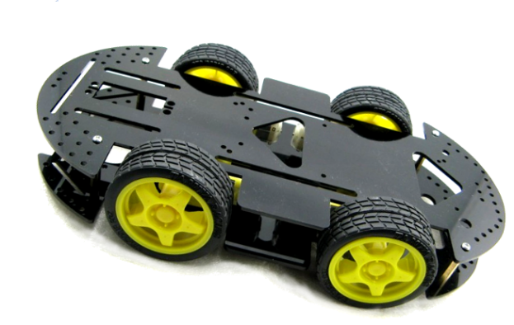
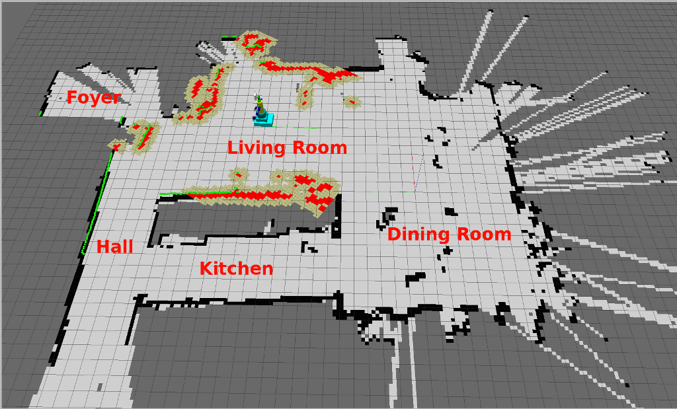
Simultaneous Localization
And Mapping
(SLAM)

Slide 2

The Robot to be used?
A Wheeled robot is going to be used and it has 4 motors which facilitates the motion and rotation of the robot.

Slide 3
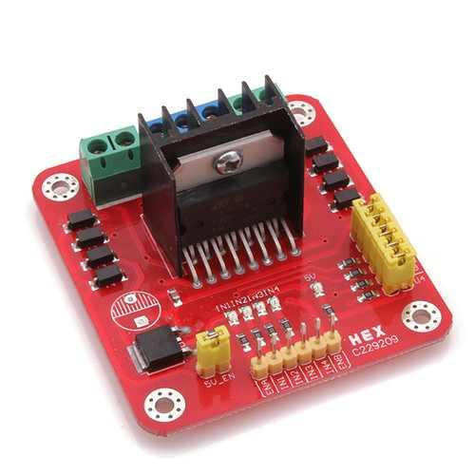
Motor Driver
L298 Dual H-Bridge Motor Driver is going to be used.
2 channel H-Bridge with 2A peak current.

Slide 4
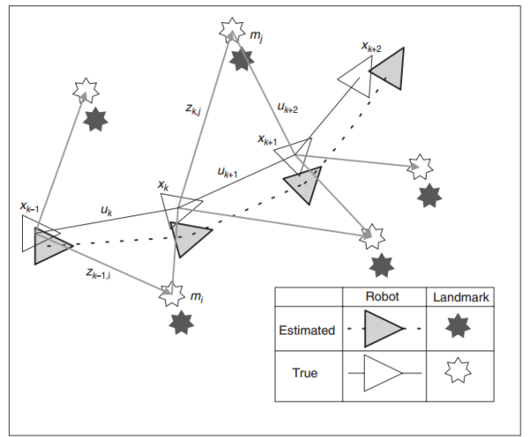
Landmarks
Landmarks is the first and most important step in SLAM

Slide 5
How to detect Landmarks?
To detect Landmarks sensor is required, types of sensors
Can be used in Landmark recognition:
Sonar
Laser-Based Sensor
Ultrasonic

Slide 6
Sonar
Sonar is mainly use underwater
and it’s not useful to use it in different place.

Slide 7
Laser-Based Sensor
Laser-Based sensor or Lidar accurate but way to detect landmarks but it’s very expensive and not available in Egypt.

Slide 8
Ultrasonic
Ultrasonic is cheap and easy to use but it’s less accurate than lidar so error correction is needed.

Slide 9
Odometry Data
Inertial Measuring unit (IMU) can be use to get the Odometry data.
Calculating the Wheels rotation isn’t accurate at all.

Slide 10
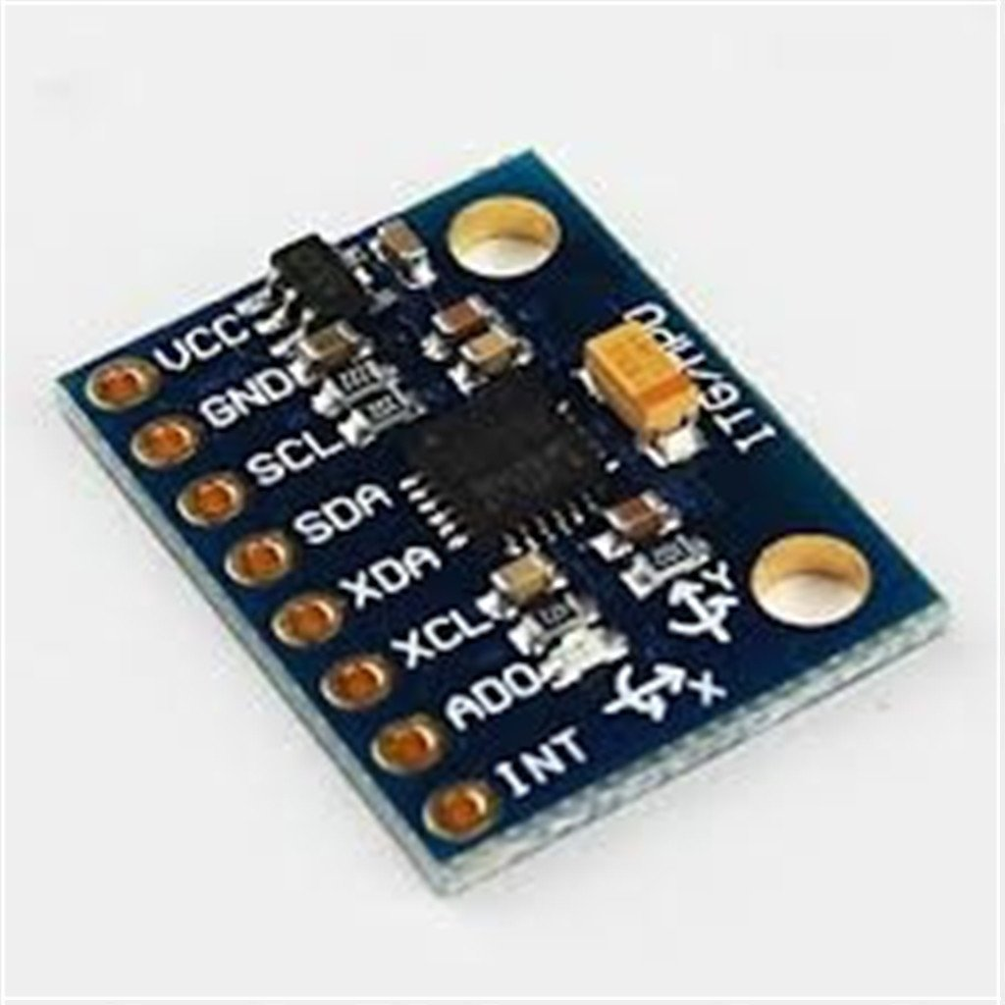
IMU
Inertial Measuring unit MPU-6050 is going to be use.
3 Axis gyro and 3 Axis Accelerometer.

Slide 11
EKF
Extended Kalman Filter or normal Kalman filter is going to be implemented to correct any error or any miss expectation .
EKF takes the Landmarks and Odometry data as input and gives a more accurate position for the robot as a output.

Slide 12
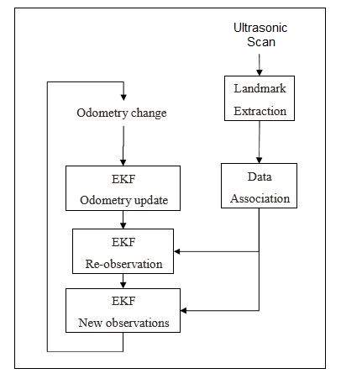
SLAM Process

