Slide 1


Intro To Web Development
How The Internet Works

Slide 2
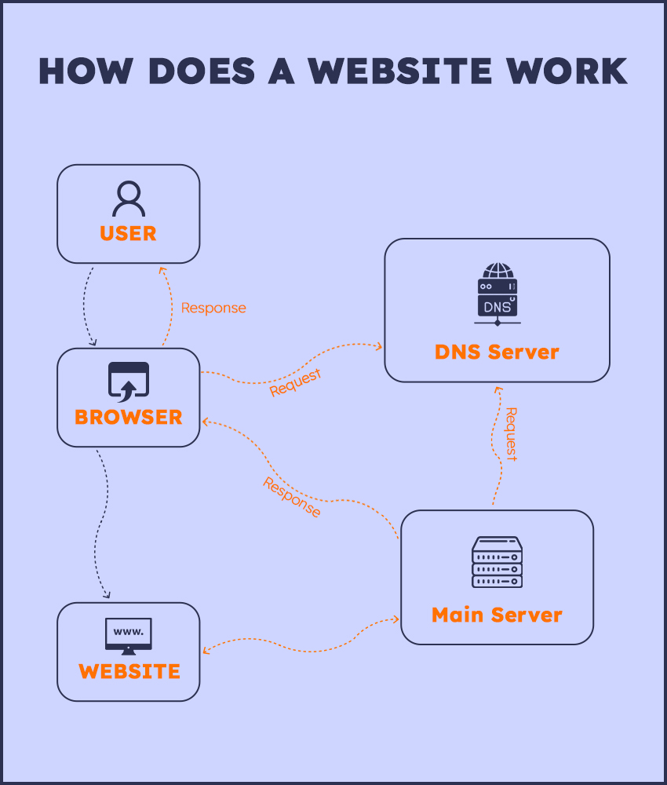
How The Internet Works
It’s all about the browser(Client) send a request to server and come back with response to client with HTTP protocol

Slide 3
Why you need to learn web Development
I need to learn backend developing to learn how the websites and functions works and to start as a freelancer for back end web developing

