Slide 1
Literate Statistical Programming with knitr and R Markdown
Biostatistics 140.776

Slide 2
Problems, Problems
Authors must undertake considerable effort to put data/results on the web
Readers must download data/results individually and piece together which data go with which code sections, etc.
Authors/readers must manually interact with websites
There is no single document to integrate data analysis with textual representations; i.e. data, code, and text are not linked

Slide 3
Literate Statistical Programming
Original idea comes from Don Knuth
An article is a stream of text and code
Analysis code is divided into text and code “chunks”
Presentation code formats results (tables, figures, etc.)
Article text explains what is going on
Literate programs are weaved to produce human-readable documents and tangled to produce machine-readable documents

Slide 4
Literate (Statistical) Programming
Literate programming is a general concept that requires
A documentation language (human readable)
A programming language (machine readable)
Sweave uses L^{A}T_{E}X and R as the documentation and programming languages
Sweave was developed by Friedrich Leisch (member of the R Core) and is maintained by R core
Main web site: http://www.statistik.lmu.de/~leisch/Sweave

Slide 5
Sweave Limitations
Sweave has many limitations
Focused primarily on LaTeX, a difficult to learn markup language used only by weirdos
Lacks features like caching, multiple plots per chunk, mixing programming languages and many other technical items
Not frequently updated or very actively developed

Slide 6
Literate (Statistical) Programming
knitr is an alternative (more recent) package
Brings together many features added on to Sweave to address limitations
knitr uses R as the programming language (although others are allowed) and variety of documentation languages
LaTeX, Markdown, HTML
knitr was developed by Yihui Xie (while a graduate student in statistics at Iowa State)
See http://yihui.name/knitr/

Slide 7
Literate Statistical Programming
Literate programming is a general concept. We need
A documentation language
A programming language
The original Sweave system developed by Friedrich Leisch used LaTeX and R
knitr supports a variety of documentation languages

Slide 8
How Do I Make My Work Reproducible?
Decide to do it (ideally from the start)
Keep track of things, perhaps with a version control system to track snapshots/changes
Use software whose operation can be coded
Don’t save output
Save data in non-proprietary formats

Slide 9
Literate Programming: Pros
Text and code all in one place, logical order
Data, results automatically updated to reflect external changes
Automatic “regression test” when building a document

Slide 10
Literate Programming: Cons
Text and code all in one place; can make documents difficult to read, especially if there is a lot of code
Can substantially slow down processing of documents (although there are tools to help)

Slide 11
What is knitr?
An R package written by Yihui Xie (while he was a grad student at Iowa State)
Available on CRAN
Supports RMarkdown, LaTeX, and HTML as documentation languages
Can export to PDF, HTML
Built right into RStudio for your convenience

Slide 12
Requirements
A recent version of R
A text editor (the one that comes with RStudio is good)
Some support packages also available on CRAN
Some knowledge of Markdown, LaTeX, or HTML
We will use Markdown here

Slide 13
What is Markdown?
A simplified version of “markup” languages
No special editor required
Simple, intuitive formatting elements
Complete information available at http://goo.gl/MUt9i5

Slide 14
What is knitr Good For?
Manuals
Short/medium-length technical documents
Tutorials
Reports (esp. if generated periodically)
Data preprocessing documents/summaries

Slide 15
What is knitr NOT Good For?
Very long research articles
Complex time-consuming computations
Documents that require precise formatting

Slide 16
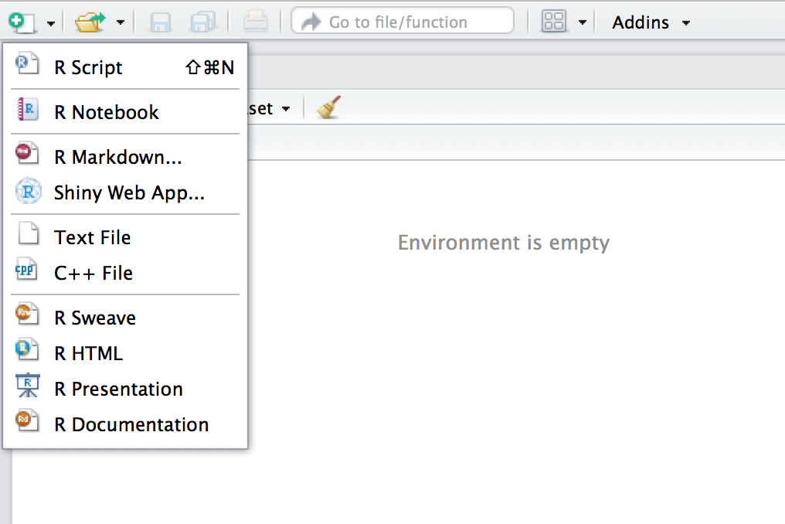
My First knitr Document
Create a new document
Choose an R Markdown Document

Slide 17
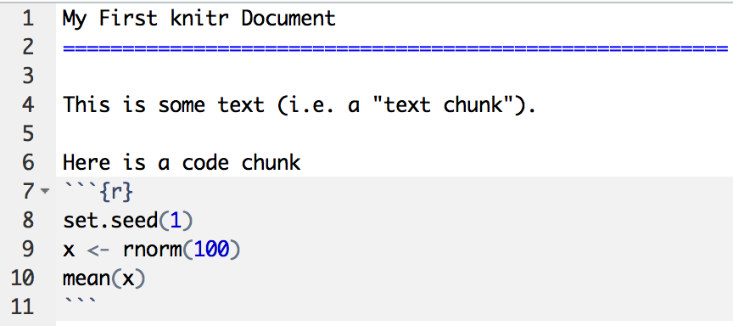
My First knitr Document
Start of code chunk
End of code chunk

Slide 18
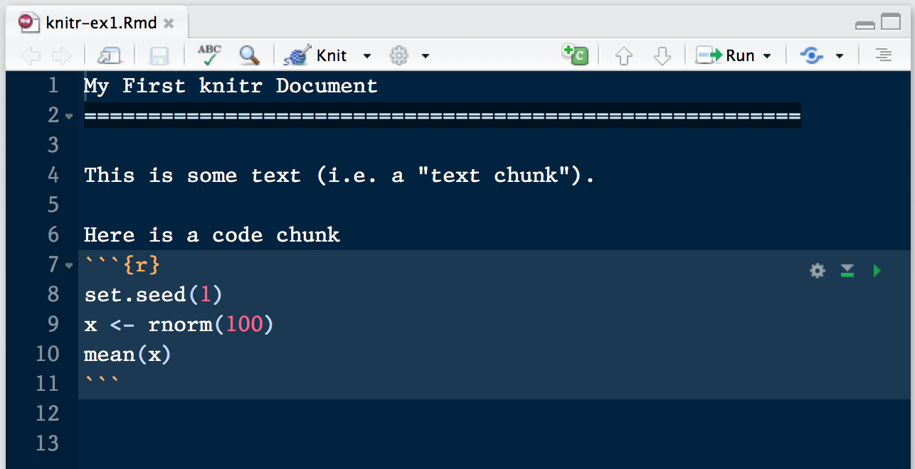
Processing a knitr Document
Push here

Slide 19
More Complicated Way
library(rmarkdown) setwd(<working directory>)
render(“document.Rmd”)
browseURL(“document.html”)

Slide 20
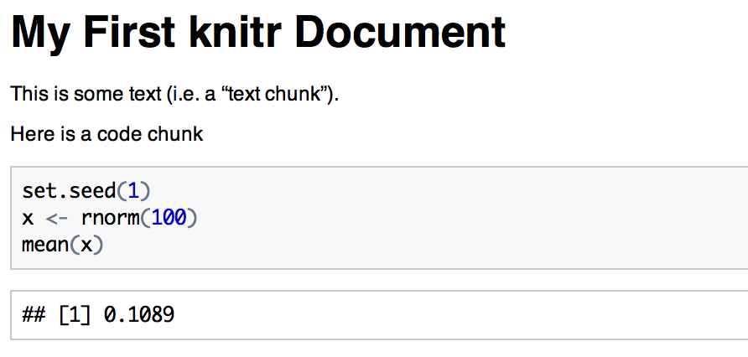
HTML Output
Code input
Numerical output

Slide 21
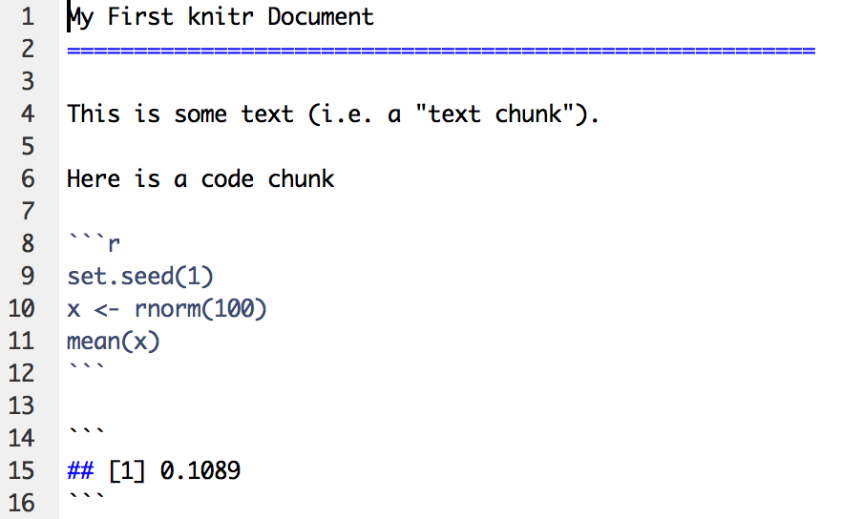
What knitr Produces: Markdown
RMarkdown Document
Markdown Document (generated)
Code is echoed
Result of evaluating R code

Slide 22
A Few Notes
knitr will fill a new document with filler text; delete it
Code chunks begin with ```{r} and end with ```
All R code goes in between these markers
Code chunks can have names, which is useful when we start making graphics ```{r firstchunk} ## R code goes here ```
By default, code in a code chunk is echoed, as will the results of the computation (if there are results to print)

Slide 23
Processing of knitr Documents (what happens under the hood)
You write the RMarkdown document (.Rmd)
knitr produces a Markdown document (.md)
knitr converts the Markdown document into HTML (by default)
.Rmd → .md → .html
You should NOT edit (or save) the .md or .html documents until you are finished

Slide 24
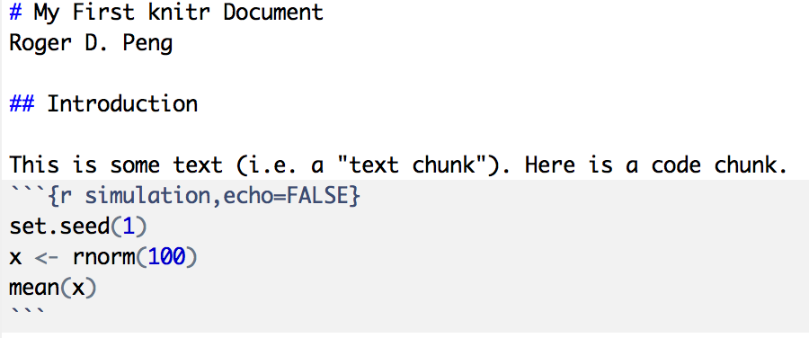
Another Example
Level 1 heading
Level 2 heading
Do not echo code

Slide 25
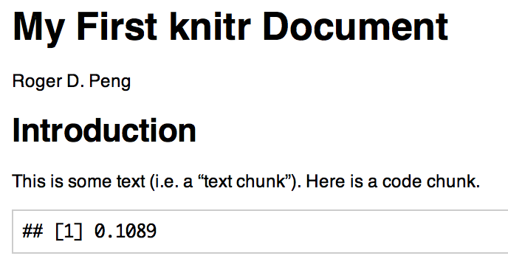
Output

Slide 26
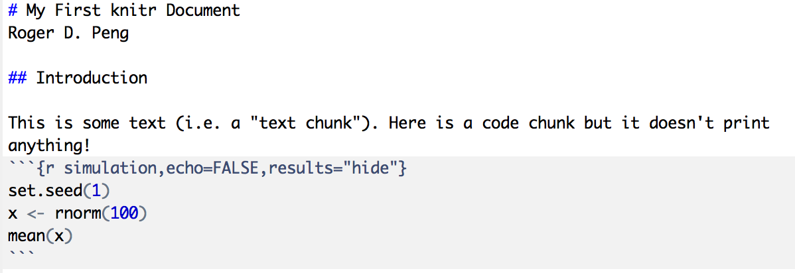
Hiding Results

Slide 27
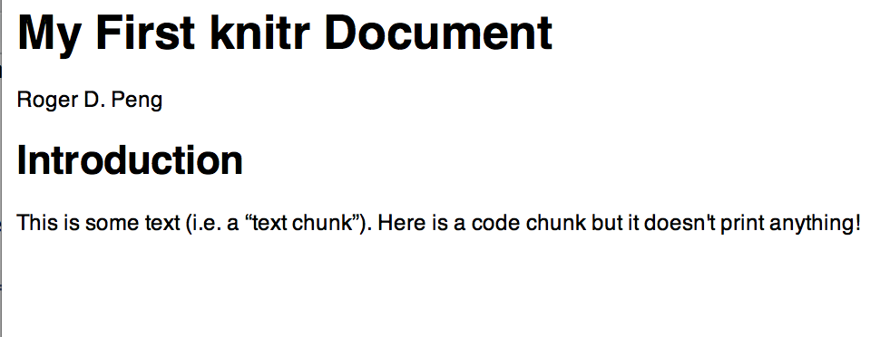
Output

Slide 28
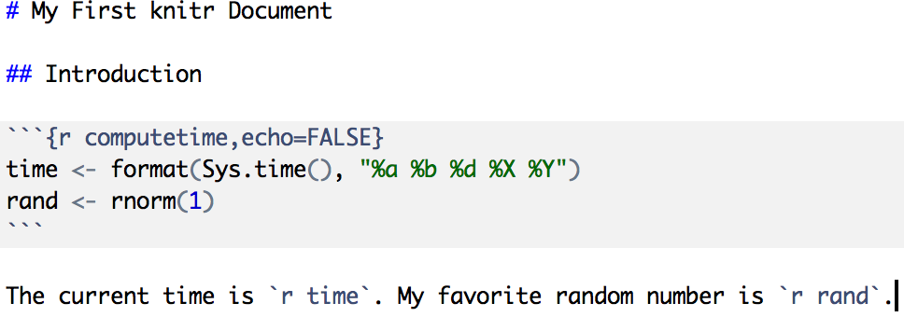
Inline Text Computations

Slide 29
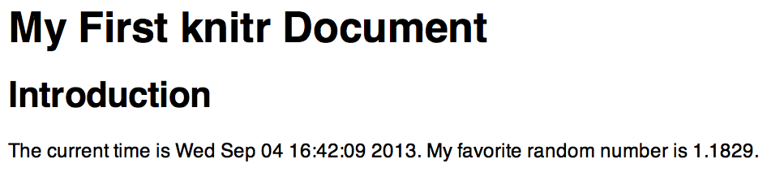
Inline Text Computations

Slide 30
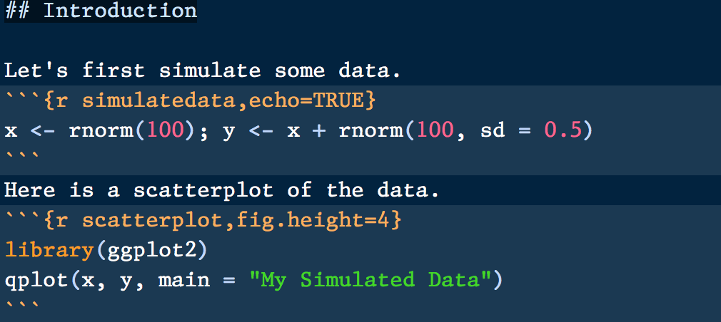
Incorporating Graphics
Adjust figure height

Slide 31
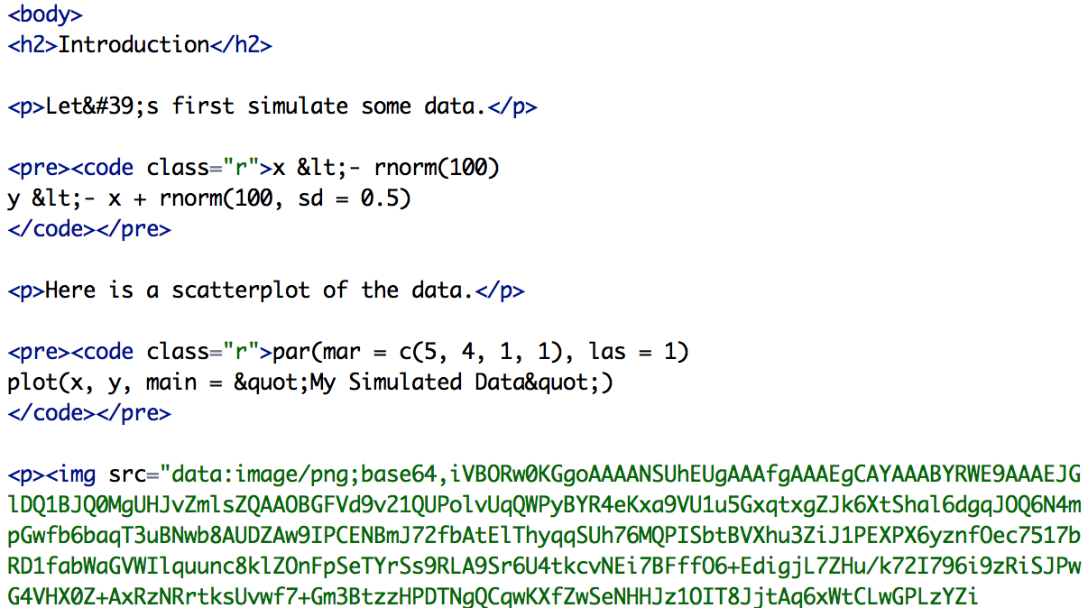
What knitr Produces in HTML
Image is embedded in HTML

Slide 32
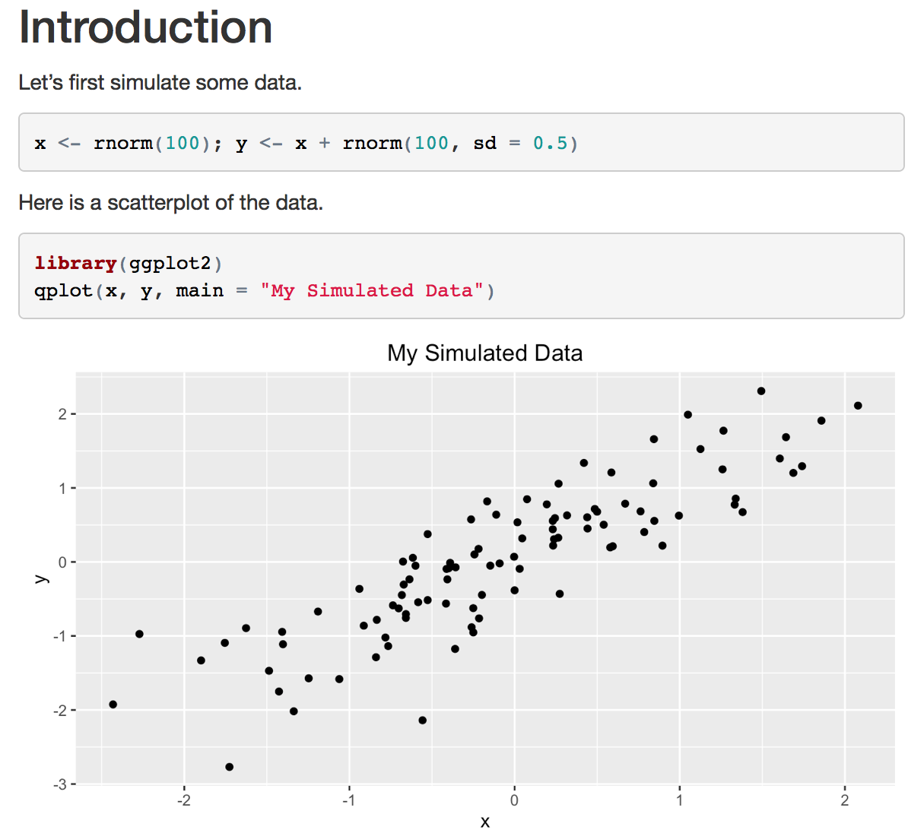
Incorporating Graphics

Slide 33
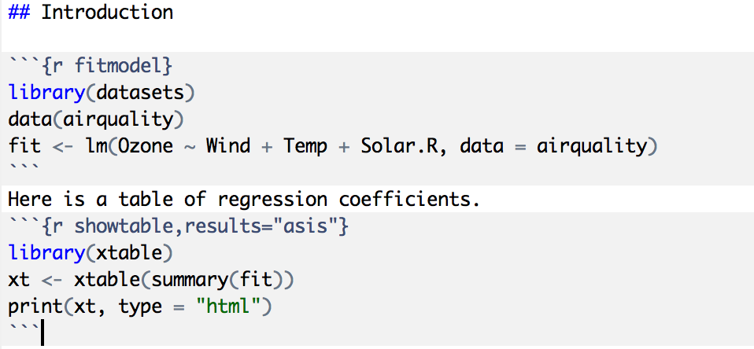
Making Tables with xtable

Slide 34
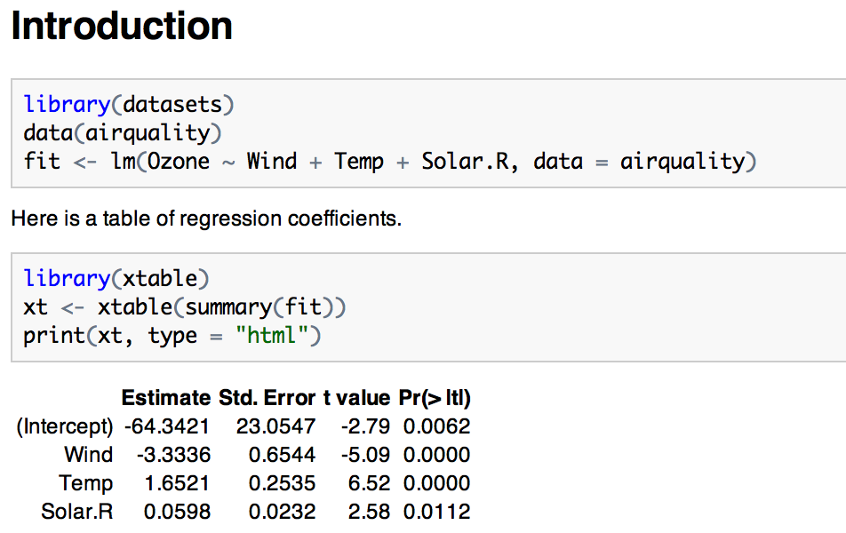
Making Tables with xtable

Slide 35
Setting Global Options
Sometimes we want to set options for every code chunk that are different from the defaults
For example, we may want to suppress all code echoing and results output
We have to write some code to set these global options

Slide 36
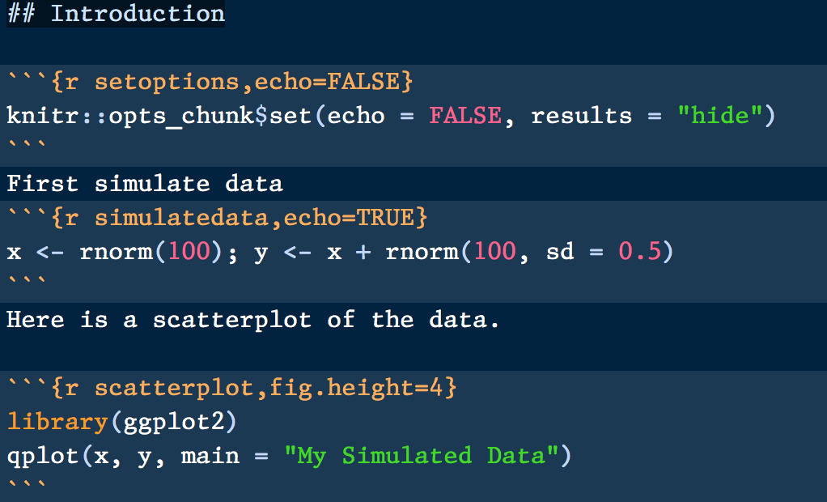
Setting Global Options
Set default to NOT echo code
Override default
Don’t echo code here

Slide 37
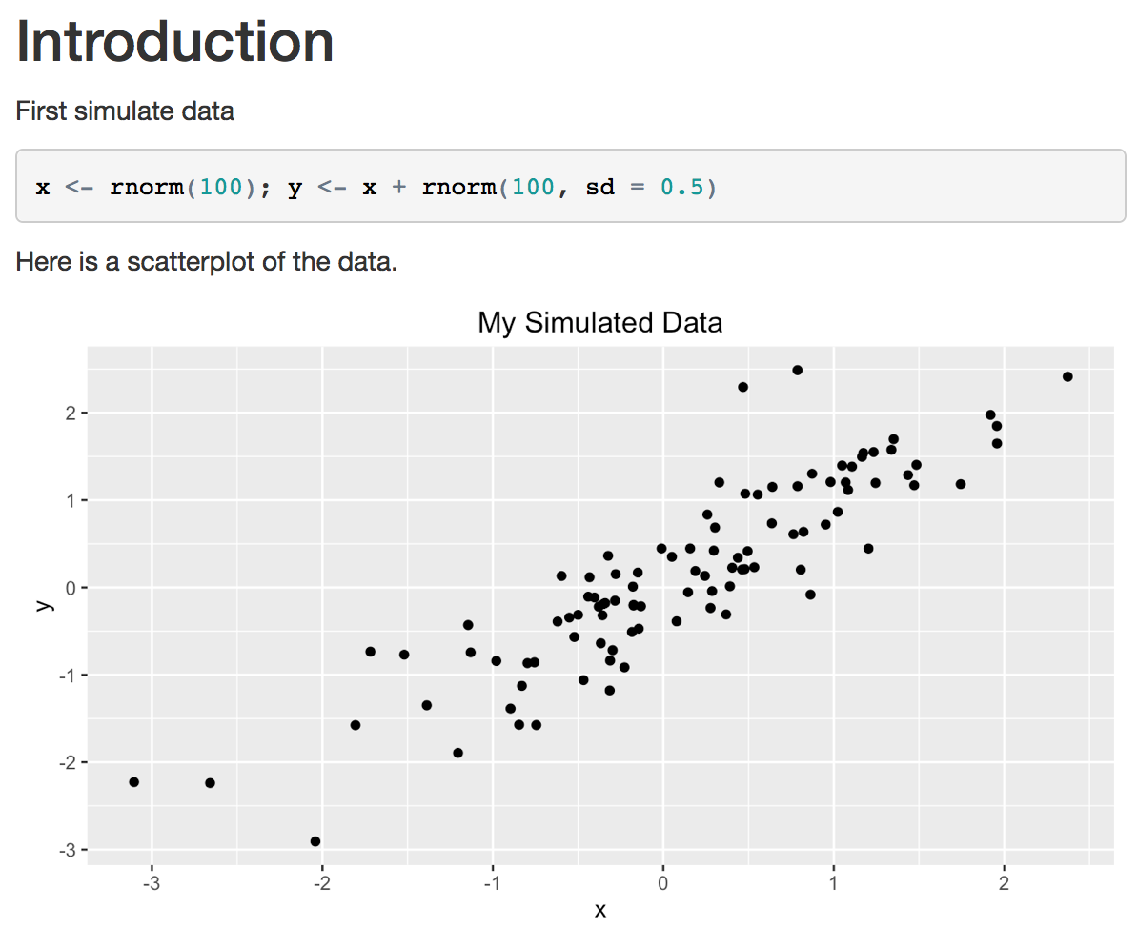
Setting Global Options

Slide 38
Some Common Options
Output
results: “asis”, “hide”
echo: TRUE, FALSE
Figures
fig.height: numeric
fig.width: numeric

Slide 39
Caching Computations
What if one chunk takes a long time to run?
All chunks have to be re-computed every time you re-knit the file
The cache=TRUE option can be set on a chunk-by-chunk basis to store results of computation
After the first run, results are loaded from cache

Slide 40
Caching Caveats
If the data or code (or anything external) changes, you need to re-run the cached code chunks
Dependencies are not checked explicitly
Chunks with significant side effects may not be cacheable

Slide 41
Summary
Literate statistical programming can be a useful way to put text, code, data, output all in one document
knitr is a powerful tool for integrating code and text in a simple document format

