Slide 1
Introduction to Shiny
Biostatistics 140.776

Slide 2
Interactivity
RStudio provides two mechanisms for introducing interactivity in statistical models
manipulate: A simple framework for making interactive plots; only works in RStudio
shiny: A much more complex and feature-filled framework for developing and deploying interactive web apps

Slide 3
manipulate
Simple mechanism for adding sliders, checkboxes and buttons to plots
Only usable with base graphics (i.e. plot())
Plot calls are wrapped in a call to the manipulate() function
A little “wheel/gear” appears in upper corner of plot that will toggle controls

Slide 4
manipulate: Example 1
library(manipulate)
data <- read.csv("eno.csv")
manipulate(
hist(log(data$eno), breaks = n.breaks),
n.breaks = slider(3, 20)
)
plotting expression
variable to control
controller

Slide 5
manipulate: Example 2
eno <- read.csv("eno.csv")
env <- read.csv("environmental.csv")
skin <- read.csv("skin.csv")
m <- merge(eno, env, by = "id")
m <- merge(m, skin, by = "id")
xlim <- range(log(m$pm25), na.rm = TRUE)
ylim <- range(log(m$eno), na.rm = TRUE)
manipulate(
with(m[m$mopos == allergic, ], {
plot(log(pm25), log(eno), xlim = xlim, ylim = ylim, type = "n")
abline(lm(log(eno) ~ log(pm25)))
if(addpoints)
points(log(pm25), log(eno), pch = 20)
}),
allergic = picker("Yes" = "yes", "No" = "no", label = "Mouse Allergic?"),
addpoints = checkbox(FALSE, "Add Points?")
)
Load/merge data
Set x/y ranges
Subset based on allergic status
Only add points if user checks box

Slide 6
manipulate
manipulate requires the use of RStudio
Doesn’t allow you to “deploy” your visualization in any useful way
Interactivity is limited (sliders, checkbox, buttons)
But, a good quick and dirty solution!

Slide 7
Shiny
Shiny is a platform for creating interactive R programs embedded into a web page.
Suppose that you create a prediction algorithm, with shiny you can very easily create web input form that calls R and thus your prediction algorithm and displays the results.
Using Shiny, the time to create simple, yet powerful, web-based interactive data products in R is minimized.
However, it lacks the flexibility of full featured (and more complex) solutions.
Shiny is made by the fine folks at RStudio.

Slide 8
Shiny
Shiny doesn't really require it, but as with all web programming, a little awareness of HTML, CSS and JavaScript is very helpful
HTML gives a web page structure and sectioning as well as markup instructions
CSS describes how content is presented
JavaScript is for interactivity
There are too many tutorials online to count for getting basic proficiency in these topics to count.
Shiny uses bootstrap (no relation to the statistics bootstrap) style, which (to me) seems to look nice and renders well on mobile platforms

Slide 9
A Shiny Project
A shiny project is a directory containing at least two parts
ui.R (for user interface) controls how it looks
server.R controls what it does
Creating a “New Shiny Project” in RStudio will create these files for you and fill them with example code

Slide 10
A Shiny Project
The components/functions in the ui.R file communicate with the functions in the server.R file
Communication is done by passing R objects back and forth in the background
Communication depends on mutually agreed upon variable/object names

Slide 11
ui.R
library(shiny)
shinyUI(fluidPage(
titlePanel(”Biostatistics Rulz!"),
sidebarPanel(
h3('Sidebar text')
),
mainPanel(
h3('Main Panel text')
)
))

Slide 12
server.R
library(shiny)
shinyServer(function(input, output) {
## Nothing for now
})

Slide 13
Run It!
In R, change to the directories with these files and type runApp()
Or put the path to the directory as an argument
It should open an browser window with the app running
In RStudio just click the “Run App” button

Slide 14
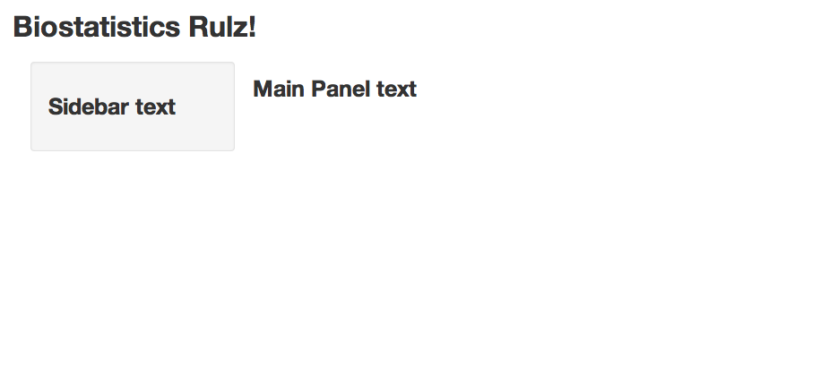
Result

Slide 15
Inputs
shinyUI(fluidPage(
titlePanel("Illustrating inputs"),
sidebarPanel(
numericInput('id1', 'Numeric input, labeled id1', 0,
min = 0, max = 10, step = 1),
checkboxGroupInput("id2", "Checkbox",
c("Value 1" = "1",
"Value 2" = "2",
"Value 3" = "3")),
dateInput("date", "Date:")
),
mainPanel(
)
))

Slide 16
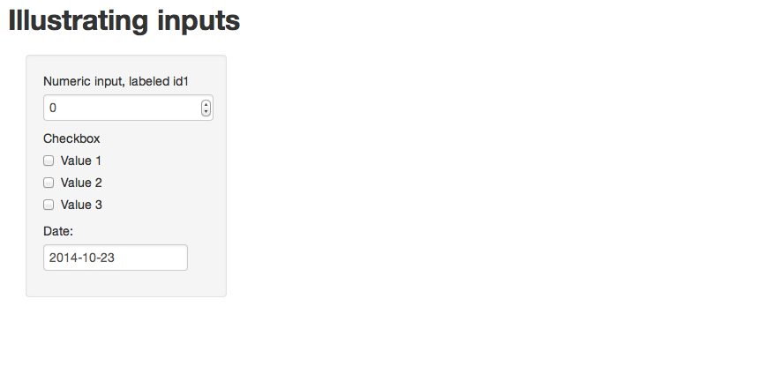
Result

Slide 17
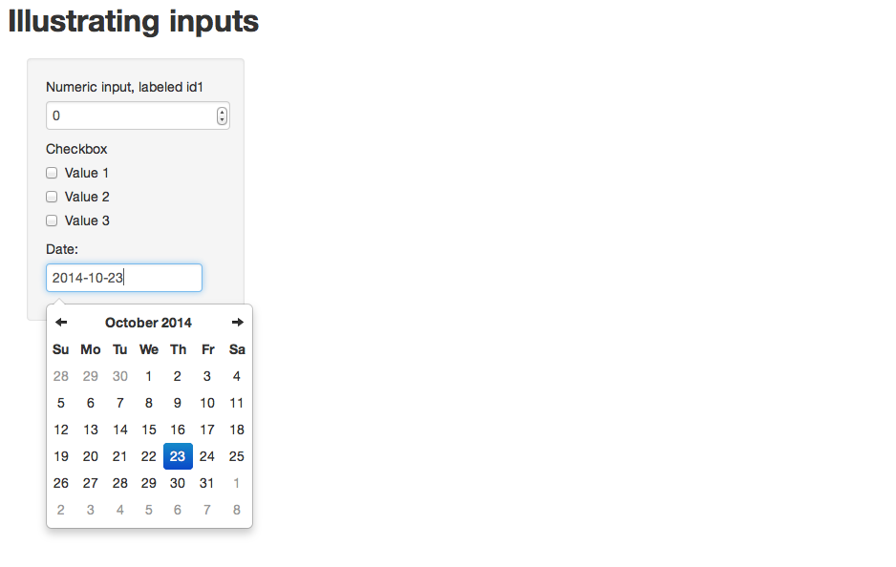
Result

Slide 18
Inputs + Outputs
shinyUI(fluidPage(
titlePanel("Illustrating inputs"),
sidebarPanel(
numericInput('id1', 'Numeric input, labeled id1', 0, min = 0,
max = 10, step = 1),
checkboxGroupInput("id2", "Checkbox",
c("Value 1" = "1",
"Value 2" = "2",
"Value 3" = "3")),
dateInput("date", "Date:")
),
mainPanel(
h3('Illustrating outputs'),
h4('Your number'),
verbatimTextOutput("id1.output"),
h4('You checked'),
verbatimTextOutput("id2.output"),
h4('Your date is'),
verbatimTextOutput("date.output")
)
))

Slide 19
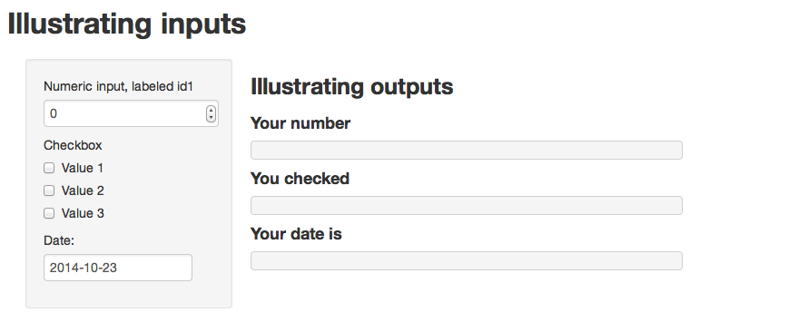
Inputs + Outputs

Slide 20
server.R
Input identifier from ui.R
Input list
Output list
library(shiny)
shinyServer(function(input, output) {
output$id1.output <- renderPrint({ input$id1 })
output$id2.output <- renderPrint({ input$id2 })
output$date.output <- renderPrint({ input$date })
})
Output identifier from ui.R

Slide 21
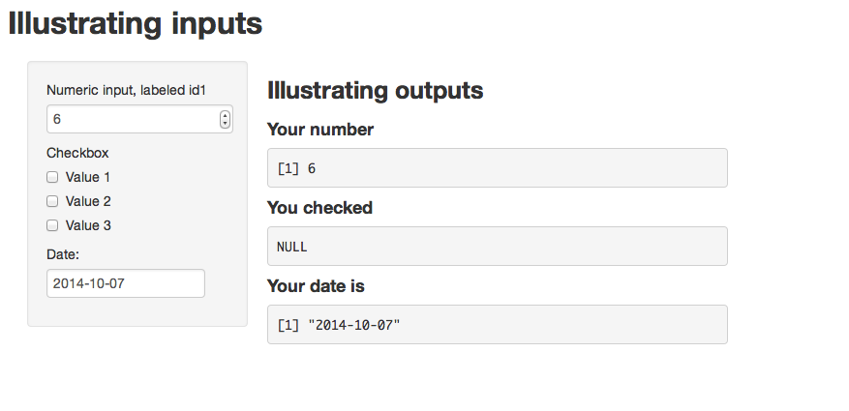
Inputs + Outputs

Slide 22
Autcomplete App
Build a simple web app that takes text and predicts the currently typed word
Need a text input field on the left
Show output on the right
Run the autocomplete() function behind the scenes and dynamically update as user types

Slide 23
ui.R
library(shiny)
shinyUI(fluidPage(
headerPanel("Text Prediction: Autocomplete"),
sidebarLayout(
sidebarPanel(
textInput(inputId = "letters", label = h3("Enter text"))
),
mainPanel(
h2("Here's your prediction!"),
textOutput("completion")
)
)
))

Slide 24
server.R
library(shiny)
source("autocomplete.R")
shinyServer(function(input, output) {
output$completion <- renderText({
autocomplete(input$letters)
})
})

Slide 25
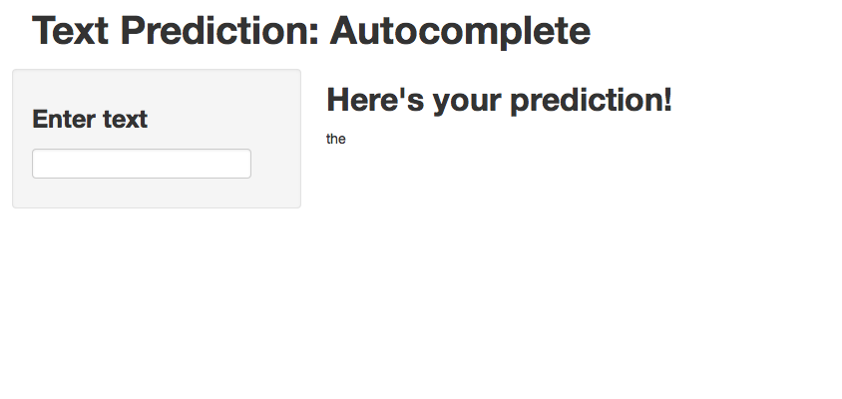
Autocomplete

Slide 26
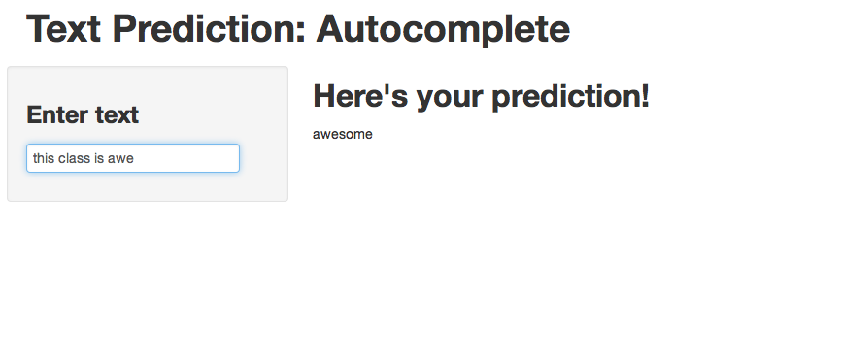
Autocomplete

Slide 27
Deploying Your App
Shiny apps can be deployed on RStudio’s shinyapps.io server (for free, at least now)
Need to install the shinyapps package from RStudio
Setup account at shinyapps.io (you can use Google or GitHub accounts)
Send server your credentials
After building/testing your app locally on your computer run deployApp()

Slide 28
Summary
Manipulate gives you a quick and dirty way to create interactive plots within RStudio
Shiny let’s you create web apps without having to focus on nuts and bolts of web programming
It’s to get into the nitty gritty web stuff if you want
Apps can be deployed on the web quickly

