Slide 1
Coding Standards
Biostat 140.776

Slide 2
Coding Standards
Enhance readability
Allow for interoperability, inclusion in other programs
Sometimes required by the language itself
Readability
Readability

Slide 3
Coding Standards
Program code files should always be ASCII text files. You should be able to source() the file into R directly without any conversion.
Always use a monospace font when displaying code; others alter structure of code and limit readability
Indent your code; use large enough indent so that old people like me can see it; I use 8 spaces (i.e. 2 tabs)
Limit to 80 columns (or so) in width; this is important!
One page per function; otherwise split

Slide 4
Linux Kernel Coding Style
Rationale: The whole idea behind indentation is to clearly define where a block of control starts and ends. Especially when you've been looking at your screen for 20 straight hours, you'll find it a lot easier to see how the indentation works if you have large indentations.
--Linus Torvalds
https://www.kernel.org/doc/Documentation/CodingStyle

Slide 5
Linux Kernel Coding Style
“Now, some people will claim that having 8-character indentations makes the code move too far to the right, and makes it hard to read on a 80-character terminal screen. The answer to that is that if you need more than 3 levels of indentation, you're screwed anyway, and should fix your program.
“In short, 8-char indents make things easier to read, and have the added benefit of warning you when you're nesting your functions too deep. Heed that warning.”
--Linus Torvalds
https://www.kernel.org/doc/Documentation/CodingStyle

Slide 6
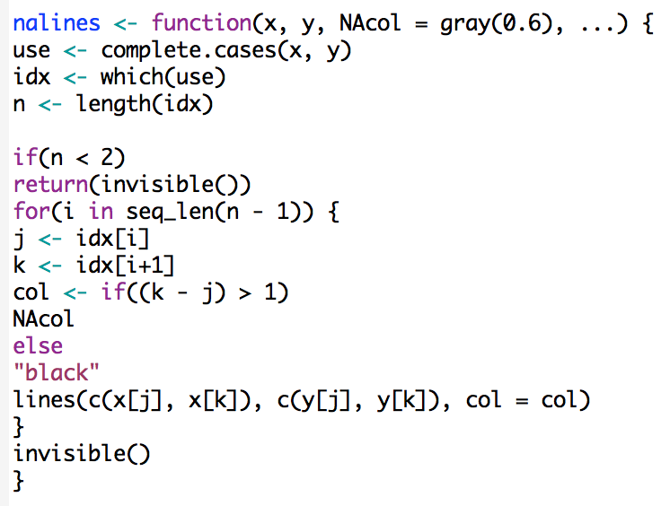
Indenting

Slide 7
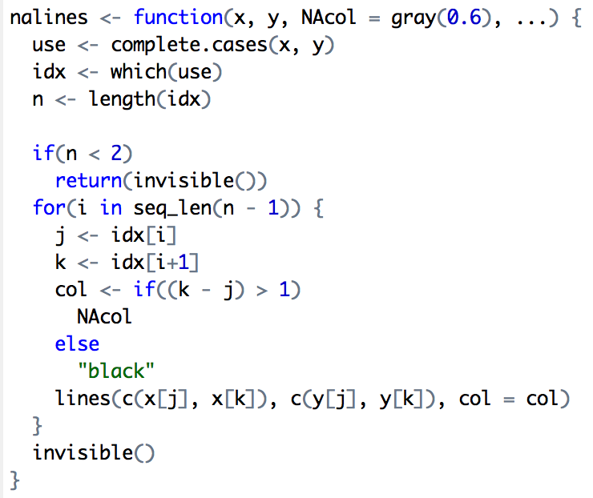
Indenting

Slide 8
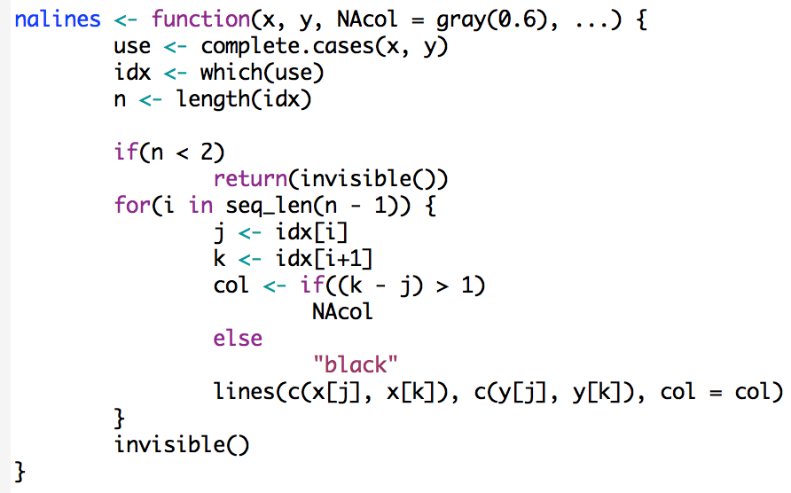
Indenting

Slide 9
Indenting
Indenting improves readability
Fixing line length (80 columns) prevents lots of nesting and very long functions
Indents of 4 spaces at minimum; 8 spaces ideal
BUT: Always follow the established style of an existing project. Don’t make trouble for the maintainer!

