Slide 1
Plotting with ggplot2: Part 1
Biostatistics 140.776

Slide 2
What is ggplot2?
An implementation of the Grammar of Graphics by Leland Wilkinson
Written by Hadley Wickham (while he was a graduate student at Iowa State)
A “third” graphics system for R (along with base and lattice)
Available from CRAN via install.packages()
Web site: http://ggplot2.org (better documentation)

Slide 3
What is ggplot2?
Grammar of graphics represents and abstraction of graphics ideas/objects
Think “verb”, “noun”, “adjective” for graphics
Allows for a “theory” of graphics on which to build new graphics and graphics objects
“Shorten the distance from mind to page”

Slide 4
Grammar of Graphics
“…the grammar tells us that a statistical graphic is a mapping from data to aesthetic attributes (colour, shape, size) of geometric objects (points, lines, bars). The plot may also contain statistical transformations of the data and is drawn on a specific coordinate system”
from ggplot2 book

Slide 5
Plotting Systems in R: Base
“Artist’s palette” model
Start with blank canvas and build up from there
Start with plot function (or similar)
Use annotation functions to add/modify (text, lines, points, axis)

Slide 6
Plotting Systems in R: Base
Convenient, mirrors how we think of building plots and analyzing data
Can’t go back once plot has started (i.e. to adjust margins); need to plan in advance
Difficult to “translate” to others once a new plot has been created (no graphical “language”)
Plot is just a series of R commands

Slide 7
Plotting Systems in R: Lattice
Plots are created with a single function call (xyplot, bwplot, etc.)
Most useful for conditioning types of plots: Looking at how y changes with x across levels of z
Thinks like margins/spacing set automatically because entire plot is specified at once
Good for putting many many plots on a screen

Slide 8
Plotting Systems in R: Lattice
Sometimes awkward to specify an entire plot in a single function call
Annotation in plot is not intuitive
Use of panel functions to annotate plots was difficult to wield and required intense preparation

Slide 9
Plotting Systems in R: ggplot2
Split the difference between base and lattice
Automatically deals with spacings, text, titles but also allows you to annotate by “adding”
Superficial similarity to lattice but generally easier/more intuitive to use
Default mode makes many choices for you (but you can customize)

Slide 10
The Basics: qplot()
Looks for data in a data frame, similar to lattice, or in the parent environment
Plots are made up of aesthetics (size, shape, color) and geoms (points, lines)
Works much like the plot function in base graphics system

Slide 11
The Basics: qplot()
Data need to be tidy (and usually in long format)
Factors are important for indicating subsets of the data (if they are to have different properties) and annotating points; factors should be labeled
The qplot() hides what goes on underneath, which is okay for most operations
ggplot() is the core function and very flexible for doing things qplot() cannot do

Slide 12
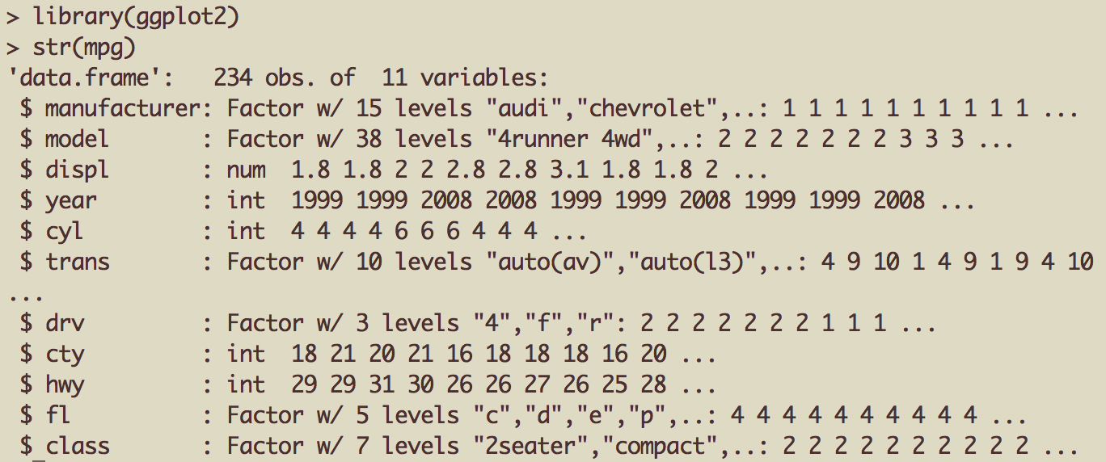
Example Dataset
Factor label information important for annotation

Slide 13

ggplot2 “Hello, world!”
x coord
y coord
data frame

Slide 14
Modifying aesthetics
auto legend placement
color aesthetic
qplot(displ, hwy, data = mpg, color = drv)

Slide 15
Adding a geom
qplot(displ, hwy, data = mpg, geom = c("point", "smooth"))

Slide 16
Histograms
qplot(hwy, data = mpg, fill = drv)

Slide 17
Facets
qplot(displ, hwy, data = mpg, facets = . ~ drv)
qplot(hwy, data = mpg, facets = drv ~ ., binwidth = 2)

Slide 18
MAACS Cohort
Mouse Allergen and Asthma Cohort Study
Baltimore children (aged 5—17)
Persistent asthma, exacerbation in past year
Study indoor environment and its relationship with asthma morbidity
Recent publication: http://goo.gl/WqE9j8

Slide 19
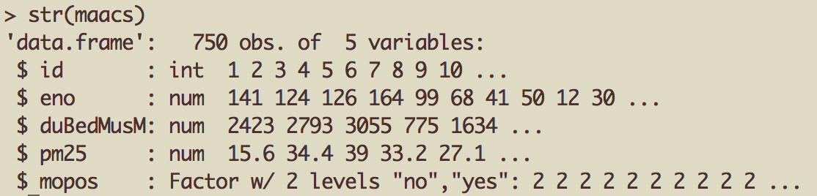
Example: MAACS
library(readr)
eno <- read_csv("eno.csv")
env <- read_csv("environmental.csv”)
skin <- read_csv("skin.csv")
maacs <- left_join(eno, env, by = “id”) %>%
left_join(skin, by = “id”)
Unzip the plotting.zip file

Slide 20
Histogram of eNO
qplot(log(eno), data = maacs)

Slide 21
Histogram by Group
qplot(log(eno), data = maacs, fill = mopos)

Slide 22
Density Smooth
qplot(log(eno), data = maacs, geom = "density")
qplot(log(eno), data = maacs, geom = "density", color = mopos)

Slide 23
Scatterplots: eNO vs. PM_{2.5}
qplot(log(pm25), log(eno), data = maacs, shape = mopos)
qplot(log(pm25), log(eno), data = maacs, shape = mopos)
qplot(log(pm25), log(eno), data = maacs, color = mopos)

Slide 24
Scatterplots: eNO vs. PM_{2.5}
qplot(log(pm25), log(eno), data = maacs, color = mopos) + geom_smooth(method = "lm")

Slide 25
Scatterplots: eNO vs. PM_{2.5}
qplot(log(pm25), log(eno), data = maacs, facets = . ~ mopos) + geom_smooth(method = “lm”)

Slide 26
Basic Components of a ggplot2 Plot
A data frame
aesthetic mappings: how data are mapped to color, size
geoms: geometric objects like points, lines, shapes.
facets: for conditional plots.
stats: statistical transformations like binning, quantiles, smoothing.
scales: what scale an aesthetic map uses (example: male = red, female = blue).
coordinate system

Slide 27
Summary of qplot()
The qplot() function is the analog to plot() but with many built-in features
Produces very nice graphics quickly, essentially publication ready (if you like the design)
Difficult to go against the grain/customize (don’t bother; use full ggplot2 power in that case)

Slide 28
Resources
The ggplot2 book by Hadley Wickham
The R Graphics Cookbook by Winston Chang (examples in base plots and in ggplot2)
ggplot2 web site (https://ggplot2.tidyverse.org)
ggplot2 mailing list (http://goo.gl/OdW3uB), primarily for developers

