Slide 1
Plotting and Color in R
Biostatistics 140.776

Slide 2
Plotting and Color
The default color schemes for most plots in R are not good
Recently there have been developments to improve the handling/specification of colors in plots/graphs/etc.
There are functions in R and in external packages that are very handy

Slide 3
Why is Color Important
Color is a key tool for allowing us to “escape flatland”
Allows for showing an extra dimension on top of whatever we may be plotting
Certain palettes of color are more appropriate for certain types of data
Some careful thinking about color can greatly enhance a data graphic

Slide 4
Colors 1, 2, and 3
col = 1
col = 2
col = 3

Slide 5
Default Image Plots in R
heat.colors()
topo.colors()

Slide 6
Color Utilities in R
The grDevices package has two functions
colorRamp
colorRampPalette
These functions take palettes of colors and help to interpolate between the colors
The function colors() lists the names of colors you can use in any plotting function
You can also use colours()

Slide 7
Color Palette Utilities in R
colorRamp: Take a palette of colors and return a function that takes values between 0 and 1, indicating the extremes of the color palette (e.g. see the ‘gray’ function)
colorRampPalette: Take a palette of colors and return a function that takes integer arguments and returns a vector of colors interpolating the palette (like heat.colors or topo.colors)

Slide 8
colorRamp
> pal <- colorRamp(c("red", "blue"))
> pal(0)
[,1] [,2] [,3]
[1,] 255 0 0
> pal(1)
[,1] [,2] [,3]
[1,] 0 0 255
> pal(0.5)
[,1] [,2] [,3]
[1,] 127.5 0 127.5
Red
Blue
Green

Slide 9
colorRamp
> pal(seq(0, 1, len = 10))
[,1] [,2] [,3]
[1,] 255.00000 0 0.00000
[2,] 226.66667 0 28.33333
[3,] 198.33333 0 56.66667
[4,] 170.00000 0 85.00000
[5,] 141.66667 0 113.33333
[6,] 113.33333 0 141.66667
[7,] 85.00000 0 170.00000
[8,] 56.66667 0 198.33333
[9,] 28.33333 0 226.66667
[10,] 0.00000 0 255.00000

Slide 10
colorRampPalette
> pal <- colorRampPalette(c("red", "yellow"))
> pal(2)
[1] "#FF0000" "#FFFF00"
> pal(10)
[1] "#FF0000" "#FF1C00" "#FF3800" "#FF5500" "#FF7100"
[6] "#FF8D00" "#FFAA00" "#FFC600" "#FFE200" "#FFFF00”

Slide 11
RColorBrewer Package
One package on CRAN that contains interesting/useful color palettes
There are 3 types of palettes
Sequential
Diverging
Qualitative
Palette information can be used in conjunction with the colorRamp() and colorRampPalette()

Slide 13
RColorBrewer and colorRampPalette
> library(RColorBrewer)
> cols <- brewer.pal(3, "BuGn")
> cols
[1] "#E5F5F9" "#99D8C9" "#2CA25F"
> pal <- colorRampPalette(cols)
> image(volcano, col = pal(20))

Slide 14
RColorBrewer and colorRampPalette

Slide 15
The smoothScatter function
x <- rnorm(10000)
y <- rnorm(10000)
smoothScatter(x, y)

Slide 16
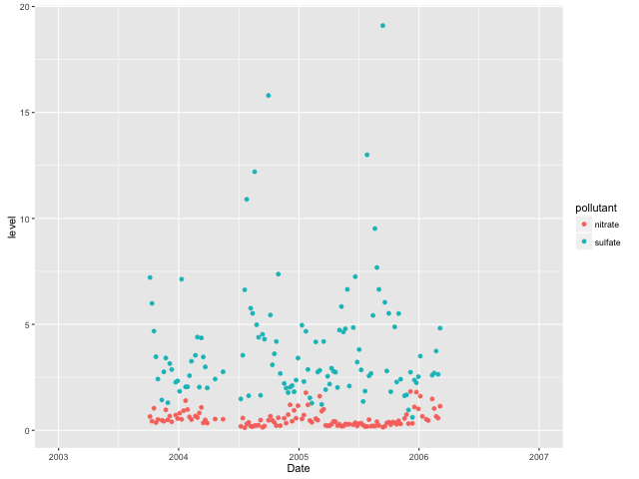
Qualitative Colors

Slide 17
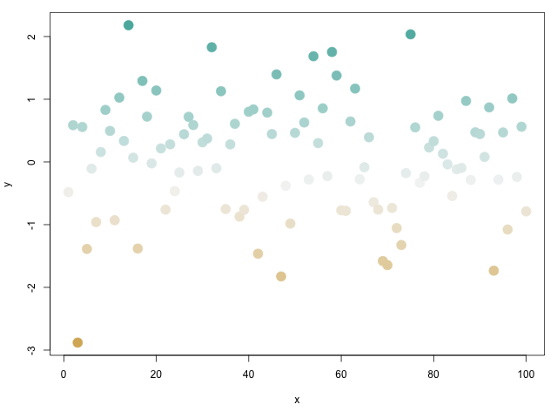
Diverging Colors

Slide 18
Some Other Plotting Notes
The rgb function can be used to produce any color via red, green, blue proportions
Color transparency can be added via the alpha parameter to rgb
The colorspace package can be used for a different control over colors

Slide 19
Scatterplot with no transparency
plot(x, y, pch = 19)

Slide 20
Scatterplot with transparency
plot(x, y, col = rgb(0, 0, 0, 0.2), pch = 19)

Slide 21
Summary
Careful use of colors in plots/maps/etc. can make it easier for the reader to get what you’re trying to say (why make it harder?)
The RColorBrewer package is an R package that provides color palettes for sequential, categorical, and diverging data
The colorRamp and colorRampPalette functions can be used in conjunction with color palettes to connect data to colors
Transparency can sometimes be used to clarify plots with many points

