Slide 1
Coding Standards
Biostat 140.776

Slide 2
Coding Standards
Enhance readability
Allow for interoperability, inclusion in other programs
Sometimes required by the language itself
Readability
Readability

Slide 3
Coding Standards
Program code files should always be ASCII text files. You should be able to source() the file into R directly without any conversion.
Always use a monospace font when displaying code; others alter structure of code and limit readability
Indent your code; use large enough indent so that old people like me can see it; I use 8 spaces
Limit to 80 columns (or so) in width; this is important!
One page per function; otherwise split

Slide 4
Linux Kernel Coding Style
Rationale: The whole idea behind indentation is to clearly define where a block of control starts and ends. Especially when you've been looking at your screen for 20 straight hours, you'll find it a lot easier to see how the indentation works if you have large indentations.
--Linus Torvalds
https://www.kernel.org/doc/Documentation/CodingStyle

Slide 5
Linux Kernel Coding Style
“Now, some people will claim that having 8-character indentations makes the code move too far to the right, and makes it hard to read on a 80-character terminal screen. The answer to that is that if you need more than 3 levels of indentation, you're screwed anyway, and should fix your program.
“In short, 8-char indents make things easier to read, and have the added benefit of warning you when you're nesting your functions too deep. Heed that warning.”
--Linus Torvalds
https://www.kernel.org/doc/Documentation/CodingStyle

Slide 6
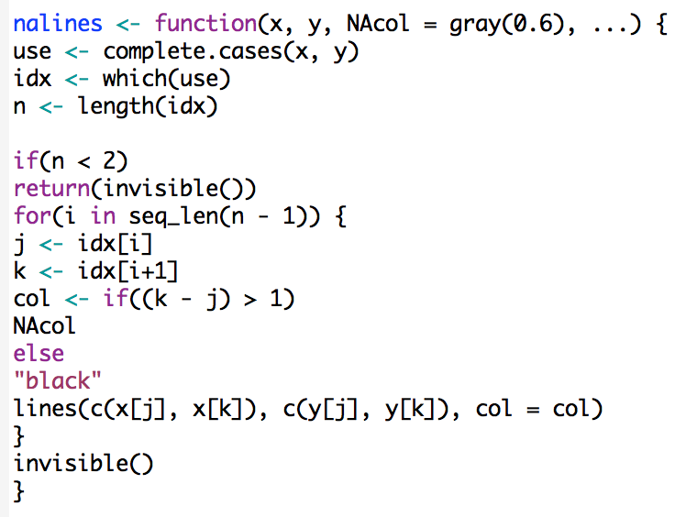
Indenting

Slide 7
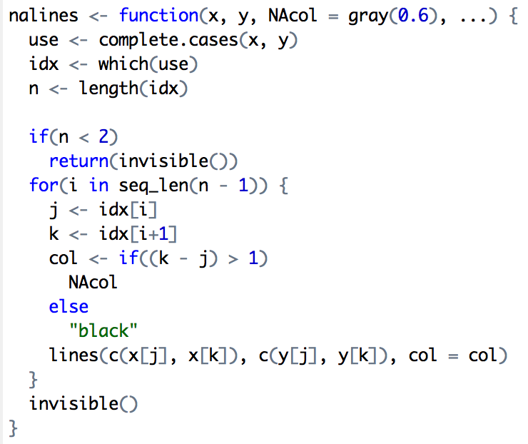
Indenting

Slide 8
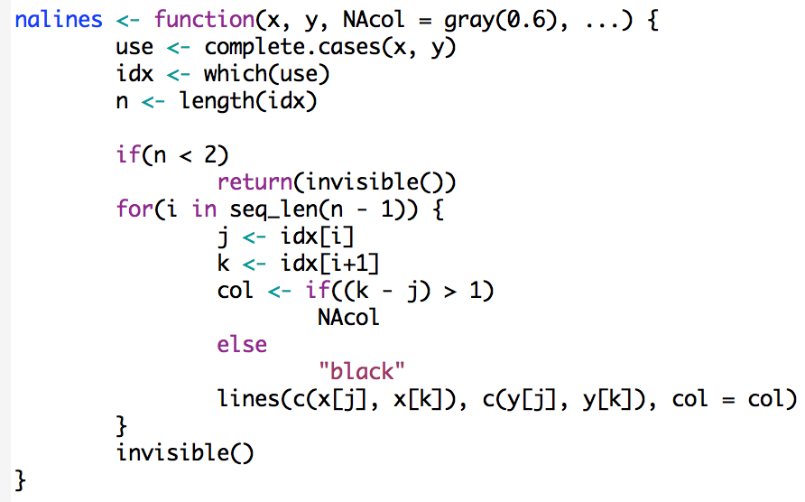
Indenting

Slide 9
Functions
Functions should do one thing well
~1 screen full of text
5-10 local variables
Informative but succinct names
If functions get long break them up into helper functions

Slide 10
Commenting
Commenting your code is good in general
There is such a thing as over-commenting
Never try to explain how your code works in a comment
Write the code so that the it is obvious how it works
Comments should explain what the code does, not how it works

Slide 11
Summary
Indenting improves readability
Fixing line length (80 columns) prevents lots of nesting and very long functions
Indents of 4 spaces at minimum; 8 spaces ideal
BUT: Always follow the established style of an existing project. Don’t make trouble for the maintainer!
Functions should do one thing well
Comments should be as simple as possible but no simpler

