Slide 1
Literate Statistical Programming with knitr and R Markdown
Biostatistics 140.776

Slide 2
What is knitr?
An R package written by Yihui Xie (while he was a grad student at Iowa State)
Available on CRAN
Supports RMarkdown, LaTeX, and HTML as documentation languages
Can export to PDF, HTML
Built right into RStudio for your convenience

Slide 3
What is knitr Good For?
Manuals
Short/medium-length technical documents
Tutorials
Reports (esp. if generated periodically)
Data preprocessing documents/summaries

Slide 4
What is knitr NOT Good For?
Very long research articles
Complex time-consuming computations
Documents that require precise formatting

Slide 5
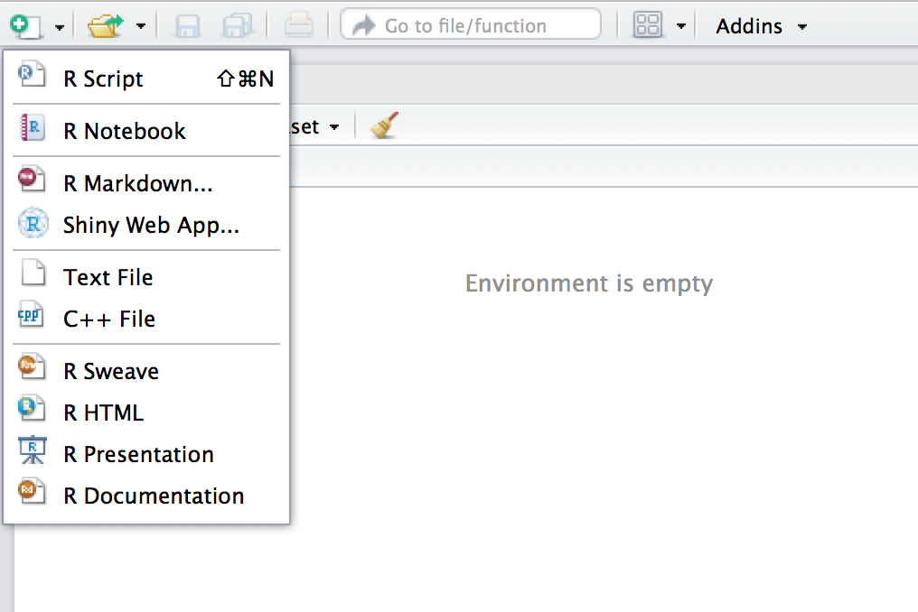
My First knitr Document
Create a new document
Choose an R Markdown Document

Slide 6
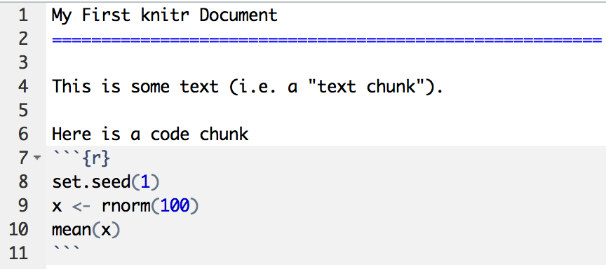
My First knitr Document
Start of code chunk
End of code chunk

Slide 7
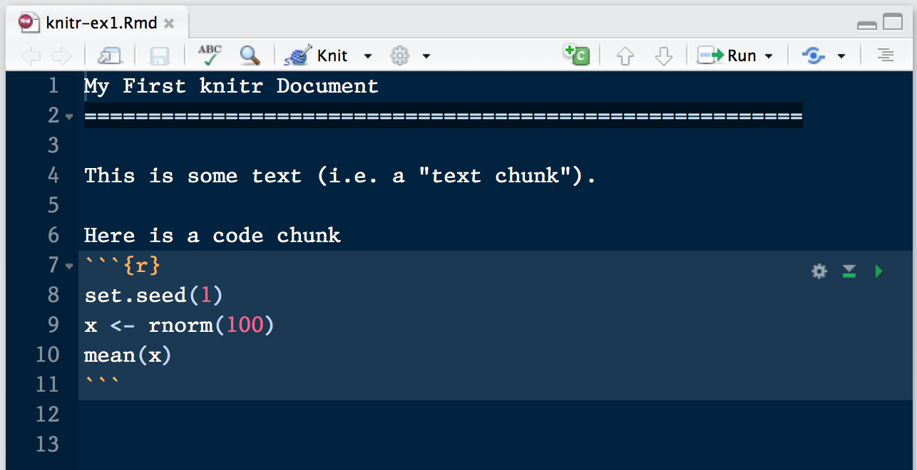
Processing a knitr Document
Push here

Slide 8
More Complicated Way
library(rmarkdown) setwd(<working directory>)
render(“document.Rmd”)
browseURL(“document.html”)

Slide 9
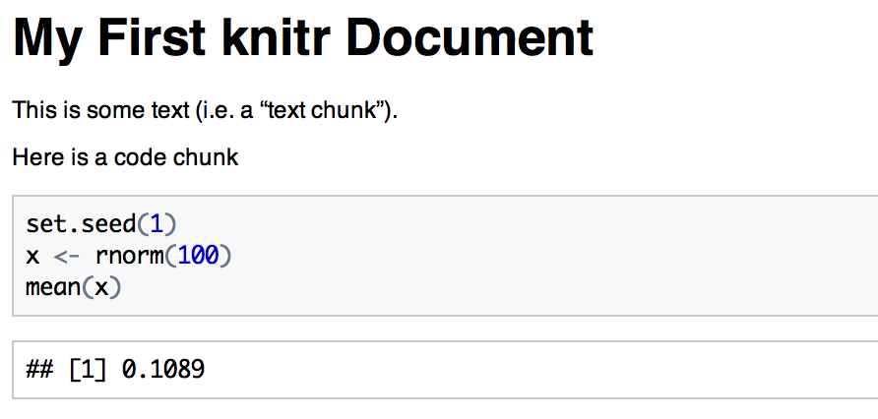
HTML Output
Code input
Numerical output

Slide 10
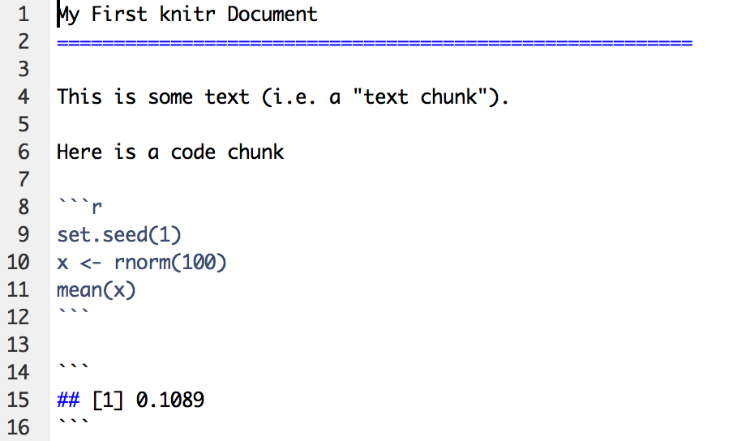
What knitr Produces: Markdown
RMarkdown Document
Markdown Document (generated)
Code is echoed
Result of evaluating R code

Slide 11
A Few Notes
knitr will fill a new document with filler text; delete it
Code chunks begin with ```{r} and end with ```
All R code goes in between these markers
Code chunks can have names, which is useful when we start making graphics ```{r firstchunk} ## R code goes here ```
By default, code in a code chunk is echoed, as will the results of the computation (if there are results to print)

Slide 12
Processing of knitr Documents (what happens under the hood)
You write the RMarkdown document (.Rmd)
knitr produces a Markdown document (.md)
knitr converts the Markdown document into HTML (by default)
.Rmd → .md → .html
You should NOT edit (or save) the .md or .html documents until you are finished

Slide 13
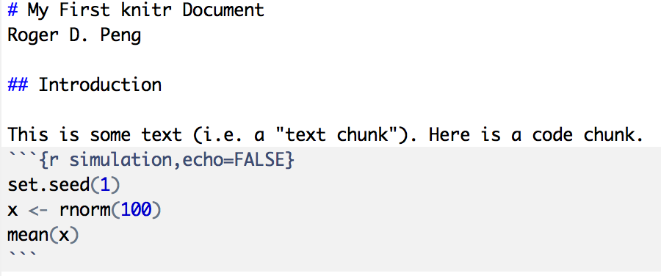
Another Example
Level 1 heading
Level 2 heading
Do not echo code

Slide 14
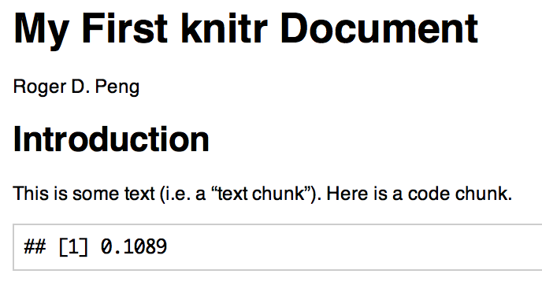
Output

Slide 15
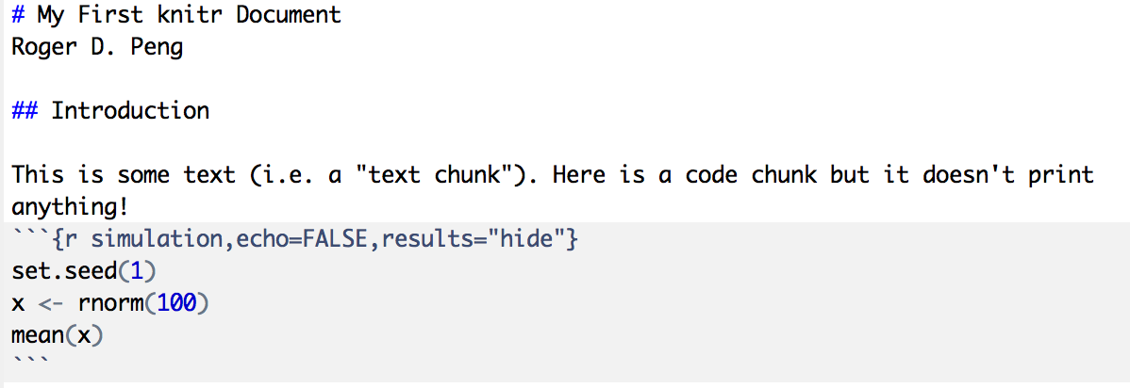
Hiding Results

Slide 16
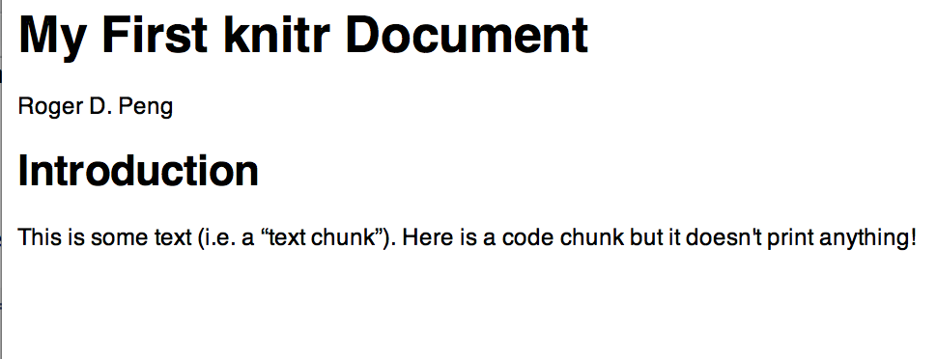
Output

Slide 17
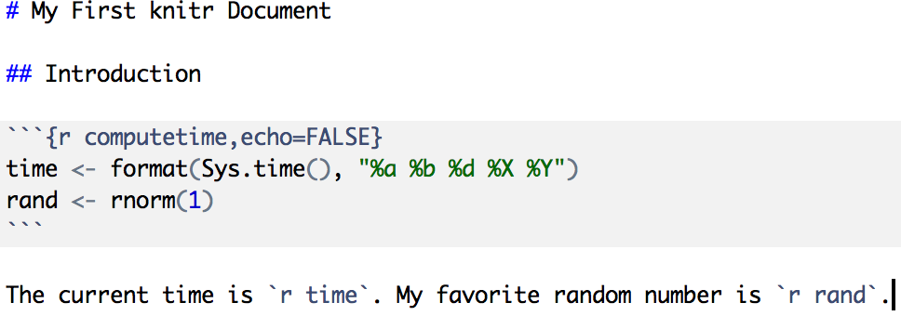
Inline Text Computations

Slide 18
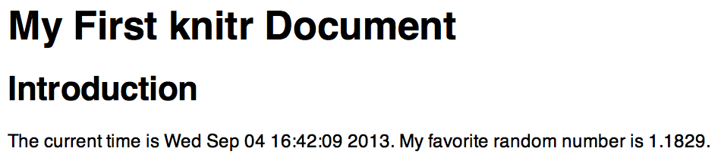
Inline Text Computations

Slide 19
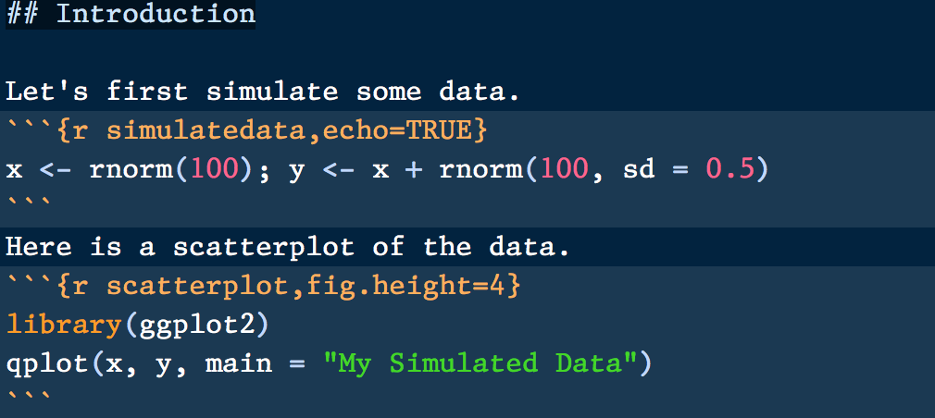
Incorporating Graphics
Adjust figure height

Slide 20
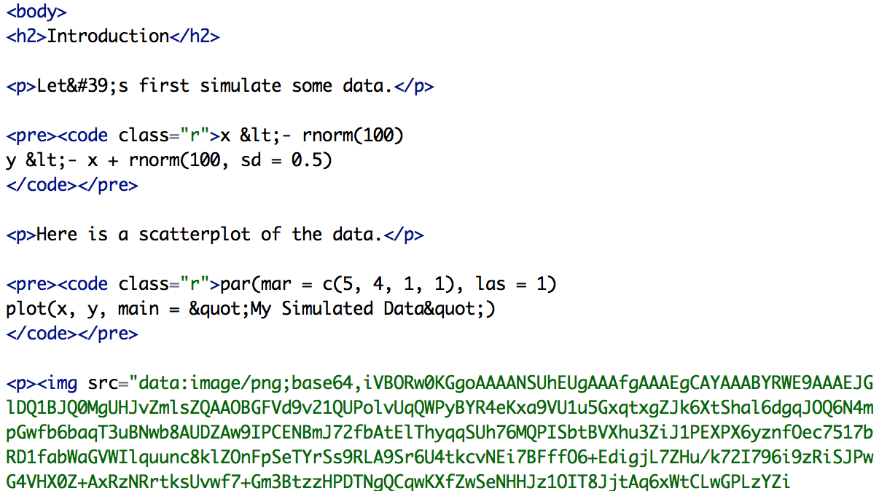
What knitr Produces in HTML
Image is embedded in HTML

Slide 21
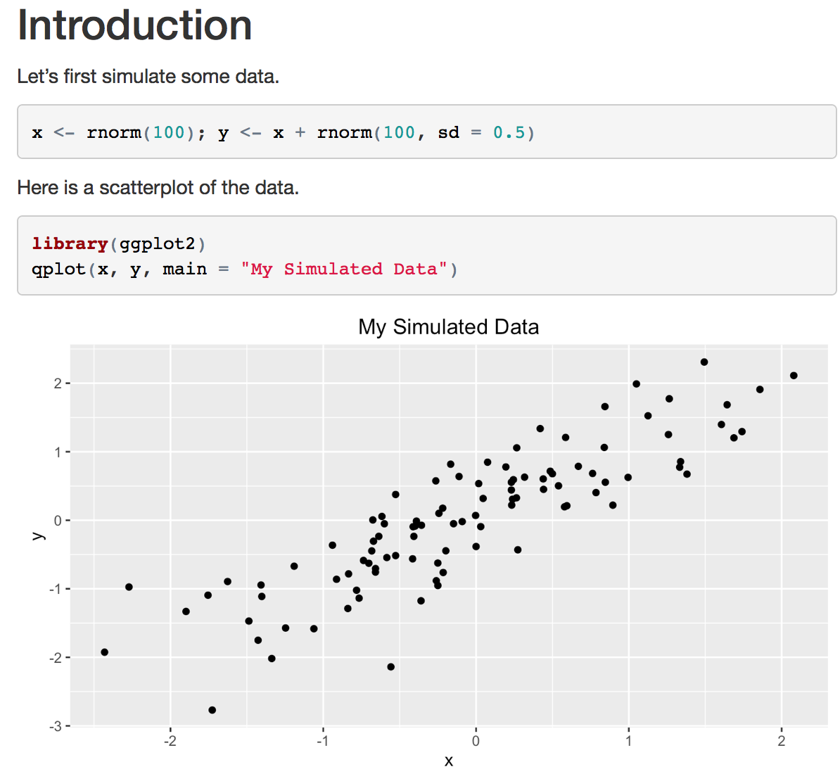
Incorporating Graphics

Slide 22
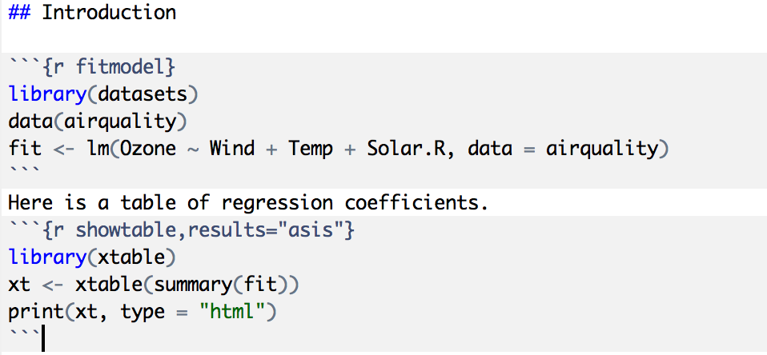
Making Tables with xtable

Slide 23
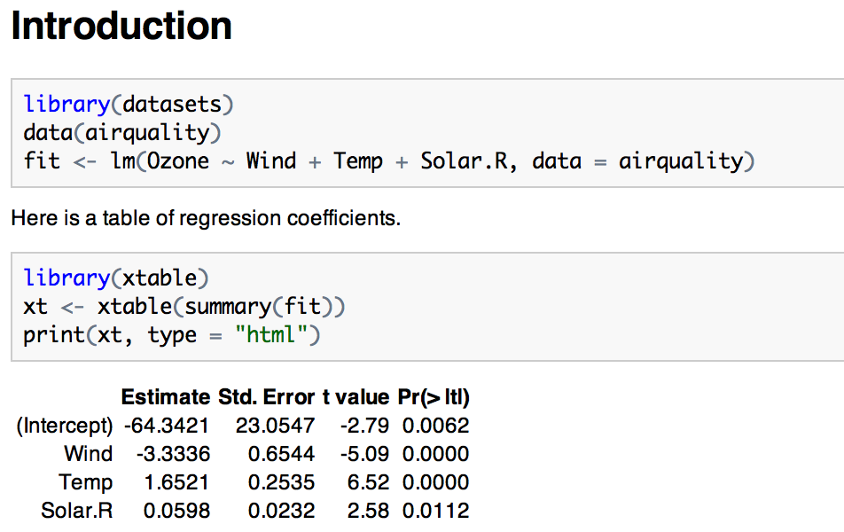
Making Tables with xtable

Slide 24
Setting Global Options
Sometimes we want to set options for every code chunk that are different from the defaults
For example, we may want to suppress all code echoing and results output
We have to write some code to set these global options

Slide 25
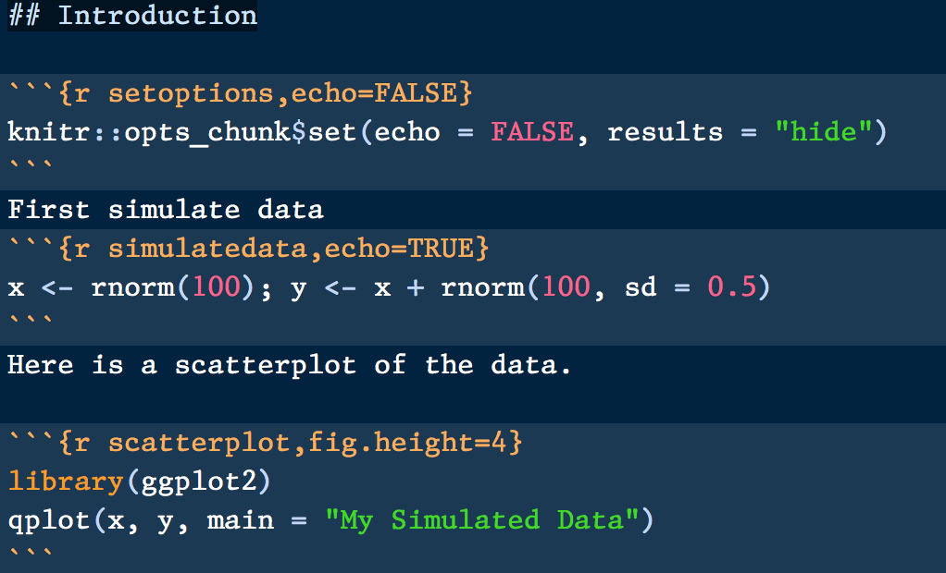
Setting Global Options
Set default to NOT echo code
Override default
Don’t echo code here

Slide 26
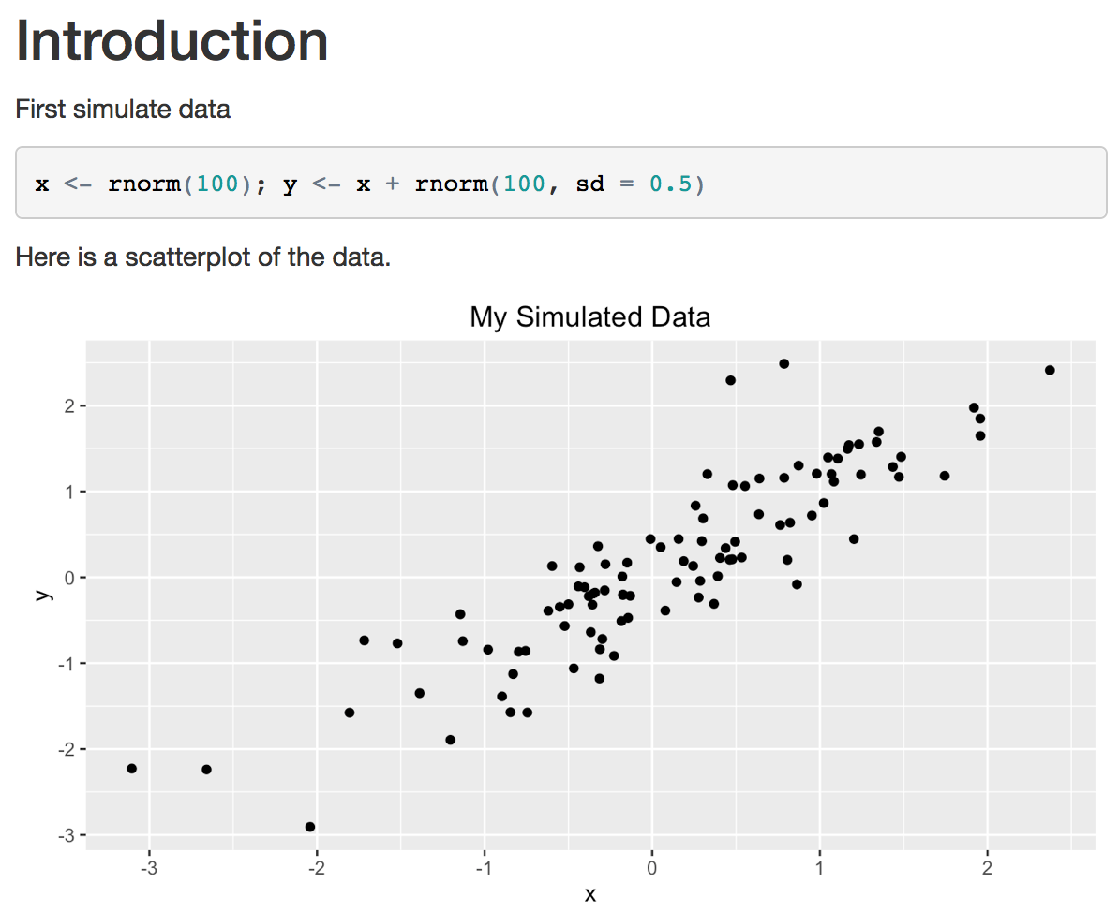
Setting Global Options

Slide 27
Some Common Options
Output
results: “asis”, “hide”
echo: TRUE, FALSE
Figures
fig.height: numeric
fig.width: numeric

Slide 28
Caching Computations
What if one chunk takes a long time to run?
All chunks have to be re-computed every time you re-knit the file
The cache=TRUE option can be set on a chunk-by-chunk basis to store results of computation
After the first run, results are loaded from cache

Slide 29
Caching Caveats
If the data or code (or anything external) changes, you need to re-run the cached code chunks
Dependencies are not checked explicitly
Chunks with significant side effects may not be cacheable

Slide 30
Summary
Literate statistical programming can be a useful way to put text, code, data, output all in one document
knitr is a powerful tool for integrating code and text in a simple document format

