Slide 1

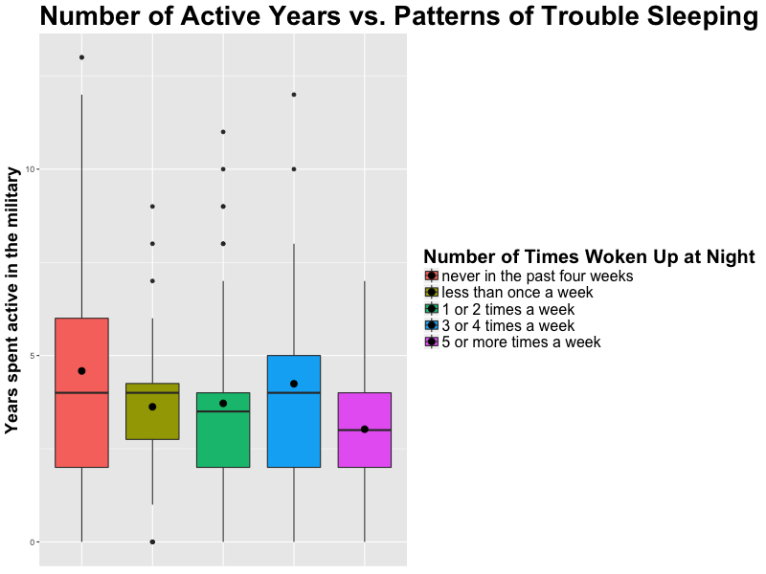
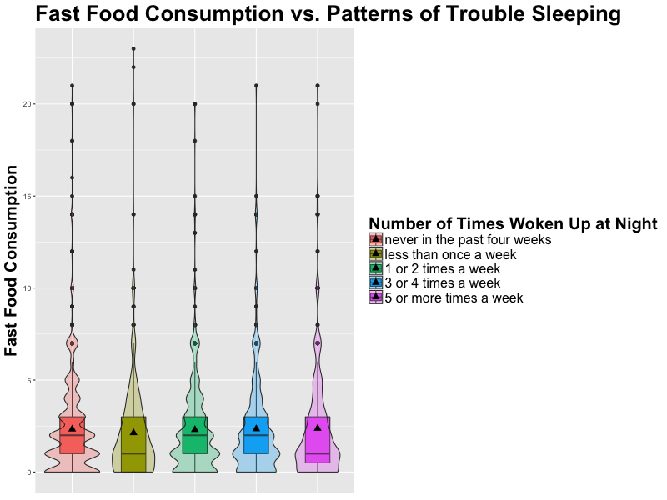
Do Lifestyle Patterns Lead to an Irregular Sleep Schedule
Perez, Juan M. ,Sandhu, Kubir
California State University, Chico
INTRODUCTION
RESULTS
CONCLUSION
Sleep is an essential part of maintaining a healthy lifestyle, studies show that different lifestyle choices can impact our health based on the change it causes to our sleep patterns (Adams, P. F., & Schoenburn, C. A., 2008). For the purpose of this study, military involvement and consumption of fast food were the most relevant to our focus. These factors were based on the current research that demonstrates a relationship between sleeping patterns and lifestyle choices.
When looking at current research insufficient sleep is greatly associated with increased caloric consumption, poor dietary habits, and obesity (Adams, P. F., & Schoenburn, C. A., 2008). Studies also show that deployment to combat significantly influenced sleep quality and quantity, personnel reporting combat exposures or mental health symptoms showed an increased chance to have trouble sleeping (Seelig, Amber, et al., 2010).
The purpose of this study was to identify lifestyle choices that severely impact participants sleep schedule by analyzing the data from the National Longitudinal Study of Adolescent to Adult Health survey Wave 4.
There seems to be a negative trend between the number of years served in the military and the number of times one wakes up in the middle of the night.
The more times a person woke up in the middle of the night was observed to come from those that served less military time.
We expected to see a positive trend in the regression analysis of number of years served in the military and trouble falling asleep. In other words, the more time someone woke up in the middle of the night was because they spent more years in the military. This was not the case, we speculate that in some cases the more time spent in the military, the higher rank you will achieve leading you to have less time in combat or in field. An interesting investigation can be done on this speculation as well as finding out exactly why those spending less time in the military are waking up more than those that served more time.
Upon conducting our test we saw that very few participants experienced a change in their sleeping patterns if they consumed fast food or served in the military. We found this to be interesting due to the fact that the research shows a completely different pattern that demonstrates that sleep deprivation leads people to consume higher calorie foods. Also it demonstrates that people who are deployed for the military tend to have issues with sleeping patterns.
Figure 1: Boxplot is demonstrating the relationship between years spend in the military and trouble sleeping.
Table 1: Referring to graph 1. Regression analysis of years served in military versus trouble sleeping.
Based on the results of our regression analysis the only significant relationship between times waking up in the middle of the night and years served in the military was in participants waking up 5 or more times a week, which served 1.65 years less in the military in comparison to those that did not wake up in the middle of the night (95% CI (-2.6,-0.7), p=.001).
Objective
# Times woken up at night. | Estimate | Std. Error | t-value | p-value
More than 1X a week. | -0.96 | .51 | -1.9 | 0.061
More than 1-2 week. | -0.87 | .48 | -1.8 | 0.074
More than 3-4week. | -0.34 | .55 | -0.62 | 0.53
More than 5+ a week. | -1.6 | .5 | -3.1 | 0.0018
IMPLICATIONS
METHODS AND MATERIALS
The results of this study could in fact be different from what the research states due to the fact that the survey we used to analyze these patterns may not provide us with an adequate representation of the lifestyle characteristic we analyzed.
Study began with the public use of the ADDHEALTH data wave IV.
ADDHEALTH is a survey based study aimed to start with adolescence.
Wave began in 1995 and concluded in 2008.
Of the fast food variable 1435 participants were omitted.
Data was analyzed in R- Studio, by graphing univariate and bivariate graphics, as well as analysis such as p-values.
A bivariate graphic was created in comparing trouble falling asleep and fast food consumption within a 7-day period.
A bivariate graphic was created in comparing years served in the military and trouble staying asleep.
For the years in active military versus sleep a Regression was conducted.
An ANOVA test was used to analyze fast food consumption and trouble falling asleep.
There is a consistent pattern among sleep and the times you wake up at night.
There is no correlation between how many times you consume fast food and how that effects your sleep (p=.363).
REFERENCES
Adams, P. F., & Schoenburn, C. A. (2008). Sleep Duration as a Correlate of Smoking, Alcohol Use, Leisure-Time Physical Inactivity, and Obesity Among Adults: United States, 2004-2006. Retrieved September 10, 2017, from https://pdfs.semanticscholar.org/9cf0/2879d31f2fd3ece4984f9156ca9d4cd0778b.pdf.2
Seelig, Amber et.al. “Sleep Patterns Before, During, and After Deployment to Iraq and Afghanistan.” Sleep, Volume 33, Issue 12, 1 December 2010, Pages 1615–1622, https://doi.org/10.1093/sleep/33.12.1615
Asarnow, Lauren D., et al. “ How many times in the past seven days did you eat food from a fast food restaurant Outcomes in a Nationally Representative Sample of Adolescents.” Journal of Adolescent Health, vol. 54, no 3, 2014, pp. 41-42, 168-173.
R Core Team (2013). R: A language and environment for statistical computing. R Foundation for Statistical Computing, Vienna, Austria. URL http://www.R-project.org/.
Figure 2: Violin plot demonstrating the relationship between consuming fast food and having issues falling asleep at night.

