Slide 1

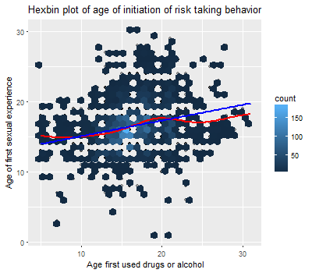
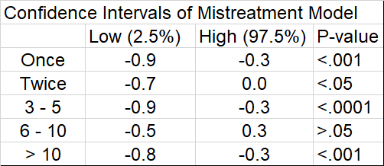
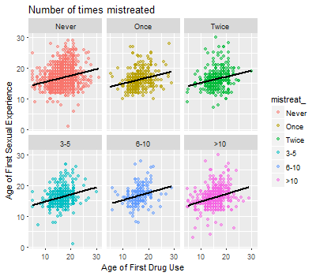
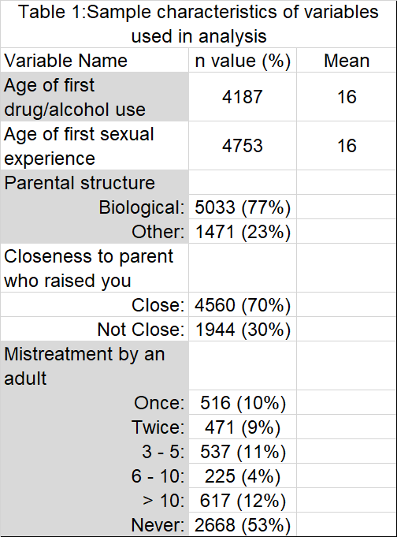
The association of parental structure and age of initiation
of adolescent risk taking behavior
Keck, S., Shilling, T.
California State University, Chico
Introduction
Discussion
Although researchers have found multiple variables associated with early adolescent risk taking behavior, there is little understanding of the parenting factors most salient for adolescent decision making. The present study attempts to better understand the association between initiation of two risk taking behaviors and whether certain family structure characteristics mediate this relationship. This study attempts to answer to two research questions: 1) Is age of first drug/alcohol use and age of first sexual experience related?; and 2) Which aspect of parental structure best predicts age of initiation of risk taking behavior in adolescents?
Results
Simple linear regression
The bivariate relationship indicates that age of first sexual experience and age of first drug/alcohol use are significantly related. Because of this, we predicted that the covariates would influence age of sex and drug/alcohol initiation similarly. When testing for potential moderators, we found that parental structure and closeness of parent-child relationship did not significantly change the relationship between age of first sexual experience and age of first drug/alcohol use. Mistreatment by adults proved to be a moderating variable. Overall, for every additional experience with mistreatment by adults, the age of first sexual experience decreased, compared to respondents who never experienced mistreatment by an adult. With the exception of the level of 6-10 experiences since the association was insignificant compared to people who never experienced mistreatment by an adult.
 | Estimate | Std. Error | t value | p value
Intercept | 13 | .23 | 56 | 0
Age_1 | 0.22 | .014 | 16 | 2.4e-58
Methods
Data Collection
Data obtained from the wave IV of the longitudinal Add Health Survey wave conducted 15 years following wave I, which took place from 1994-95. Wave IV data consists of 5114 respondents ranging in age from 24-32.
Age of first drug or alcohol use (Age_1): two variables combined by subsetting data and selecting the youngest observation of the two variables.
Age of first sexual experience (Age1_sex): one variable; no major recoding.
Parental structure (pstructure): two variables regarding bloodline relation of maternal and paternal parent figure. Combined and recoded as one binary factor variable indicating “Biological” or “Other” (non-biological) relation.
Relationship to parental figure (prelationship): two variables regarding closeness of relationship with maternal and paternal parental figures. Combined and recoded as one binary factor variable indicating “Close” or “Not Close.”
Mistreatment by adults (mistreat): one categorical variable grouped by number of times person was made to feel unwanted or unloved by an adult before the age of 18.
Analysis
Simple linear regression used to examine the relationship between age of first drug/alcohol use and age of first sexual experience. Multiple linear regression used to further examine the relationship between age of first sexual experience and three predictor/moderating variables including, parental structure, closeness of relationship to parent figure, and mistreatment by adults.
For every year older a person is for first time drug/alcohol use, their age of first sexual experience increases by .22 (95%CI: .20, .25, p-value < .0001).
There is a weak, positive, linear relationship between age first used drugs or alcohol and age first experienced sexual intercourse (r=.25).
Implications
The topic of our research question shows that parental structure and closeness of parent-child relationship did not significantly change the relationship between age of first sexual experience and age of first drug/alcohol use. The adversity of negative experience showed to be most significant in predicting the age of first sexual experience more readily.
Further research involving different types of mistreatment by an adult is needed to better understand adolescent decision making and the associated level/type of mistreatment experienced. For example- verbal, physical, and sexual mistreatment may be associated differently with the response variable and may vary in strength and direction of the relationship.
Figure 1. Hexbin plot used for a scatterplot alternative to create an accurate representation of the high density data. The intensity of the color is interpreted as the concentration of data points within a spatial area of the chart. The darker the color, the higher density of data point.
Multiple linear regression
One experience of mistreatment, age decreased by -.54 (p<.001)
Two experiences of mistreatment, age decreased by -.34 (p<.05)
3-5 experiences of mistreatment, age decreased by -.58 (p<.0001)
6-10 experiences, age decreased by -.06 (p>.05)
More than 10 experiences, age decreased by -.48 (p<.001).
Overall, for every additional experience with mistreatment by adults, the age of first sexual experience decreases, compared to respondents who never experienced mistreatment by an adult.
References
Bramlett MD, Radel LF. Adverse family experiences among children in nonparental care, 2011–2012. National health statistics reports; no 74. Hyattsville, MD: National Center for Health Statistics. 2014.
Fomby P, Cherlin AJ. Family Instability and Child Well-Being. American sociological review. 2007;72(2):181-204.
King V, Stamps KC, Hawkins DN. Adolescents with Two Nonresident Biological Parents: Living Arrangements, Parental Involvement, and Well-Being. Journal of family issues. 2010;31(1):3-30. doi:10.1177/0192513X09345833.
Langton CE, Berger LM. Family Structure and Adolescent Physical Health, Behavior, and Emotional Well-Being. The Social service review. 2011;85(3):323-357.
Pearson, J., Muller, C., and Frisco, M. L. (2006). Parental involvement, family structure, and adolescent sexual decision making. Sociological Perspectives, 49(1):67–90.
Wilder EI, Watt TT. Risky Parental Behavior and Adolescent Sexual Activity at First Coitus. The Milbank Quarterly. 2002;80(3):481-524.
Harris, Kathleen Mullan. 2009. The National Longitudinal Study of Adolescent to Adult Health (Add Health), Waves I & II, 1994–1996; Wave III, 2001–2002; Wave IV, 2007-2009 [machine-readable data file and documentation]. Chapel Hill, NC: Carolina Population Center, University of North Carolina at Chapel Hill. DOI: 10.3886/ICPSR27021.v9
Figure 2. Scatterplots of bivariate relationship stratified by levels of mistreatment by an adult.
Notes:
‹#›
Need to fix:
Add table of MLR with all covariates

