Slide 1

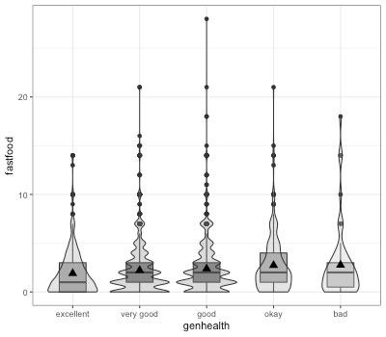
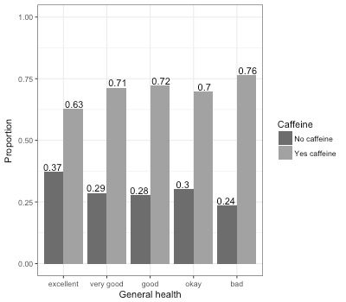
Examining the Association Between Caffeine Consumption
and General Health
Dara Stroup and Kaylee White
Math 315 Applied Statistics, Section 01 Fall 2017, California State University, Chico
Delete me & place your
LOGO
in this area.
Delete me & place your
LOGO
in this area.
Introduction
Bivariate Results
Multivariate Results
Conclusion
When talking about caffeine, have you been told that it is good or bad for you? In today's world we often get mixed reviews and easily misinformed by the media. Previous studies conducted regarding a correlation between caffeine consumption and the general health of the consumer or the non-consumer have shown a significant correlation between high caffeine intake resulting in poor general health, and low caffeine intake resulting in patients with good general health (Richards & Smith 2016).
With this mixed view and the variety of data received, the goal of this research question is to discover the trends between how someone views their overall health and if they consume caffeine regularly.
Analysis Of Variance
Logistic Regression
After adjusting for the potential confounding factor of fast food consumption, caffeine consumption (1.018, CI 0.832-1.253, p <.05) was significantly and positively associated with the likelihood of being in good general health.
In this analysis, the odds ratio tells us that those who consumed caffeine in the last 24 hours are 1.02 times more likely to perceive themselves to be in good general health.
Based on these analyses, fast food consumption is a confounding factor because the association between caffeine consumption and general health is significant after accounting for fast food consumption.
General Health vs Fast Food
Table 1. Logistic Regression controlling for caffeine consumption and fast food consumption.
 | OR | LCL | UCL | P-value
Drank Caffeine (past 24 hrs) | 1.02 | 0.83 | 1.25 | 0.89
Ate Fast food (past week) | 1.30 | 1.03 | 1.65 | 0.03
After controlling for fast food consumption, caffeine consumers have 1.02 times the odds of reporting poor general health compared to non caffeine consumer.
After controlling for caffeine consumption, fast food consumers have 1.30 times the odds of reporting poor general health compared to non fast food consumers.
Fast food is a stronger predictor of general health than caffeine consumption.
Figure 1. Violin plot of General Health vs Fast Food Consumption
Figure 1. Average amount of fast food consumed over a 7 day period is associated with the different levels of general health perception. Those who view their health to be excellent, consume fast food an average of 2.0 times per week SD(2.78). Those who view their health to be good consume fast food an average of 2.47 times per week SD(2.92). Those who perceive their overall health to be okay consume the most fast food throughout the week with an average of 2.8 times SD(3.01). Overall those who view their health to be good visit fast food on average .33 times less a week than those who view their health to be okay.
Research Question
Do people who view their health to be good or excellent consume tend to drink caffeine more than those who view their health to be less than good or excellent?
Implications
Measures
Results cannot determine how amount of caffeine consumed, amount of fast food consumed has any effect of general health as both we binary, “yes” or ”no” questions.
Also, types of caffeine consumed may have an effect on general health, for example consume black coffee versus energy drinks or sweetened beverages.
General Health: Individual’s perception of their general health. Responses ranged from excellent to poor.
20% excellent, 38% very good, 33% good, 8% okay, 1% bad.
Caffeine: Whether caffeine was consumed over the last 24 hours.
30% did not consume caffeine, 70% consumed caffeine.
Fast Food: The number of times an individual consumes fast food over a 7 day period. Mean=2.264. Any value larger than 30 was removed.
Data was analyzed by running chi-square and logistic regression tests using RStudio.
Chi-Square
General Health and Caffeine Consumption
Discussion
After initially comparing the proportion of caffeine consumers and non caffeine consumers to their respective general health levels, and finding a significant association between the two, an association was then found between the number of times an individual visits a fast food restaurant over a 7 day period and their perceived general health.
When controlling for caffeine consumption, it was found that those who consume fast food are more likely to report poor general health than non fast food consumers.
References
(
Richards, G., & Smith, A. P. (2016). Caffeine Consumption and General Health in Secondary School Children: A Cross-sectional and Longitudinal Analysis. Frontiers in Nutrition, 3, 52. http://doi.org/10.3389/fnut.2016.00052
Harris, Kathleen Mullan. 2009. The National Longitudinal Study of Adolescent to Adult Health (Add Health), Wave IV, 2007-2009 [machine-readable data file and documentation]. Chapel Hill, NC: Carolina Population Center, University of North Carolina at Chapel Hill. DOI: 10.3886/ICPSR27021.v9.
RStudio Team (2016). RStudio: Integrated Development for R. RStudio, Inc., Boston, MA URL http://www.rstudio.com/.
R Core Team (2017). R: A language and environment for statistical computing. R Foundation for Statistical Computing, Vienna, Austria. URL https://www.R-project.org/.
(
Figure 2. Proportion of general health levels who did and did not consume caffeine in the last 24 hours.
Data Analyzed
National Longitudinal Add Health Wave IV Survey
Consisted of 6.504 observations ages 24-32
Figure 2. A consistently larger proportion of people who did consume caffeine over the 24 hour period for all levels of perceived general health.
There is sufficient evidence to conclude that the average amount of fast food consumed over a 7 day period is associated with different levels of general health perception (p<.05).
dstroup@mail.csuchico.edu, Kwhite47@mail.csuchico.edu

