Slide 1



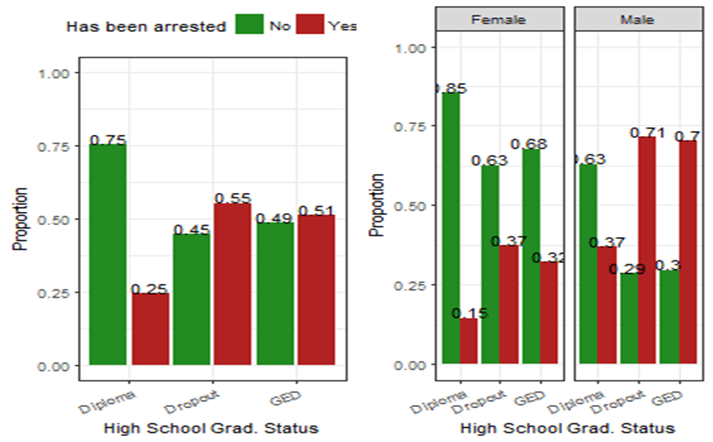
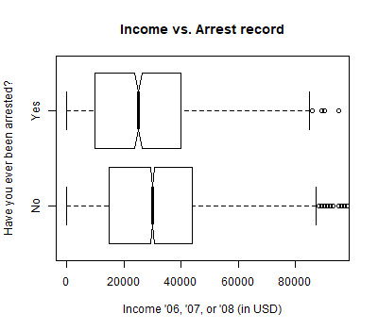
Associations Between Criminal Activity, Economic Status, and Education
Is it more likely for a person who graduated high school to stay out of trouble with the law, compared to someone who dropped out? Are those who have been arrested more likely to have low income, as compared with those who haven’t? Our research looks into the connection between level of education, level of income, and overall education status for respondents to the AddHealth Wave IV study
Edward Brown, and John Selzer
INTRODUCTION
SAMPLE CHARACTERISTICS
CONCLUSION
Is it more likely for a person who graduated high school to stay out of trouble with the law, compared to someone who dropped out? Are those who have been arrested more likely to have low income, as compared with those who haven’t?
Our research looks into the connection between level of education, personal income, and overall education status for respondents to the AddHealth Wave IV study.
How many people
The Add Health Wave IV data set contains survey responses from 6504 people.
What gender
2353 men (36.2%)
2761 women (42.5%)
1390 NA values (21.7%)
What age
Aged 24 to 32
What ethnicity
71.9% white
24.3% black
3% asian or pacific islander
0.8% native american or alaskan native
Our graphical and inferential results tell us that there is an association between number of arrests and personal income, and between high school graduation status and arrest record. This association is significantly moderated by gender.
Our research supports the hypothesis that population with more education, is less likely to be arrested. Those who have received a diploma have a much smaller chance of getting arrested (25%), than do dropouts (55%).
The overall trend of the data, is that those who have received a high school diploma, have a smaller tendency to be arrested, and a better financial outlook, than those who dropped out, or earned a GED or certificate.
Previous research has shown that more education leads to reduced crime (Lang et al, 1989).
METHODS
RESULTS
For our analysis, we used the Add Health Wave IV data set. The variables we examine focus mainly on comparison with the binary variable “Ever Been Arrested”. The other variables that we examine, in comparison with “Ever Been Arrested”, include “High School Graduation Status”, “Level of Education”, and “Self-reported Personal Income”.
Ever been arrested
Answers were reduced to 0 and 1, being “No” and “Yes”
High school graduation status
Answers were recorded as factors in the range from 1 to 4, which we reduced to three final groups consisting of individuals who obtained a GED or Certificate of Completion, graduated with a diploma, or dropped out.
Personal Income
Responses had a wide range, from $0 to almost $1,000,000 (USD).
Any individuals who earned above $100,000 were recoded as NA. This allows us to make more meaningful graphs from the data, as they are not skewed heavily by the large outliers in the $1 million range.
Gender
Male and Female were originally coded as 0 or 1. We changed it to a factor of “Male” and “Female”
We tested Gender as a moderator, for the relationship between graduation status and crime, and found that it had a significant moderating effect on crime, when compared across graduation status
IMPLICATIONS
The knowledge that people with more education are less likely to have trouble with the law could be a great motivator for students, and those who work in education.
Gender being a moderator indicates that efforts focused specifically on young males might be especially helpful.
Further research to solidify our topic could include; comparing the GPAs of students who have been arrested to those who haven’t, including data on the subjects’ upbringing, the further categorization of types of crimes committed.
REFERENCES
Machin, S., Marie, O., & Vujić, S. (2011). The Crime Reducing Effect of Education*. The Economic Journal, 121(552), 463-484. doi:10.1111/j.1468-0297.2011.02430.x
Lang, R. E., & Kahn, J. V. (1989). Effects of an Experimental Special-Education Crime-Prevention Intervention: A Time-Series Study. Journal of Clinical Child Psychology, 18(3), 263-270. doi:10.1207/s15374424jccp1803_10
Lochner, L. (2011). Non-Production Benefits of Education: Crime, Health, and Good Citizenship. doi:10.3386/w16722
Walters, G. D. (2013). Delinquency, parental involvement, early adult criminality, and sex: Evidence of moderated mediation. Journal of Adolescence, 36(4), 777-785. doi:10.1016/j.adolescence.2013.03.011

