Slide 1

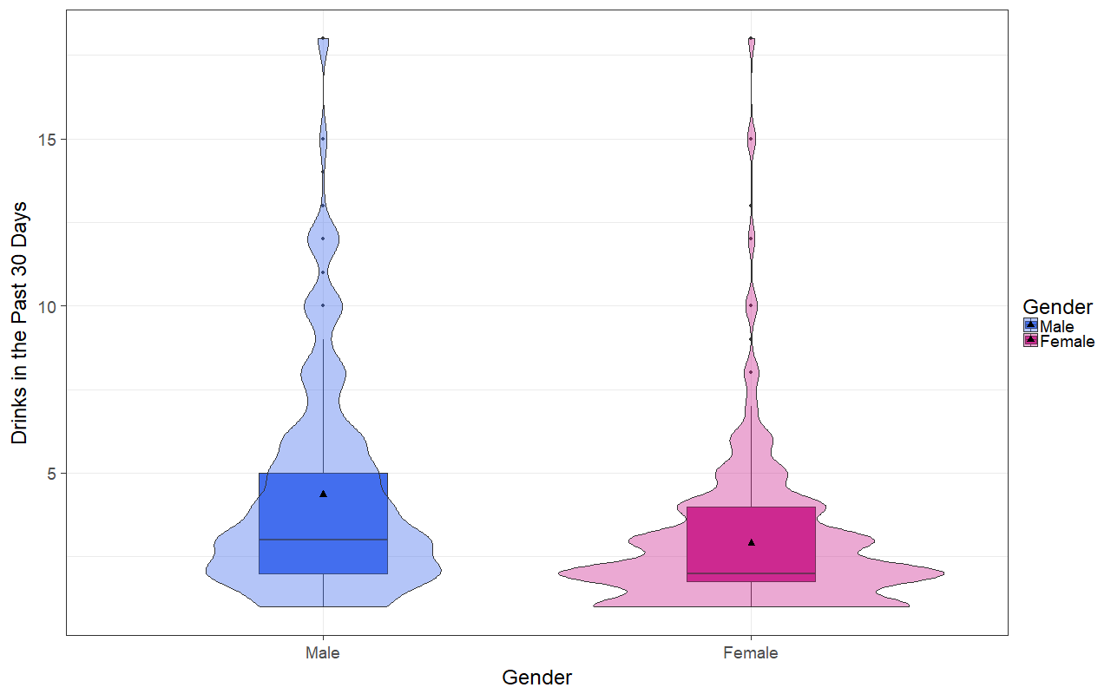
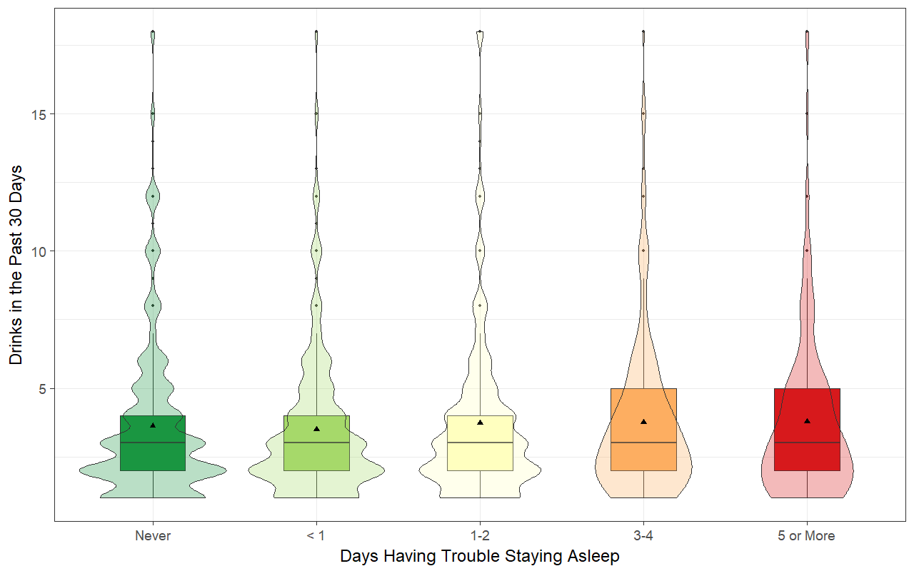
Alcohol consumption and its relationship to sleep quality
Estrada, C., Matson, L. | MATH 315 | Section 1| CSU Chico | Undergraduate
Introduction
Results
Conclusions
Alcohol has been shown to not only be addictive and cause physiological harm, but it can also interfere with sleep quality¹. Unlike the obvious detrimental effects alcohol has on the body, it’s effects on sleep are less conspicuous. Studies have shown that those who regularly drink alcohol get less sleep, do worse in work/school, and are prone to consuming more alcohol². Previous research has also shown that alcohol can have damaging effects on sleep years after abstaining from the drink². With most people in the United States regularly drinking alcohol, it is important to better understand the damage alcohol can inflict through poor sleep quality. The purpose of this project is to use data from the Addhealth: Wave IV codebook to determine if alcohol consumption has an impact on the sleep quality of the consumer.
The goal of this study was to examine the relationship between alcoholic drinks consumed when individuals drank in the past 30 days and trouble staying asleep.
According to our results there is a significant relationship between gender and the number of alcoholic drinks had everyday respondents consumed alcohol in the past 30 days.
Contrary to previous research, no significant relationship was observed between the number of drinks a respondent had in the past 30 days and the number of days respondents had trouble staying asleep.
However, the last time respondents had an alcoholic drink showed a significant relationship with the respondent’s wake up time. The linear regression model showed a slightly negative correlation with respondents waking up earlier the later they had an alcoholic drink.
After accounting for the possible cofounding factor of gender in the association between last drink time and wake up, we found gender to not be a cofounder as the relationship was still significant.
Alcoholic Drinks in the Past 30 Days
Research Question
Figure 1: T-test showed that there is a significant relationship between gender and the number of alcoholic drinks had every day respondents consumed alcohol in the past 30 days. Males drank 1.48 more drinks than females (95% CI (1.25, 1.66), p-value<0.0001). Males had an average of 4.36 alcoholic drinks in the past 30 days, which is more than the average of 2.90 for females. Males also had more variation in the number of drinks they consumed in the past 30 days. Both male and female distributions are right skewed.
Is there a relationship between days having trouble staying asleep and the number of drinks in the past 30 days?
Methods
Implications
Data used was gathered by Respondents from the National Longitudinal Study of Adolescent Health Wave IV (AddHealth)³.
Analysis and models were obtained using R Studio⁴.
The T-test was used to determine a difference, if any, between males and females and the number of alcoholic drinks had every day respondents consumed alcohol.
We conducted an analysis of variance (ANOVA) to test for a relationship between the number of days respondents had trouble staying asleep per week and the number of alcoholic drinks consumed in the past 30 days every day respondents drank alcohol.
A multiple linear regression was conducted to test gender as a confounder to the relationship between the last time respondents had an alcoholic drink and their wake up time.
Both wake up time and last alcoholic drink time variables were recoded as to display a 24-hour time interval.
Trouble Staying Asleep vs Drinks in the Past 30 Days
Alcohol problems have cost the United States an estimated $184.6 billion in 1998, with alcohol-related insomnia making up about $18.5 billion¹.
Exploring the relationship between alcohol intake and sleep quality is important to better help those affected by alcohol’s detrimental effects.
It is important to take into account the influence the wide range of variables that cannot be controlled when looking into the effects of alcohol on both the body and mind.
This study was limited by the fact that Addhealth is based on an extensive questionnaire, which may lead to some unreliable information and which does may not take into account most external variables that may influence results. .
Even studies in which laboratories were used to perform observations of alcohol and it’s effects on REM sleep must take into account uncontrollable variables, making these endeavors to understand alcohols physical and mental effects difficult to pin down⁵.
Future research can help us further understand the effects alcohol can have on sleep quality by controlling for possible confounding variables, such as BMI and age,.
Figure 2: ANOVA showed no significant relationship between the number of drinks a respondent had in the past 30 days and the number of days respondents had trouble staying asleep (p>0.0001).
Sample Characteristics
Table 2: After adjusting for the potential confounding factor of gender, last drink time (b1=-0.068, 95% CI: (-0.09, -0.05), p<0.0001) was significantly and negatively associated with wakeup time. Approximately 3.6 % of the variance of wake up time can be accounted for by the last drink time after controlling for gender. Gender is not a confounder (p<0.0001).
Table 1.
References
1. Brower, Kirk J. “Alcohol’s Effects on Sleep in Alcoholics.” Alcohol research & health: the journal of the National Institute on Alcohol Abuse and Alcoholism 25.2 (2001): 110-125. Print.
2. Oscar-Berman, M., & Marinković, K. (2007). Alcohol: Effects on Neurobehavioral Functions and the Brain. Neuropsychology Review, 17(3), 239–257. https://doi.org/10/1007/s11065-007-9038-6
3. Harris, Kathleen Mullan. 2009. The National Longitudinal Study of Adolescent to Adult Health (Add Health), Waves I & II, 1994–1996; Wave III, 2001–2002; Wave IV, 2007-2009 [machine-readable data file and documentation]. Chapel Hill, NC: Carolina Population Center, University of North Carolina at Chapel Hill. DOI: 10.3886/ICPSR27021.v9.
4. R Core Team (2017). R: A language and environment for statistical computing. R Foundation for Statistical Computing, Vienna, Austria. URL https://www.R-project.org/
5. Ebrahim, I. O., Shapiro, C. M., Williams, A. J. and Fenwick, P. B. (2013), Alcohol and Sleep I: Effects on Normal Sleep. Alcohol Clin Exp Res, 37: 539‘-549. doi:10.1111/acer.12006 2.

