Slide 1
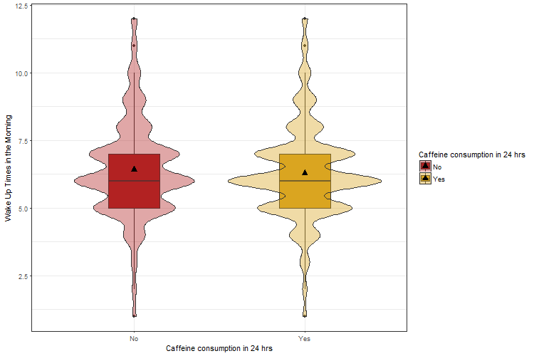
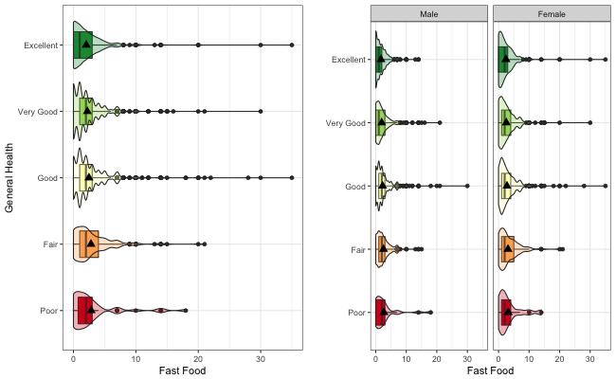

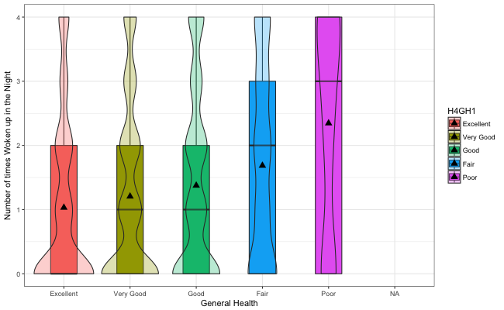


Analyzing the Correlation Between General Health and Sleep Patterns
Rodriguez L. and McColm T.
California State University, Chico – Math 315 - 01
Introduction
Results
Conclusion
Is there a relationship between an individual’s general health and overall sleep quality? Sleep is an essential part life, in order to ensure a higher quality of overall health. Lack of sleep is known to have effects on the ability to perform daily functions. We hypothesized that individuals categorized as “Healthy” would ultimately show greater sleep quality than compared to those categorized as “Unhealthy”. This research will be providing possible factors that may contribute to sleep patterns. Specifically, the purpose of this research is to identify correlations between general health and sleep patterns/quality.
Figure 1: The graph above shows the relationship between caffeine consumption and times woken up in the morning.
We observed the relationship between caffeine consumption and times woken up in the morning. As shown in the Figure 1, there is a relationship between the two variables. What is shown is that the individuals whom said they had consumed caffeine in the last 24 hours woke up more often earlier in the morning than those who said they did not. Individuals who drank caffeine in the past 24 hours have a higher density around times ranging from 5 am to 7:30 am. We also performed a two sample t-test obtaining a p-value of 0.01955. More individuals wake up early in the morning when consumed caffeine during the past 24 hours.
Figure 2. The graph above displays the distribution of responses between the number of times an individual wakes up within each general health category.
The variables chosen for this graph were General Health as the categorical explanatory variable and Times Woken Up as the quantitative response variable. Based on the graph, we observed that the individuals with "Fair" and "Poor" health rates tend to show slightly higher frequencies of waking up in the night compared to individuals with "Good" to "Excellent".
Figure 3. The graph above displays a conducted analyses of a moderator variable.
The graph displayed above involved running an ANOVA test on three variables collected from the “Add Health: Wave 4 In-Home Interview Code Book”. We observed if the relationship between two variables could potentially be dependent on a third (the moderator). The selected variables included: General Health as the Categorical explanatory variable, Fast Food as the Quantitative response variable, and Gender as the Categorical Potential Moderator. Ultimately we examined if gender influenced the relationship between fast food consumption per week and an individual's personal view of health.
Table 1. The table above describes the relationship between average fast food consumption rate for male and female displays an increasing trend. As perceived, fast food intake increased as general health decreased for both groups. Fast food consumption increased within each health category for both male and female, with females displayed higher ratings.
After conducting a series of analysis, several relationships were observed between general health habits and sleep patterns. Certain factors like caffeine and fast food consumption have shown to have an affect towards sleep quality and sleep patterns. Other factors such as how much physical activity is performed during the day and general health can also contribute to sleep patterns and overall sleep quality.
People can often disregard and overlook just how general health can relate to their quality of sleep. Lack of sleep and poor health have shown to have a direct relationship with each other.
Based on our findings, there was significant evidence to support the original claim; there is a correlation between general health and an individual’s sleep quality. We were successful in finding significant evidence for supporting the main argument, that “Healthy” respondents have a higher quality of sleep than those considered to be “Unhealthy”. Our collected results could potentially serve researchers information on how to monitor and/or analyze the correlation between an individual’s general health and their overall quality of sleep.
Methods
Sample Characteristics:
Survey size: 7,159 males and 6,655 females, ages 24 to 32
“Healthy” : 4,625 participants
“Unhealthy” : 489 participants
Measures:
Data obtained from sections general health and sleep patterns in the Add Health: Wave 4 In-Home Interview Code Book
Responses like “don’t know” or “refuse” were omitted from the obtained data to get better results.
Several variables were examined including caffeine consumption, the amount of times woken up, and view of general health.
Performed analyses and used univariate, bivariate, as well as multivariate graphics to examine any correlations between selected variables.
Displayed graphics and tests were obtained using R studio.
References
St-Onge, M., Mikic, A., & Pietrolungo, C. (2016). Effects of Diet on Sleep Quality. Europe PMC.
Chaput, J. (2014). Sleep patterns, diet quality and energy balance. Physiology & Behavior, 134, 86-91.
Crispim, C. A., Zimberg, I. Z., Reis, B. G., Diniz, R. M., Tufik, S., & Mello, M. T. (2011). Relationship between Food Intake and Sleep Pattern in Healthy Individuals. Journal of Clinical Sleep Medicine.
Contact information:
Linda Rodriguez:
lrodriguez52@mail.csuchico.edu
Tara McColm:
tmccolm@mail.csuchico.edu

