Slide 1

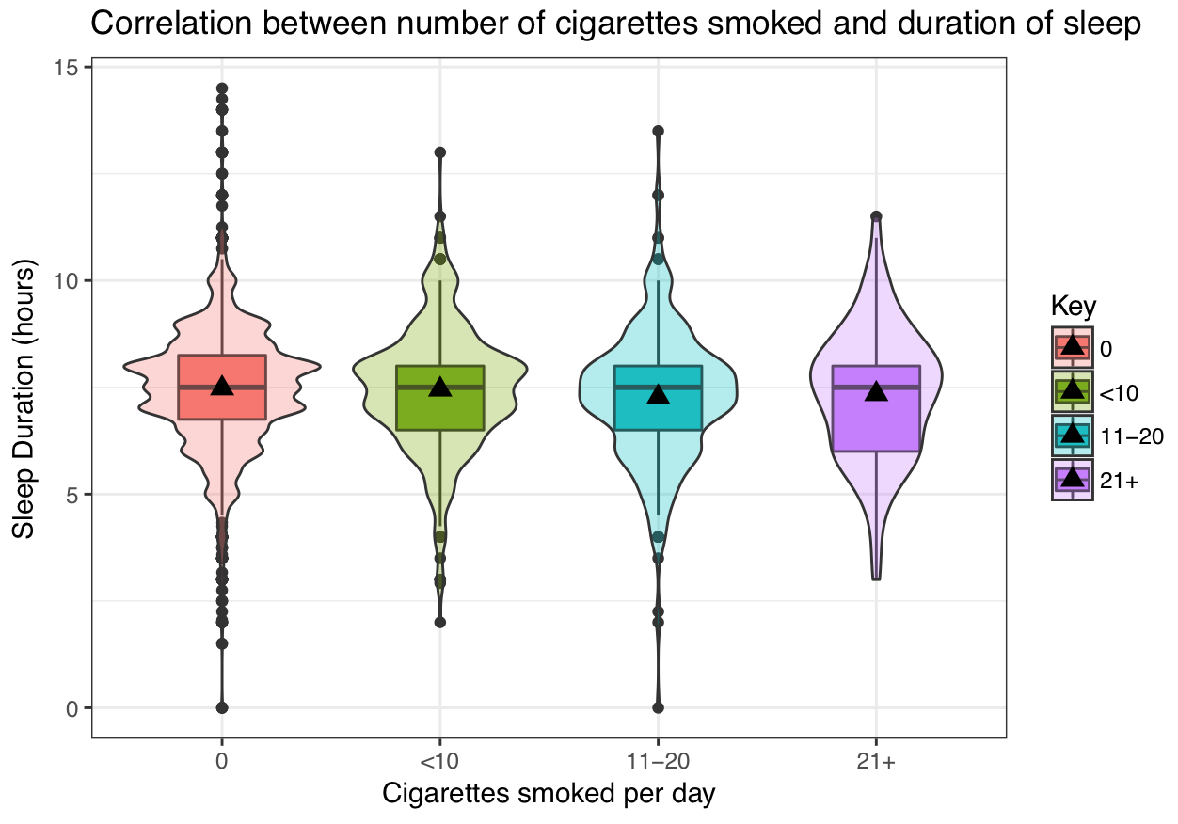
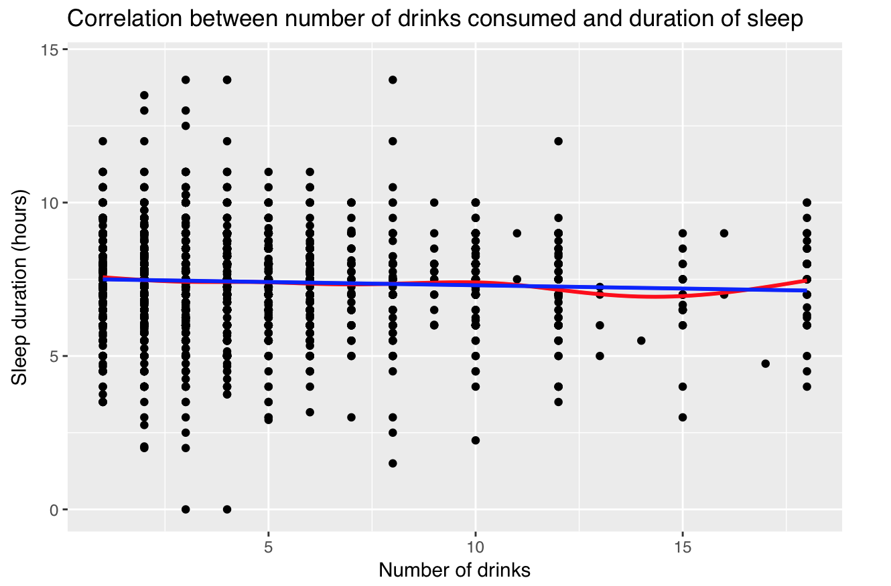
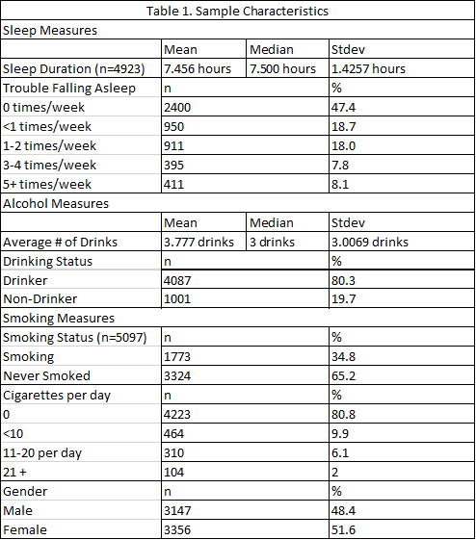
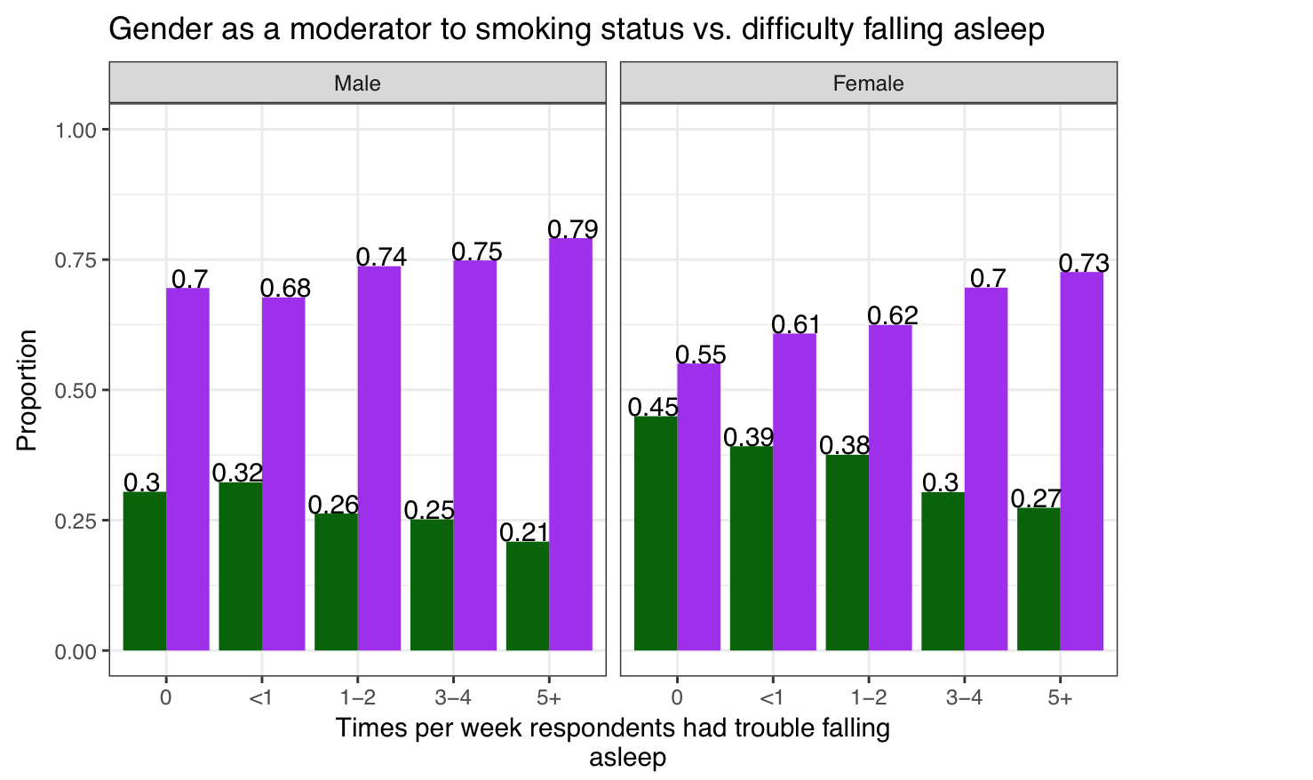


The Association Between Alcohol and Cigarette use with Sleep Duration and Quality
Mann, R., Moore, T., Rowe, R.
California State University, Chico - MATH 315 applied statistics 01 - fall 2017, section 01
Introduction
Results
Discussion
Insomnia is one of the most common sleep disorders in the world, and it’s estimated to affect up to 60 million Americans. Is this merely a natural occurrence, or are there habits among humans that deprive them of their sleep? The effects of both cigarettes and alcohol consumption on sleep quality are not clearly established. If alcohol and tobacco consumption are shown to be correlated with insomnia, then a better understanding of this relationship could stand to benefit the 60 million of those who suffer.
Alcohol, when used in moderate quantities, appears to initially increase the ease of falling asleep. The relationship becomes less clear when examining sleep duration and alcohol consumption, especially once alcohol consumption becomes excessive. One study found no significant difference between individuals that drank and those that did not in regards to the duration of sleep (Pavlovic, 2014).
The studies that have attempted to connect alcohol and cigarette use with sleep often do so individually and rarely compare both. Many studies fail to use consistent definitions of what they consider adequate amounts of sleep (Stein, 2005).
In our previous research, we learned that nicotine from cigarettes could suppress and shorten the duration of REM-sleep, which may also lead to an overall reduction in sleep duration. Researchers also found that chronic smokers typically had insomnia and nightly awakenings due to nicotine’s cravings. (Dieter, 2009)
However, most of our graphics have been showing little to no trend when sleep duration is compared to the number of cigarettes smoked and alcohol consumption (Figures 1 and 2).
In an ANOVA of duration of sleep compared to the number of cigarettes smoked per day, we found insufficient evidence that the number of cigarettes smoked per day correlated with a shorter duration of sleep, contrary to what we found in our research. We saw no significant trend in this graph (Figure 1).
When comparing people who have smoked and those that have never smoked, we saw very little correlation to sleep duration, as they appeared to get around the same amount of sleep in our two sample t-test for independent groups. This could very well be due to many of those that have smoked, never smoked again.
We also performed a Chi-squared test of association between smoking and how often people had trouble falling asleep. In this test we found significant evidence that this was the case. Users that smoked saw an upward trend in how often they had trouble falling asleep while non-smokers had a downward trend in how often they had trouble falling asleep (Figure 3).
This correlates to our research that states that nicotine can inhibit sleep and cause other problems that can make it harder to fall asleep. It was explained that nicotine, found in cigarettes, caused sleep disturbances because it “stimulates the release of sleep regulating neurotransmitters.”(Sabanayagam, 2010)
In studies done on alcohol it was found that, when used in small doses, alcohol would actually help people fall asleep sooner if used less than twice a week. However, heavy users would find it harder to fall asleep and would have more issues that inhibit sleep such as: heartburn, sleepwalking,snoring, and high blood pressure.(Stein, 2005)
When looking at alcohol, we performed a correlation analysis on the duration of sleep and the number of drinks consumed when the respondent went out on a night to drink. We found that there was a negligible negative correlation between drinks consumed and the duration of sleep received (Figure 2). This did not seem like the research we found on alcohol, much at all. We just saw a slight downward trend the more that people drank.
We also performed Chi-squared tests of association between whether a person drinks or not and the amount of times they have trouble falling asleep and staying asleep. We found no significant relationship.
Bivariate Analysis
Research Questions
Does cigarette usage result in a reduced quality of sleep and sleep duration?
Does alcohol usage result in a reduced quality of sleep and sleep duration?
Figure 1.
Using ANOVA, we found that there is not a significant relationship between the amount of cigarettes a person smokes and the amount of sleep that they get.
Figure 2.
Using a correlation analysis we determined that there was a statistically significant and negligible negative correlation between the amount of drinks an individual has when they drink and the duration of sleep they receive.
Sample Characteristics
Multivariate Analysis
Conclusion
The data set being examined is the Wave IV public survey use file that contains 5114 respondents, aged 24 to 32.
This cohort consists of a percentage of the nationally representative sample of individuals that were originally interviewed in 1995 as adolescents and later located for the Wave IV interview.
The respondents were composed of a representative sample of individuals living in the United states.
Respondents were asked many different questions such as: how often they had slept, whether or not they have done drugs, how their overall health was, etc.
The interviews took place between 2008 and 2009.
Comprised of 48.4% female and 51.6% male participants
After performing bivariate analyses, we tested to see whether gender was a moderator or confounder to any of the relationships used in our analysis. We did not find gender to be a significant confounder or moderator to any of the relationships tested. However, Figure 3 shows that gender influenced the strength of the relationship tested.
We found little correlation between cigarettes and sleep duration in our ANOVA test, but found significant evidence between cigarette usage and sleep quality in our Chi-squared test. With this information we can conclude that cigarettes are associated with a decline in sleep quality, the more that respondents smoke per day. However, cigarette usage does not appear to have an effect on sleep duration. We ran a correlation analysis between number of drinks consumed and duration of sleep and found a significant negligible negative correlation between the two variables. In our Chi-squared association test between whether a person drinks and the amount of times they have trouble falling asleep, we found no significant relationship. With this information we can conclude that alcohol has a negative effect on sleep duration but no effect on sleep quality.
Implications
The results of our statistical tests on the Wave IV sample show that the more cigarettes a person smokes, the less sleep they will get and the more trouble they will have falling asleep.
These results imply that if a person is having trouble sleeping, it could be a result of smoking cigarettes.
Further research should be conducted that closely monitors precise alcohol and cigarette consumption on a daily basis over the period of several months. This could be used in conjunction with a daily sleep log to examine the relationship between the substances use and sleep duration over a long period of time. If this was conducted at a large enough scale with sample representative of the U.S. population, health care officials may be able to treat patients suffering from insomnia more effectively.
Methods
References/Acknowledgements
The data set being examined is the Wave IV public use file that contains 5114 respondents, aged 24 to 32. The analysis of this data involved utilizing: ANOVA, t-tests, Chi-squared tests, and correlation inferences to determine if there is a significant relationship between smoking and sleep or alcohol and sleep.
DiBonaventura, M., Richard, L., Kumar, M., Forsythe, A., Flores, N., & Moline, M. (2015). The Association between Insomnia and Insomnia Treatment Side Effects on Health Status, Work
Productivity, and Healthcare Resource Use. PLoS One, 10(10), PLoS One, Oct 2015, Vol.10(10).
Dieter, R. et al. (2009). Effects of nicotine on sleep during consumption, withdrawal and replacement therapy. Sleep Medicine Reviews, 13(5), 363-77
Harris, Kathleen Mullan. 2009. The National Longitudinal Study of Adolescent to Adult Health (Add Health), Waves I & II, 1994–1996; Wave III, 2001–2002; Wave IV, 2007-2009. Chapel
Hill, NC: Carolina Population Center, University of North Carolina at Chapel Hill. DOI: 10.3886/ICPSR27021.v9.
Pasch, K., Latimer, L., Cance, J., et al. (2012). Longitudinal Bi-directional Relationships Between Sleep and Youth Substance Use. Journal of Youth & Adolescence, 41(9), 1184-1196.
Pavlović, Marko & Đinđić, Boris. (2014). Alcohol Consumption Habits And Sleep Quality. Acta Medica Medianae, 53(2), 10-15.
RStudio Team (2015). RStudio: Integrated Development for R. RStudio, Inc., Boston, MA URL http://www.rstudio.com/.
R Core Team (2017). R: A language and environment for statistical computing. R Foundation for Statistical Computing, Vienna, Austria. https://www.R-project.org/.
Sivertsen, Skogen, Jakobsen, & Hysing. (2015). Sleep and use of alcohol and drug in adolescence. A large population-based study of Norwegian adolescents aged 16 to 19 years. Drug and
Alcohol Dependence, 149, 180-186.
Stein, M. D., & Friedmann, P. D. (2005). Disturbed Sleep and Its Relationship to Alcohol Use. Substance Abuse: Official Publication of the Association for Medical Education and Research
in Substance Abuse, 26(1), 1-13.
Sabanayagam, Charumath, and Anoop Shankar. (2010). The Association between Active Smoking, Smokeless Tobacco, Second-Hand Smoke Exposure and Insufficient Sleep. Sleep
Medicine, 12(1), pp. 7-11.
Contact: rmann3@mail.csuchico.edu
Figure 3.
Using the Chi-Square test, we determined that there is a significant relationship between whether a person smokes or not and the amount of times that person has difficulty falling asleep.
The trend shows that people who have trouble falling asleep more often are more likely to have smoked.
Using a moderator test, we found that this relationship is much stronger in females than it is in males, though both genders show significant trends.

