Slide 1


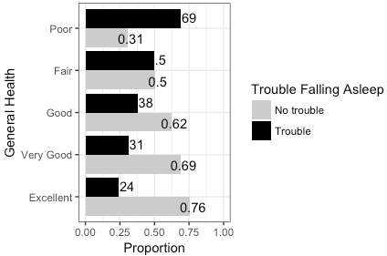
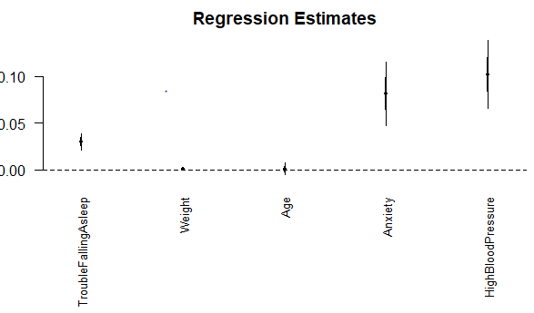

The Association Between Quality of Sleep and General Health
Rudy, R., Coia, V.
California State University, Chico
Fall 2017 Math 315-02
Introduction
Methods
Graphical Results
Conclusion
Sleep is a vital process our bodies need in order to maintain well-being. Not only does a lack of sleep cause us to feel exhausted and unable to properly function throughout the day, it affects our mood as well. The amount of sleep one gets has been proven to affect their mood often times negatively until they get more sleep, as well as increased weight gain if not enough sleep (Winter, 2017). Sleep however may be affecting us even greater than just a bad mood, a lack of sleep specifically could be detrimental to our actual health.
Sleep allows the brain to function properly by regaining all the energy to process normally. This is specifically important for students who spend all day at school, all night doing homework, then sleeping very little and doing it all over again. It has been proven that students who sleep the recommended 8+ hours do better on tests, have an easier time focusing in class, and get overall better grades. Sleep deprivation has been linked to substantially deteriorated performance as opposed to enough sleep (Chua, 2017).
The research hypothesis for this experiment is there is an association between quality of sleep and general health.
The data set used for this research was the National Longitudinal Study of Adolescent to Adult Health (Add Health) data set, specifically wave IV.
The specific variables chosen for this experiment were trouble falling asleep, which was made into a binary variable, and general health. Each numerical value was labeled for both variables.
Age, Anxiety, and High blood pressure were also cleaned and tested. Age was found by subtracting when the study was conducted by the year born. Anxiety and HBP were turned into binary categorical variables.
Chi- Square test using two binary categorical variables was used to test the relationship between general health and trouble falling asleep.
Potential moderators and confounders tested were age, weight, anxiety, and high blood pressure.
A multivariable analysis was conducted of general health against trouble falling asleep, after controlling for age, weight, anxiety, and HBP.
Lack of sleep has been known to cause problems including mood swings and low energy, but not everyone thinks about the more serious underlying problems that it might be causing. College students in particular are known to have poor quality of sleep and most ignore the fact that sleep affects brain function which in turn can affect overall school performance (Culnan, 2013). However, what really needs to be taken into account is the potential damage being caused to your body when you’re constantly losing sleep.
Based on our bivariate graphical results we are able to observe the relationship between trouble falling asleep and general health. We found an in increase in trouble falling asleep as general health declined and an increase in no trouble falling asleep as general health increased, supporting our claim that there is a relationship between quality of sleep and general health.
Figure 1. Bivariate plot observing the relationship between general health and whether or not the respondents had trouble falling asleep.
Implications
If this research question proves a significant relationship between quality of sleep and general health, this furthers the relationship and can help us understand why one who has trouble falling asleep may be struggling with other everyday health aspects. This can be used to help those with general health issues improve their quality of sleep as a response to these specific issues.
Based on the numerous literature supporting the necessity of hours of sleep in students, it may be relevant to further research into how quality of sleep affects students learning (Culnan, 2013 & Ashrafioun, 2016).
One may want to further research what specific general health issues sleep quality affects, rather than general health overall. The possibilities range from disease, to weight, to attitudes and personality behaviors.
Sample Characteristics
Written Results
Characteristic | Mean | Standard Deviation | N (%) (N=5067)
Female |  |  | 51.6% Female
Age | 29 years | 2 years
Weight | 182.8 lbs. | +/- 46.1 lbs.
General Health |  |  | 19.1% Excellent Health
Trouble Falling Asleep |  |  | 34.5% Trouble Falling Asleep
Anxiety Diagnosis |  |  | 17.2% Positive Diagnosis
High Blood Pressure |  |  | 10.8% Positive Diagnosis
Based on the bivariate plot in figure 1 there is an association general health and trouble falling asleep (X2=137.0, df=4, p-value<.0001). The test statistics (Chi-Square) are significant and the proportion of anxiety diagnosis does significantly differ between pairs of anxiety diagnosis and trouble falling asleep.
The regression coefficient plot in figure 2 was created because no potential moderators or confounders were found to be significant after running ANOVAs and multiple linear regressions.
After controlling for the relationship between general health and trouble falling asleep, the effect of weight and age on general health show little to no significance.
High blood pressure and anxiety diagnosis show a greater significance.
Figure 2.
Regression coefficient plot observing the effects of weight, age anxiety and high blood pressure on the relationship between trouble falling asleep general health.
References
Ashrafioun, L., Bonar, E., & Conner, K. R. (2016). Health attitudes and suicidal ideation among university students. Journal Of American College Health, 64(3), 256-260. doi:10.1080/07448481.2015.1081911
Chua, E. C., Fang, E., & Gooley, J. J. (2017). Effects of total sleep deprivation on divided attention performance. Plos ONE, 12(11), 1-11. doi:10.1371/journal.pone.0187098
Culnan, E., Holliday, S. B., Daly, B. P., Aggarwal, R., & Kloss, J. D. (2013). Insufficient Sleep and Weight Status in High School Students: Should We Be Focusing on the Extremes?. Children's Health Care, 42(2), 99-115. doi:10.1080/02739615.2013.786551
WINTER, W. C. (2017). The Sleep-Weight Connection. Better Nutrition, 79(10), 56.
Table 1. Depicts statistics of sample characteristics used within this research. Means, standard deviations, and N(%) provided where necessary.
Acknowledgements
rrudy1@mail.csuchico.edu
vcoia@mail.csuchico.edu

