Slide 1

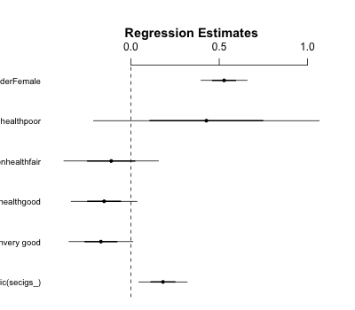
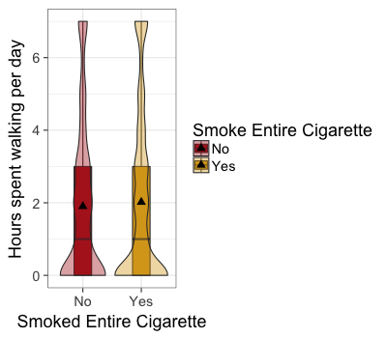
Smoking, Exercise and Perceived Health
Rynewicz, S., McNamara, T.
Fall 2017 Math 315, Section 1
Introduction
Sample Characteristics
Results(cont)
Discussion
Although smoking rates have declined, 15.1 percent of U.S. adults smoke on a daily basis (CDC.gov). Research has been done to show that smoking cigarettes can impair physical fitness such as walking.(Leyk). Other research shows that people who have smoked an entire cigarette has a worst perceived health and from the same study it showed that gender was only a factor in older men and not women and younger adults (Ho).
With smoking being a huge killer each year and increased amount of obesity especially here in America, we want to see from the data we were given, if there is a relationship between walking for exercise and smoking habits. Along with that, we will see if their perceived general health or gender alters this relationship in any way.
 | Mean | Median | SD
Walkdays | 1.975 | 1 | 2.316
Regression analysis for frequency of walking over one week vs. smoking habits plus perceived general health and gender as altering variables.
Our results suggest that there is no significant relationship between walking for exercise throughout the week and smoking habits.
When we alter the relationship for perceived general health and gender, there was a slightly significant relationship between this relationship when altered for genera health and gender.
For perceived general health, under the categories of “good”, “fair”, and “poor” the results showed insignificant numbers to prove that general health did not alter the relationship, where as the “very good” category almost identical our linear regression test.
Females significantly altered this relationship and ultimately changing it from slightly no relationship to a significant relationship between walking for exercise and smoking habits after altering for perceived general health and gender.
 |  | N | %
Smoking habits | Yes | 3324 | 65
 | No | 1773 | 35
General health | Excellent | 979 | 19
 | Very Good | 1963 | 38
 | Good | 1683 | 33
 | Fair | 434 | 9
 | Poor | 55 | 1
Gender | Male | 3147 | 48
 | Female | 3356 | 52
Methods
Figure 2: There was slight insignificance for the simple model(p-value=.089>.05). When we alter the relationship with the variable perceived health, the categories “Very Good”, “Good”, and “Fair” were all confidently insignificant (P-value .15,.26 ,and .75, respectively) were as “Poor” was almost identical with the simple model (P-value .087) being slightly insignificant. But gender altered the relationship (P-value7.95e-16).
Implications
Our results suggests against Leyk that smoking impairs physical activity. But the lack of relationship could be due to poll bias. Due to the survey being anonymous, it makes it easy for the individual to answer untruthfully. Some data sets were also lacking complete participation, which could lead to different results than if everyone answered. From the amount of non-responses and possibility of poll-bias, we could be getting skewed results compared to our research. If we could get respondent's answers knowing there is no chance of poll bias and have no non-responses, we would most likely get similar results as the research we conducted.
Further research could be conducted looking into groups of smokers vs people who had quit smoking. This would allow us to gauge smoking long term effects on exercise and health perception, after an individual has quit smoking. We could also compare former smokers to current smokers, and people who have never smoked to see which group they related most with. With this data we could determine if someone who quit smoking could return to their previous healthy state before initial cigarette consumption.
Data was retrieved from the data the AddHealth: Wave 4: In-home interview codebook. Data set included 5,094 participants ranging from ages 24-32 years young.
Data was collected through a 90 minute questionnaire done by person or computer.
Walkdays was created from the frequency they walk for exercise throughout one week.
Smoking habits was created from respondents answering yes or no to smoking an entire cigarette or not.
Modifications: NA answers were removed
We conducted a Multiple Linear Regression test.
Perceived general health and Gender were added to see if these variables altered this relationship in anyway.
Results
Frequency of walking for exercise over one week vs
smoking habits
Results Analysis
Model Type+Variables | Β / SE | P-Value
Linear Regression: Frequency of walking for exercise per week vs. Smoked an entire cigarette (Y/N) | .18 / .068 | .089
Multiple linear regression: Frequency of walking for exercise per week vs Smoked an entire cigarette (Y/N) + general health perception + gender | Total general health: 0 / .158 Very Good: -.17 / .09 Good: -.15 / .093 Fair: -.11 / .13 Poor: .43 / .32 Gender: .53 | TGH: .1586 VG: .15 G: .26 F: .75 P: .087 Gender: 7.95e-16
Multiple linear regression: Frequency of walking for exercise per week vs Smoked an entire cigarette (Y/N) + Gender | .18 / .068 | .0079
Research Question
Question: Is there a relationship between the amount an adult walks for exercise throughout the week and their smoking habits and does their perceived general health or gender alter this relationship?
Figure 1: People that have smoked an entire cigarette have a slightly higher frequency of walking for exercise
throughout one week.
References
References
1)Ho, S. Y., Lam, T. H., Fielding, R., & Janus, E. D. (2003). Smoking and perceived health in Hong Kong Chinese. Social Science & Medicine, 57(9), 1761-1770. doi:10.1016/s0277-9536(03)00021-2
2)Leyk, D., Rüther, T., Witzki, A., Sievert, A., Moedl, A., Blettner, M., … Löllgen, H. (2012). Physical Fitness, Weight, Smoking, and Exercise Patterns in Young Adults. Deutsches Ärzteblatt International, 109(44), 737–745. http://doi.org/10.3238/arztebl.2012.0737
3) "Current Cigarette Smoking Among Adults in the United States." Centers for Disease Control and Prevention. December 01, 2016. Accessed December 03, 2017. https://www.cdc.gov/tobacco/data_statistics/fact_sheets/adult_data/cig_smoking/index.htm.
4) R: A language and environment for statistical computing. R Foundation for Statistical Computing, Vienna, Austria. ISNB 3-9051-07-0, URL http://www.R-project.org & Rstudio Team (2015). Rstudio. Integrated Development for R. Rstudio, Inc., Boston, MA http://rstudio.com/.
5"Wave IV." UNC Carolina Population Center. May 31, 2017. Accessed December 03, 2017. http://www.cpc.unc.edu/projects/addhealth/design/wave4.
6) "Chico state logo." 12.000 vector logos. July 02, 2014. Accessed December 03, 2017. http://ancul.us/chico-state-logo/.

