Slide 1


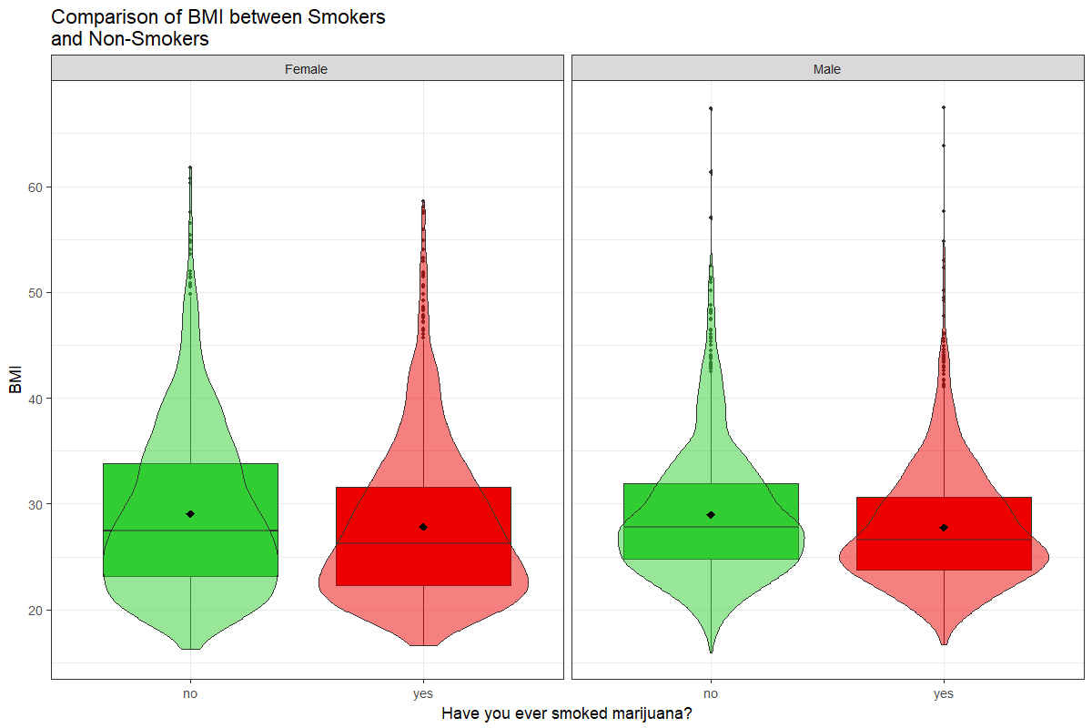
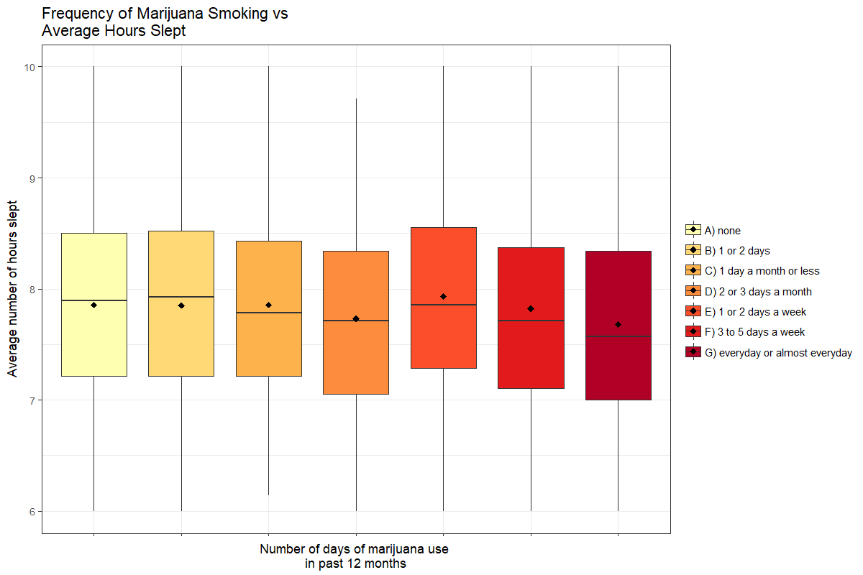
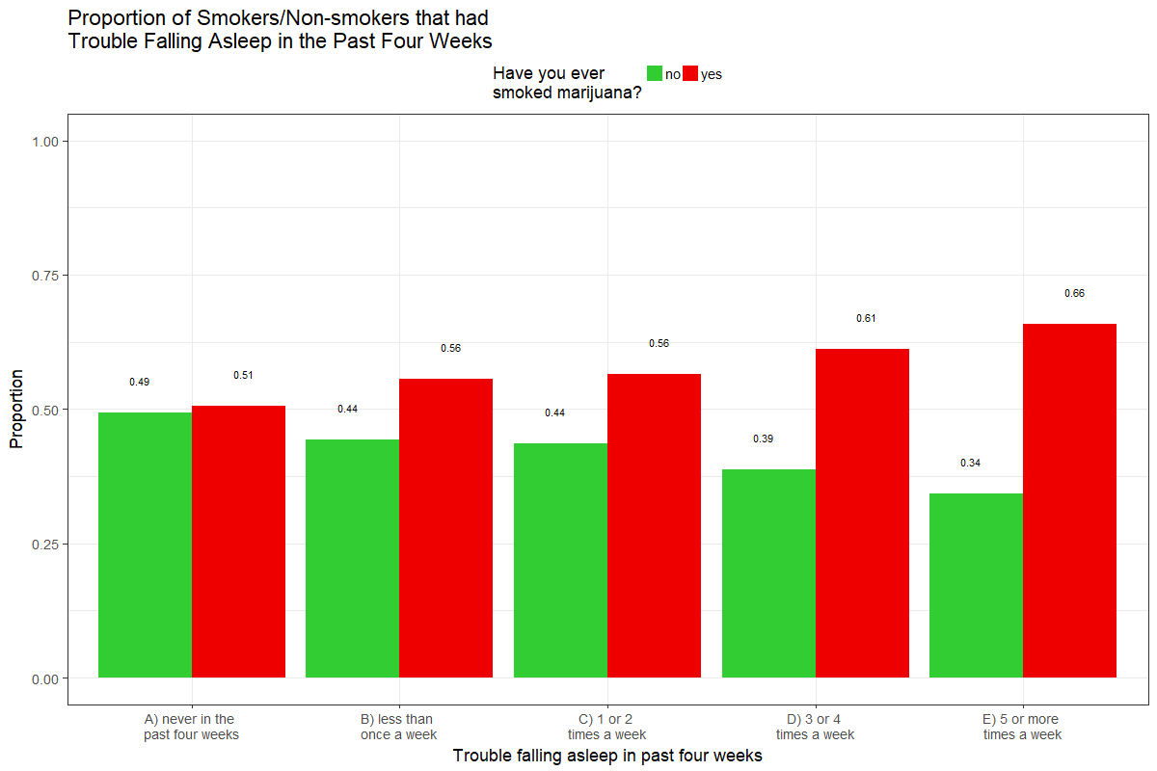
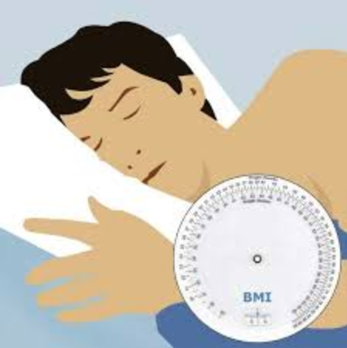
The Relationship that Marijuana Smoking Frequency has on Sleep Quality & BMI
Adam Thao & Stephanie Barajas
California State University, Chico
Introduction
Variables of Interest
Marijuana has been known to treat various symptoms and illnesses but it will also be wise to analyze the relationship to their general health. Some research has shown that smoking marijuana actually allows the person to stay asleep longer during the night (Babson, Sottile, & Morabito, 2017). Measurements of a person’s body mass index(BMI), which is a ratio of their height and weight, can provide some helpful insight to their health. Marijuana usage has been shown to increase a person’s appetite and may have an effect on a person’s BMI (Sansone & Sansone, 2014).
With growing support for marijuana legalization and more states allowing the sale of marijuana, it is important to analyze how it can affect a person’s health and lifestyle. One of the specific things to discuss is how the frequency of marijuana usage plays a role in overall sleep quality. This includes the time they go to sleep and wake up at, but more importantly, how difficult it is for them to fall asleep and how often they have trouble staying asleep. We will also see how smoking affects BMI so we can gain further insight on their general health.
Our sample size is 5114 with ages ranging from 24 to 32.
 |  | N | %
Gender | Male | 3147 | 48
 | Female | 3356 | 52
Smoking Status | Non-smoker | 2300 | 45
 | Smoker | 2778 | 55
 | Mean | Median | SD
BMI | 28.4 | 27.1 | 6.86
Average Hours Slept | 8.3 | 7.9 | 2.29
Results
Figure 3: Marijuana smokers on average have 1.2 (95% CI: -0.84, -1.61) lower BMI than non-marijuana smokers. By splitting the two groups into gender, the mean BMI stays relatively the same with the female group having a stronger right skew.
Conclusion
Methods
Our results suggest that people who smoke marijuana have a lower quality of sleep compared to those that don’t.
Our findings suggested that the more a person smoked marijuana, the less amount of sleep they had.
Marijuana smokers were found to have a lower BMI compared to non-smokers.
Smokers were more likely to have trouble falling asleep.
Further research could also look at other ways that smoking marijuana affects a person’s lifestyle.
Our data comes from a nationally representative sample of adolescents from the AddHealth data set.
BMI was created from the height and weight of the sample.
Average number of hours slept was created from the time they went to sleep at night and the time they woke up.
We performed a 2 sample t-test for a difference in means between smokers and non-smokers and checked if gender was a moderator.
Smoking status was also checked as a confounding variable for BMI and trouble falling asleep.
Figure 1: As the frequency of marijuana smoking increases, there is a slight overall decrease in the average number of hours slept.
Implications
Research Questions
Our data does not indicate at what time they smoked marijuana so we cannot tell if it directly affects their sleep quality.
Although we saw that marijuana smokers had a lower BMI compared to non-smokers, it would be wise to consider if BMI is a good indicator of general health.
Our data set does not include the number of times they smoked marijuana in a day.
How does marijuana smoking frequency affect the quality of sleep?
Is there a relationship between BMI and whether or not a person has ever smoked marijuana?
References
Babson, K., Sottile, A., & Morabito, J. (2017). Cannabis, Cannabinoids, and Sleep: A Review of the Literature. Current Psychiatry Reports, 19(4), 1-12.
Bilsky, S., Feldner, M., Knapp, A., Babson, K., & Leen-Feldner, E. (2016). The interaction between anxiety sensitivity and cigarette smoking level in relation to sleep onset latency among adolescent cigarette smokers. Journal of Adolescence, 51, 123-32.
Chiolero, A., Cornuz, J., Faeh, D., & Paccaud, F. (2008). Consequences of smoking for body weight, body fat distribution, and insulin resistance. The American journal of american Nutrition, 801-817.
Sansone, R., & Sansone, L. (2014). Marijuana and Body Weight. Innovations in Clinical Neuroscience, 11(7-8), 50-54.
Figure 2: Smokers made up a larger proportion of the people who had trouble falling asleep. This is most evident for people who had trouble falling asleep 5 or more times a week with the proportion of smokers being twice than non-smokers.

