Slide 1

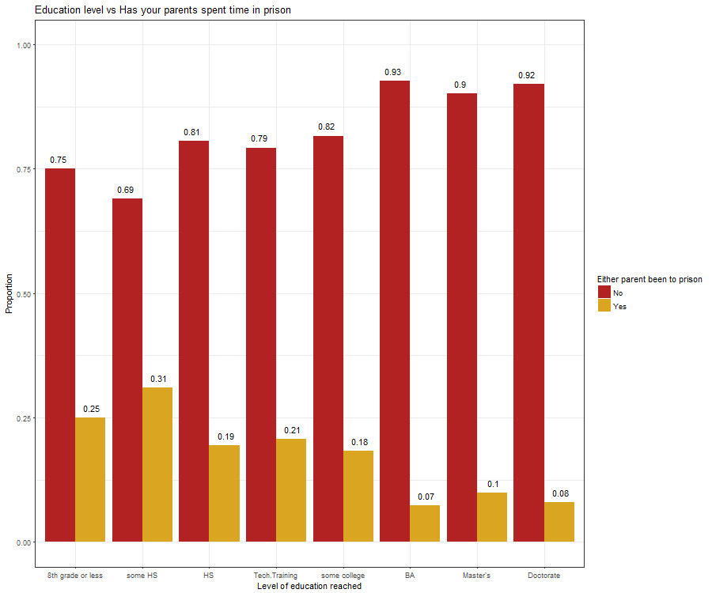
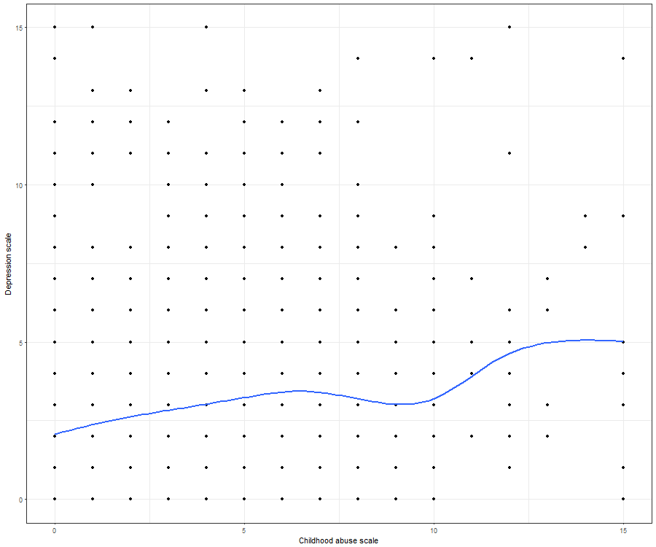
Parental Relationships and Adult Mental Health and Drug Use
Couch, M. and Tilton, A.
Introduction
Sample Characteristics
Conclusion
Growing up, we have numerous factors that influence who we become as adults. One of the most significant influences in our upbringing is that of our parental figures.
We studied the importance of the choices of a respondent's parents. We aim to see how much of a factor the parents action’s make in influencing who children become and what choices they make in their adult lives.
AddHealth database.
The data set came from a sample size of approximately 6,504 participants
Included male (3150) and female (3350) adults between the ages of 24 and 34
Participants were American mostly English speaking
Overall, we found after analyzing many variables and graphs from our univariate/bivariate/multivariate studies, that our hypothesis of parental characteristics/actions have a significant impact on children.
When examining the overall trends with regards to mental health, crime, and socio-economic status, as the condition of the parents declined, so too did that of the participants.
Background and Hypothesis
Results
Parental relationships that are unsupportive, nonexistent, unhealthy, or neglectful can lead to “poor health behaviors, especially substance abuse” and can also lead to “accumulating risk for mental health disorders” (Repetti, 2002).
Based on this research, we can assume that those who have unhealthy relationships or lack relationships with their parental figures will display more drug use and present more cases of mental health disorders.
Implications
Research Question
The main takeaway from this study is that the impact that parents leave upon their children in their upbringing needs to be recognized more so in society.
Other people who may be prospective parents may consider how their actions & behaviors may reflect upon the prospects of their children, and set out to be a more positive role model.
More research needs to be done to find any other possible confounding or moderating variables, such as ethnicity, geographic location, & other potential factors. Our results include very nuanced statistics that need to be examined for any outside influences.
Does the quality of parental relationships directly affect substance abuse, mental health, and education level?
Variables / Methods
We analyzed those who had present and absent parents and if those relationships were healthy or unhealthy relationships.
We then took this information and compared it with substance abuse, mental health disorders, and highest education level.
Explanatory Variables | Response Variables | Possible Confounders
Respondent has a good relationship with their mother Been emotionally, sexually, or physically abused by a parent/caregiver Times someone's mother and father have been arrested. | The rates in which a respondent has been diagnosed with Depression (H4ID5H) The rates in which a respondent has used Cocaine (H4TO65C) Education level (H4ED2) | Income level (H4EC1) Gender
Works Cited
CUI, MING & FINCHAM, FRANK D. (2010). The differential effects of parental divorce and marital conflict on young adult romantic relationships. Personal Relationships, 17, 331-343.
Murray, J., & Farrington, D. (2008). The Effects of Parental Imprisonment on Children. Crime and Justice, 37(1), 133-206. doi:10.1086/520070
Repetti, R. L., Taylor, S. E., & Seeman, T. E. (2002). Risky families: Family social environments and the mental and physical health of offspring. Psychological Bulletin, 128(2), 330-366. doi:10.1037//0033-2909.128.2.230
Roy A. Bean, Brian K. Barber & D. Russell Crane (2006). Parental Support, Behavioral Control, and Psychological Control Among African American Youth. Journal of Family Issues, 27, 1335-1355.

