Slide 1

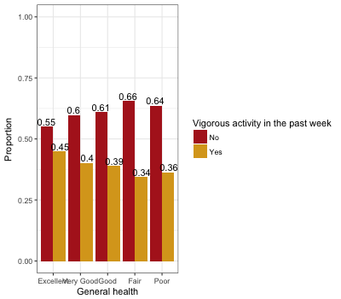
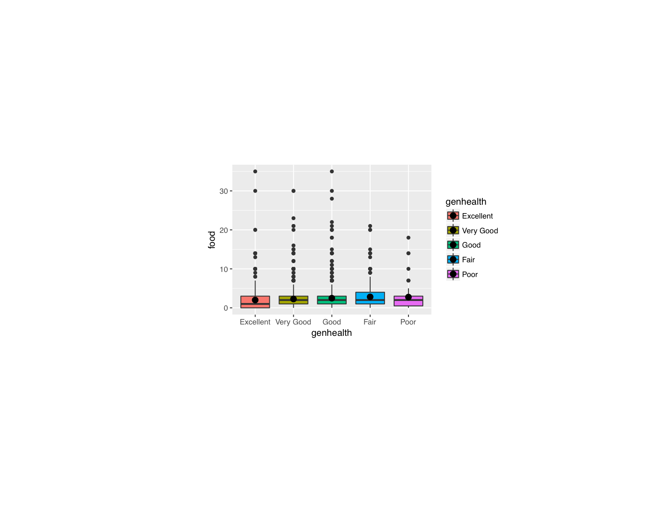

The Association Between Diet and Exercise
Activity on General Health
Manveer Dhillon, Selena Hennessey
California State University, Chico
Introduction/ Abstract
General health is universally important since personal health has an effect on everyday life. Diet and exercise and their relationship to general health have been compared in many studies; Results show that a combination of physical activity along with a healthy diet will produce the best results in terms of general health.
Poor health is linked to many physical and mental diseases that can greatly reduce the quality of life, while a healthy whole foods diet combined with frequent exercise activity leads to excellent general health. Options like sweetened drinks and fast food meals with little to no activity will worsen general health(Wu, 2009). This study will analyze the relationship between a person's general health and their diet and exercise.
Methods
Data was taken from the Addhealth: Wave 4 In-Home Interview Codebook. Data set used 6,504 participants that age from 24 to 32 years.
The data was collected through a 90 minute interview in which questions were asked by an interviewer or computer.
Modifications made to the data:
  All NA answers were removed
  Unreasonable outliers were removed
Statistical analyses used:
  t.test, Chi-squared test of association, and linear regression
Confounding factors:
  Vigorous activity participation was tested as a confounding factor.
Variables that were used in this study:
  H4GH1-General health and diet
  H4GH9- Sweetened Drink consumption
  H4GH8- Fast Food Consumption
  H4DA11- Vigorous Activity Participation
Results
Bivariate Model: Relationship between Vigorous Activity and General Health
Discussion
After examining the relationship between general health and vigorous activity, it was discovered that a persons participation in vigorous activity directly affects their general health. The chart for this data shows that on average people who participate in vigorous activity have a better health than those who do not.
Finally in the multivariate model, after examining the relationship between sweet drinks consumption, fast food intake and general health , the group discovered that the amount of sweetened drinks consumed weekly is significantly associated with fast food intake. General health is significantly associated with fast food intake, the average fast food intake increases as reported general health decreases.
Those who have a healthy diet tend to have a better health status than those who eat a poor diet consisting of fast food and sugary beverages. People who a active on a daily basis tend to be more healthy than those who don’t participate in vigorous activity. Even those who might not have a healthy diet but are regularly active have better health than those who are eating poorly and not exercising.
P-value = 0.002284
Multivariate Model: Relationship between Fast Food Intake and General Health
Sample Characteristics
Mean:
General Health
3
# of Sweetened Drinks Weekly
14.22
# of Fast Food Meals Weekly
3.35
Participation in Weekly Vigorous Activity
0.5
Implications
This study can be helpful to those who are trying to make a change in their lifestyle. We can look at this data and see how different factors such as diet and exercise can affect how healthy or unhealthy we are.
This can aid those who want to use this information in future research ideas for example, conducting a study on obesity in our country.
Discussion
After conducting a series of tests on the different variables in our research study, there is sufficient evidence to suggest that diet and exercise does have a relationship with general health, supporting the hypothesis.
References
Warburton, D., Nicol, C., Bredin, S. (2006) Health benefits of physical activity: the evidence. CMAJ, 174 (6). Retrieved from http://www.cmaj.ca/content/174/6/801.short
Wu, T., Gao, X., Chen, M., Van Dam, R. (2009). Long-term effectiveness of diet-plus-exercise interventions vs. diet-only interventions for weight loss: a meta-analysis. Wiley Online Library, 10 (3). Retrieved from http://onlinelibrary.wiley.com/doi/10.1111/j.1467-789X.2008.00547.x/full

