Slide 1
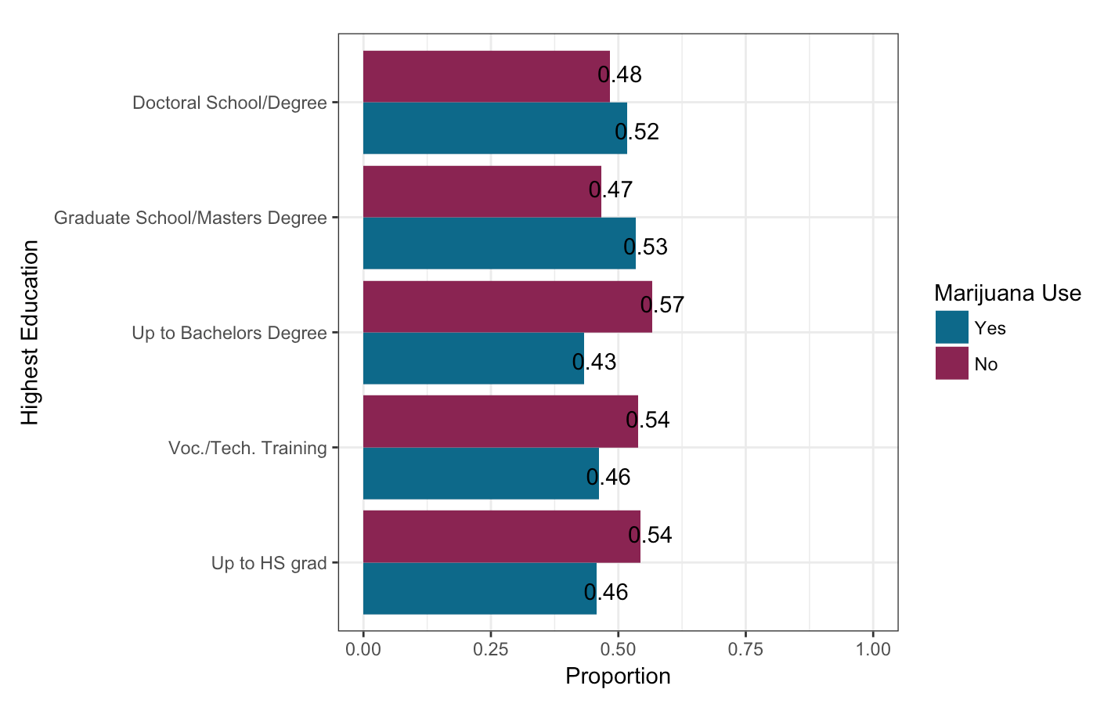
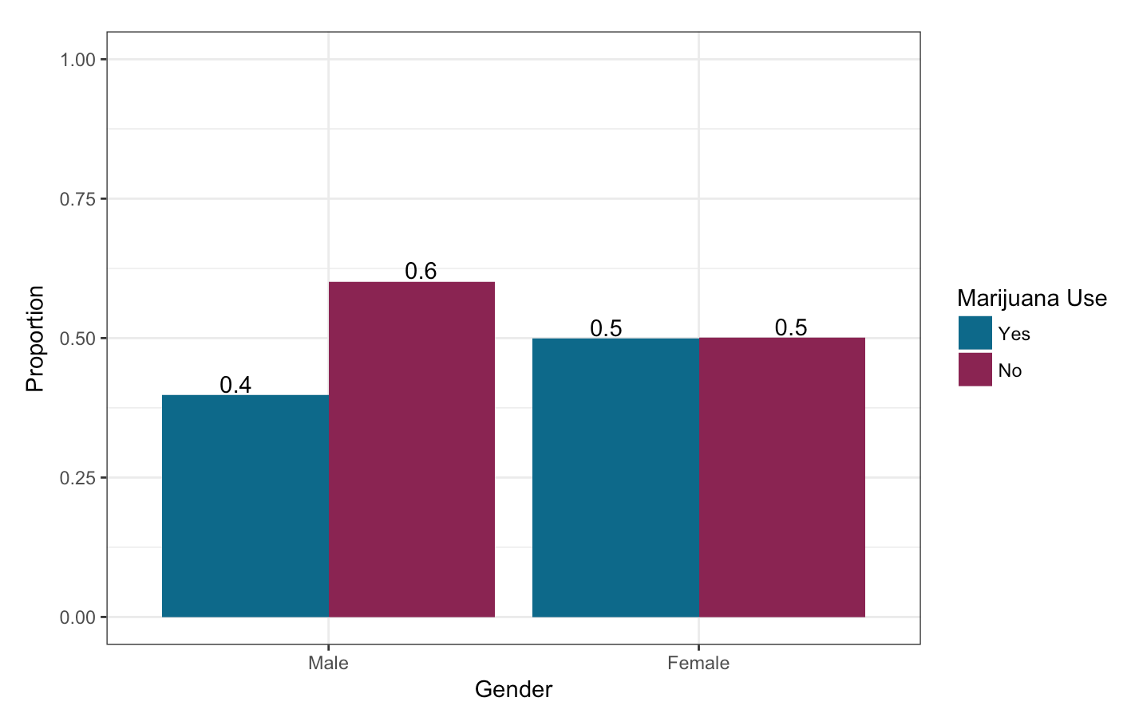
The Association Between Marijuana Use and Education Levels
Dutra A. & Gleaton C.
Department of Mathematics and Statistics, California State University, Chico
Introduction
Results
Bivariate Results
Research Problem
Marijuana use and education use has been a topic of discussion for many years. Marijuana is one of the most frequently used drugs in adolescents and many high school students use marijuana during the school day. The relationship between marijuana use and achievement in academics have mixed results, Finn, K (2012) reported that students who use marijuana in general exhibit poorer behavior than those who did not.
Drug use is a severe epidemic throughout the world and the fact that the problem has permeated into the academic world is not one to be taken lightly. Studies have generated some specific numbers on the percentages of students that are involved in the drug world. 69% of a 262-student survey reported that they have experienced some negative consequences as a result of their drug use, and 28% of the students reported some moderate concern about their drug or medication misuse (Palmer, R. S., McMahon, T. J., Moreggi, D. I., Rounsaville, B. J., & Ball, S. A., 2012).
Research Question
Is there an association between marijuana usage and the ability to be academically successful?
Education Level vs. Marijuana Use
Gender vs. Marijuana Use
Figure 1 is displaying the relationship between a person’s education level and whether or not they have used marijuana; marijuana does not seem to have a significant effect on a person’s ability to be successful in academics.
Table 1. Shows the number of responders that have used marijuana across education levels.
Table 2. Shows the number of respondents that use marijuana between males and females
Marijuana Use | Up to HS Grad | Voc./Tech Training | Up to Bachelors Degree | Grad School/ Masters Degree | Doctoral School Degree
Yes | 554 | 233 | 1173 | 243 | 46
No | 659 | 272 | 1535 | 212 | 43
Marijuana Use | Male | Female
Yes | 929 | 1370
No | 1403 | 1375
Multivariate Analysis Results
After adjusting for the potential confounding factor of High school graduation, Gender (0.66, CI0.59-0.74 p <.0001) was significantly and positively associated with the likelihood of using marijuana.
In this analysis, the odds ratio tells us that Females are 0.65 times more likely use marijuana.
These analyses show that Marijuana use is not a confounding factor because the association between gender and marijuana use is still significant after accounting for High School graduation.
Results
Based on the research on the relationship between marijuana use and education level, there is no clear indication that the two have any significant correlation.
Marijuana does not seem to affect a person’s ability to succeed in academics, 52% of the add health responders that have a doctoral degree have used marijuana.
Methods
Figure 2. Shows the proportion of marijuana use across males and females.
6,504 individuals in The National Longitudinal Study of Adolescent to Adult Health Wave IV survey
Ages 24-34
Education Level
Academic successfulness is examined through the variable, Highest level of education achieved.
Initially there were eleven education levels ranging from 8th grade or less to obtaining a doctoral degree.
In order to make the variable manageable, it was broken down into just five levels.
The five levels represent Up to Highschool graduation, any vocational or technical training, up to obtaining a Bachelor’s Degree, graduate school or Master’s degree, and Doctoral school or Doctoral degree.
Marijuana Use
Add Health respondents were asked if they had used marijuana in their lifetime. 45% of the 5,078 respondents have smoked marijuana.
Gender
2,332 Male respondents
2,745 Female respondents
.
Figure 1. Shows the proportion of marijuana use across education levels.
Multivariate Analysis
Table 3 is showing the multivariate analysis of marijuana use compared with highest education and gender. OR is the odd ration, standard deviation is a quantity calculated to indicate the extent of deviation for a group as a whole, and p-value is the probability for a given statistical model that, when the null hypothesis is true, the statistical summary would be the same as or of greater magnitude than the actual observed results.
Conclusion/Implications
These data support our null hypothesis that there is no correlation between marijuana use and a person’s ability to be successful in school.
Marijuana does not see to have a significant effect on a person’s ability to be successful academically.
Measures | OR | 95% Confidence Interval | P-value
Gender(Female) | 0.66 | (0.59,0.74) | <0.0001
Education
Up to High School | 1.09 | (0.95,1.24) | 0.21
Voc/Tech Training | 1.02 | (0.83,1.26) | 0.86
Bachelor's Degree | 1.17 | (1.02,1.34) | 0.03
Grad School/Masters | 0.81 | (0.65,1.00) | 0.05
Doctorate Degree | 0.88 | (0.57,1.35) | 0.55
References
Finn, K. (2012). Marijuana Use at School and Achievement-Linked Behaviors. The High School Journal, 95(3), 3-13. Retrieved from http://www.jstor.org/stable/41343019
Ellickson, P. L., Martino, S. C., & Collins, R. L. (2004). Marijuana Use From Adolescence to Young Adulthood: Multiple Developmental Trajectories and Their Associated Outcomes. Health Psychology, 23(3), 299-307. http://dx.doi.org/10.1037/0278-6133.23.3.299
Palmer, R. S., McMahon, T. J., Moreggi, D. I., Rounsaville, B. J., & Ball, S. A. (2012). College Student Drug Use: Patterns, Concerns, Consequences, and Interest in Intervention. Journal of College Student Development, 53, 124-132. Retrieved September 10, 2017.
Harris, K.M., C.T. Halpern, E. Whitsel, J. Hussey, J. Tabor, P. Entzel, and J.R. Udry. 2009. The National Longitudinal Study of Adolescent to Adult Health: Research Design [WWW document]. URL: http://www.cpc.unc.edu/projects/addhealth/design.

