Slide 1

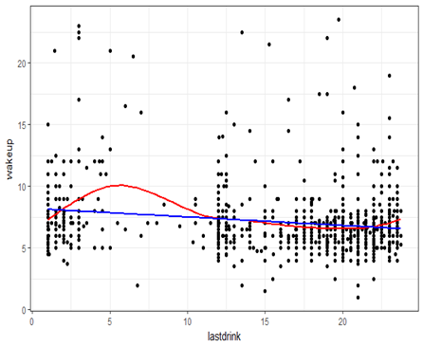
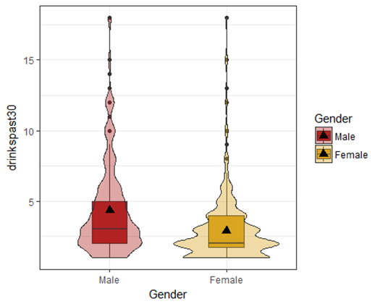
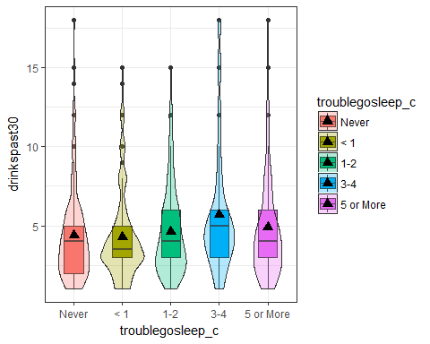
Alcohol consumption and its relationship to sleep quality of the consumer
Estrada, C., Matson, L. | MATH 315 | Section 1| CSU Chico | Undergraduate
Introduction
Results
Last Time Drank Alcohol vs Wake Up Time
Alcohol has been shown to not only be addictive and cause physiological harm, but it can also interfere with sleep quality. Unlike the obvious detrimental effects alcohol has on the body, it’s effects on sleep are less conspicuous. Studies have shown that those who regularly drink alcohol get less sleep, do worse in work/school and are prone to consuming more alcohol. Previous research has also shown that alcohol can have damaging effects on sleep years after abstaining from the drink. With most people in the United States regularly drinking alcohol, it is important to better understand the damage alcohol can inflict through poor sleep quality. The purpose of this project is to use data from the Addhealth: Wave IV codebook to determine if alcohol consumption has an impact on the sleep quality of the consumer.
Alcoholic Drinks in the Past 30 Days
Figure 3: Linear regression shows significant negative correlation. The later in the day respondents had an alcoholic drink, the earlier they would wake up (p<0.0001)
Figure 1: T-test showed males, on average, drank 1.48 more drinks in the past 30 days than did females (p-value <0.0001)
Conclusions
Research Question
The number of drinks a respondent had in the past 30 days had no significant effect on the number of days they had trouble sleeping (p>0.0001). This is surprising because it is contrary to what some literature shows.
There is a relationship between gender and the number of alcoholic drinks in the past 30 days: males drank 1.48 more drinks than females (p-value<0.0001).
There was a statistically significant negative correlation between the last time respondents had an alcoholic drink and their wake-up time, r = -0.22, CI (-0.14, -0.29), p<0.0001. The significant negative correlation shows that the later in the day respondents had an alcoholic drink, the earlier they would wake up.
After accounting for gender in the association between last drink time and wakeup time, it is not a cofounder due to a significant p-value of p<0.0001.
Is there a relationship between days having trouble going to sleep and the number of drinks in the past 30 days?
Is there a relationship between the last time respondents had an alcoholic drink and their wake up time?
Trouble Going to Sleep vs Drinks in the Past 30 Days
Methods
Data used was gathered by Respondents from the National Longitudinal Study of Adolescent Health (AddHealth); “Second Wave”.
Genders have been shown to have varying affects from alcohol and so we included it in our data.
The number of alcoholic drinks respondents had in the past 30 days was used to check for a relationship with trouble going to sleep.
The last time respondents had an alcoholic drink was used against their wake up time.
Implications
Alcohol and poor sleep quality seem to be a staple of American culture.
Exploring the relationship between alcohol intake and sleep quality is important in helping to better understand the effects of alcohol on sleep.
Future research can expand our knowledge by examining the possibility of a relationship between alcohol intake and fatigue/overall health.
Sample Characteristics
Figure 2: An analysis of variance (ANOVA) showed no significant effect between the two variables (p>0.0001)
Gender
Wake Up Time (24 Hour Interval)
Last Alcoholic Drink (24 Hour Interval)
Trouble Going to Sleep
References
1. Brower, Kirk J. “Alcohol’s Effects on Sleep in Alcoholics.” Alcohol research & health: the journal of the National Institute on Alcohol Abuse and Alcoholism 25.2 (2001): 110-125. Print.
2. Ebrahim, I. O., Shapiro, C. M., Williams, A. J. and Fenwick, P. B. (2013), Alcohol and Sleep I: Effects on Normal Sleep. Alcohol Clin Exp Res, 37: 539‘-549. doi:10.1111/acer.12006 2.
3. Oscar-Berman, M., & Marinković, K. (2007). Alcohol: Effects on Neurobehavioral Functions and the Brain. Neuropsychology Review, 17(3), 239–257. https://doi.org/10.1007/s11065-007-9038-6

