Slide 1
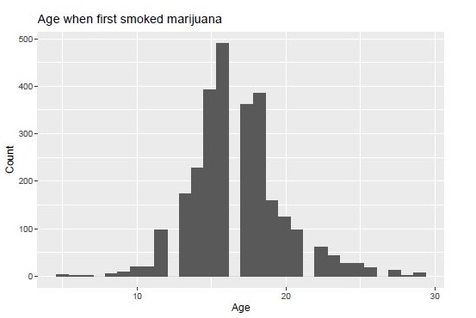
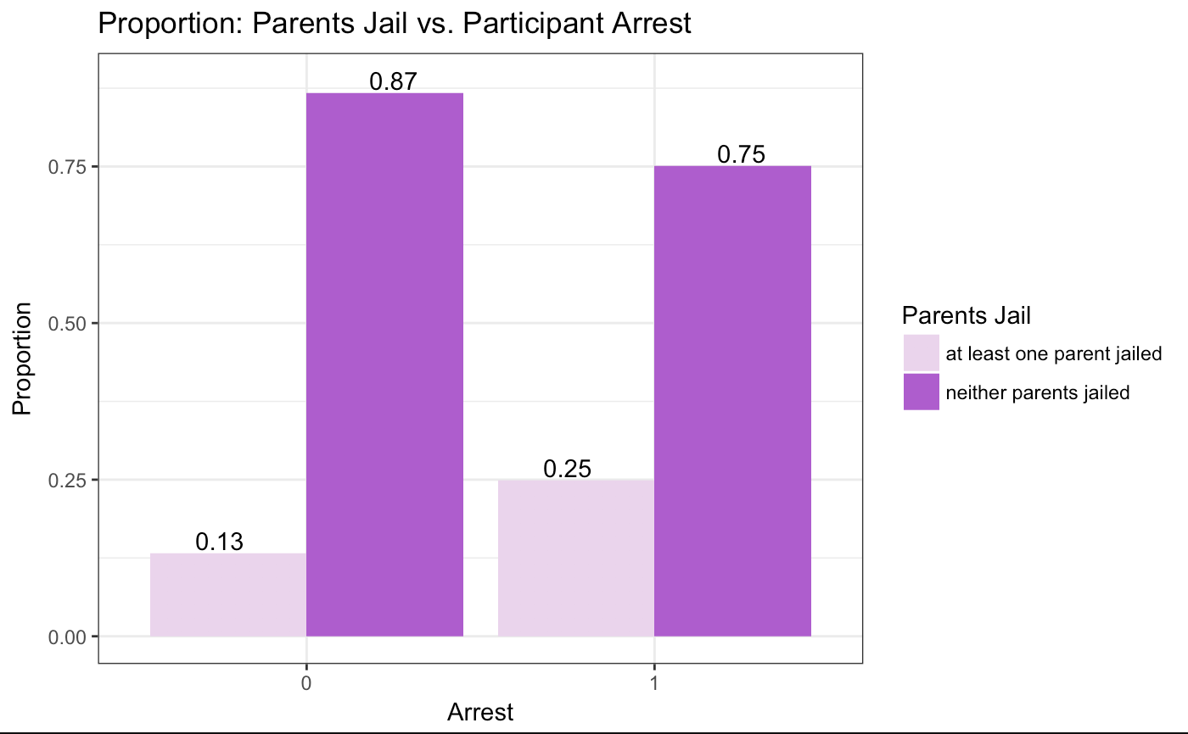
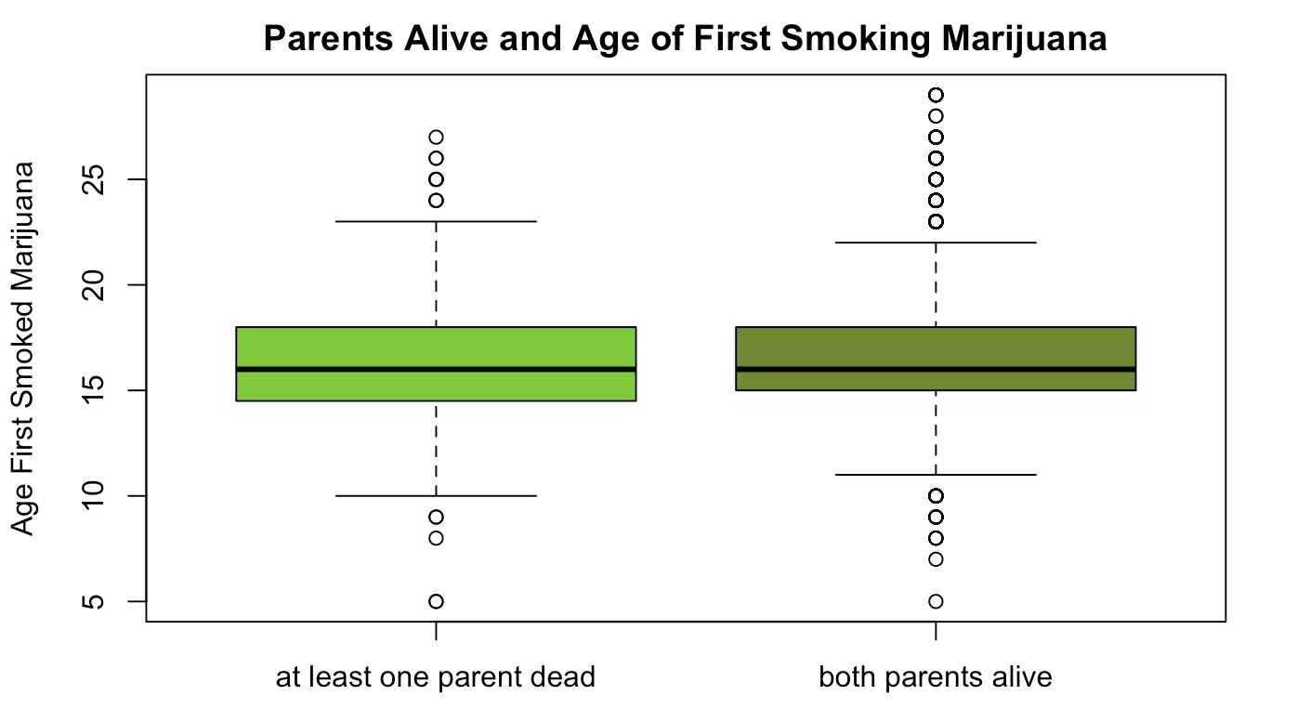
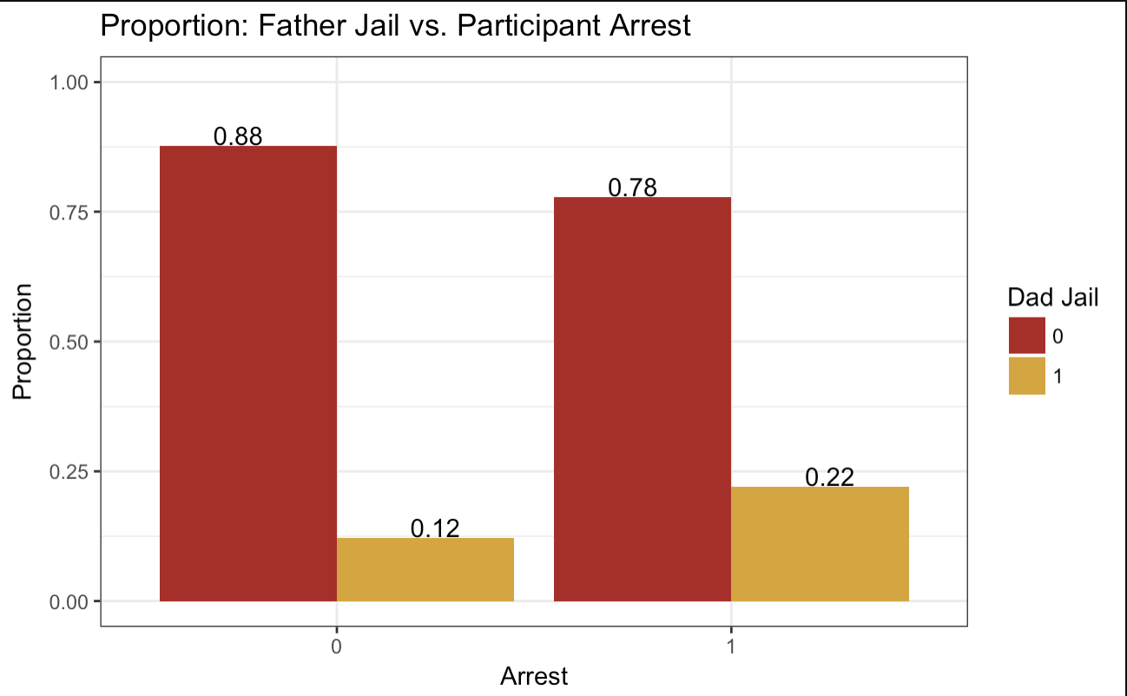
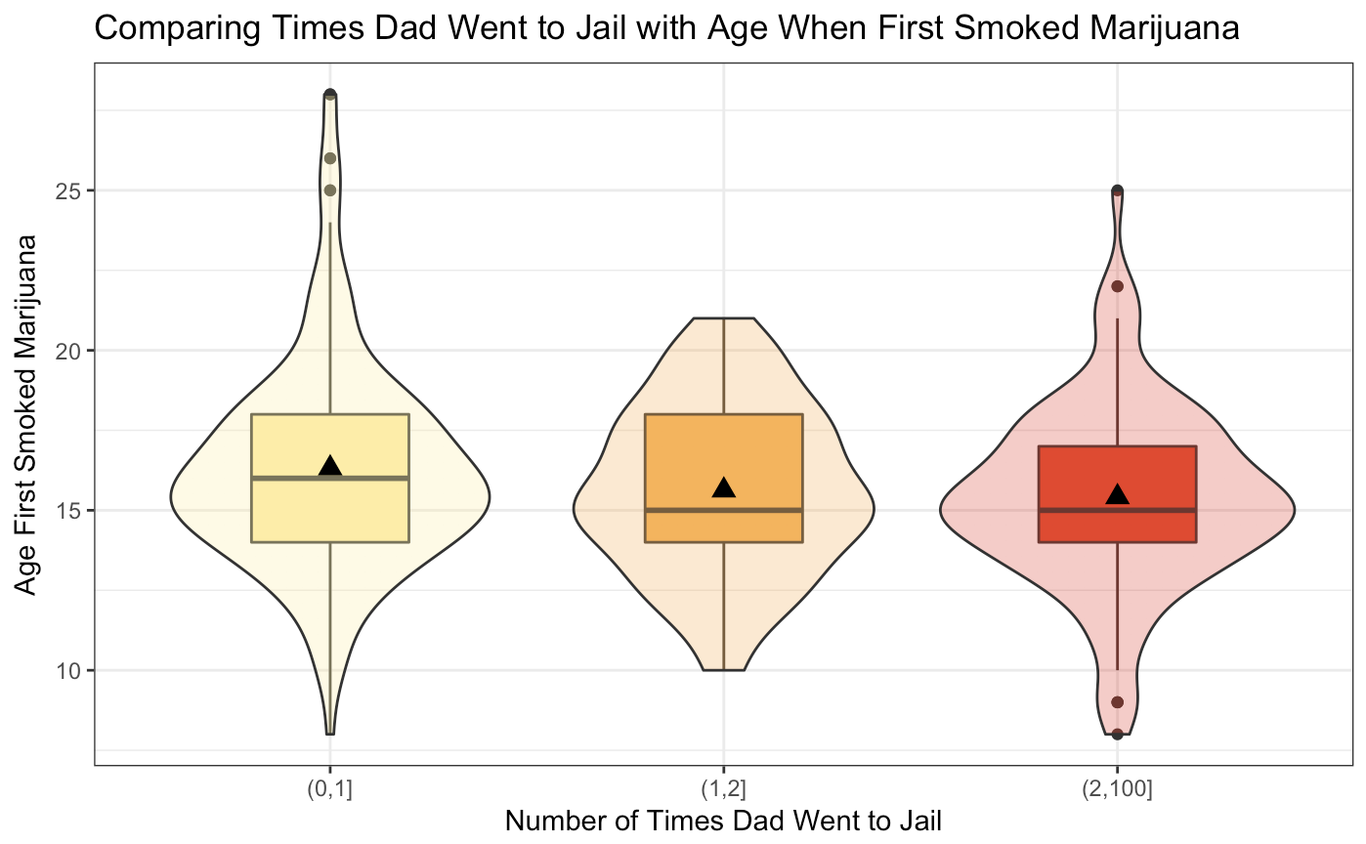
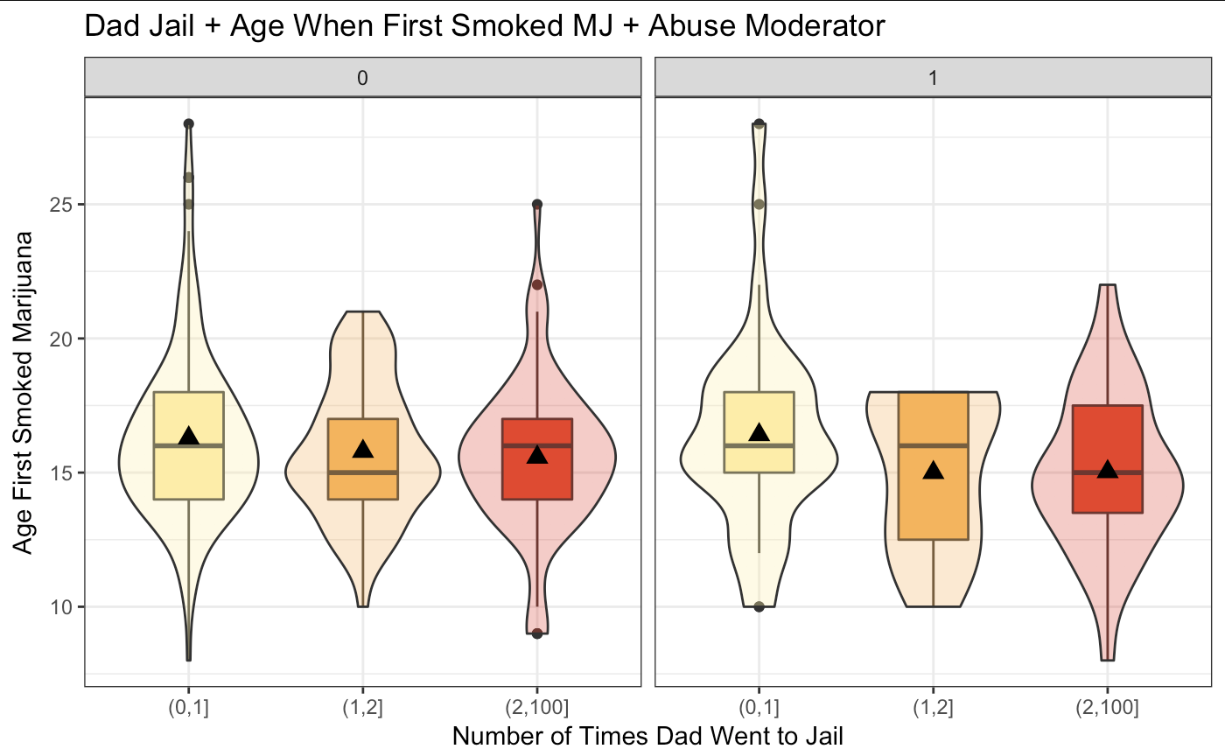
Investigating the Association Between Parental Dynamics and Adolescent Deviant Behavior A. Flores, and S. Turner MATH 315-02, Fall 2017
Introduction
Discussion
Hirschi’s “Social Control Theory” states that only one moral compass exists in mankind, unchanging across individuals¹. In an attempt to explain moral deviance in adolescents, this research investigates the association between parental dynamics and child misbehavior. Parental dynamics that have been previously associated with deviant behaviors include strength in familial bonds, parental presence or absence and monitoring, and parental self control^{1,2,3,4,5,6}.
The use of recreational drug use at early ages may be investigated through specific associations of parental dynamics such as their absence due to death or time spent in jail. Figure 2-4 show the age of when first smoked marijuana, the ages range from 5 to 32 years old. The average age when participants first used marijuana significantly differed depending on the number of times their father went to jail (Figure 3). As a way to visualize the direction and strength of the relationship between those two variables, a potential moderator abuse. On Figure 4, the two-way ANOVA test was used to evaluate the synchronized effect of the times their father went to jail and the age when first smoked marijuana on a response variable of abuse. Revealing that participants who had reported being abused had a younger age of first using marijuana regardless if their father went to jail.
Figure 2 shows that if at least one parent is dead, participants were more likely smoking marijuana at a younger age. To conform this the Welch Two Sample t-test was used to analyze the hypothesis that those whose participants parents were absent have the same mean as the age of respondents first smoking marijuana. Lastly the Pearson’s Chi-squared test with Yates’ continuity correction was applied to assess the frequency distribution of those who reported one of their parents going to jail and those participants who have been arrested. Figure 1 shows that those whose parents have never been arrested are less likely to have been arrested. Through analyzing the age of which participants first used marijuana and if they have been arrested, we are able to see the factors that affect early drug use and deviant behaviors.
Figure 1: Age first smoked marijuana
Min | Max | Mean | Count
5 | 29 | 16.7 | 2762
Figure 1: Parents Jail Time vs. Participants Arrest
Of those who reported never being arrested, 87% reported neither parent going to jail, while 13% reported at least one parent jailed
Of those participants who reported being arrested, 75% reported neither parent going to jail, while 25% reported that at least one parent went to jail
Chi-squared test used to assess statistical significance
x²=92.9, p-value<0.0001
Figure 2: Parents Alive vs. Age of First Smoking Marijuana
Of those who participated and reported at least one parent no longer alive, the mean age of first smoking marijuana was 16.3 years
Of those who participated and reported both parents as alive, the mean age of first smoking marijuana was 16.8 years
Welch Two Sample T-Test used to test for statistical significance (t=-2.7, df=527.8, p-value <0.05).
Materials & Methods
Data from National Longitudinal Study of Adolescent to Adult Health
5114 adults, ages 24-32
46% male, 54% female
Started in 1994 - 2008 (Wave IV)
Statistical analysis performed in R
ANOVA (One + Two-Way)
Chi-Squared Test
Welch Two-Sample T-Test
Explanatory Variables:
Parents alive/dead
Father’s jail time
Parents ever in jail
Response Variables
Age first smoked marijuana
Ever arrested
Implications
Research done by Parke and Clarke-Stewart show an increase in behavioral problems are more prevalent in children whose families have been affected by jail time death, and neglect. This information could be the reasons to imply models that can be applied to parenting skills to bypass risky adolescent behavior. Support groups for those children who have a form of an absent parental figure could significantly improve the wellbeing of those affected by trauma.
Figure 1: Father Jail v. Participant Arrested
Chi-Squared Test of used to test for statistical significance (X²=73.4, df=1, p-value <0.0001)
88% of respondents who had not been arrested responded that their fathers did not go to jail, 12% of their fathers went to jail
78% of respondents who had been arrested responded that their fathers did not go to jail, 22% of their fathers went to jail
Figure 3: Times Dad In Jail with Age First
Smoked Marijuana
ANOVA used to test for statistical significance (F=3.4, p-value <0.05)
Figure 4: Dad Jail + Age Smoke MJ + Abuse Moderator
Two-Way ANOVA Test (non-abused: F=1.58, p>0.05; abused: F=1.73, p-value>0.05)
References
“Add Health: the National Longitudinal Study of Adolescent to Adult Health”. University of North Carolina: Carolina Population Center. Accessed 10/13/2017 from
http://www.cpc.unc.edu/projects/addhealth/about
Bahr, S., Hoffmann, J., Yang, X. (2005). Parental and Peer Influences on the Risk of Adolescent Drug Use. 26(6). DOI:10.1007/s10935-005-0014-8
Bailey, J., Hill, K., Guttmannova, K, Oesterle, S., Hawkins, D., Catalano, R., & McMahon, R. (2013). The Association Between Parent Early Adult Drug Use Disorder and Later Observed Parenting Practices
and Child Behavior Problems: Testing Alternate Models.Development Psychology. 49 (5) 887-899. DOI: 10.1037/a0029235
Broman, C., Li, X., Reckase, M. (2008). Family Structure and Mediators of Adolescent Drug Use. 29(12). DOI: 10.1177/0192513X08322776
Cassidy, T. (2011). Family background and environment, psychological distress, and juvenile delinquency. Psychology. 2(9). 941-947. DOI:10.4236/psych.2011.29142
Ford, J. (2009). Nonmedical Prescription Drug Use Among Adolescents: The Influence of Bonds to Family and School. Youth and Society. 40 (3). 336-352. DOI: 10.1177/0044118X08316345
Freisthler, B., Byrnes, H., & Gruenewald, P. (2008). Alcohol outlet density, parental monitoring, and adolescent deviance: A multilevel analysis. Children and Youth Services Review. 31. 325-330. DOI: 10.1016/j.childyouth.2008.08.006
Parke, Ross D, and Alison K Clarke-Stewart. “Effects of Parental Incarceration on Young Children.” ASPE, Dec. 2011, aspe.hhs.gov/basic-report/effects-parental-incarceration-young-children. Acknowledgements
Taunya and Stephanie for being such fabulous ladies to see three times a week. Tutors etc. etc. “Dad and Child” retrieved October 13, 2017 from http://stmedia.startribune.com/images/ows_145688925517929.jpg

