Slide 1

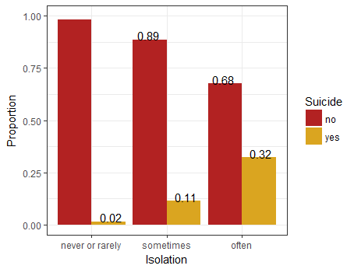
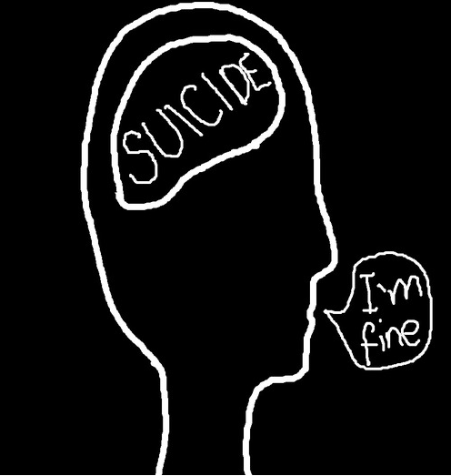

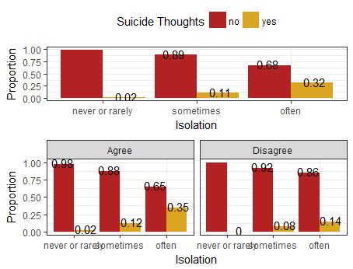
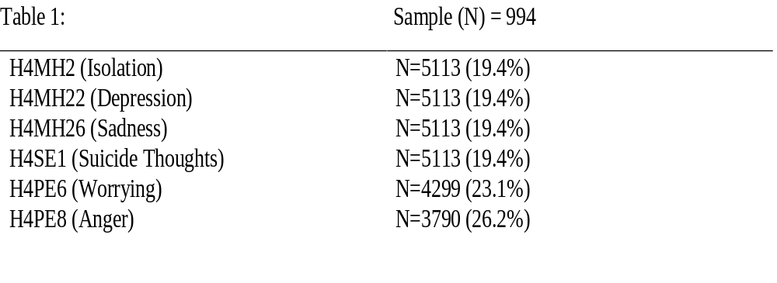
How Personality Traits Are Associated With
Depression and Suicide
By: Gomez G. and Pharn S.
California State University, Chico
Introduction
Results
Conclusion
Throughout history, neurotic personality types have shown to be strongly related to depression and/or suicide (Joshi and Yadav, 2017). Neuroticism is defined as the condition of experiencing feelings such as isolation, depression, sadness, and anger in excessively greater frequencies than the average, mentally stable person. Evidence for this association was extrapolated from several resources, which show strong correlations linking neuroticism to depression and suicide, relative to other personality types. Because a neurotic personality type is a strong indicator for depression and suicide, it may be beneficial to investigate the personality traits which make up neuroticism, and determine which specific traits most significantly contribute to these results. Our referenced studies prompted this analysis on neurotic personality traits and their relation to depression and suicide, as well as an attempt to determine whether or not these traits act as potential risk factors for the aforementioned effects.
Research studies since the 1950s have identified several personality types that may contribute to depression and suicide. A study published by the Indian Journal of Health and Wellbeing, conducted on 80 subjects ages 18-40, found that personality type can lead to certain emotional and behavioral disorders, which are responsible for feelings of depression and alienation (Joshi and Yadav, 2017). A Scandinavian study using standardized personality measures discovered that hopelessness, neuroticism, and surprisingly extroversion may be useful markers of suicide risk (Brezo, Paris, & Turecki, 2006).
This analysis specifically investigates the differing correlations between isolation and thoughts of suicide, when subjects did and did not admit to having a tendency to worry. Another analysis was conducted to compare the relationship between feelings of sadness and feelings of depression, specifically differentiating subjects who admitted to getting angry easily and those who did not.
Upon analysis of our study, one can observe a positive correlation between feelings of isolation and suicidal thoughts. Our graphical data supports our claim that only certain neurotic traits can predict the frequency of depression and thoughts of suicide. Feelings of isolation and depression positively correlate with suicide and depression, but tendencies to worry about things did not.
Although our respective research articles were from overseas studies-India, Scandinavia, and Europe-the correlation between the chosen neurotic traits and their undesirable effects showed to be significant in the majority of accounts. Aside from the neurotic personality trait of having a tendency to worry, our chosen variables showed significant relationships between experiencing feelings of depression and thoughts of suicide.
We can conclude that there is an association between the feeling of isolation from others and the thoughts of suicide (X2 = 122.4, df = 3, p < 0.0001). The proportion of feelings of isolation significantly differs between all pairs of thoughts of suicide. The graph shows that as the feeling of isolation becomes more frequent the thoughts of suicide also becomes more frequent. We used a chi-square test of association to analyze this bivariate graph.
Methods
The sample came from the AddHealth Wave IV Code Book
H4MH2 (Isolation) - Asks how often do you feel isolated from others and includes four answers: “never”, “rarely”, “sometimes”, and “often”
H4MH22 (Depression) - Asks how often you felt depressed during the past seven days and includes four answers: “never or rarely”, “sometimes”, “a lot of the time”, and “most of the time or all of the time”
H4MH26 (Sadness) - Asks how often you felt sad during the past seven days and includes four answers: “never or rarely”, “sometimes”, “a lot of the time”, and “most of the time or all of the time”
H4SE1 (Suicide Thoughts) - Asks if you have seriously thought about committing suicide during the past 12 months and includes two answers: “no” and “yes”
H4PE6 (Worrying) - Asks if you worry about things and includes four answers: “strongly agree”, “agree”, “disagree”, and “strongly disagree”
H4PE8 (Anger) - Asks if you get angry easily and includes four answers: “strongly agree”, “agree”, “disagree”, and “strongly disagree”
We have changed all of our variables into categorical variables and have removed outliers and unnecessary answers that don’t contribute to the question from all of the variables.
For the isolation variable we have truncated the 4 levels into 3 levels. For the depression, sadness, worrying, and anger variables we have truncated the 4 levels within each variable into 2 levels
We used the chi-square test and the logistical regression test for our statistical analysis
H4PE6 (Worrying) was tested as a moderator for H4MH2 (Isolation), and H4PE8 (Anger) was tested as a confounder for H4MH26 (Sadness)
Implications
Our results show that certain traits of neuroticism can be predictors for both depression and thoughts of suicide. However, we need to be careful as to not say that those certain traits are real predictors for both depression and thoughts of suicide because our results also show that some neurotic traits are moderated by each other. Future research must be conducted on all traits defining neuroticism-feelings such as isolation, depression, sadness, and anger-while cycling the controlling for each specific trait. This way, we can be more confident in which specific traits of the neurotic personality type can really predict whether someone will experience depression and thoughts of suicide.
Sample Characteristics
The distribution of feelings of isolation from others across the categories of thoughts of suicide differs greatly between individuals who worry about things and individuals who don't worry about things in two levels of isolation (sometimes and often). We can conclude that the effect of feelings of isolation on thoughts of suicide is modified by the individuals' status of worrying about something because the strength of the relationship for individuals who don't worry about things has been greatly attenuated. The p-value for the stratified model for individuals who don't worry about things is approximately 1100 times larger than both the stratified model for individuals who worry about things and the overall model (2.2e-16 vs 2.2e-16 and 1.311e-05).
REFERENCES
Brezo, J., Paris, J., & Turecki, G. (2006). Personality traits as correlates of suicidal ideation, suicide
attempts, and suicide completions: a systematic review. Acta Psychiatrica Scandinavica, 113(3), 180-206. doi:10.1111/j.1600-0447.2005.00702.x
Duriez, B., Klimstra, T. A., Luyckx, K., Beyers, W., & Soenens, B. (2012). Right-Wing Authoritarianism:
Protective Factor Against or Risk Factor for Depression?. European Journal Of Personality, 26(5), 536-549. doi:10.1002/per.853
Joshi, R., & Yadav, K. (2017). Effect of ICBT on alienation among individuals with depression in relation to
personality type. Indian Journal Of Health & Wellbeing, 8(3), 234-236.
Yen, S., Shea, M. T., Sanislow, C. A., Skodol, A. E., Grilo, C. M., Edelen, M. O., & ... Gunderson, J. G.
(2009). Personality traits as prospective predictors of suicide attempts. Acta Psychiatrica Scandinavica, 120(3), 222-229. doi:10.1111/j.1600-0447.2009.01366.x
ggomez24@mail.csuchico.edu
spharn@mail.csuchico.edu

