Slide 1
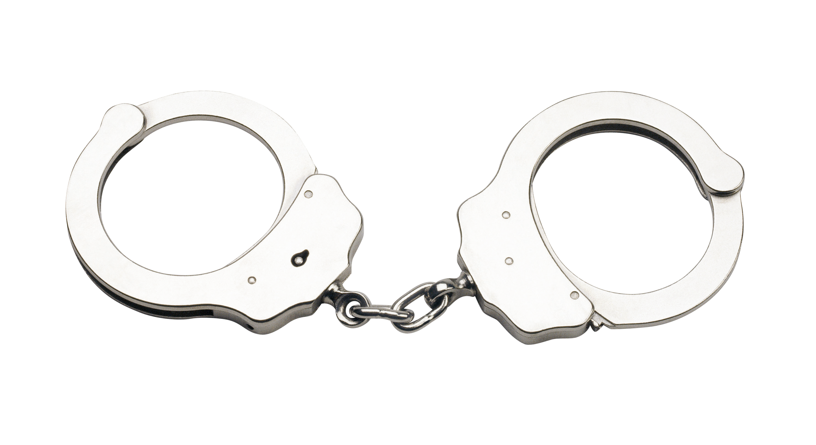
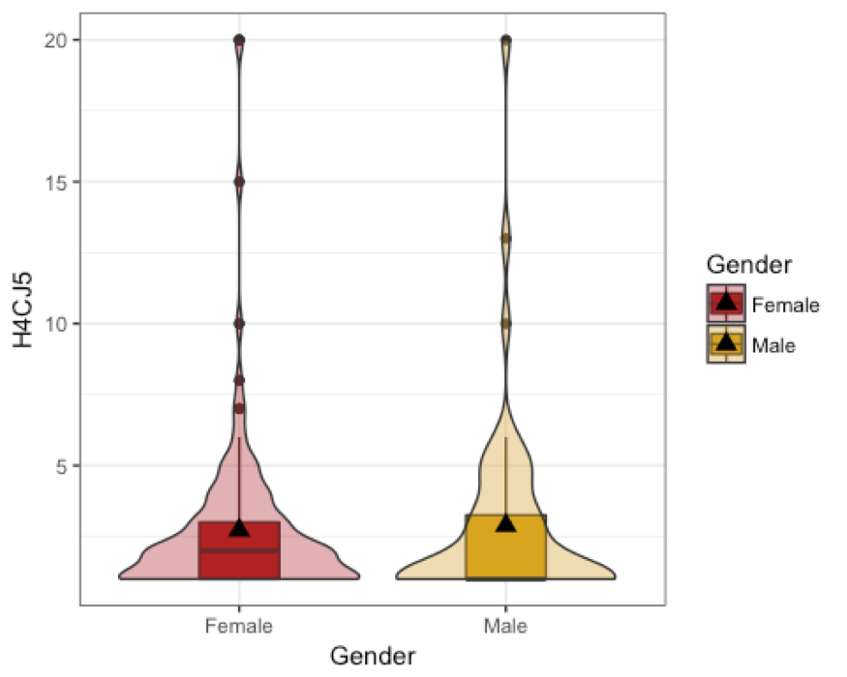
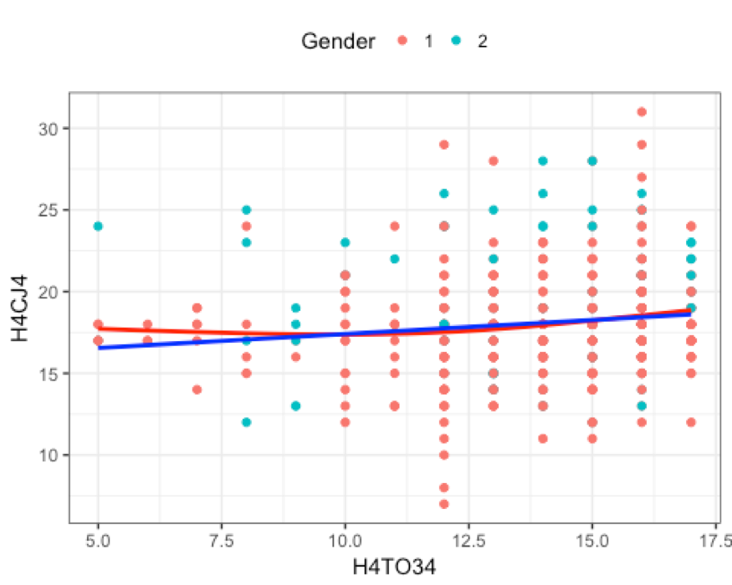
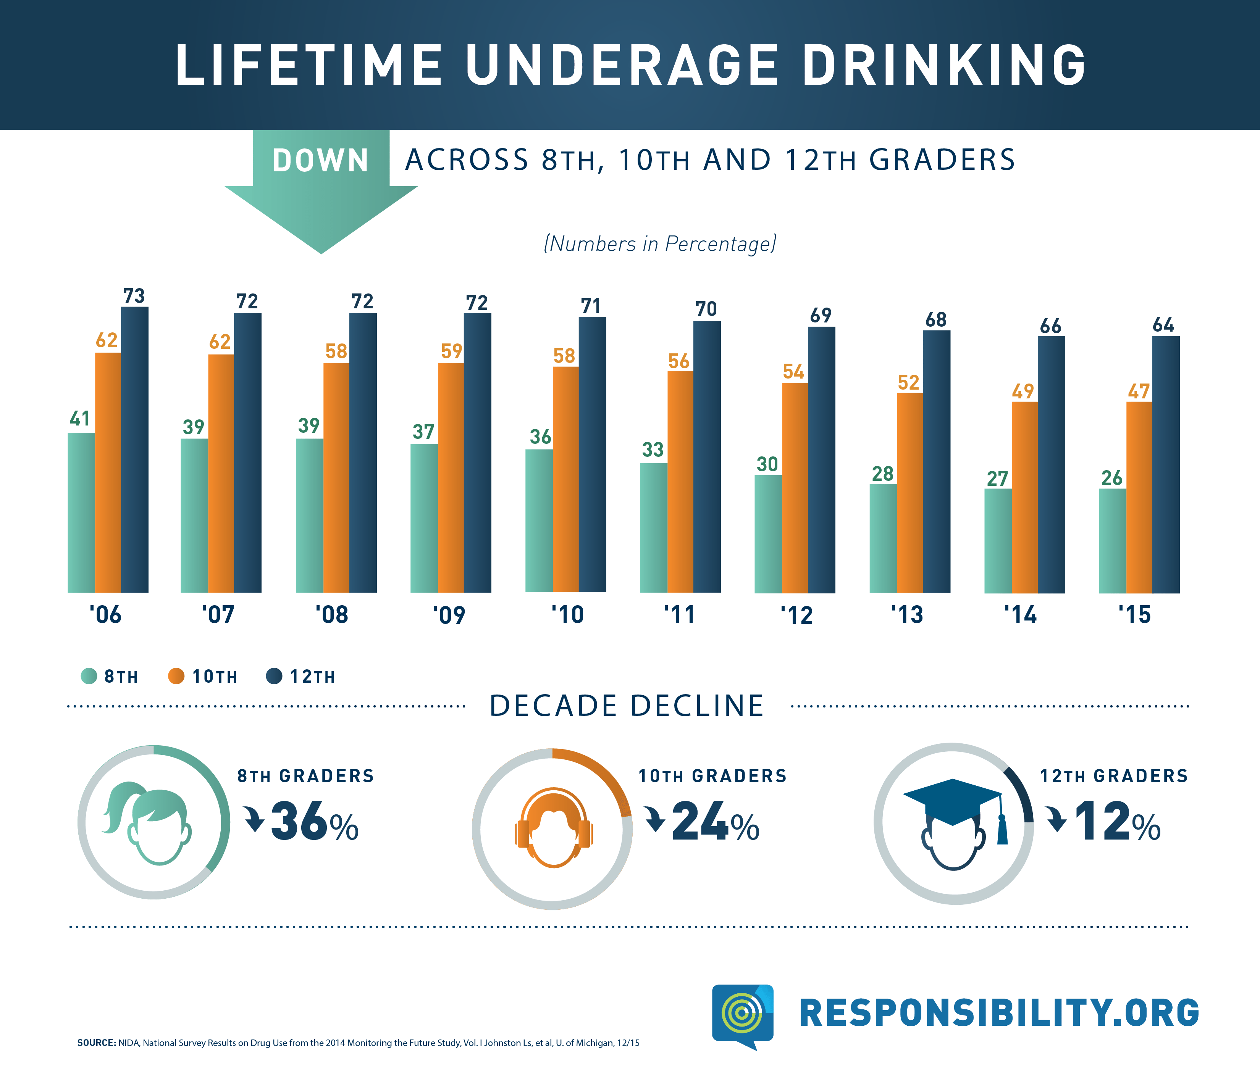
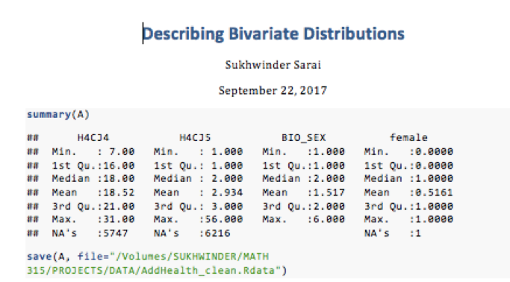
The Association Between Recidivism Rates in Convicts Under The Age of 18 in Accordance to the First Arrest and Age of First Alcoholic Drink
Sarai, S.
California State University, Chico
Senior, MATH 315, Statistical Methods, Section 01
Abstract/ Introduction
Violin Plot Results of Gender and H4CJ5
Scatterplot Results of H4CJ5 and H4TO34
Conclusion/ Discussion
What is Recidivism? Recidivism is one of the most fundamental concepts in criminal justice. It refers to a person's relapse into criminal behavior, often after the person receives sanctions or undergoes intervention for a previous crime.
I hypothesize that criminals that have been arrested by the age of 18 have an increased likelihood of being re-incarcerated.
A majority of criminals who had been released in 2005 were re-incarcerated within three years. This is an alarming rate. This also backs up our research question of recidivism. ¹
The results focus on the question, do criminals that have been arrested by the age of 18 have an increased likelihood of being re-incarcerated if they also drank their first alcoholic drink before the age of 18? The two tests that I conducted to come to my conclusion are bivariate violin and scatterplots. The data was collected from 6504 participants including both males and females of all ethnicities, in which the ages ranged from 24-32, 48.4% were males and 51.6% were females. The data shows that the median age of first arrest is 18.52 and that most participants were arrested 2 times before the age of 18. It was also noted that females were arrested at a younger age than males. Half of the arrests that occurred before the age of 18 is two times. The data shows that most males drank their first alcoholic beverage at the age of 12.2 while most females consumed their first alcoholic drink at the age of 9 years old. Youth who drink alcohol are more likely to experience legal problems, such as arrest for driving or physically hurting someone while drunk.³
Research Questions
Do criminals that have been arrested by the age of 18 have an increased likelihood of being re-incarcerated
Do criminals that have drank their first alcoholic beverage before the age of 18 have an increased chance of being re-incarcerated?
A bivariate analysis was conducted via a Welch two sample t-test was done to compare the means of two independent samples. The mean of how many times were the respondents were arrested before their 18th birthday for females is 1.6 and for males it is________________________. The data for each gender is slightly skewed right, but there is more variability among male respondents.
The relationship we would like to examine is does the age of the first arrest correlate with an increase amount of recidivism before the age of 18.
Null Hypothesis : There is no increase in the number of arrests in relation to the age of the first arrest.
Alternate Hypothesis: There is a positive correlation between the age of the first arrest and the number of times the participant was arrested before the age of 18.
The p-value was higher than 0.05. It was 0.927.
Since the p-value is higher than 0.05, we can accept the null hypothesis.
This scatterplot graph shows that there is a linear slightly positive trend between the variables how old were you the first time you were arrested H4CJ4 and the age of first alcoholic drink consumption H4TO34. This scatterplot also takes into account the variable gender. The data shows that most males drank their first alcoholic beverage at the age of 12.2 while most females consumed their first alcoholic drink at the age of 9 years old. This scatterplot shows that the average age of first arrest for both genders is 18.52.
Sample Measures
Implications
A total of 6504 participants include both male and females of all ages and ethnicities. The data used was taken from the add health. Data was collected from 2008-2009 via 90 minute in-home interviews. The study that we used for our analysis is The National Longitudinal Study of Adolescent Health: Wave IV. The amount of respondents that were incarcerated was 757.
Age Ranges: 24-32 years old
Males: 48.4%
Females: 51.6%
The measures at use are:
How old were you the first time you were arrested? (age at first arrest)
Range of answers: 7-31 years old
How many times were you arrested before you 18th birthday? (frequency <18 arrest)
Range of answers 1-5 times arrested
How old were you when you had your first alcoholic drink? (Age of first drink LT)
Range of answers 5-21 years old
The statistical analysis methods used were a t- test and linear regression.
The variables were tested as moderators and/or confounders was gender.
Studies that have tracked the relationship between recidivism and educational attainment generally point to reduced recidivism and better preparation for transition back into their communities and the workforce upon release (nearly 690,000 people walk out of prisons each year, and several million will mill through local jails).²
Lifetime Underage Drinking
Summary Statistics
References
1. Kirk, D. (2015, Jun 2). Retrieved from https://www.ncbi.nlm.nih.gov/pmc/articles/PMC4460478/
2. Castillo, R., Sessions, W. (2014, May). Retrieved from https://www.ussc.gov/sites/default/files/pdf/research-and-publications/research-publications/2004/200405_Recidivism_First_Offender.pdf
3. Sacks JJ, Gonzales KR, Bouchery EE, Tomedi LE, Brewer RD. 2010 National and State Costs of Excessive Alcohol Consumption. Am J Prev Med2015; 49(5):e73–e79.
4. Underage Drinking Statistics. Retrieved from https://www.responsibility.org/get-the-facts/research/statistics/underage-drinking-statistics/
The amount of respondents that were incarcerated was 757.
The data shows that the median age of first arrest is 18.52. It is evident that a large majority of the participants did not answer the question. For variable H4CJ4, 5747 did not submit a response and for H4CJ5, 6216 did not respond to the question. This large number of NA’s affects our data by hindering the effectiveness of our sample. This large amount of NA’s means that our data is incomplete.
According to the 2015 National Survey on Drug Use and Health (NSDUH) nearly 6.8 million 12-20 year old girls reported consuming alcohol in the past year.
In 2015, slightly more females aged 12 to 20 reported past month alcohol consumption than their male peers (19.8 % v. 20.8%, respectively), however, they reported relatively the same rate of binge drinking (13.4% v. 13.2%), and heavy drinking (3.6% v. 3.0%).
Among 12- to 17-year olds, males and females reported comparatively equal rates of current consumption (9.9% v. 9.3%, respectively) and binge drinking (5.8% v. 5.8%). ⁴
Acknowledgements & Contact info
The authors that I wish to thank are Mitch Borgert, Mariby Cruz and my STATS 315 professor, Dr. Robin Donatello.

