Slide 1
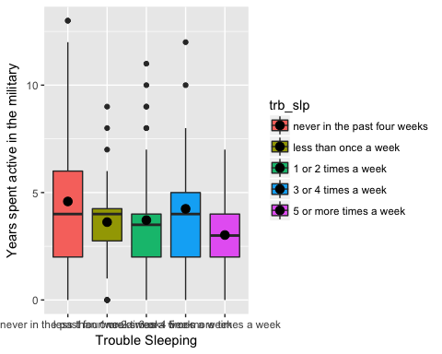
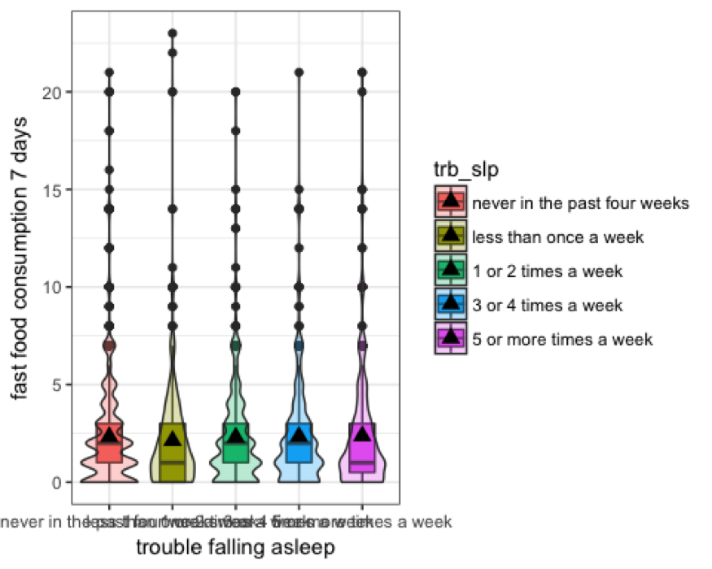
Do Lifestyle Patterns Lead to Sleep Deprivation
By: Juan Perez and Kubir Sandhu
INTRODUCTION
RESULTS
CONCLUSION
-Sleep is an essential part of maintaining a healthy lifestyle, studies show that different lifestyle choices can impact our health based on the change it causes to our sleep patterns (Adams, P. F., & Schoenburn, C. A., 2008). For the purpose of this study, military involvement and consumption of fast food were the most relevant to our focus. These factors were based on the current research that demonstrates a relationship between sleeping patterns and lifestyle choices.
-When looking at current research insufficient sleep is greatly associated with increased caloric consumption, poor dietary habits, and obesity (Adams, P. F., & Schoenburn, C. A., 2008). Studies also show that deployment to combat significantly influenced sleep quality and quantity, personnel reporting combat exposures or mental health symptoms showed an increased chance to have trouble sleeping (Seelig, Amber, et al., 2010).
-The purpose of this study was to identify lifestyle choices that severely impact participants sleep schedule by using the data from the National Longitudinal Study of Adolescent to Adult Health survey Wave 4.
Years Spent in the Military vs. Trouble Staying Asleep
-Based on the results of our regression analysis the only significant correlation between sleep and serving in the military exist in participants waking up 5 or more times a week, (CI 95% (-2.6,-0.7), p=.001).
-Upon conducting statistical test we saw that very few participants experienced a change in their sleeping patterns if they consumed fast food or served in the military. Both figure 1 and figure 2 show minimal difference among the study group.
-We found this to be interesting because the research shows a completely different pattern that demonstrates that consuming higher calorie foods leads people to form sleep deprivation.
-Research also demonstrates that people who are deployed for the military tend to have issues with sleeping patterns.
-The results of this study could in fact be different from what the research states due to the fact that the survey does not provide us with an adequate representation of the lifestyle characteristic we analyzed.
Figure 1: Box plot is demonstrating the relationship between years spend in the military and trouble staying asleep at night.
Fast Food Consumption vs. Trouble Falling Asleep
Objective
METHODS AND MATERIALS
Data were retrieved from the data set National Longitudinal Study of Adolescent to Adult Health (AddHealth) wave 4, an in-home interview codebook.
The sample size was approximately 15,000, of this original value only 13,193 participants data was collected from. Gender of both sexes was used, as well as all ethnicities. Ages ranged from adolescence to young adulthood.
Due to the focus of our study individuals who responses were not appropriate were not used in the data analysis to generate a graph
Of the fast food variable 3500 participants were not included.
Data was analyzed in R- Studio, by graphing univariate and bivariate graphics, as well as analysis such as p-values.
Bivariate Graphic was created in comparing trouble falling asleep and fast food consumption within a 7-day period.
Bivariate Graphic was created in comparing years served in the military and trouble staying asleep.
REFERENCES
Figure 2: Violin plot demonstrating the relationship between consuming fast food and having issues falling asleep at night.
Adams, P. F., & Schoenburn, C. A. (2008). Sleep Duration as a Correlate of Smoking, Alcohol Use, Leisure-Time Physical Inactivity, and Obesity Among Adults: United States, 2004-2006. Retrieved September 10, 2017, from https://pdfs.semanticscholar.org/9cf0/2879d31f2fd3ece4984f9156ca9d4cd0778b.pdf.2
Chaput, Phillppe Jean. “Sleep patterns, diet quality and energy balance.” Physiology & Behavior,Vol. 134, 2014, https://doi.org/10.1016/j.physbeh.2013.09.006.
Cowel, P., & Libert, M. A. (2014). Associations between Sleep Duration, Sleep Quality, and Cognitive Test Performance among Older Adults from Six Middle Income Countries: Results from the Study on Global Ageing and Adult Health (SAGE). Retrieved September 10, 2017, from https://www.ncbi.nlm.nih.gov/pmc/articles/PMC4031401/
Merrill, Ray et.al, “Can an improvement in sleep positively impact on health?”,American Journal of Health Education, Vol 39, 2008, http://dx.doi.org.mantis.csuchico.edu/10.1080/19325037.2008.10599060.
Peuhkuri, Kari, Sihvola, Nora, Korpela, Riitta. “Diet promotes sleep duration and quality.” Nutrition Research, Vol. 32, Issue 5, 2012, Pages 309-319, https://doi.org/10.1016/j.nutres.2012.03.009.
Seelig, Amber et.al.“Sleep Patterns Before, During, and After Deployment to Iraq and Afghanistan.” Sleep, Volume 33, Issue 12, 1 December 2010, Pages 1615–1622, https://doi.org/10.1093/sleep/33.12.1615
Notes:
Juan: Work on Intro/ Abstract , Results, Conclusion.

