Slide 1
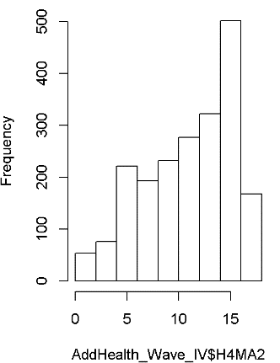
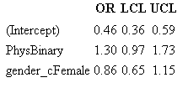
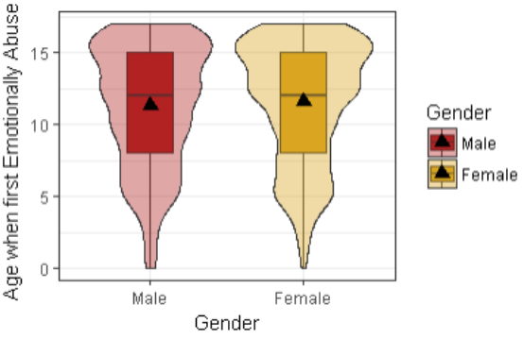
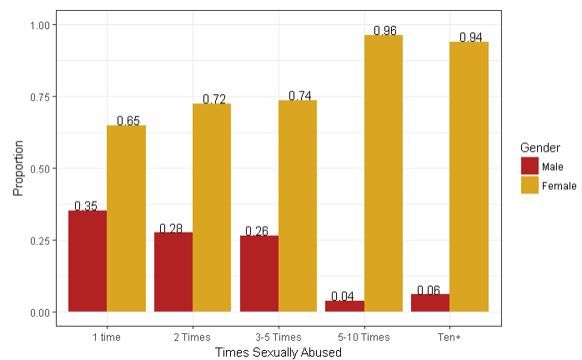
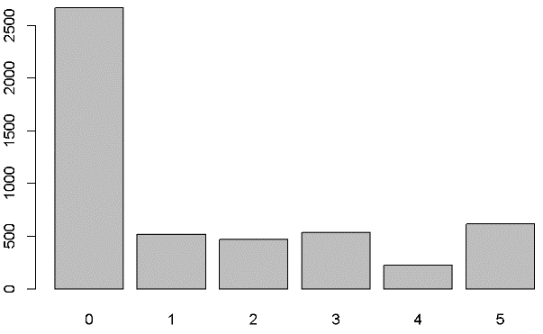
Mistreatment by Adults
Lovodi K. Lee, Theodore T. Lee
California State University, Department of Environmental and Biological Sciences
Introduction
Results
Results
Conclusion
Children are vulnerable targets for abuse, be it domestic or not. Our research involves mistreatment of children up to the age of 17. The abuse being analyzed are emotional abuse, physical abuse, and sexual abuse. We are attempting to find any correlation between the children and the abuse they are receiving, and whether gender or the age at which the abuse started plays a role in how often they are abused. Hopefully, with the results from the analysis, we can find out why children are being abused, and what correlates to the type of abuse, and in turn, can attempt to lower the rate at which children are being abused.
The hypothesis is that gender will play a key role in dictating the type of abuse children are receiving, as well as the frequency of said abuse. Data analysis was conducted to see whether this hypothesis was correct or not.
Univariate of Ages When First Emotionally Abused
The focused age group analyzed were between the ages of 0-17.
The graph above shows the frequency on the Y-Axis, for how often they were emotionally abused.
The X-Axis represents the ages of the children.
Analysis of the data and graph reveals it to be left skewed, meaning younger children were less frequently emotionally abused.
Chi-Square of Sexual Abuse Between Genders
A chi-square test was ran to determine any correlation between the frequency of sexual abuse and males and females.
The graph above shows that females are more prone to be sexually abused over males, even to the extremes of 24:1.
The analysis shows that for males, the graph became right skewed, but is the opposite for females.
The data analysis supported the claim that females were sexually assaulted more frequently than males were.
In our analysis of abuse in children, it was hypothesized that gender would have played a major role in the types of abuse a child would receive, as well as how frequent they would be abused.
With the multiple data analyzed, it was determined that gender was only a key role in determining sexual abuse among children, as females were definitely more frequently abused than males.
It was determined for emotional abuse that the difference in frequency of abuse between the two genders were too minute to be considered significant, thus rejecting the claim that gender played a role in the abuse frequency.
Physical abuse, poverty was used as a potential confounding variable for gender, and although females were less likely to be in poverty by half, the ones who were in poverty were about 30% more likely to be physically abused than males were.
Regression of Physical Abuse and Poverty
Poverty was used as a possible confounding variable for this regression analysis.
The “point” of poverty was set at $10,000 annual income for each household, regardless of being obtained legally or illegally.
The rate of physical abuse
was to be tested between
males and females and to
see the difference in abuse
when poverty is taken into
consideration.
The table on the right shows that the proportion of females being
in poverty compared to males is .46, slightly over half the proportion.
However, females who are in poverty were proportioned to be 1.3 times more likely to be physically abused than males.
Females also reported their annual earned wages at a lower rate of .14 times than males.
Bivariate Analysis of Emotional Abuse
The graph above is a violin plot for males and females in terms of frequency of emotional abuse.
Slightly thinner in the early ages for females than males.
When analyzing the data for both genders, the difference was too minute between them, that the data was considered insignificant due to lack of support.
This concludes that there is no difference in frequency of emotional abuse for both female and male children.
Methods
Data was collected and managed through AddHealth, specifically, Wave IV.
Due to the focus of this research being on individuals who have been abused, the people who were surveyed but not abused were omitted.
Data contained three main categories of abuse types: Emotional Abuse, Physical Abuse, and Sexual Abuse.
Based on the type of abuse, there was also data on the age when said abuse was first committed on the individuals questioned.
Age of first sexual abuse was used as a moderator.
Gender was also taken into account and a binary variable was created for gender.
This variable was also tested to determine if it were a confounder.
First, for univariate analysis, sample size of emotional abuse frequency was determined.
Using the sample of emotional abuse, another graph was made using the age at which emotional abuse started and a total was taken for each age.
Using the frequency and age it started, a bivariate analysis was used with consideration of gender.
A second bivariate was taken, but in relation to sexual abuse instead of emotional abuse.
Univariate of Total Emotional Abuse
The graph above shows total number of people who were emotionally abused.
0 – Never abused or refused to answer.
1 - Abused once
2 - Abused twice
3 - Abused 3-5 times
4 - Abused 5-10 times
5 - Over 10 times
References
Beyaztas, F. Y., MD, Dokgoz, H., MD, Oral, R., MD, & Demirel, Y. (2006, March). Child Physical Abuse: A Five Case Report. Retrieved September 10, 2017, from http://www.mejfm.com/journal/March2006/childabuse.htm
Blaszczak-Boxe, A. (2014, June 2). 1 in 8 US Kids Gets Maltreated. Retrieved November 11, 2017, from https://www.livescience.com/46050-child-abuse-neglect-us-kids.html
The National Longitudinal Study of Adolescent to Adult Health (Add Health). (n.d.). ADDHEALTH: WAVE4 IN-HOME INTERVIEW CODE BOOK. Carolina.

