Slide 1
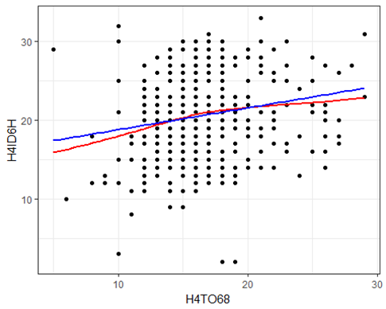
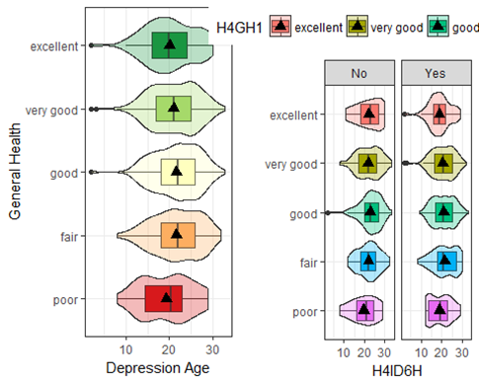
Marijuana Usage Age, Depression Diagnosis and & General Health among Individuals in South Carolina
Mata , A. and Strickland, J.
California State University, Chico
Abstract
Sample Characteristics
Implications
Marijuana, since being first discovered, has been used as a means of recreation by many people. A common notion about marijuana is that it is seen as a “safe” drug to use with no serious complications or side effects. Some individuals use marijuana as a means of coping with certain pressures in their lives such as exams, deadlines, relationships, and stress. Others, use it as a way of relieving boredom, frustration, anxiety, or even depression. On the contrary, some studies suggest that there is some correlation between marijuana consumption and depression. According to a study published by The Office of National Drug Control Policy, they found that teen marijuana use worsened depression symptoms (Office of National Drug Control Policy 2008) Depression is not only a state of being sad, it is a disease that conquers the ability to feel emotion, whether good or bad, whatsoever. Depression not only involves the mind, it also involves the body and thoughts. According to the Anxiety and Depression Association of America, Major Depression Disorder affects more than 16.1 million American adults, or about 6.7% of the U.S. population age 18 and older in a given year (Anxiety and Depression Association of America 2016) In our study, we hope to discover more trends trying to link and correlate marijuana consumption with depression. For our study, we are looking at two questions: 1) Does the age of depression diagnosis corollate to the age of first usage of marijuana? 2) Is marijuana a moderator for depression age and general health? We are hypothesizing that there will be a correlation between the age of depression diagnosis corollate to the age of first usage of marijuana and that marijuana is a moderator for age of depression diagnosis and general health.
-5112 participants in the sample from Add Health
-Age range- 24-32
-Males: 46.0%
-Females: 54.0%
-Ethnicities: White, Black/African American, Asian/Pacific Islander, American Indian, Alaska Native.
In our study, we found that age of depression diagnosis and age of first encounter with marijuana are are statistically correlated and that age of marijuana usage is a moderator for a age of depression and age of first encounter of marijuana usage. This leads us to ask more questions. In regards to gender. In one study, it was found that females have a higher rate of depression and had a higher rate of marijuana usage than males. (Crane 2015) Future studies with the AddHealth data should focus on weather gender is correlated with age of depression and age and marijuana usage while also exploring if gender is a moderator for age of depression diagnosis and for general health. Another thing that can be looked at is weather cigarette smoking and depression is higher or lower between ages. In the same study, it was found that males have a higher rate of smoking cigarettes and depression rates than females.(Crane 2015) It would be interesting to see if this is applicable to this sample.
Results
Figure 1: There was a statistically significant but weak correlation between the Age of a person when they were first diagnosed with depression and the age of a person when they first used marijuana, r(517)=0.18, p < 0.0001.
H4ID6H- Age of depression diagnosis.
H4TO68- Age of first usage of marijuana
Conclusion
Statistically significant but weak correlation between the Age of a person when they were first diagnosed with depression and the age of a person when they first used marijuana.
Marijuana is a moderator for age of depression diagnosis and for general health of the individuals sampled.
Figure 2: When looking at general health and the age of a person when they were first diagnosed with depression, we attempted to see if marijuana usage (No or Yes) would change the relationship between the two variables. The original model yielded a p-value of (p=0.053) which is slightly significant. The stratified ANOVA models for marijuana users and non-users yielded p=values of (p=0.050) and (p=0.436) respectively. There is not a clear difference in the relationship between general health and the age of a person when they were first diagnosed with depression for those who use marijuana and those who don’t. So marijuana usage is a moderating variable for this relationship
References
Crane, N. A., Langenecker, S. A., & Mermelstein, R. J. (2015). Gender differences in the associations among marijuana use, cigarette use, and symptoms of depression during adolescence and young adulthood. Addictive Behaviors, 49, 33-39.
Add Health. (2017, June 16). Retrieved November 29, 2017, from http://www.cpc.unc.edu/projects/addhealth
Teen Marijuana Use Worsens Depression . (2008). Retrieved from https://www.ncjrs.gov/ondcppubs/publications/pdf/marij_mental_hlth.pdf
Facts & Statistics. (n.d.). Retrieved November 29, 2017, from https://adaa.org/about-adaa/press-room/facts-statistics
Methods & Materials
Our study sample came from a codebook called AddHealth Wave IC Codebook, provided by the Carolina Population Center. Data was taken from individuals who are ages 24-32. While there were 5,114 participants, 5,113 individuals sampled had depression and 2,775 individuals had used marijuana in the past. In order to answer our questions proposed above, we did a correlation analysis and we conducted a moderation analysis to see if marijuana usage was a moderator for depression and general health.
Acknowledgements
We would like to thank the Carolina Population Center for allowing us to use their AddHealth Codebook for our study. We would also like to thank our professor Robin Donatello for helping and guiding us though our study.

