Slide 1

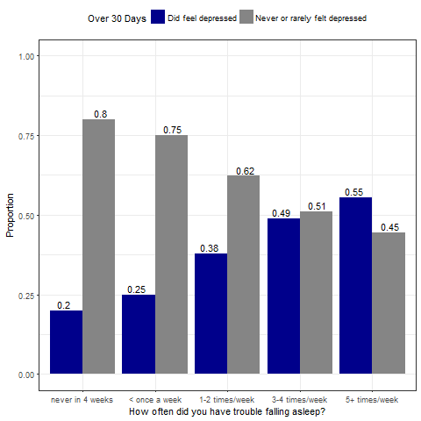
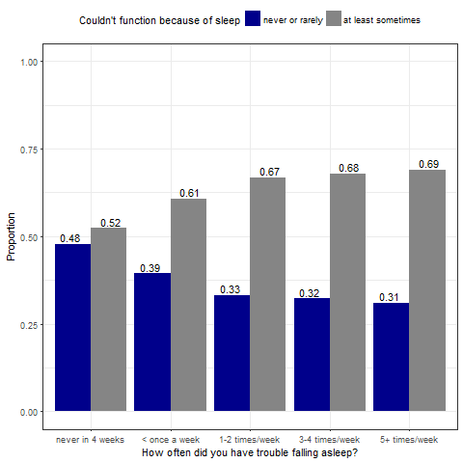
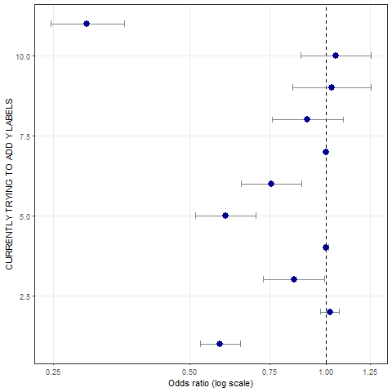
The Relationship between Sleep Disturbance and Mental Health
Seth Myrick and Shyanne Rizzo
California State University, Chico
INTRODUCTION
ANALYSIS METHODS
While there are other factors that play as much or more of a role in leading to depression, and we can’t definitively say “if you don’t sleep well you’ll 100% be depressed”, it is clear that the more poorly you sleep, the more you will feel out of shape mentally in more ways than one.
From Nyer, M., et al. (2013) and “Sleep and Mental Health” we learned that this relationship between sleep and depression may go both ways, as people who already have depression tend to exhibit worse symptoms and functional impairment when struggling to get quality sleep, and that treating sleep disorders can alleviate symptoms of mental health diseases.
We have come to the same conclusion as Dag, B., & Kutlu, F. Y. (2017), controlling for the same factors, though they used much more advanced methods of scoring sleep quality (Pittsburgh Sleep Quality Index) and depression (Beck Depression Inventory).
Baglioni, C., et al. (2011) found non-depressed people with sleep disturbance have a twofold risk to develop depression, compared to people who sleep soundly. We found similar results from odds ratios (3.57 times more likely to be depressed if struggling to sleep 3-4 times/week, 3.7 times for 5+ times/week).
Sleep disturbance is a symptom that is commonly encountered in many psychiatric illnesses that affects their progression. Morbidity studies have demonstrated that insomnia and sleep disturbance, characterized by difficulty falling asleep and/or staying asleep, are associated with an increased risk of major depressive disorder (MDD) and anxiety disorders (Baglioni, C., 2011). Studies show that people who have trouble sleeping are more likely to be negatively impacted health wise. The general field consensus is that further research and replication is needed, specifically towards deciding if sleep disturbances can be a cause of mental health problems, or just a factor that makes pre-existing disorders even worse. A broader age range also needs to be included in future studies, as most currently only involve young adults. With so many correlations between mental health issues and sleep quality, it seems pertinent to start analyzing sleep patterns and figure out methods to improve sleep quality among those with and without mental health issues alike.
Being young adults in college, we chose topics from Addhealth that are relatable. Trouble sleeping, or unhealthy sleep patterns are probably the most common occurrence besides anxiety and depression for students, which is what led us to asking ourselves, “How do certain sleep patterns affect a person? Are sleep issues related to mental health issues like depression, and can certain sleep patterns be a precursor to BPD, or do they just exacerbate them?” With the Addhealth survey, we can begin to assess the relationship between sleeping patterns and depression.
Our observations and data available led us to a narrowed-down main research question:
“Is there a relationship between sleep disturbance and mental health, namely depression?” (We hypothesize yes)
Sleep: These questions that we included for our research asked how often a participant had trouble staying asleep/falling asleep, and if they snored, not how long they slept for.
Mental Health: Responses included were either measured on a likert frequency (“never/rarely/sometimes/often”) or opinion(attractiveness = “very/ moderately/ slightly/not at all”) scale. The questions asked how participants felt about the world around them, themselves, how they compare to others, and how they think others see them.
Some ordinal categorical variables were split into binary categories for testing purposes, such as turning a sleep disturbance or mental health question into “event/non-event”.
All of the mental health, personality, and sleep variables we used for research were categorical.
The data used contained no outliers, only missing data to be coded out.
Constructed Depression Variable: Combined two variables, one directly asking if the participant has been diagnosed with depression, the other being a likert scale of frequency of feeling depressed that month. If the score was greater than 2, we conclude the participant is depressed.
Moderation Testing:
We tested the relationship between trouble staying asleep and depression, and the relationship between trouble falling asleep and ability to function the next day, considering snoring/not snoring, gender, and smoking/not smoking as potential moderators.
We did not test the relationship between trouble falling asleep and depression with the potential moderators, as we assumed we would get the same results as the moderation test for trouble staying asleep and depression, since the two relationships are almost identical.
Confounder Testing:
We tested the relationship between trouble falling asleep and depression, and the relationship between ability to function after poor sleep and depression, considering smoking status as a confounder.
Like with moderation, we did not test smoking as a confounder on the relationship between trouble staying asleep and depression, for the same reason as before.
Final Model: Also included income(categories with smallest being less than $5,000 annually and max being $150,000+) and BMI to be tested for their effect on the relationship between sleep disturbance and depression.
We’ve concluded that frequent sleep disturbance plays a significant role in determining depression, we see that as one struggles to fall/stay asleep more often and sleep quality declines, the likelihood that one will begin to become depressive and lose ability to function as a result significantly increases as well.
This comes after controlling for the effect that smoking, gender, BMI, income, and other sleep factors like snoring also have on the relationship through a multivariable model.
IMPLICATIONS
These results can be used to inform the work of other researchers on this subject and to build evidence proving this relationship, so that more medical effort and public awareness can be put towards improving people’s sleep patterns and keeping them mentally fit.
Limitations:
There was limited qualitative sleep data, we would have liked to work with more. The format of the quantitative sleep data was basic sleep/wake times.
The mental health section had many interesting questions for participants, like “How often were you bothered by things that usually don’t?”, but only a few of them could be clearly related back to a specific mental health issue like depression.
Since as many as 40 percent of those with depression can trace it to a genetic link, we would have loved to test for family history of mental illness as a predictor/confounder of the sleep~depression relationship. No such variables existed.
Future Research:
Gather more data creating survey questions about sleep patterns. An ideal method would be using an effective field tested-and-approved survey like the Pittsburgh Sleep Quality Index (PSQI).
Include more quantitative testing with addhealth variables having to do with sleep. Determine how much sleep length also affects mental health issues.
Test sleep disturbance’s relationship with addhealth personality/behavior questions for significance as well.
Work to distinguish the difference between sleep’s effect on depression, and depression’s effect on sleep. As of now this is cloudy in even the best research.
Our results support the hypothesis that there is a relationship between sleep quality and mental health, namely depression.
SAMPLE CHARACTERISTICS
This research uses the National Longitudinal Study of Adolescent to Adult Health (Addhealth), a study of a nationally representative sample of adolescents grade 7-12 in the U.S. during the 1994-95 school year.
The survey has followed respondents “into young adulthood with 4 in-home interviews, the most recent completed in 2008.” Our data is from Wave IV, the 2008 survey.
Table 1. Characteristics of key variables
Figure 2. Proportion of depression by sleep disturbance frequency
REFERENCES
1. Baglioni, C., Battagliese, G., Feige, B., Spiegelhalder, K., Nissen, C., Voderholzer, U. al. (2011). Insomnia as a predictor of depression: a meta-analytic evaluation of longitudinal epidemiological studies. Journal of Affective Disorders, 2011;135:10–19.
2. Dag, B., & Kutlu, F. Y. (2017). The relationship between sleep quality and depressive symptoms in adolescents. Turkish Journal Of Medical Sciences, 47(3), 721-727. doi:10.3906/sag-1507-14
3. Faulkner, S., & Bee, P. (2017). Experiences, perspectives and priorities of people with schizophrenia spectrum disorders regarding sleep disturbance and its treatment: a qualitative study. BMC Psychiatry, 171-17. doi:10.1186/s12888-017-1329-8
4. Lemola, S., Ledermann, T., & Friedman, E. M. (2013). Variability of Sleep Duration Is Related to Subjective Sleep Quality and Subjective Well-Being: An Actigraphy Study. Plos ONE, 8(8), 1-9. doi:10.1371/journal.pone.0071292
5. N.a. (2009). Sleep and mental health. Harvard Health Publications, Harvard Mental Health Letter.
6. Nyer, M., Farabaugh, A., Fehling, K., Soskin, D., Holt, D., Papakostas, G., Mischoulon, D. (2013). Relationship between sleep disturbance and depression, anxiety, and functioning in college students. Depression and Anxiety, 30(9), 873-880.
7. Plante, D., Frankenburg, F., Fitzmaurice, G., & Zanarini, M. (2013). Relationship between sleep disturbance and recovery in patients with borderline personality disorder. Journal of Psychosomatic Research, 74(4).
RESULTS
Figure 3. Proportion of reported malaise by sleep disturbance frequency
Figures 2 and 3 show that depression increased 35% from no sleep disturbance to disturbance 5+ times/week, and ability to function decreased 17% as well.
Differences in depression were significant across all levels of disturbance aside from 3-4 times/week vs 5+. The same goes for functional ability except 1-2 times/week vs. 3-4 times, and 3-4 times vs. 5+.
Figure 1. Odds ratios for the sleep disturbance~depression model

Slide 2
Poster Draft (Due 11/29)
Peer Review Poster Draft (Due 12/1)
Final version of poster (Due 12/3)
Final poster scoring (Due 12/8)
Team evaluation (Due 12/8)
Build your exam questions (Due 12/6)

Slide 3
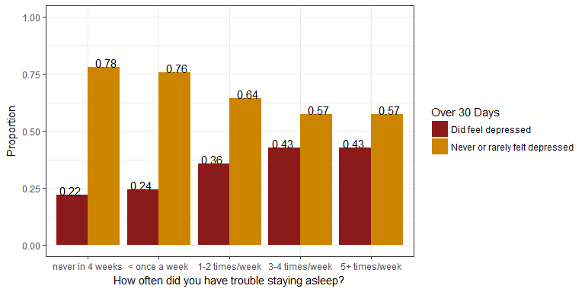
Bivariate Analyses: Chi-Square
The distribution of depression is significantly different across almost all levels of sleep quality. People who felt depressed make up 22% of those who slept soundly all month, but 43% of those who had trouble staying asleep 5+ times every week.
We conclude that there is an association between how often you have trouble staying asleep and feelings of depression (X-squared = 179.28, df = 4, p-value < .0001).
The proportion of those who felt depressed significantly differs between all pairs of sleep disturbance except between never in 4 weeks vs. < once a week (22% vs 24% depressed), and 3-4 times/week vs. 5+ times/week (43% vs 43% depressed).
Essentially, people who struggle staying asleep often have more trouble with depression than those who sleep more soundly.
Notes:
http://www.cookbook-r.com/Graphs/Legends_(ggplot2)/#changing-the-position-of-the-legend
Consider redrawing your graphics to only show the % of the “positive” outcome. I demo’d this in the moderation assignment.

Slide 4
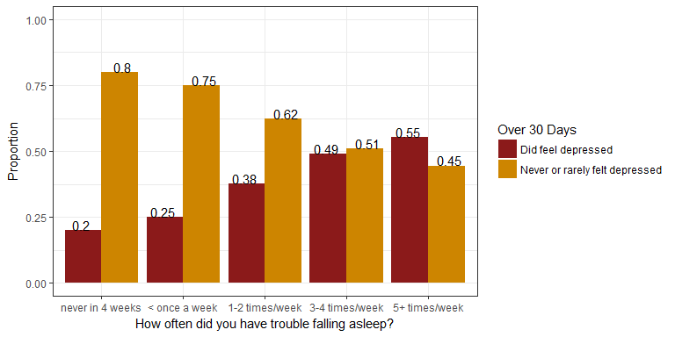
Bivariate Analyses: Chi-Square
The distribution of depression is significantly different across all but one pair of sleep quality levels. People who felt depressed make up 20% of those who slept soundly all month, and 55% of those who had trouble falling asleep 5+ times every week.
Put simply, people who struggle falling asleep often have more trouble with depression compared to those who sleep more soundly.
We conclude that there is an association between how often you have trouble falling asleep and feelings of depression (X-squared = 350.39, df = 4, p-value < .0001).
The proportion of those who felt depressed significantly differs between all pairs of disturbance falling asleep except between 3-4 times/wk and 5+ times/wk (49% vs 55% depressed)

Slide 5
Moderation Testing: Snoring, Gender, Smoking
Snoring and gender were very clearly NOT moderators, having no impact at all on the test statistics ran and visual interpretations created when including them as moderators.
Smoking seemed to have some effect on the relationships tested, but not enough to warrant controlling for (p values all still < .0001, differences in proportions didn’t change relationship direction and/or strength for the two stratified groups) i.e., even though there were more depressed smokers than nonsmokers, the "less sleep=more reported depression" still existed (statistically) strongly in both groups.
Although smoking status was NOT a moderator since all relationships were still significant and strong when controlling for it, we did find that being a smoker is almost as strong of a predictor for depression as some sleep variables (odds ratios of 1.86 and 1.77 times more likely to be depressed if a smoker, depending on the sleep~depression relationship tested with).
Note to self: Review Estrada_Matson for final poster draft

