Slide 1
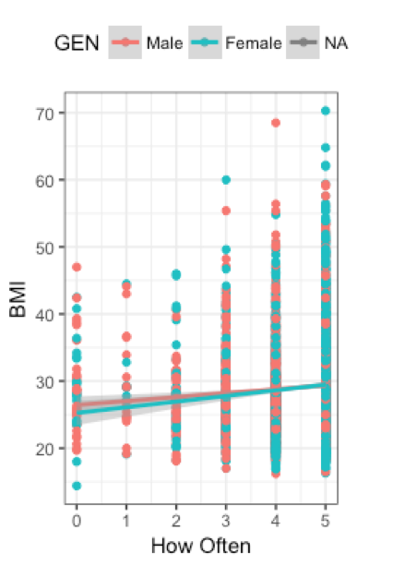
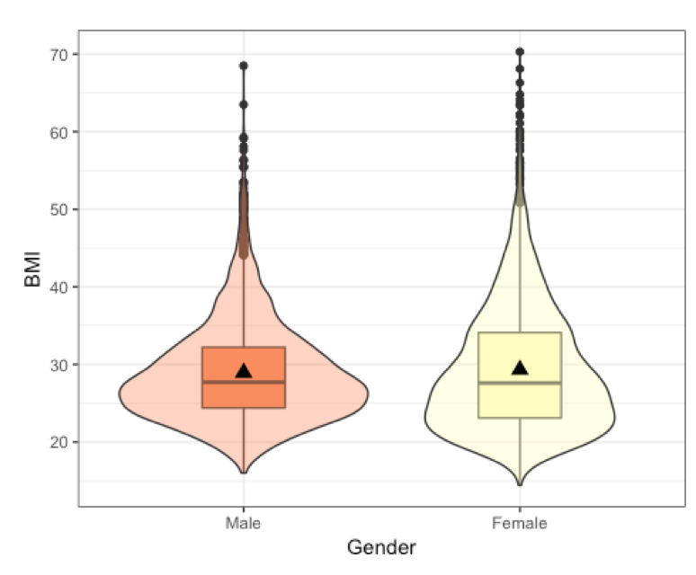
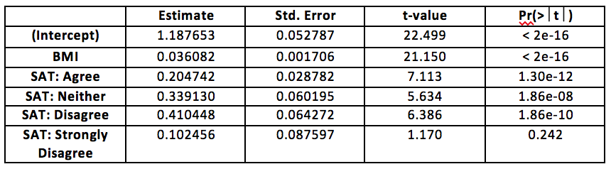
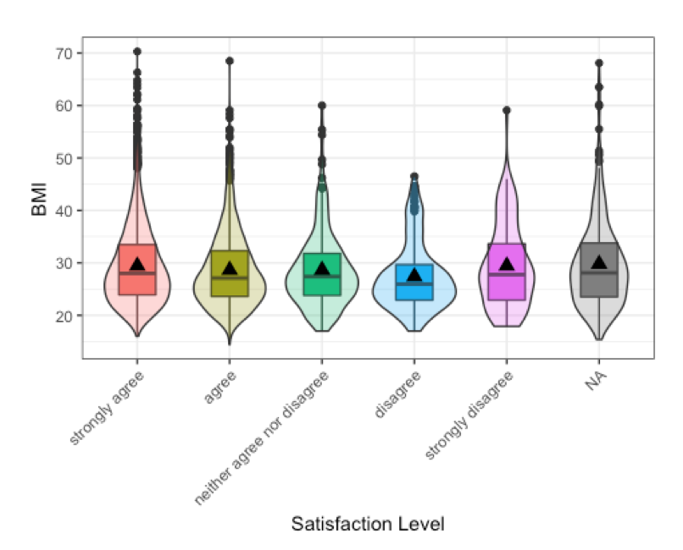
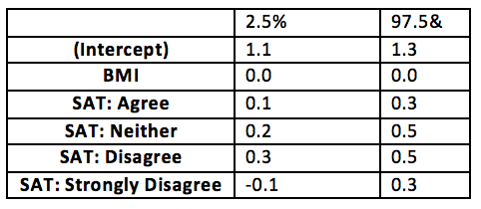
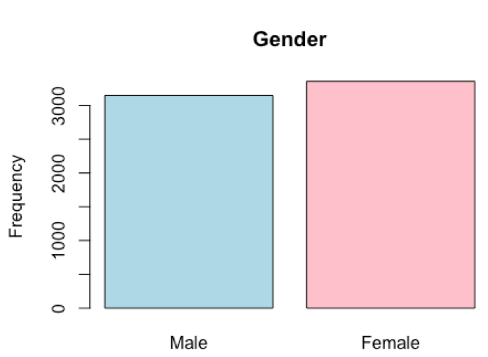
The Correlation Between Maternal Relationships and Rising Obesity Rates, Namely BMI
Hurley P., Taue M.
California State University, Chico
Introduction
Regression Analysis
Conclusions
According to most recent data, the prevalence of obesity in US adults is more than one third, 36.5% of the population. Public health officials have gone as far as to call obesity an epidemic.
Several studies have shown that parent–child interactions and the home environment can greatly influence children's behaviors related to food intake and physical activity. Parents are role models and are able to shape their child's development of eating habits and activity levels. In most cases the child is going to adopt the habits and lifestyles of their parents or caregivers. Findings show that parental obesity more than doubles the risk of a child 10 years and under, who is more likely to become obese as an adult. However, reports show that mother–child obesity has a stronger relationship than father–child obesity.
This research project investigates the question of whether or not the relationship you have with your mother affects your BMI and overall general health. In addition, it will also explore how difference in gender may affect the probability of obesity and the quality of maternal relationships. We hypothesize that high-quality maternal relationships produce young adults with lower BMI rates.
Based on our results from whether or not the relationship you have with your mother affects your BMI we can conclude that there is positive relationship between these two variables.
Overall the trend in our data shows there is a significant difference between BMIs of males and females. Overall BMI does seem to be related the relationship you have with your mother. Parents are role models and are able to shape their child's development of eating habits and activity levels. In most cases the child is going to adopt the habits and lifestyles of their parents or caregivers
Some practical implications of these findings would be that by trying and working to prevent diabetes and high blood pressure from an early age then maybe having increasing BMI could be prevented. Further research that should be conducted would be to examine the relationship between that the father and what affect these relationships have on BMI and measure these effects against the relationship with the mother.
Figure 2. Summary statistics of the varying BMI readings of the respondents. BMI's range from 14.4 to 70.3. The average BMI was 29.14, which is considered overweight. The majority (61%) lies within the normal (18.5 – <25) or overweight (25 – <30) categories. 37.3% of adolescents identified as obese.
Bivariate Analysis
Methods
References
To understand and analyze the quality of maternal relationships and the effect they have on BMI and overall general health we took data from The National Longitudinal Study of Adolescent Health: Wave IV taking place from 2008 to 2009 in a series of in-home interviews. The survey is a nationally representative sample of U.S. consisting of 5114 adolescents and young adults ranging in age from 24 to 32.
We transformed out data sets using the statistical program R and RStudio to interpret our data by preforming univariate and bivariate analyses, and logistical regression models to create graphics and tables in order to get meaningful results that we could interpret and draw conclusions from.
The variables that used in our research are:
Gender (BIO_SEX)
BMI - Body Mass Index (H4BMI)
BMI Classification (H4BMICLS)
General Health (H4GH1)
Are you satisfied with the way you and your mother communicate with each other? (H4WP23)
How often do you talk with your mother? (H4WP22)
We truncated the satisfaction level you have with your mother into a binary variable. General health was also truncated into a binary variable when needed for data analysis as well. We tested gender and how satisfied you are with the relationship you have with your mother as cofounding variables.
1. Bell, L. (2007). Increasing body mass index z-score is continuously associated with complications of overweight in children, even in the healthy weight range. The Journal of ClinicalEndocrinology and Metabolism, 92(2), 517-22.
2. Ogden, C., Carroll, M., Curtin, L., Mcdowell, M., Tabak, C., & Flegal, K. (2006). Prevalence of Overweight and Obesity in the United States, 1999-2004. JAMA, 295(13), 1549-1555.
3. “Overweight & Obesity.” Centers for Disease Control and Prevention, Centers for Disease Control and Prevention, 29 Aug. 2017, www.cdc.gov/obesity/data/adult.html.
4. Wheelwright, J. (2014, January 01). Childhood Obesity Reversed. Discover, p. 21.
Figure 3. The bivariate relationship between gender of the respondents and the varying BMIs. After conducting a t-test our p-value is 0.0616, with a 95% confidence interval. It is on the edge of significance which suggests that there might be a significant average in the difference between males and females in this study.
Figure 5. The linear regression relationship between how often you talk to your mother and BMI. There is a small positive correlation between how often you talk with your mother and your BMI. The correlation coefficient for females and males is essentially the same being 0.088. The points are clustered, but as the time spent talking to your mother increases, the BMI does increase.
Acknowledgements
Testing for cofounders we tested the relationship between general health and BMI with satisfaction level. After controlling for satisfaction level, those who strongly agree that they are satisfied with their maternal relationship have a BMI that increases by 0.036 (p<0.0001). Those who agreed that they were satisfied with their maternal relationship have 0.205 (0.1,0.3,p<0.0001) higher BMIs compared to those who strongly agree that they are satisfied with their maternal relationship. Those who could neither agree or disagree with the satisfaction they have with their maternal relationship have 0.339 (0.2,0.5, p<0.0001) higher BMIs compared to those who strongly agree that they are satisfied with their maternal relationship. Those who disagree with being satisfied with their maternal relationship have 0.410 (0.3,0.5, p<0.0001) higher BMIs as compared to those who strongly agree that they are satisfied with their maternal relationship. Those who strongly disagree that they are satisfied with their maternal relationship have 0.102 (-0.1,0.3, p=0.242) higher BIMs as compared to those who strongly agree that they are satisfied with their maternal relationship. After controlling for satisfaction level, general health is significantly associated with BMI. General health is associated with BMI, the average BMI increases as the general health level decreases.
Phurley@mail.csuchico.edu
California State University, Chico Seal (2017)
Univariate Analysis
Figure 4. The bivariate relationship between BMI between the quality of maternal relationships. After running an ANOVA test on this data we got a p-value of 0.0013. There is sufficient evidence to support the claim that there is a relationship between the satisfaction with the way you communicate with your mother and BMI.
Figure 1. Univariate bar graph of the frequency of males and females in this survey. Males makeup up 3147 respondents, representing 48.4%, while the females consist of 3356 respondents, representing 51.6% of the population.

