Slide 1
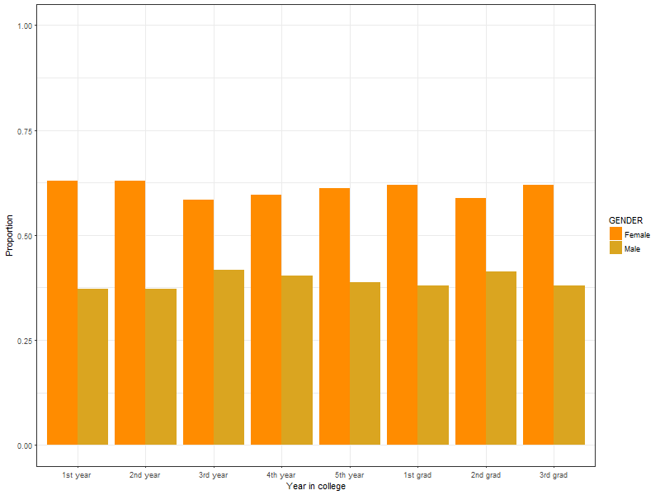
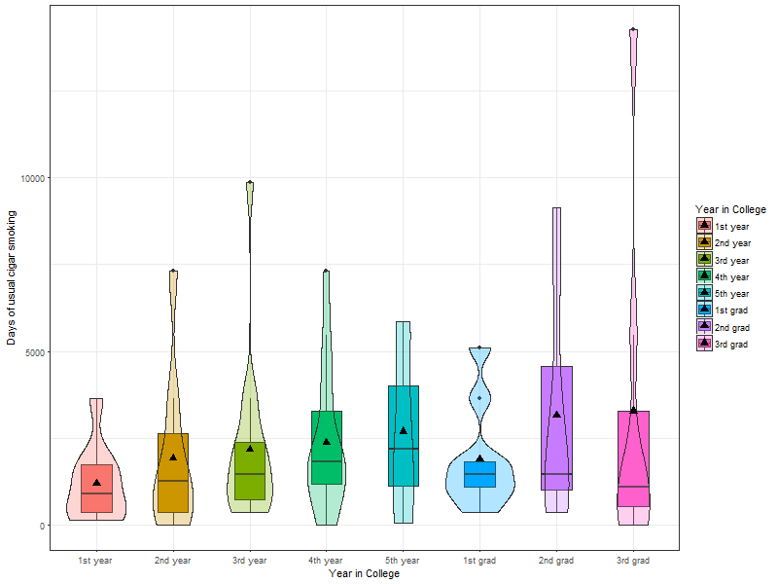
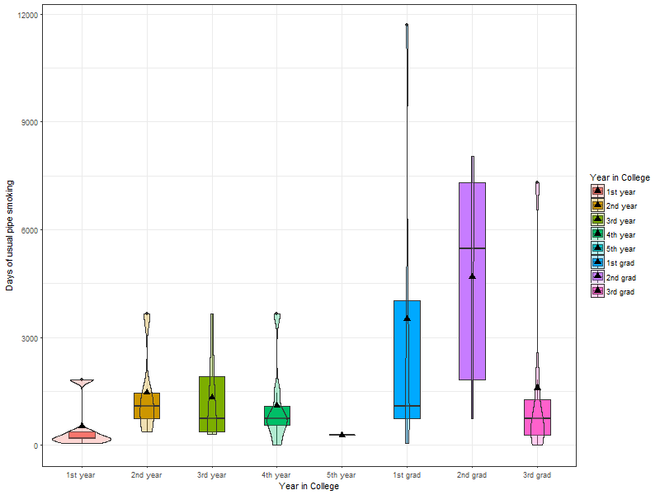
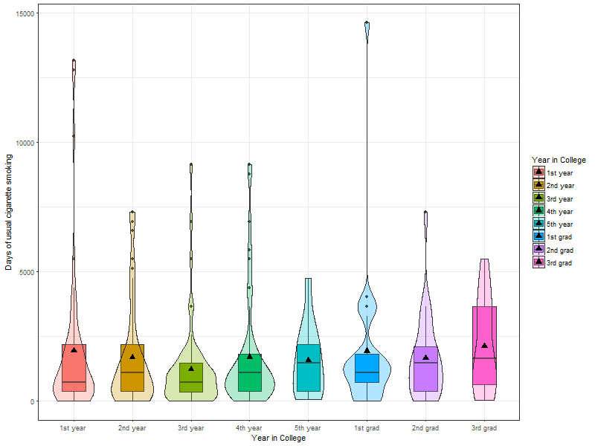

Is there a correlation between gender and smoking habits in college?
Castro, E., Villegas, B.
FALL 2017 MATH 315: Applied Statistical Methods I, California State University, Chico
Introduction
Sample Characteristics
Conclusion/Discussion
Our group focused our attention on the correlation between gender and smoking habits in college students. The main focus was whether a college student who smoked was more likely to be a female or male. Many forms of smoking exist so our focus was on anyone who smoked any substance that was not synthetic (chemically manufactured). We accounted for smoking cannabis, tobacco, and vaping. Articles reviewed were directly related to smoking habits that included hook, vaping, cannabis smoking and cigarette smoking. Articles reviewed indicated an apparent increase in smoking was due to the fact that flavored tobacco was easily accessible and because of the increase of ways someone could smoke.
Variables
SEX | FEMALE: 24,575 (57%) MALE: 18,518 (43%)
YEAR IN COLLEGE | FIRST YEAR UNDERGRADUATES: 501 SECOND YEAR UNDERGRADUATES: 805 THRID YEAR UNDERGRADUATES: 581 FOURTH YEAR UNDERGRADUATES: 416 FIFTH YEAR UNDERGRADUATES: 103 FIRST YEAR GRADUATES: 347 SECOND YEAR GRADUATES: 240 THIRD YEAR GRADUATES: 245
Based on our results between gender and smoking habits in college we can conclude that gender doesn’t play a major role in the smoking habits of a college student. However we can see that as females enter their first year of graduate school, there smoking habits decrease while males smoking habits remain the same .
Our results brought us to only one relationship between smoking habits and age across both genders. We can see with the inclusion of age after controlling for the usual frequency when smoking out of a pipe, the average age until a first full cigarette was smoked increases as the age of a first full bowl of tobacco smoked out of a pipe decreases.
 | MIN | 1st Qu | Median | Mean | 3rd Qu | Max
Days of usual cigarette smoking | 1 | 1 | 504 | 74081 | 122724 | 999999
Days of usual cigar smoking | 1 | 731 | 17532 | 120551 | 175320 | 999999
Days of usual pipe smoking | 1 | 87660 | 175320 | 214126 | 280512 | 999999
Implications
Methods
Results
Implications that may have occurred in the study may be due to the big difference in sample size when comparing females and males respondents in the NESARC Wave book. 57% of respondents were females while 43% of respondents were males. Out of the data 23,901 respondents were lifetime nonsmokers which concluded to our sample size being cut down in half. Accounting for Years in College only 3238 respondents were in College during the year of 2000-2001.
Data used in this research was from the NESARC Wave 1 Code Book which was a data set of 43, 093
18518 of the respondents were Male (43%)
24575 of the respondents were Female (57%)
NESARC survey Wave 1 was conducted from 2001 to 2002
Graphical representations from R studio
Q~C Analysis of Variance: conducted for visual representation of bivariate relationship between categorical explanatory variable and a quantitative response variable
Variables included
S1Q7D (Years in College)
S3AQ3D2R (Days of usual cigar smoking)
S3BQ4 (Days of usual pipe smoking)
S3AQ3D2R (Days of usual cigarette smoking)
Year in college vs Smoking status
 | 1st year Undergrad | 2nd year Undergrad | 3rd year Undergrad | 4th year Undergrad | 5th year Undergrad | 1st year Graduate | 2nd year Graduate | 3rd year Graduate
Current user | Female: 24% Male: 39% | Female: 20% Male: 30% | Female: 24% Male: 32% | Female: 21% Male: 25% | Female: 26% Male: 17% | Female: 11% Male: 20% | Female: 10% Male: 22% | Female: 10% Male: 23%
Ex user | Female: 8% Male: 13% | Female: 9% Male: 11% | Female: 9% Male: 10% | Female: 8% Male: 14% | Female: 11% Male: 8% | Female: 14% Male: 11% | Female: 13% Male: 11% | Female: 12% Male: 17%
Lifetime nonsmoker | Female: 68% Male: 48% | Female: 71% Male: 59% | Female: 67% Male: 58% | Female: 71% Male: 61% | Female: 63% Male: 75% | Female: 75% Male: 69% | Female: 77% Male: 67% | Female: 78% Male: 60%
References
Anonymous. (2015). Why People Start Smoking in College. USA Today, 144(2843), 6.
Erin Nuzzo, Ariel Shensa, Kevin H. Kim, Michael J. Fine, Tracey E. Barnett, Robert Cook, Brian A. Primack; Associations between hookah tobacco smoking knowledge and hookah smoking behavior among US college students, Health Education Research, Volume 28, Issue 1, 1 February 2013, Pages 92–100, https://doi.org/10.1093/her/cys095
Braun, R. E., Glassman, T., Wohlwend, J., Whewell, A., & Reindl, D. M. (2011). Hookah Use Among College Students from a Midwest University. Journal of Community Health, 37(2), 294-298. doi:10.1007/s10900-011-9444-9
Printz, C. (2015). Smoke signals: New reports reflect “staggering” increases in youth e‐cigarette usage. Cancer, 121(22), 3927-3928.
Using Analysis of Variance test no clear consistency in the smoking status and year in college is apparent. The smoking status and year in college was different between males and females but no apparent pattern was noted.
H_{a}: At least one group mean is different.
Alternate hypothesis is supported because there is sufficient evidence that there is a difference in current user and year in college.
p<0.0001

