Slide 1
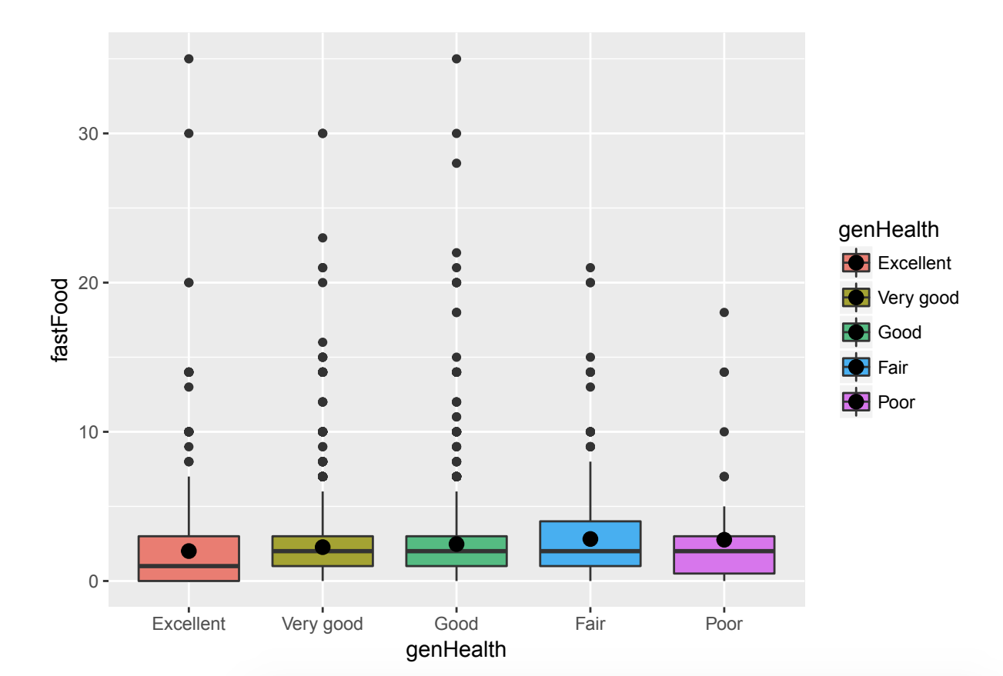
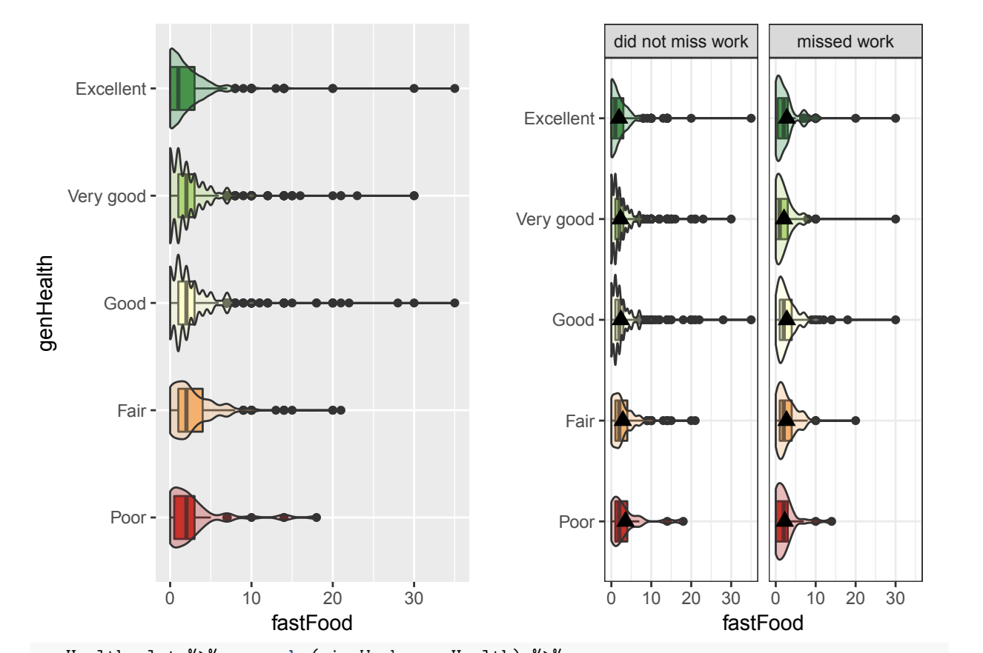
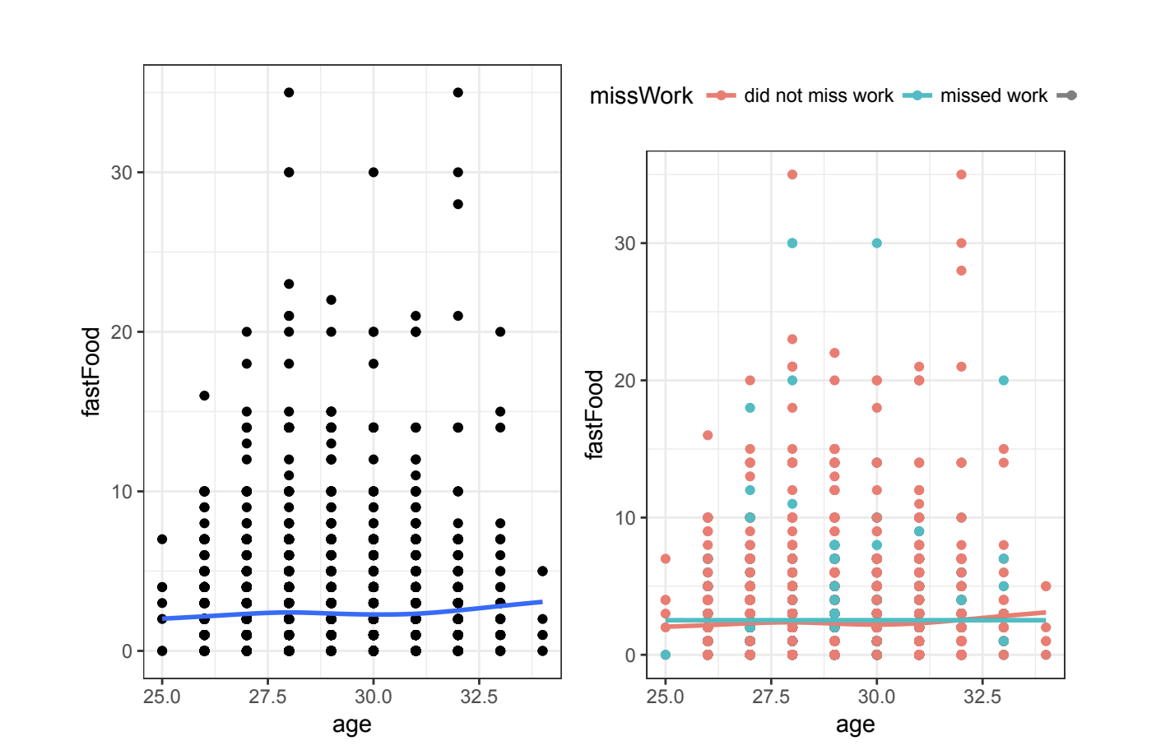
An Investigation of Fast-Food and its Association with General Health
Prado J., Sterback L.
Donatello R. DrPH California State University, Chico
Introduction
Sample Characteristics
Results
The consumption of fast-food has been known to affect a person’s health and everyday life. Due to the low nutritional value, high fat, high calorie and sodium content of these foods can lead to extensive health problems. Those who consume it daily contribute to the deterioration of their health, both physically and mentally. Research claims that the ingestion of junk food increases you chance of getting a health problem by 35 percent, whether it's obesity or heart disease. When a person becomes addicted to fast food it can also cause them to miss school or work from feeling fatigue or illness.
The purpose of this investigation is to determine if there is a relationship between individuals who eat fast-food more than usual and how it influences their overall health. The person who eats fast-food regularly is prone to having a higher risk of getting sick and more likely to miss work.
Univariate Analysis
DataSet | N(%) | Min | 1st Qu. | Median | Mean | 3rd Qu. | Max. | STDEV
FastFood | 19.5 | 0.0 | 2.0 | 2.3 | 3.355 | 3 | 998.9
Conclusion
Bivariate Analysis
Implications
Methods
This research is important because it reveals how people who obtain a poor diet regularly could run into serious health issues. Some people are more at risk than others through genetics or simply because of a bad habit that has lost control. Ongoing research has led to informing people the potential dangers of eating junk-food daily. Even though there are people who fear addiction, there is always a solution wether its to give the refrigerator a makeover, attend overeaters anonymous, or even seek serious help by consulting your doctor (Gunnars, 2017).
In order to comprehend and analyze the connection between poor eating habits and how it affects human health, we used a nationally representative sample of people ages 28-32 retrieved from the AddHealth Data Set. This provided data set contained 5,114 respondents in the years 2008-2009, in this specific study we focused on those individuals who consumed fast-food more than once a week and how they felt it affected their overall health. The variables that we used were H4GHI, H4GH2, H4GH7 and H4GH8. The variables that were tested as moderators were H4GH2 and H4GH8.
We utilized our data sets by using RStudio, which allowed us to implement statistical computing and graphics. We also used this in order to interpret the data and view relationships between variables. This allowed us to extract logistical regression models, bivariate and univariate analyses to create graphics, tables and charts in order to get accurate results from where we could derive our conclusions.
Regression Analysis
References
A. Astrup, J. Dyerberg, S. Stender. (2007). Fastfood: Unhealthy and Unfriendly. International Journal of Obesity, 31, 887–890.
Gunnars, Kris. Food Addiction- A serious Problem with a Simple Solution. (2017, June 9). Retrieved from https://www.healthline.com/nutrition/how-to-overcome-food-addiction#modal-close
3. Jacobs, David R. (2006) Fast food and sedentary lifestyle: a combination that leads to obesity. The American Journal of Clinical Nutrition.
4. Myles, Ian A. (2014). Fast food fever: reviewing the impacts of the Western diet on Immunity. BioMed Central Nutrition Journal, 13:61

