Slide 1

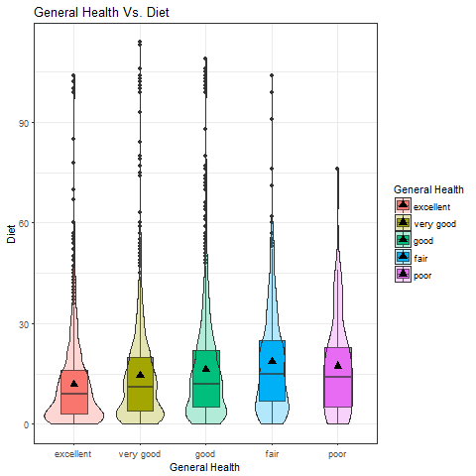
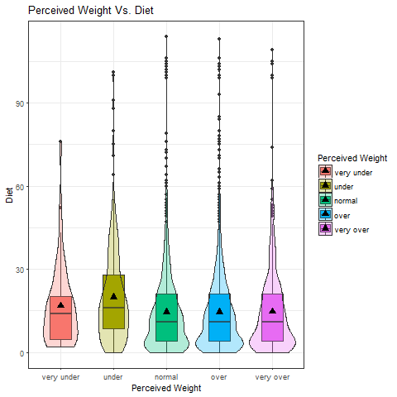
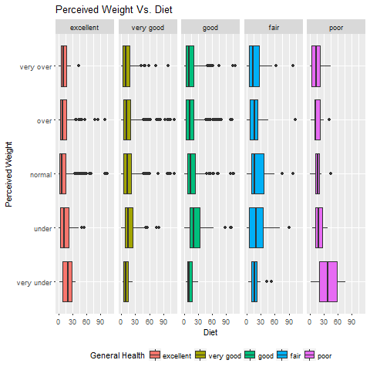
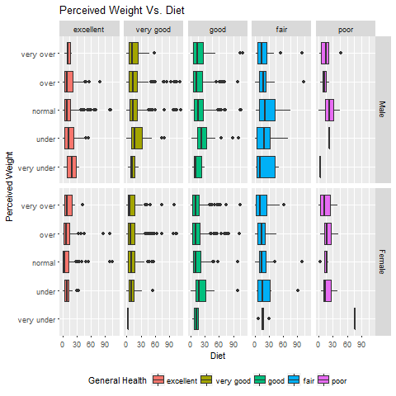
The Association Between Body Image Perception and Dietary Choices
Dan Hiney, Manpreet Mann, and Rana Yousaf Department of Mathematics, California State University, Chico
Objectives
Research Questions
Does a person’s perceived weight or perceived general health affect their weekly dietary choices?
Is there a difference in this association across gender lines?
Results
Examine the relationship between body image perception and a person’s dietary choices in terms of fast food and sugar-filled drink consumption across general health perception across gender lines.
The goal of this study was to examine the relationship between body image perception and dietary choices.
There is a significant relationship between perceived general health and dietary choices.
There is a significant relationship between perceived weight and dietary choices.
However, when building a linear model between perceived general health, perceived weight, and dietary choices perceived weight does not maintain its significance in this model. The p-values across all factors of perceived weight range from .09-.90.
When gender is added to the linear regression model the relationship of perceived general health and diet remains significant. This is true for both males and females, p<.0001.
Respondents who perceive themselves to be in excellent health and their weight to be very underweight make more poor dietary choices than all other factor levels of perceived weight (figure 3).
Respondents who perceive themselves to be in poor health yet very underweight make the most poor dietary choices on average of all factor levels of both variables
(figure 3).
Females who perceive their weight as very underweight and their general health as excellent make the least poor dietary choices on average across all factor levels of both variables and across both gender lines (figure 4).
Males who perceive their weight as normal and their general health as poor make the most poor dietary choices on average across all factor levels of each variable and across gender lines (figure 4).
Respondents who perceive their general health as fair make the most poor dietary choices on average (figure 1).
Respondents who perceive their weight as underweight make the most poor dietary choices on average (figure 2).
Background and Literature Review
Statistical Analysis
The National College Health Assessment survey showed that 50% out of a population of 38,204 college students were trying to lose weight even though only 28% of them were overweight (Wharton et al., 2008).
As for females, 28.8% are actually overweight or obese, yet 38.0% perceive themselves as overweight. For males, 39.4% are considered to be overweight or obese yet, only 30.8% perceive themselves as overweight (Harring et al., 2011).
Examined the relationship between a person’s perceived general health and their dietary choices.
H₀=There is no association between these variables.
Hₐ=There is an association between these variables.
Performed an analysis of variance using Anova.
Reject the Null, p<.001
Introduction
Do you perceive your body weight to be underweight, normal, or overweight? The perception of one’s body can have more of an impact on dietary habits and exercising based on not just the scale, but also how a person perceives their self.
It is our intent to investigate the relationship between how a person perceives their general health and weight and how that affects their dietary habits. In other words, does body perception have any effect on dietary habits?
Body mass Index (BMI) can be used to classify weight management strategies. Based on the self-reported height and weight of the respondents, the actual BMI and the respondent’s perceived weight body were largely drawn across gender lines (Harring et al., 2011).
Our study will use the Add Health Wave Ⅳ In-Home Interview (Add Health) codebook that provides variables and frequencies from Wave Ⅰ respondents in 2008-2009.
Figure 1. Graph of general health against diet.
Examined the relationship between a person’s perceived weight and their dietary choices.
H₀=There is no association between these variables.
Hₐ=There is an association between these variables.
Performed an analysis of variance using Anova.
Reject the Null, p<.001
Discussion
According to our findings, there is a relationship between Perceived Weight and Diet
There is a difference between gender against diet
Gender is not a modulator when introduced to the relationship with perceived weight and diet.
Perceived general health is significant to diet and exercise overall compared to perceived body weight.
Figure 2. Graph of perceived weight against diet.
Implications
Sample Characteristics
Our results show that people who perceive themselves to be healthy make better dietary choices whereas those who perceive themselves to be overweight or very overweight do not.
Our results are consistent with previous research (Harring et al., 2011, Neumark-Sztainer et al., 2006, Wharton et al., 2006).
Previous research (Harring et al., 2006) note that a positive body image that correlates to actual weight can lead to a healthy lifestyle.
This is only a brief examination of this topic, previous studies agree with our findings, but more studies are necessary before the results can be conclusive.
Variables | Percentage | Observations
Sex | Male 48.4% | 6503
 | Female 51.6%
General Health | Excellent 19.1% | 5114
 | Very Good 38.4%
 | Good 32.9%
 | Fair 5.5%
 | Poor 1.1%
Percieved Weight | Very Under 0.8% | 5112
 | Under 7.6%
 | Normal 34.6%
 | Over 43.1%
 | Very Over 13.9%
 | Very Over 13.9%
Diet | Range 0-93 | 5934
Examined the relationship between a person’s perceived weight and their dietary choices across all factors of general health.
Performed a linear regression model and in this model, perceived weight became an insignificant variable, p-values>.005.
Figure 3. Graph of perceived weight against diet wrapped by
general health.
Works Cited
Harring, H. A., Montgomery, K., Hardin, J., (2011). Perceptions of Body Weight, Weight Management Strategies, and Depressive Symptoms Among US College Students. Journal of American College Health, 59(1), 43-50
Neumark-Sztainer, D., Paxton, S. J., Hannan, P. J., Haines, J., and Story, M. (2006). Does Body satisfaction Matter? Five Year Longitudinal Associations between Body Satisfaction and Health Behaviors in Adolescent Females and Males. Journal of Adolescent Health, 39(2), 244-251.
RStudio: Integrated Development Environment for R (2016). RStudio Team, RStudio, Inc., Boston, MA, 2016. Found at http://www.rstudio.com/
Wharton, C. M., Adams, T., and Hampl, J. S., (2008). Weight Loss Practices and Body Weight Perceptions Among US College Students. Journal of American College Health, 56(5), 579-584
Examined the relationship between a person’s perceived weight and their dietary choices across all factors of general health and gender lines.
Performed a linear regression model for these variables and gender is significant and perceived weight is not.
The relationship does not change when gender is added to the model.
Figure 4. Graph of perceived weight against diet wrapped by
general health and gender.
Notes:
1

