Slide 1

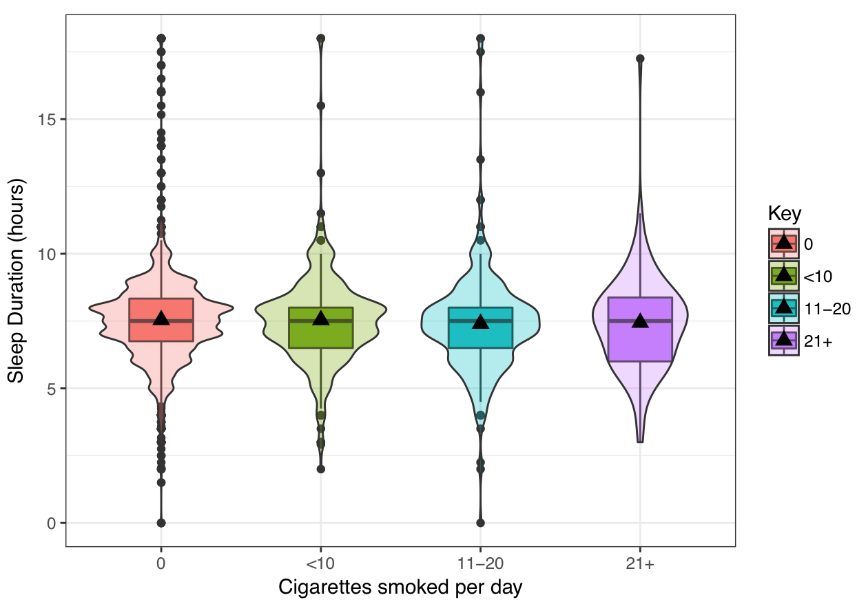
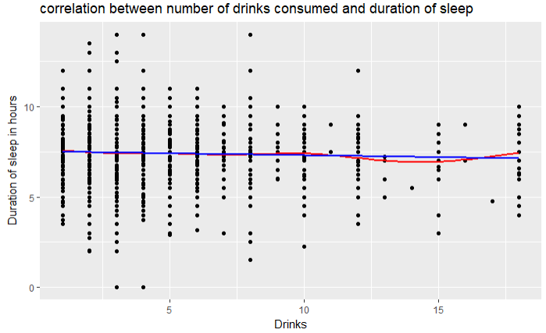
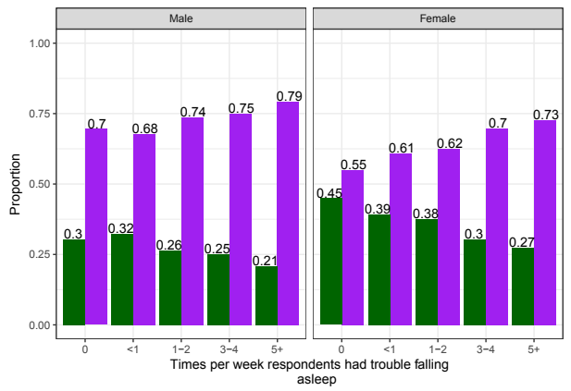
The Association Between Alcohol and Cigarette use with Sleep Duration
Ryan Mann, Trevor Moore, and Ryan Rowe
CSU, Chico - MATH 315 Section 1
Introduction
Results
Conclusion
Insomnia is one of the most common sleep disorders in the world, and it’s estimated to affect up to 60 million Americans. Is this merely a natural occurrence, or are there habits among humans that deprive them of their sleep? The risk of cancer from tobacco and general health effects from alcohol seem to be well know among the public, however the effects of both of these on sleep quality are much less known. If alcohol and tobacco consumption are shown to be correlated with insomnia, then a better understanding of this relationship could stand to benefit the 60 million of those who suffer.
Alcohol, when used in moderate quantities, appears to initially increase the ease of falling asleep. The relationship becomes less clear when examining sleep duration and alcohol consumption, especially once alcohol consumption becomes excessive. One study found no significant difference between individuals that drank and those that did not in regards to the duration of sleep (Pavlovic, 2014).
The studies that have attempted to connect alcohol and cigarette use with sleep often do so individually and rarely compare both. Many studies fail to use consistent definitions of what they consider adequate amounts of sleep (Stein, 2005).
With this information we can conclude that cigarettes cause a slight decline in sleep duration, the more that respondents smoke per day. We can also conclude that alcohol also causes a slight decline in sleep duration, the more that respondents drank per day. Looking at both of these we see that both alcohol and cigarettes both cause a slight decrease in sleep duration and quality.
Sample Characteristics
Figure 1.
Using ANOVA, we found that there is not a significant relationship between the amount of cigarettes a person smokes and the amount of sleep that they get.
Figure 2.
Using a correlation analysis we determined that there was a statistically significant and negligible negative correlation between the amount of drinks an individual has when they drink and the duration of sleep they receive.
The data set being examined is the Wave IV public survey use file that contains 5114 respondents, aged 24 to 32.
This cohort consists of a percentage of the nationally representative sample of individuals that were originally interviewed in 1995 as adolescents and later located for the Wave IV interview.
The respondents were composed of a representative sample of individuals living in the United states.
Respondents were asked many different questions such as: how often they had slept, whether or not they have done drugs, how their overall health was, etc.
Physical tests were also administered after the interview.
The interviews took place between 2008 and 2009.
Comprised of 48.4% female and 51.6% male participants
Sleep Variables participants (n=4,923)
Smoking Variables participants (n=5,097)
Research Questions
How is the duration of sleep is associated with both the use of cigarettes and the use of alcohol?
How does the relationship between sleep duration and alcohol compare to that of cigarettes and sleep duration?
Figure 3.
Using the Chi-Square test, we determined that there is a significant relationship between whether a person smokes or not and the amount of times that person has difficulty falling asleep.
The trend shows that people who have trouble falling asleep more often are more likely to have smoked.
Using a moderator test, we found that this relationship is much stronger in females than it is in males, though both genders show significant trends.
Table 1. Quantitative Summary Statistics
Variables | Mean | Median | Stdev
Sleep Duration | 7.456 hours | 7.500 hours | 1.4257 hours
Average # of Drinks | 3.777 drinks | 3 drinks | 3.0069 drinks
Methods
The data set being examined is the Wave IV public use file that contains 5114 respondents, aged 24 to 32. The analysis of this data involved utilizing ANOVA and t-tests to determine if there is a significant difference in the means of our categorical data. This allowed us to determine any correlations between sleep and both alcohol and cigarette use. In order to begin the analysis, we had to find variables within the data set. The variables had to be cleaned and manipulated in order to run statistical tests on them. The following variables were the ones that were required to complete our analysis:
Discussion
We attempted to learn whether alcohol or cigarettes had an effect on sleep quality. Most of our graphics have been showing little to no trend when sleep duration is compared to the number of cigarettes smoked and alcohol consumption. In our previous research, we learned that nicotine from cigarettes could suppress and shorten the duration of REM-sleep, which may also lead to an overall reduction in sleep duration. Researchers also found that chronic smokers typically had insomnia and nightly awakenings due to nicotine’s cravings. (Dieter, 2009) It was explained that nicotine, found in cigarettes, caused sleep disturbances because it “stimulates the release of sleep regulating neurotransmitters.”(Sabanayagam, 2010) When comparing people who have smoked and those that have never smoked, we saw very little correlation, as they appeared to get around the same amount of sleep in our two sample t-test for independent groups. This could very well be due to many of those that have smoked, never smoked again. In an ANOVA of duration of sleep compared to the number of cigarettes smoked per day, we found insufficient evidence that the number of cigarettes smoked per day correlated with a shorter duration of sleep, much like we found in our research. We saw a downward trend in this graph with different values in each category, a couple of these values were significant as well. Although it does not directly answer our research questions, we also performed a Chi-squared test of association between smoking and how often people had trouble falling asleep. In this test we found significant evidence that this was the case. Users that smoked saw an upward trend in how often they had trouble falling asleep while non-smokers had a downward trend in how often they had trouble falling asleep. This correlates to our research that states that nicotine can inhibit sleep and cause other problems that can make it harder to fall asleep. In studies done on alcohol it was found that, when used in small doses, alcohol would actually help people fall asleep sooner if used less than twice a week. However, heavy users would find it harder to fall asleep and would have more issues that inhibit sleep such as: heartburn, sleepwalking,snoring, and high blood pressure.(Stein, 2005) When looking at alcohol, we performed a correlation analysis on the duration of sleep and the number of drinks consumed when the respondent went out on a night to drink. We found that there was a negligible negative correlation between drinks consumed and the duration of sleep received. This did not seem like the research we found on alcohol, much at all. We just saw a slight downward trend the more that people drank.
Implications
Among all of the tests that have been performed, the most significant relationship in regards to practical implications is the relationship between cigarettes and sleep duration/ quality. The results of our statistical tests on the Wave IV sample show that the more cigarettes a person smokes, the less sleep they will get and the more trouble they will have falling asleep. These results imply that if a person is having trouble sleeping, it could be a result of smoking cigarettes.
Further research should be conducted that closely monitors precise alcohol and cigarette consumption on a daily basis over the period of several months. This could be used in conjunction with a daily sleep log to examine the relationship between the substances use and sleep duration over a long period of time. If this was conducted at a large enough scale with sample representative of the U.S. population, health care officials may be able to treat patients suffering from insomnia more effectively.
Sleep variables
H4SP1H- Hour respondent typically wakes up (during the week). Set 96 and 98 to NA.
H4SP1M- Minute respondent wakes up. Set 96 and 98 to NA.
H4SP1T- Wake up in AM or PM? Set 6 and 8 to NA.
H4SP2H- Hour respondent went to sleep. Set 96 and 98 to NA.
H4SP2M- Minute respondent went to sleep
H4SP2T- Minute respondent went to sleep. Set 6 and 8 to NA.
sleep_duration- The total duration of sleep respondent got on a workday night. Calculated using the above variables. Removed outliers past 15 hour mark.
Cigarette Variables
H4TO11- Number of cigarettes respondent smokes per day. Recoded values to add labels: ‘0’, ‘10’, ‘11-20’, ‘21+’
H4TO1- Whether or not respondent has smoked a single cigarette before. Recoded values to add labels: ‘Has Smoked’ and ‘Never Smoked’.
Alcohol Variables
H4TO35- During past 12 months, how many days respondent consumed alcoholic beverages? Recoded values to add labels.
H4TO39- During past 30 days, how many alcoholic drinks did respondent consume? Recoded values to add labels.
H4TO36- On days respondent drank, how many drinks did they usually have on those days? Recoded values to add labels.
References/Acknowledgements
Multivariate Analysis
DiBonaventura, M., Richard, L., Kumar, M., Forsythe, A., Flores, N., & Moline, M. (2015). The Association between Insomnia and Insomnia Treatment Side Effects on Health Status, Work Productivity, and Healthcare Resource Use. PLoS One, 10(10), PLoS One, Oct 2015, Vol.10(10).
Dieter, R. et al. (2009). Effects of nicotine on sleep during consumption, withdrawal and replacement therapy. Sleep Medicine Reviews, 13(5), 363-77
Pasch, K., Latimer, L., Cance, J., et al. (2012). Longitudinal Bi-directional Relationships Between Sleep and Youth Substance Use. Journal of Youth & Adolescence, 41(9), 1184-1196.
Pavlović, Marko & Đinđić, Boris. (2014). Alcohol Consumption Habits And Sleep Quality. Acta Medica Medianae, 53(2), 10-15.
Sivertsen, Skogen, Jakobsen, & Hysing. (2015). Sleep and use of alcohol and drug in adolescence. A large population-based study of Norwegian adolescents aged 16 to 19 years. Drug and Alcohol Dependence, 149, 180-186.
Stein, M. D., & Friedmann, P. D. (2005). Disturbed Sleep and Its Relationship to Alcohol Use. Substance Abuse: Official Publication of the Association for Medical Education and Research in Substance Abuse, 26(1), 1-13.
Sabanayagam, Charumath, and Anoop Shankar. (2010). The Association between Active Smoking, Smokeless Tobacco, Second-Hand Smoke Exposure and Insufficient Sleep. Sleep Medicine, 12(1), pp. 7-11.
Contact: rmann3@mail.csuchico.edu
After performing bivariate analyses, we tested to see whether gender was a moderator or confounder to any of the relationships used in our analysis. We did not find gender to be a significant confounder or moderator to any of the relationships tested. However, Figure 2 shows that gender influenced the strength of the relationship tested.

